Slide 2
Meet Your New AI Assistant

Slide 3
Collective Brain Dump
Outside of teaching, what takes up most of your work time?
Menti.com Code: XXXX XXXX
[Insert QR here]
Notes:
K20 Center. (n.d.). Collective Brain Dump. Strategies. https://learn.k20center.ou.edu/strategy/111

Slide 4
Essential Question
How can educators effectively integrate AI technology to enhance teaching practices and streamline administrative tasks?

Slide 5
Session Objectives
Explore AI education tools to assist in lesson planning
Incorporate AI technology to assist with classroom administration tasks and increase student engagement

Slide 6
Why-Lighting
On the Best Practices handout, highlight the text you find most important or surprising.
Explain your highlights in the margins of the document.
Notes:
K20 Center. (n.d.). Why-Lighting. Strategies. https://learn.k20center.ou.edu/strategy/128

Slide 7
Best Practices for Using AI Technology
Bias and Accuracy | 80-20 Approach | Your Judgement Matters | Know the Limits | Protect Privacy
AI might occasionally produce biased or incorrect content. Always double-check before sharing with students. | Use AI for initial work, but make sure to add your final touch, review bias and accuracy, and contextualize appropriately for the last 20%. | See AI-generated content as a starting point, not a final solution. Always adhere to your school’s guidelines. | Most LLM AI knowledge stops at 2021, so be aware when dealing with recent topics. | Don’t include personal student details like names or addresses. Treat using AI the same as posting on the internet.

Slide 8
Choice Board Bingo
Go to magicschool.ai.
Create an account using your Google account.
Pick one option on the bingo card and test it out.
Try as a table to select different activities to get a group bingo.
Share with your table group the results of your AI output.
Notes:
K20 Center. (n.d.). Choice board. Strategies. https://learn.k20center.ou.edu/strategy/73

Slide 9
Lesson Creation Race
Find an article or YouTube video related to your current curriculum content.
Use diffit.me to adjust it to the appropriate grade level.
Generate a vocab list, quiz, and short essay assignment.

Slide 10
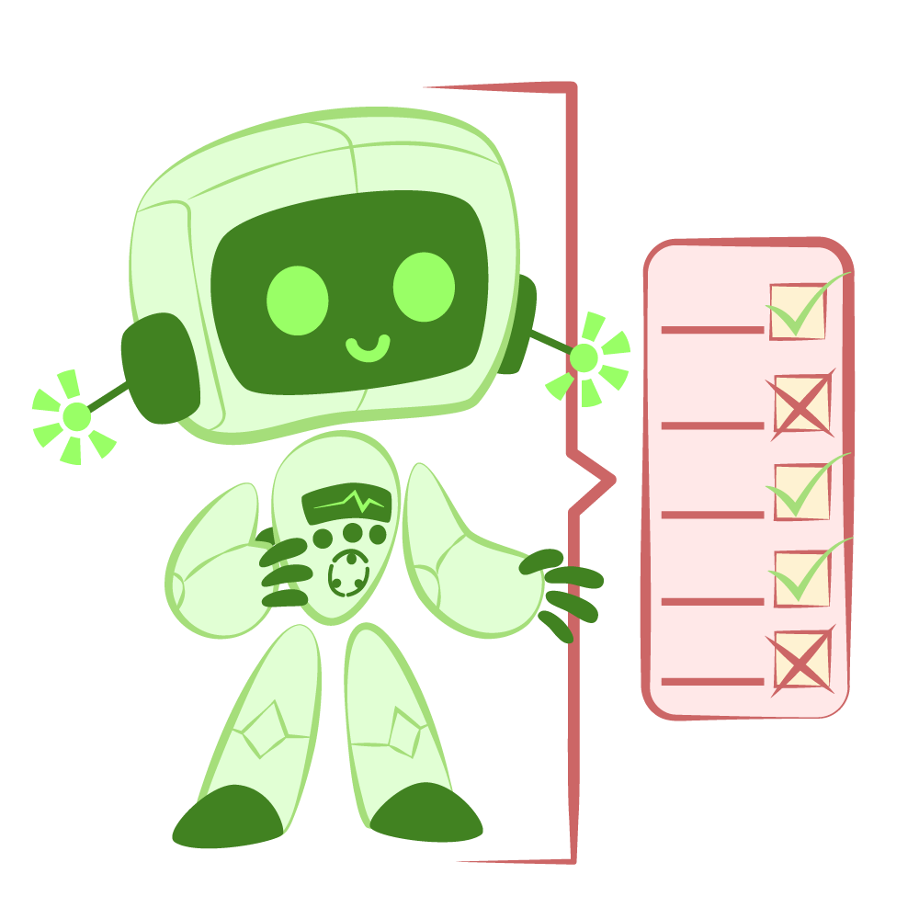
Critique the Bot
Read, analyze, and critique the AI generated feedback of this PD session.
Mark any mistakes.
Do you agree/disagree?
Concerns or thoughts?
Notes:
K20 Center. (n.d.). Critique the bot. Strategies. https://learn.k20center.ou.edu/strategy/3491

Slide 11
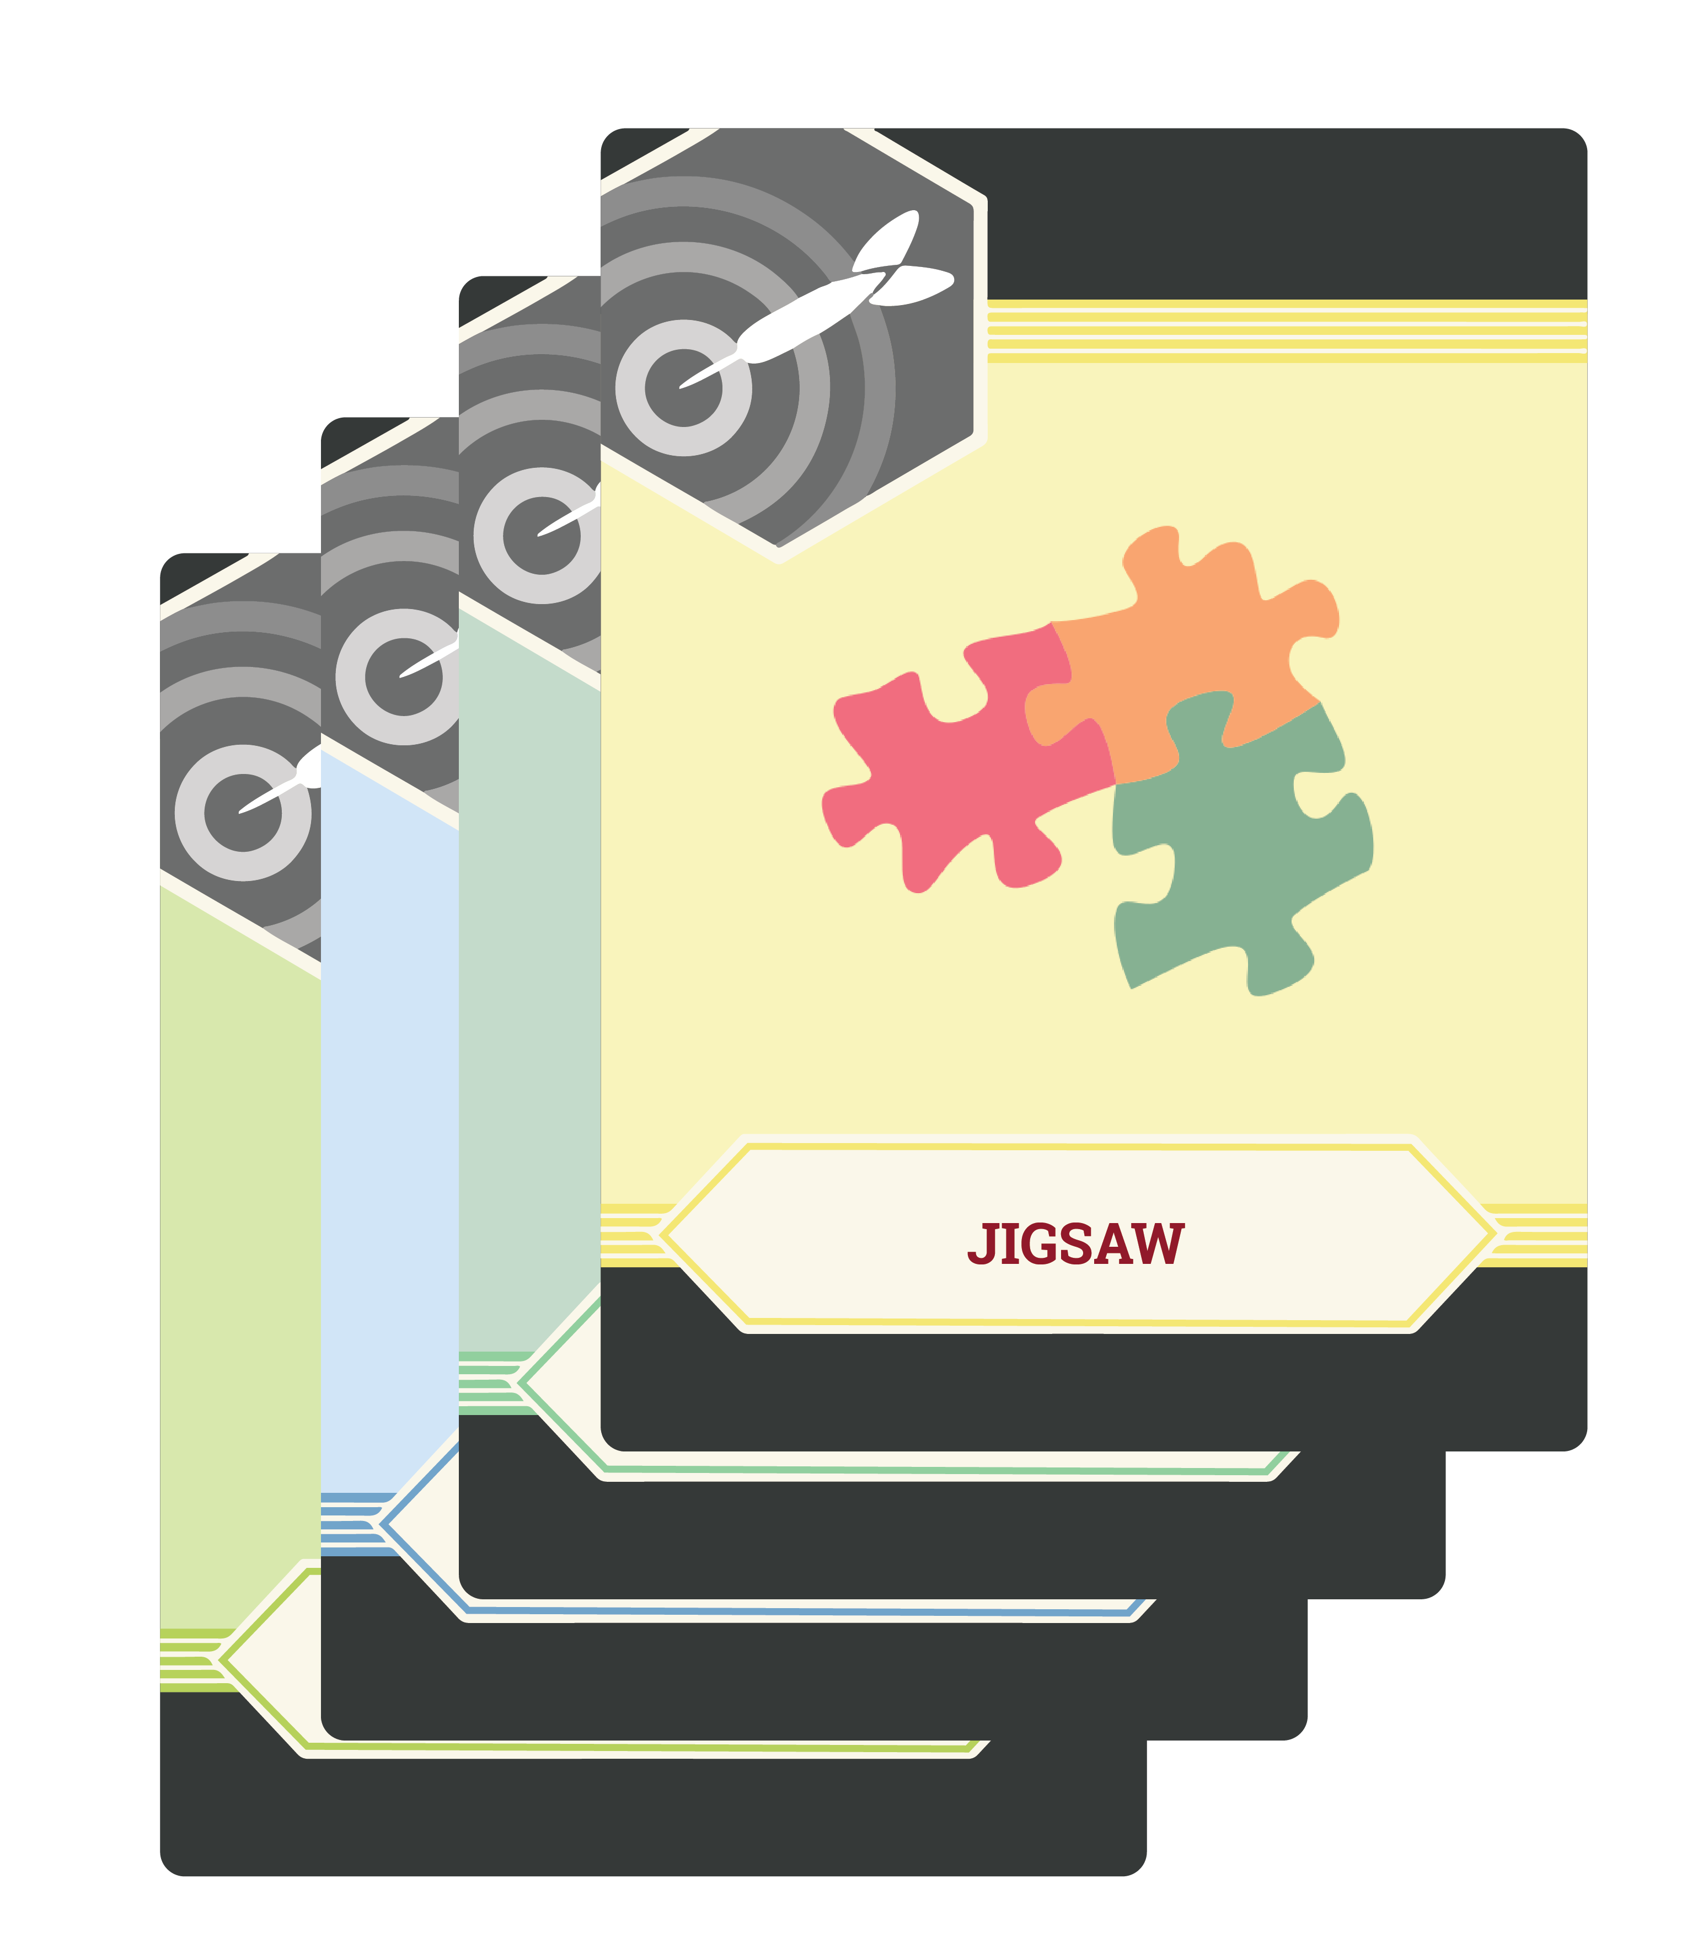
LEARN Strategy Reflection
Collective Brain Dump
Why-Lighting
Choice Board Bingo
Critique the Bot

