Slide 2
Closing Time
Exploring closure activities on LEARN

Slide 3

Preflection
Why are closure strategies important to the learning process?
What ideas do you have for closure strategies?
Notes:
Write your answer on a post-it. Put the post-it aside and we will come back to these at the end.

Slide 4
Objectives
Examine the purpose of closure strategies
Explore various closure strategies that can be used across content areas

Slide 5
Essential Question
What values can closure bring to a lesson?

Slide 6
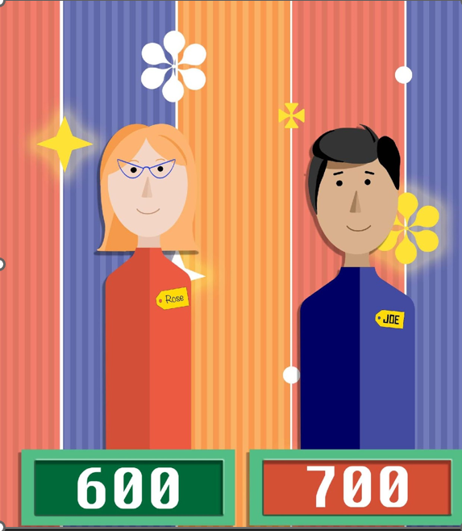

StratEDgy Showcase
Explore the K20 LEARN Exit Strategies Collection and pick one that you believe would be the best fit for the following scenarios.
k20.ou.edu/exit
Notes:
Use your strategy card ring. The digital collection could be used if you don’t have printed cards.

Slide 7
Scenario 1
Dr. Frankenstein just wrapped up a lesson on the parts of a cell in his science class. He's unsure if all students understood the content.
Notes:
Have some share what they selected and discuss as a whole group. There is no one size fits all strategy.

Slide 8
Scenario 2
Ms. Muffet wants to end her geometry lesson on area in a way that reinforces the day's learning objectives and prepares students for the next lesson on volume.
Notes:
Have some share what they selected and discuss as a whole group.

Slide 9
Scenario 3
Mr. Crane has just finished a literature lesson on the themes of friendship and betrayal in Shakespeare's Julius Caesar. He wants to ensure that his students reflect on and remember the core elements discussed during the class, relating them to their own experiences or those of the broader world.
Notes:
Have some share what they selected and discuss as a whole group.

Slide 10
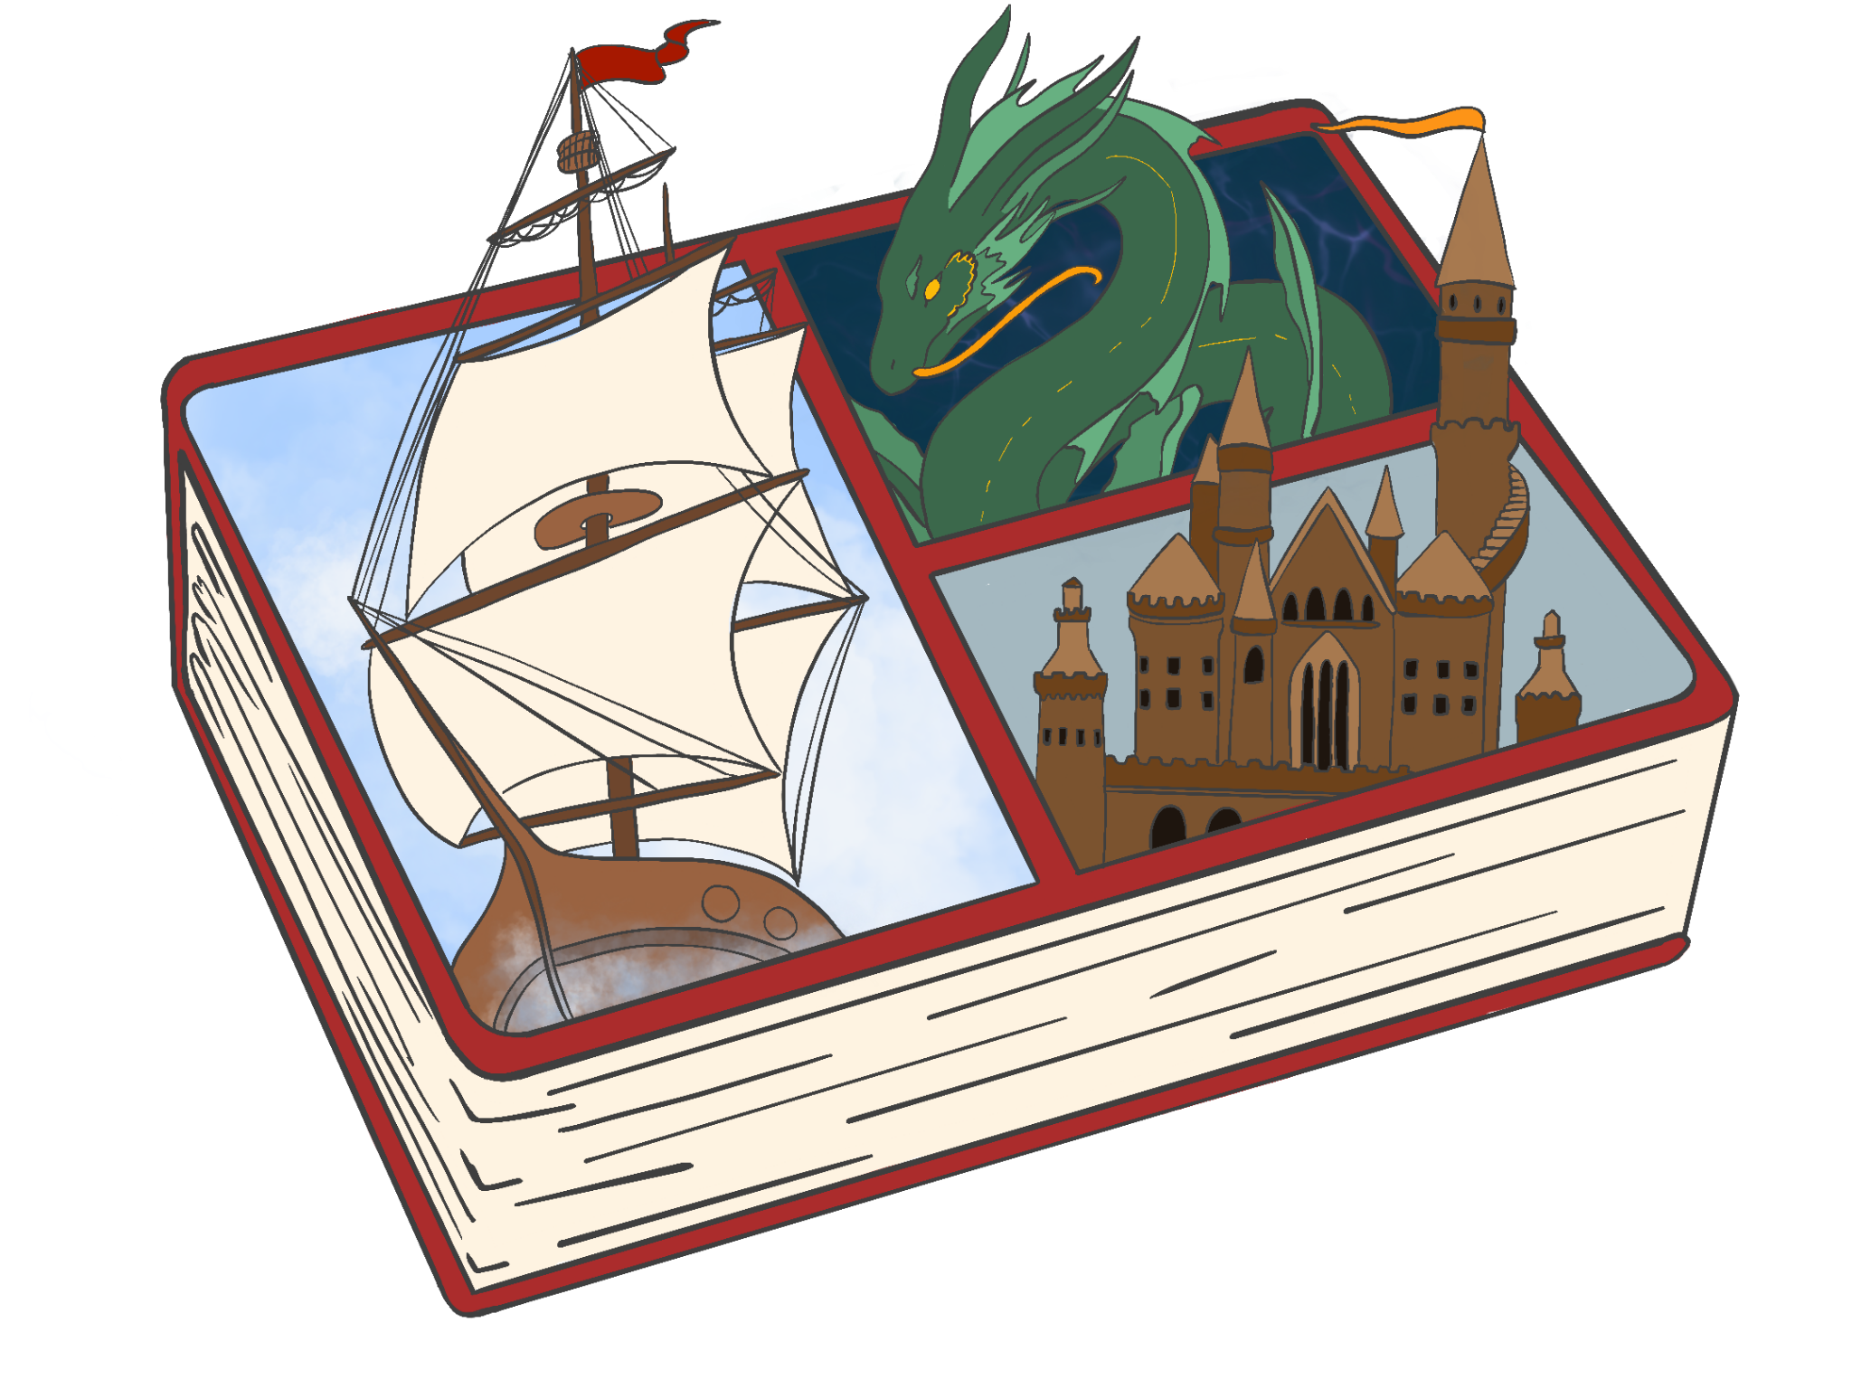
Choose Your Own Adventure
Choose a closure strategy to practice with the excerpt from Lesson Closure: An Important Piece of the Student Learning Puzzle.
Share which strategy you tried and your answer from it.
Notes:
Pick a strategy from the card ring or collection and use it as an exit strategy to share what you learned from the reading.
Article: https://ila.onlinelibrary.wiley.com/doi/epdf/10.1002/trtr.1587
Bit more recent: https://www.jstor.org/stable/27135422?casa_token=LJm36AxIzLAAAAAA%3AqmjxdlzdZx99m4RED-O1Zlx6OH31YxA7d2m_x7sljkjkxvT44b_aGPVFtzBD3ubS420kQ-uBRS71PIynYI6YF6LXzbkZz5IjZAkpuGNn2RHmuhTTsUdJBg&typeAccessWorkflow=login&seq=1

Slide 11
Strategy Reflection
Look at all the strategies we used in this session today and reflect on how you could use them in your classroom. Take notes on the provided note catcher.
  Write the title of the strategy.
  Write how you saw it used today.
  Write an idea for how you would use it in your classroom.

Slide 12

Rose, Bud and Thorn
Rose: Successes you’ve had with closing strategies.
Bud: Something you’re looking forward to trying now that you’ve learned more about closing strategies.
Thorn: What has been an obstacle for effective lesson closure for you so far?
[QR CODE]
[short url here]
Notes:
Post-its on posters or make a copy of the padlet

Slide 13
Preflection Revisited
Why are closure strategies important to the learning process?
What ideas do you have for closure strategies?
Notes:
Divide into three groups to discuss the post-its, address them, and share with the whole group a summary of the ideas that came through that discussion

