Slide 2
Inquiry is…
seeking information by questioning
the act of investigating or researching
a study of a worthy question, problem, or idea
a process that involves asking questions and looking for answers
systematic investigation into a problem, issue, topic,
or idea
Notes:
Random internet search shows these ideas. Definitions differ depending on the discipline, but all have something like this included.
Note: Some people differentiate between inquiry and research. The last bullet reflects this with the word “systematic.” Our educational definition comes from a research perspective.
We are interested in what that looks like for education and schools.

Slide 3
Inquiry in educational settings is a systematic process used for improving student outcomes such as achievement, engagement, and empowerment.
Notes:
This is a general definition for inquiry in education. It involves a research perspective.
No need to discuss this definition at this time. The next activity assesses their current understanding of this idea.

Slide 4
Characteristics of Inquiry
Write down 3–5 things that you think are the most important aspects of the process for using inquiry to improve student outcomes.
Notes:
Participants should write down their ideas so they can check them off in the Stand Up, Sit Down strategy.

Slide 5
Characteristics of Inquiry
Talk at your table about what each of you wrote down.
Your table will share your results
Notes:
Participants should write down their ideas so they can check them off in the Stand Up, Sit Down strategy.

Slide 6
Stand Up, Sit Down
Everyone stand up.
One at a time, read one item from your list aloud.
Others mark this item off their own list if it is the same as or similar to something they already have.
Sit down when all the characteristics you listed have been stated.
Notes:
Write out responses on the board or chart paper as they are shared.
Create an anchor chart with the responses on it. This will be referred to and revised as needed over the course of the session.
After completing the chart, point out that this strategy allows us to find out the current understanding of the entire group and serves as both activation of prior knowledge and formative assessment.
Note: If working with a large group, a step can be added for table groups to share with each other and come up with their group’s top five. This will streamline the process.

Slide 7
Essential Questions
What is the role of inquiry in improving learner engagement, empowerment, and achievement?
What factors contribute to the successful implementation of data-based decision-making in schools?

Slide 8
Session Objectives
Establish a definition of the inquiry process.
Identify the steps of the inquiry process.
Explore the conditions and methods for successfully. using data-based inquiry to solve problems in schools.
Examine characteristics of data literacy.
Notes:
Participants will examine the conditions and methods for successfully using data-based inquiry to solve problems in schools.
Participants will identify components of inquiry in a case study.
Participants will create their own definition of inquiry.
Participants will reflect on how they can use inquiry to address learning issues in their district/school context.

Slide 9
ABC Middle School
Review the school and district level information about the demographics and state mathematics scores for ABC Middle School. Use the focus questions in the scenario to guide a discussion of what you see.
Notes:
Data: https://drive.google.com/file/d/1iZavKnTjtZTuQ-U3HFJLFlGhWMMFPbn_/view?usp=sharing
Groups of four or so read the scenario information and discuss the data using the focus questions on the next slide.
Data sets:
School profile data
Math data - 8th grade
Math data - 4th grade
This is intended to be fairly open-ended so they can see the type of discussion that might occur at the beginning of the inquiry process.

Slide 10
Focus Questions
What are some patterns you see in this data set?
What question(s) do these data bring up?
Notes:
Have groups share out some of their insights and proposed next steps for this group of teachers. State that this is an example of how the process of inquiry often begins. Go to the next slide to show an overall look at the phases of inquiry.
Point out that there is a process for finding and addressing problems related to student achievement. It involves the four major steps shown on the next slide.

Slide 11
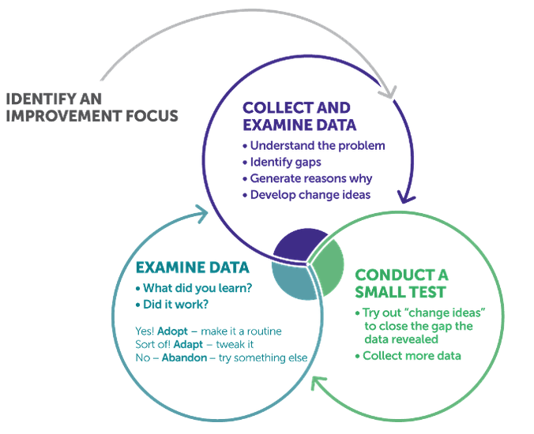
The Inquiry Process
Notes:
This is just a big-picture model. We will get into the K20 Inquiry Cycle soon.
Point out that what they did in the ABC scenario in the starting steps in the inquiry process.
Note that inquiry always starts with questions and that the entire process continues to be driven by generating questions, looking for answers, and then generating new questions to continue the improvement cycle.
Source: Literacy Improvement Partnership. (September 2018). Using Learning Huddles to Improve Teaching and Learning. REL West.

Slide 12
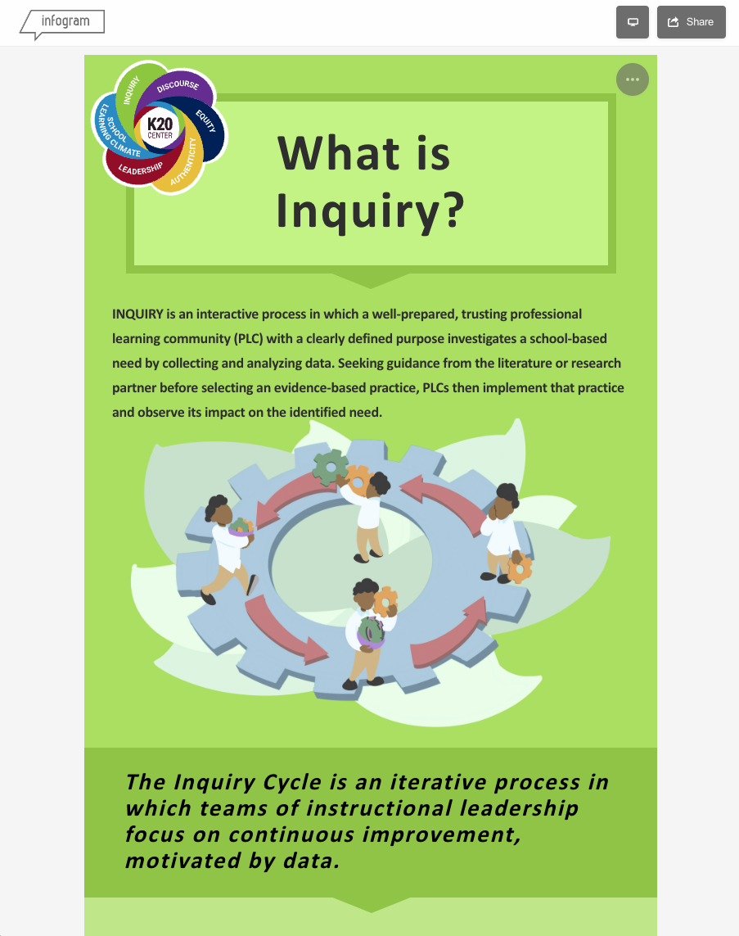
The Inquiry Cycle
k20.ou.edu/inquiry-cycle
Articulate a goal
Select an indicator
Analyze data
Learn
Make decisions
Act
Collect data
Reflect and adjust
Notes:
Have participants navigate with you to the infographic and look at just the inquiry cycle portion at this time. Discuss the steps of the inquiry cycle and relate them to the basic process shown in the previous slide.

Slide 13
So… How do we create supportive conditions for using inquiry to improve student outcomes?
Ingredients for a Culture of Inquiry
Professional Learning Communities (1,5)
Positive Data Culture (2,6)
Data-based Decision-making (3,7)
Research Practice Partnerships (4,8)
Notes:
Create eight groups.
Go back to the infographic and show where each of these components is found. Assign a component to each group.
Photo:
Raw Pixel. (n.d.) Free cake ingredients image, public domain food CC0 photo [Photograph]. https://www.rawpixel.com/image/5923442

Slide 14
INQUIRY JIGSAW
Go to k20.ou.edu/inquiry-cycle to access the Inquiry infographic.
Discuss with your group how your practice of inquiry plays a role in the analysis/actions of ABC Middle School data.
Notes:
Have each group read over their section of the infographic and create a graphic representation of their component. It can be in any form they wish other than a paragraph and should reflect the most important ideas about their component.
Have groups share their reflections with the whole group while viewing the Google Slides deck.

Slide 15
INQUIRY JIGSAW
Each group will go to the Google Slides Deck at [make a copy of the link in the notes and insert a short URL or QR code here] and find their component page.
Create a graphic representation of how your component might look in action with the ABC School case.
You can use words, charts, graphic organizers, mind maps, pictures, etc., to convey your idea.
Notes:
Have each group read over their section of the infographic and create a graphic representation of their component. It can be in any form they wish other than a paragraph and should reflect the most important ideas about their component.
Have groups share their reflections with the whole group while viewing the Google Slides deck.
Slides: https://docs.google.com/presentation/d/1bo2HBu-kn9dHoJKLAppisvc8CKKnHkgO8P6UDD0-7rI/copy

Slide 16
Surprising-Interesting-Troubling
As you read the article “Every Teacher Should Succeed with Data Literacy,” consider these questions:
How do we define data literacy?
What skills are necessary for data literacy?
Why is data literacy important?
Note things you find surprising, interesting, and troubling from the article.
Notes:
One important condition of the process of successful data-based decision-making is data literacy for people who are employing it. This is one area where it is important to develop teachers’ skills. We are asking you to read an article about this topic and make notes as you read using the S.I.T. strategy.
Link to the article: https://bit.ly/DataLiteracyarticle

Slide 17
Focus Questions
Revisit the questions you had while looking at ABC School data earlier in this session:
What further types of data would be needed to answer your question(s)?
What actions could be taken to target problems identified in this data set?

Slide 18
Revisit Characteristics of Inquiry
Review the Characteristics of Inquiry anchor chart.
For each idea on the chart, identify which component from the inquiry infographic affirms it.
Add anything that’s missing from the anchor chart.
Mark off anything that doesn’t seem to fit.
Notes:
After each group presents their slide, revisit the Characteristics of Inquiry anchor chart from the beginning of this session and star ideas that are reinforced. Strike out any that don’t seem to fit anymore. Using the themes represented, generate a rough draft definition of inquiry.

Slide 19
Define Inquiry
With your components of inquiry group members, create a definition of inquiry after hearing about all the components and what you thought of after reading the article.
[Paste Mentimeter QR
code image here]
Access menti.com by scanning the QR code to the right.
Notes:
Presentation:[enter link for your Mentimeter presentation here]

Slide 20
Inquiry Definition
INQUIRY is the ongoing process in which learning communities come together and engage in data-based decision-making. Through analysis and reflection, gaps in student learning, achievement, engagement, and/or empowerment are identified to inform interventions that result in equitable and improved student outcomes.
Notes:
Return to the beginning of the infographic and review the definition.

Slide 21
Two-Minute Paper
How can you use what you have learned about inquiry and data-driven decision-making in your own school or classroom?
Notes:
If time allows.

Slide 22
LEARN Strategies and Tools
Gist
Jigsaw
Mentimeter
S-I-T
Stand Up, Sit Down
Two-Minute Paper
Notes:
Talk about how the strategies covered during this session model inquiry.

