Slide 1


Slide 2
Welcome!
While waiting…
Find the strategies from your prework anchor chart
Write each strategy on a sticky note
Place the sticky note at the bottom of the poster that best reflects its purpose within the Authenticity Framework

Slide 3
LEAD Facilitators
Facilitator name, facilitator title
Your School
Facilitator name, facilitator title
Your School
Facilitator name, facilitator title
Your School

Slide 4

GEAR UP Grants
Gaining Early Awareness and Readiness for Undergraduate Programs
This program is designed to increase the number of students who enter and succeed in postsecondary education.

Slide 5

GEAR UP & LEAD
LEAD was developed by the K20 Center to meet the following goals for three 2018 grants:
Increase the percentage of students who are academically prepared for postsecondary education upon graduation.
Increase the high school graduation rate and postsecondary education enrollment rates.
Increase expectations and students’ and families’ knowledge of postsecondary education options, preparation, and financing.

Slide 6
Why LEAD?
Shared Leadership
In the school environment, shared leadership can extend beyond definite limits to be shared with all staff as long as the focus remains on student achievement (Cobanoglu, 2020; Torres et al., 2020).
This type of leadership builds capacity for change and improvement through cultivating leadership at all levels of the school, to empower others to also take on decision-making (Grice, 2019).

Slide 7

Hear What Others Have to Say
Notes:
K20 Center. (n.d.). LEAD: Leading Educators in Authentic Development [Video]. YouTube. https://youtu.be/Br35tZsaApI?si=vJeMpF6xfYW6L-2o

Slide 8

Sweet Talk!
Choose one piece of candy

Slide 9
Sweet Talk!
Share the answers that correspond to your candy selection.
Laffy Taffy - What is the best professional development you have received that made an impact on your teaching?
Twix - What teacher or teachers helped you be successful? How did they help you?
Kit Kats - What do you believe are the biggest challenges your students will face in the future?

Slide 10
Essential Question
How do the components of authentic instruction support meaningful learning and college and career readiness?

Slide 11
Learning Goal
Recognize and understand the role of authenticity in student learning and postsecondary readiness.

Slide 12


Authenticity
Using your why-lighting document:
Summarize authenticity in your own words.
Discuss how authenticity supports student learning.
Think-Pair-Share

Slide 13

Authenticity
Choose one component from your anchor chart.
Move to that poster.
  Maximum 6 participants per poster
Discuss the importance of this component.
Four Corners

Slide 14
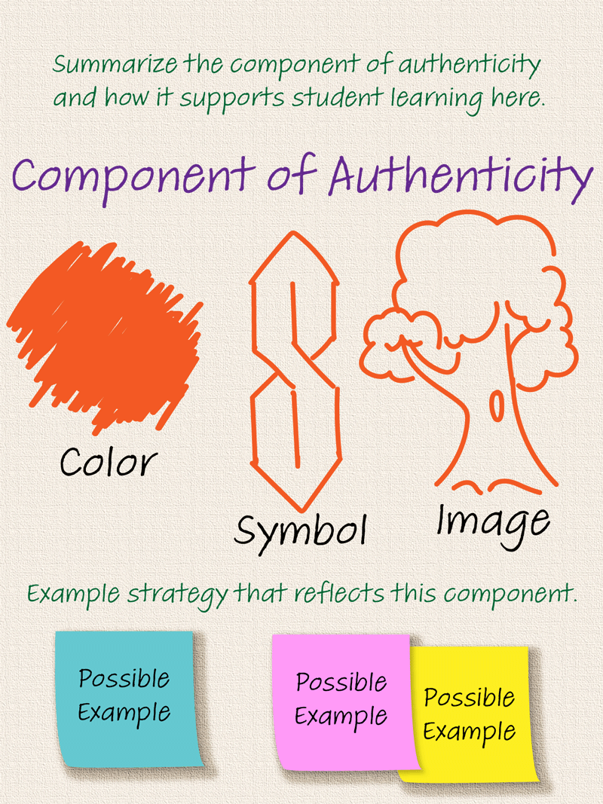
Authenticity
Above the title: With your group, summarize the component of authenticity and how it supports student learning.
Below the Title: Choose a color, create a symbol, and draw an image.
Bottom: Select an example strategy that reflects this element. (Use the sticky notes as possible examples.)

Slide 15

LEARN Strategy Reflection
Why-Lighting
Anchor Chart
Sweet Talk
Think-Pair-Share
Four Corners
Color, Symbol, Image (CSI)

Slide 16


Slide 17

College or Career Success
With your table, think about the skills that students need to be successful in a career or college.
Brainstorm as many skills as possible in four minutes.
Collective Brain Dump

Slide 18

College or Career Success
Go to menti.com. Use the code 11 111 111.
[Insert QR
code here]
Collaborative Word Cloud
Add 4–5 phrases from your collective brainstorm list.

Slide 19

Table Talk
Compare the skills generated on Mentimeter with the elements of Authenticity to address this question.
How can implementing the components of authenticity help teachers prepare students for pursuing postsecondary opportunities?
Table Talk

Slide 20

Elevator Speech
Select one component of Authenticity.
Jot down some important ideas.
Create a 60-second pitch that describes your component and its role in fostering college- and career-readiness.
Elevator Speech

Slide 21

Elevator Speech Reflection
Present your elevator speech to your partner.
After the speech, reflect on your own presentation using Two Stars and a Wish:
  “I like that I ______ and _______.
  I wish I had [done this] __________.”
Two Stars and
a Wish

Slide 22
LEARN Strategy Reflection
Collective Brain Dump
Mentimeter
QR Codes
Collaborative Word Cloud
Elevator Speech
Two Stars and a Wish

Slide 23

Notes:
change

