Slide 2
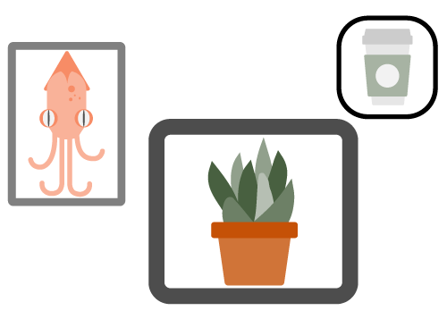
Pick a Pic
Find a photo or image that reflects how you are feeling today or something you would like to share.
Pick a Pic
Notes:
K20 Center. (n.d.). Pick a pic. Strategies. https://learn.k20center.ou.edu/strategy/91

Slide 3
Pick a Pic
Upload your pic to the Padlet.
Be prepared to share your pic, its significance, and a little about yourself
School
Grade
Subject
Padlet
[Insert Padlet
QR code here]
Notes:
Don’t forget to replace the QR Code on this slide with one that directs participants to your Padlet, or provide them with a link. In Padlet, select Open Share Panel > Share > Get QR Code > Download or Share Panel > Links > Copy link to clipboard.
K20 Center. (n.d.). Padlet. Tech Tools. https://learn.k20center.ou.edu/tech-tool/1077

Slide 4
Essential Question
How do the components of authentic instruction and the Adult Learning Theory support meaningful learning for educators?

Slide 5
Learning Goal
Understand how effective professional learning incorporates Adult Learning Theory and Authenticity.

Slide 6
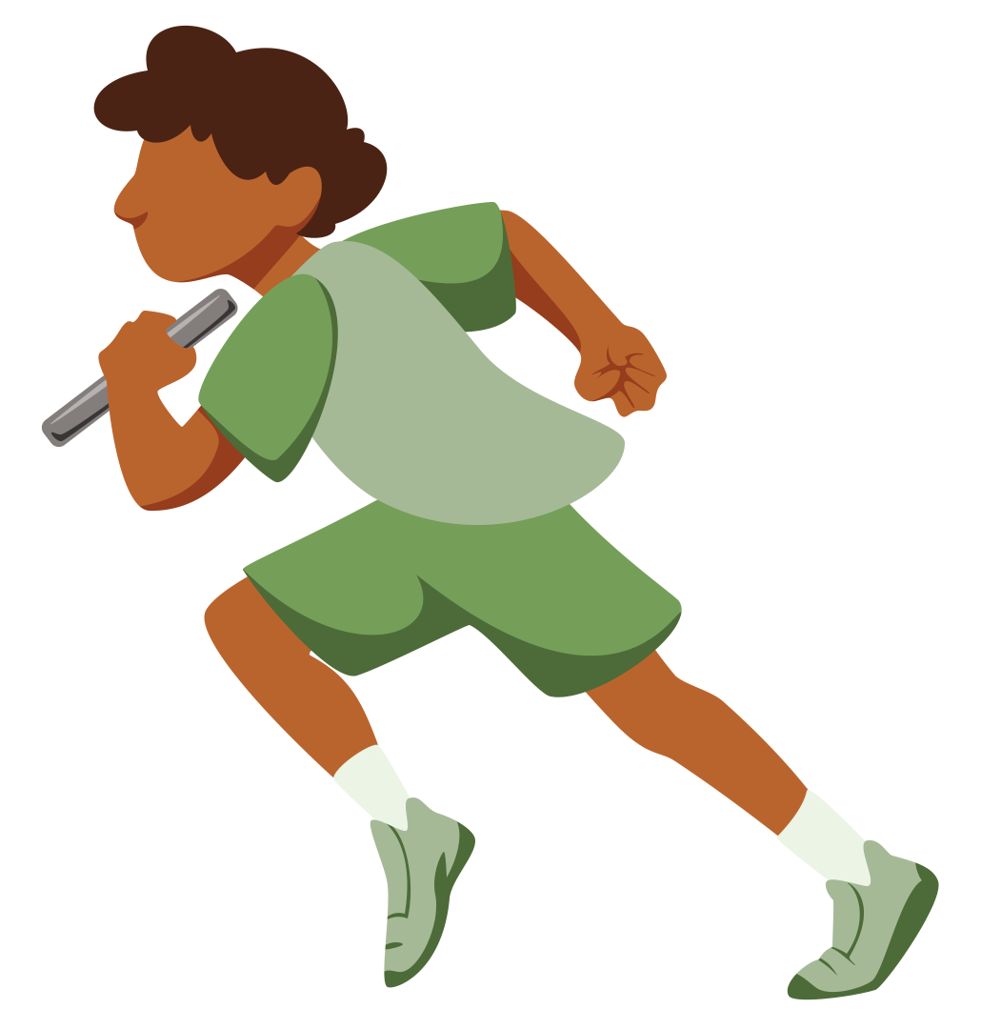
Adult Learning: Review Relay
Line up as a team.
Each team member selects a word and places it in the sentence that makes the most sense.
You may only make one move per turn (place or change a card).
Teams will then compare answers.

Slide 7
Effective PD & Adult Learners
What are the characteristics of effective PD?
What do adult learners need for professional development?
Categorical Highlighting
Notes:
Pass out handout after the relay. Discuss what Malcolm Knowles (considered the father of adult learning theory) means by saying that adult learners:
move from dependent learners as children to self-directed learners
learn because they want to
prefer informal learning through active engagement; have had bad experiences with PD in the past
need to know the relevance of what they learn; want to apply knowledge immediately
are internally motivated to learn
learn best through process-centered approaches instead of content-oriented approaches.

Slide 8
Adult Learning Debrief
What differences did you note, comparing examples of effective PD with a less effective session that you have attended in the past?
Did anything resonate concerning needs of adult learners?
What is one thing you might you think you could implement immediately?

Slide 9
Effective PD
Task: Create a scenario showing effective PD based on your categorical highlights.
Tool: Use one of the comic strip templates in Canva.
Share: When you’re done, share your PD Comic on Padlet.
bit.ly/add_link
Cognitive Comics
How-to guide:
Using Canva to create comics
bit.ly/K20CCC
Notes:
Use a free URL shortener, such as bitly or tinyURL, to create a short link to your Padlet.
K20 Center. (n.d.) Cognitive comics with Canva. Tech-Integrated Strategies. https://learn.k20center.ou.edu/tech-strategy/3025

Slide 10
LEARN Strategy & Tool Reflection
Pick a Pic
Padlet
Categorical Highlighting
Cognitive Comics
Shortened URL Links
Canva

Slide 12
Sequencing Authentic Science Lessons

Slide 13
Session Objectives
Experience and reflect on a science lesson structure.
Compare and evaluate several lesson models.

Slide 14
Vervim in Pharkles
Creating Plopidectus

Slide 15
A cratusis is used as a source of vervim. If a flam is used to make a pathway connecting opposite ends of a cratusis, a pharkle is created. In a pharkle, vervim burbles from the compendic end of the cratusis to the impendic end of the cratusis. This vervim burble is called plopidectus. A merobite can be added to the pharkle using flams. Plopidectus burbling through the pharkle causes the merobite to turn. When plopidectus is burbling through a pharkle, we say that the pharkle is closed. If the pharkle is broken at any location, this results in an open pharkle. Plopidectus will not burble in an open pharkle.

Slide 16
Vervim in Pharkles Quiz Answers
A source of vervim.
A pharkle.
From the compendic end of the cratusis to the impendic end of the cratusis.
Vervim burble.
A flam.
False.

Slide 17
Can You Make the Merobite Turn?
Draw a model and explain what is happening.
Make sure you use the following words in your model.
Show the direction the vervim burbles with arrows.
Cratusis
Vervim
Merobite
Flam
Compendic End
Impendic End

Slide 18
Will the Merobite Turn?
Use your initial model and the supplies to build your pharkle.

Slide 19
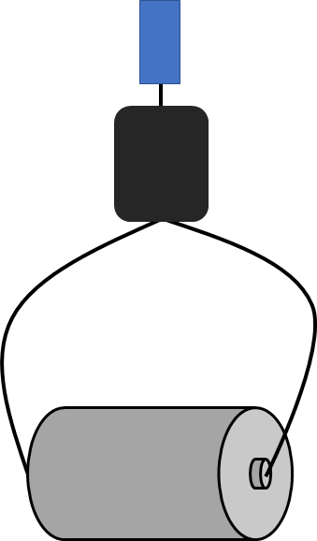
Will the Merobite Turn?
merobite
flam
vervim
flam
cratusis

Slide 20
Symbols
Cratusis
= Battery
Flam
= Wire
Merobite
= Motor
M

Slide 21
Vervim in Pharkles Answers
Battery
A source of energy.
A circuit.
From the negative end of the battery to the positive end of the battery.
Energy flow.
A wire.
False. (Electricity won’t flow in an open circuit.)
Wire
M
Motor

Slide 22
Pharkles Reflection
How would starting with the activity rather than the reading have changed your learning experience?
“Although vocabulary is important for science learners, we
must remember that words are not science. . . . Vocabulary needs to be introduced to students in the midst of their engagement with objects.”
Notes:
Konicek-Moran, R., and Keeley, P. (2015). Teaching for conceptual understanding in science. NSTA Press.

Slide 23
ABC Instructional Models
Activity
Before
Content
This prioritizes student exploration and investigation prior to engaging in technical science content and vocabulary.

Slide 24
ABC Instructional Model Exploration
Look through the materials at your station.
On your chart paper, record the following information in each “window”:
Characteristics
Teacher/student roles
Benefits
Questions you have
Window Notes
Notes:
Stations w/example of ABC lesson structures
Project-Based Learning
https://drive.google.com/drive/folders/1uf8jytvpkQy97QQJ4rAQxZ1u2k5G5Y-J
https://www.pblworks.org/what-is-pbl
Tinkering Pedagogy
http://www.museoscienza.it/tinkering-eu/download/Tinkering-A-practitioner-guide.pdf (p.15, 20, 26-27)
https://web.archive.org/web/20170830005016/http://tinkering.exploratorium.edu/sites/default/files/pdfs/PetrichWilkinsonBevan-ItLooksLikeFun.pdf (p.10-12, p.14-16)
http://93.42.126.186/tinkering-eu/download/tinkering-total-Hres.pdf (p.36-39)
Place-Based Instruction
How place-based science education strategies can support equity for students, teachers, and communities(resource)
Environmental Impact Studies
Creature Connection
Documenting Biodiversity in Your Schoolyard (p.41)

Slide 25
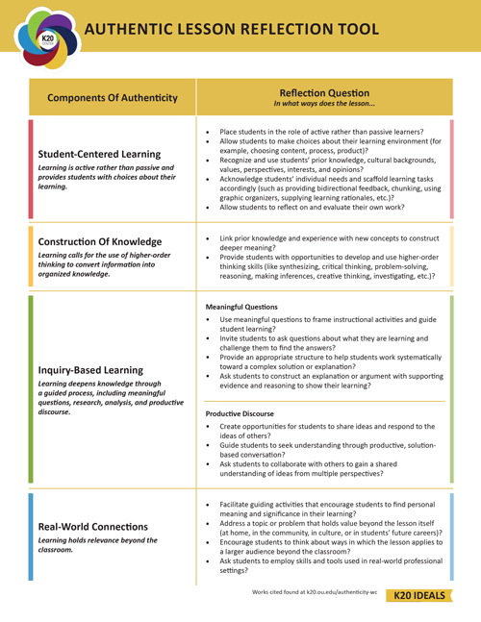
Authenticity in Science Instruction
Look over the Authenticity Lesson Reflection Tool handout.
Where do you see Components of Authenticity reflected in the instructional models we explored?

Slide 26
What the Research Says
The sequence of a learning experience matters.
Students prefer beginning with experiences over content.
Relevance of content is more apparent with activity first.
Optimal learning takes place when the content is introduced in context.
Place an activity upfront to help students connect prior experiences in ways that make sense to them.
Invest the extra time for students to explore.
Many questions you plan for will come up organically.
Embed formal instruction in discourse.
Provide opportunities for students to be in disequilibrium.
Including phenomena, discrepant events, or open-ended investigation.

Slide 27
I Used to Think... But Now I Know...
Before you go, grab a sticky note and respond to the following prompt:
I used to think (about teaching)...
But now I know...
I Used to Think…
But Now I Know

Slide 28
LEARN Strategy & Tool Reflection
Window Notes
I Used to Think…But Now I Know

Slide 29
Reflection and Follow-up Tasks
Task 1
Go to [add shortened URL here]
Make a Padlet video answering the following questions
What are the characteristics of a positive classroom culture?
How do you make this happen?
Task 2
Make a single slide in this slide show about something you are passionate about.
[add shortened URL here]
Notes:
If you are facilitating all four sessions, encourage participants to spend 5-10 minutes on Task 2. This task will serve as an opportunity for them to practice their presentation skills in session four.

Slide 30
Wrapping Up Day 1
Tomorrow’s session starts at 8:00 a.m.
Bring your charged laptop.
Leave all supplies on the tables.
Notes:
If you are facilitating the four sessions over a two-day period, unhide this slide and add any necessary information to help learners prepare for Day 2.

