Slide 2
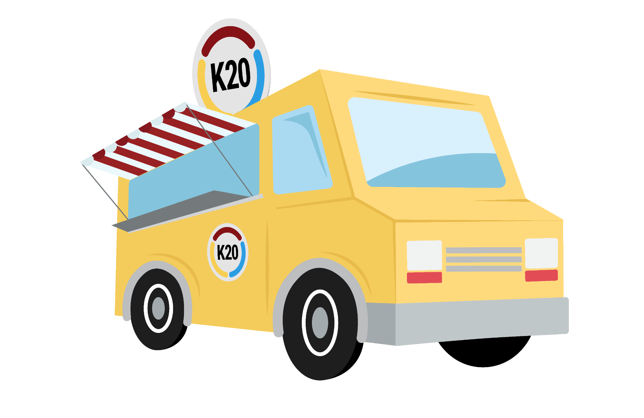
Instructional Strategy
Food Truck
Take a Bite out of Instructional Strategies

Slide 3

Walk Up Order: Fiction In the Facts
Student engagement increases when students are empowered to make choices in the learning process.
Student engagement increases when students connect what they are learning to their personal experiences.
Student engagement increases when every lesson begins with a synchronized dance routine led by the teacher, energizing students and priming their brains for optimal learning.
Notes:
K20 Center. (n.d.). Fiction in the Facts. Strategies. K20 LEARN | Fiction in the Facts (ou.edu)

Slide 4
Essential Question
How do instructional strategies enhance student learning?

Slide 5
Learning Goals
Participants will:
Investigate new instructional strategies to enhance learner engagement through hands-on activities.
Develop implementation plans to integrate new strategies effectively in their classrooms.
Critically analyze the impact that student engagement has on student outcomes to optimize instructional practices.

Slide 6
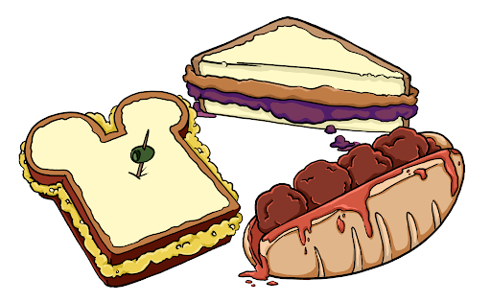
Quick Bite Menu
Double Bubble Map
The double bubble map is a graphic organizer used to compare and contrast two concepts. The attached version uses squares instead of bubbles. It shows two separate squares connected by lines. Lines connecting the squares are used to write down similarities. Additional squares are added for unique features or differences. It helps students to organize comparisons visually, identify relationships, and generate ideas.
Or
Dividing the Pie
Students are provided with an event and several causes to analyze. After an analysis of the content, students determine a percentage to represent the impact of each cause. They then create a pie chart and explain their reasoning for each of the percentages in the chart.
Notes:
K20 Center. (n.d.). Dividing the pie. Strategies. https://learn.k20center.ou.edu/strategy/1867
K20 Center. (n.d.). Double bubble. Strategies. https://learn.k20center.ou.edu/strategy/3035

Slide 7
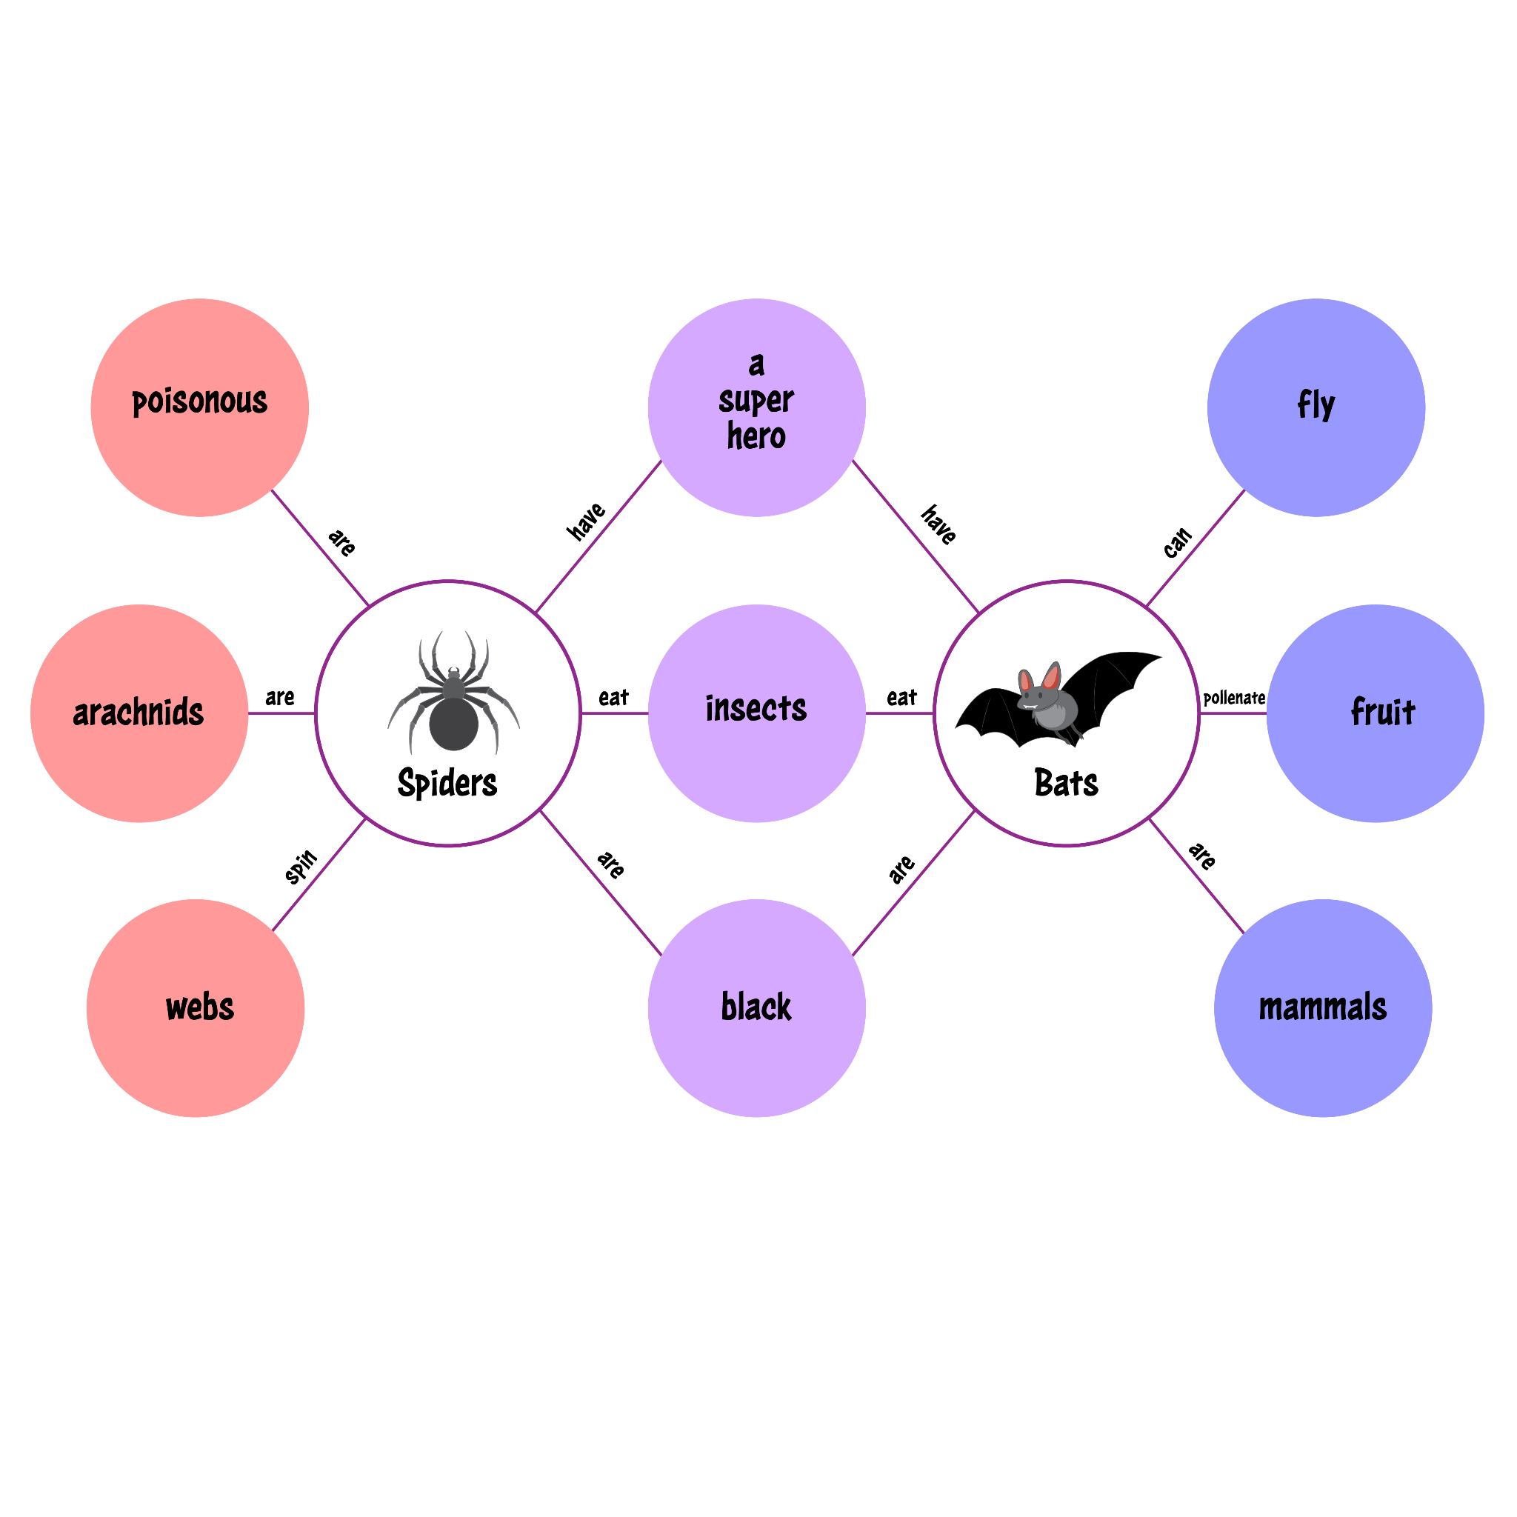
Double Bubble Map
Use the Double Bubble (Square) Map to compare and contrast Tacos and Corn Dogs.
Alternate topic: State Fairs v. Ball Parks
Notes:
K20 Center. (n.d.). Double bubble. Strategies. https://learn.k20center.ou.edu/strategy/3035

Slide 8

Dividing the Pie
Create a pie chart that breaks down the causes for the success of a restaurant.
Alternate topic: Causes of “a hot dog is a sandwich” debate.
Notes:
K20 Center. (n.d.). Dividing the pie. Strategies. https://learn.k20center.ou.edu/strategy/1867

Slide 9

Student Engagement
As you watch the student engagement videos, take note of the most significant point for each of the following constructs.
Affective
Behavioral
Cognitive
Emotional
Notes:
K20 Center. (n.d.). Poms: Point of most significance. Strategies. https://learn.k20center.ou.edu/strategy/101​​​​​​​

Slide 10

Aspects of Student Engagement: Affective
Notes:
K20 Center. (n.d.). Poms: Point of most significance. Strategies. https://learn.k20center.ou.edu/strategy/101​​​​​​​
K20 Center. (2019, July 10). Affective engagement [Video file]. YouTube. https://www.youtube.com/watch?v=-IdBno-4DpE

Slide 11
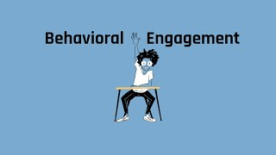
Aspects of Student Engagement: Behavioral
Notes:
K20 Center. (n.d.). Poms: Point of most significance. Strategies. https://learn.k20center.ou.edu/strategy/101​​​​​​​
K20 Center. (2019, July 9). Behavioral engagement [Video file]. YouTube. https://youtu.be/lsH2_Ufk8JI

Slide 12
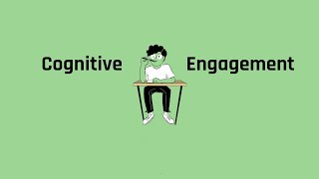
Aspects of Student Engagement: Cognitive
Notes:
K20 Center. (n.d.). Poms: Point of most significance. Strategies. https://learn.k20center.ou.edu/strategy/101​​​​​​​
K20 Center. (2019, July 9). Cognitive engagement [Video file]. YouTube. https://youtu.be/JHNFhmYhzaE

Slide 13

Aspects of Student Engagement: Emotional
Notes:
K20 Center. (n.d.). Poms: Point of most significance. Strategies. https://learn.k20center.ou.edu/strategy/101​​​​​​​
K20 Center. (2019, July 9). Emotional engagement [Video file]. YouTube. https://www.youtube.com/watch?v=9RtHYJn-qwU

Slide 14
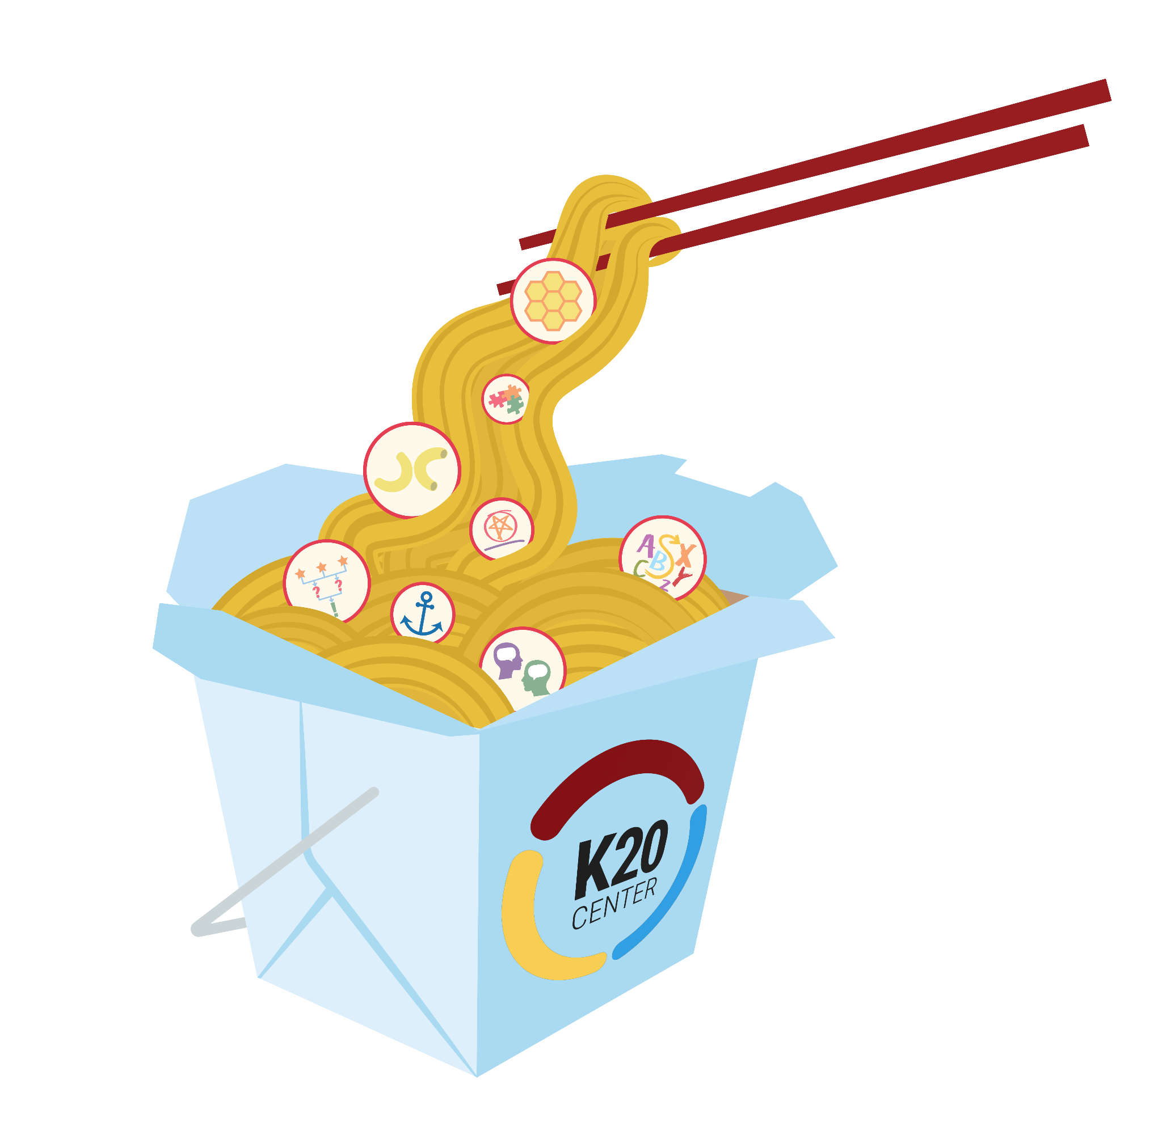
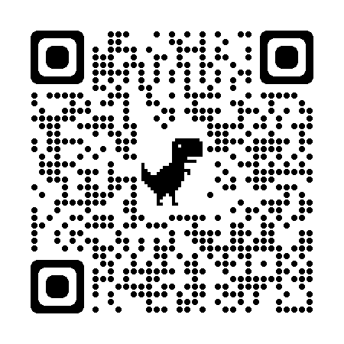
Strategies Takeout
learn.k20center.ou.edu
Notes:
https://commons.wikimedia.org/wiki/File:Oyster_pail_takeout_box_(2558467231).jpg

Slide 15

Lettuce Wrap Up: Fist to Five
Show the likelihood of using the strategy covered today in your class by holding up your hand with the appropriate number of fingers:
Fist (Never) to Five (I’m using it today)
Notes:
K20 Center. (n.d.). Fist to five. Strategies. https://learn.k20center.ou.edu/strategy/68

