Slide 2
How People Learn

Slide 3
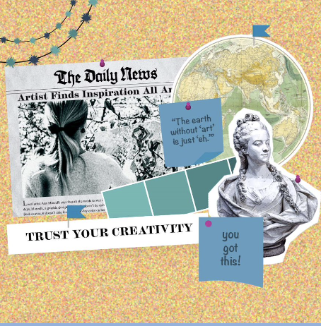

Vision Boards
Create a vision board using the following prompt:
What does your ideal classroom look like, sound like, and feel like?
Use colors, images, emojis, GIFs, words, and symbols to illustrate your ideal classroom.
Notes:
K20 Center. (n.d.). Vision board. Strategies. https://learn.k20center.ou.edu/strategy/2054
K20 Center. (2021, September 21). K20 Center 15 minute timer [Video]. YouTube. https://www.youtube.com/watch?v=m3zT2IxZQaw

Slide 4

Vision Board Gallery Walk
What does your ideal classroom look like, sound like, and feel like?
As you observe others’ vision boards think about similarities or differences between them.
Are there any components that you want to add to your board?
Notes:
K20 Center. (n.d.). Gallery walk / carousel. Strategies. https://learn.k20center.ou.edu/strategy/118

Slide 5
Essential Question
How can authenticity be used to support how students learn?

Slide 6
Learning Goals
Engage in the experiences of how people learn.
Identify key principles and practices of how people learn, including memory and learning, transfer of learning, cues and integration, and culture and context.
Reflect on research related to how people learn and how it supports the Authenticity Framework.

Slide 7


Chat Stations
Read or watch the information at your station with your group.
Respond to the questions for that station on your Chat Station Handout.
Rotate to the next station when time is called.
Notes:
K20 Center. (n.d.). Chat stations. Strategies. https://learn.k20center.ou.edu/strategy/944
K20 Center. (2021, September 21). K20 Center 10 minute timer [Video]. YouTube. https://www.youtube.com/watch?v=9gy-1Z2Sa-c

Slide 8
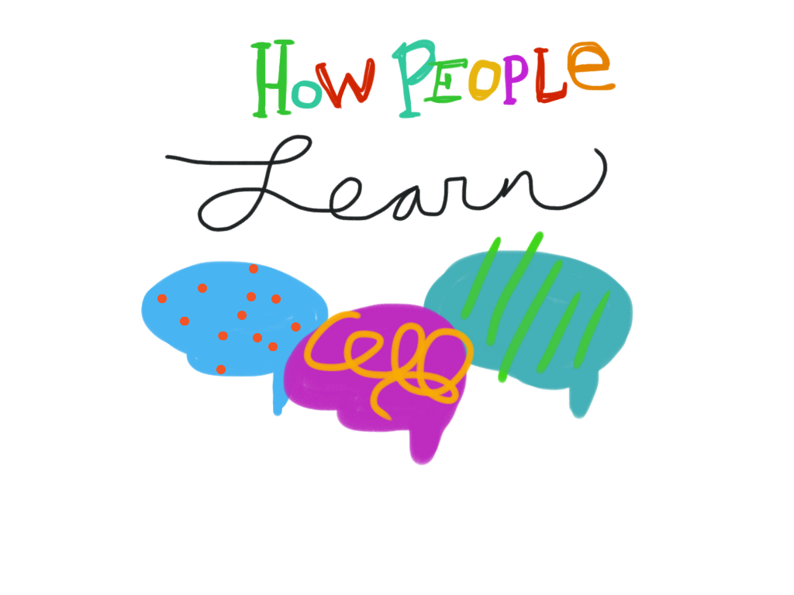
Foundations
of Authenticity
The Authenticity Framework is supported by the body of research on how people learn. Research on memory, learning transfer, environmental cues, culture, and context is crucial to the study of authenticity.

Slide 9
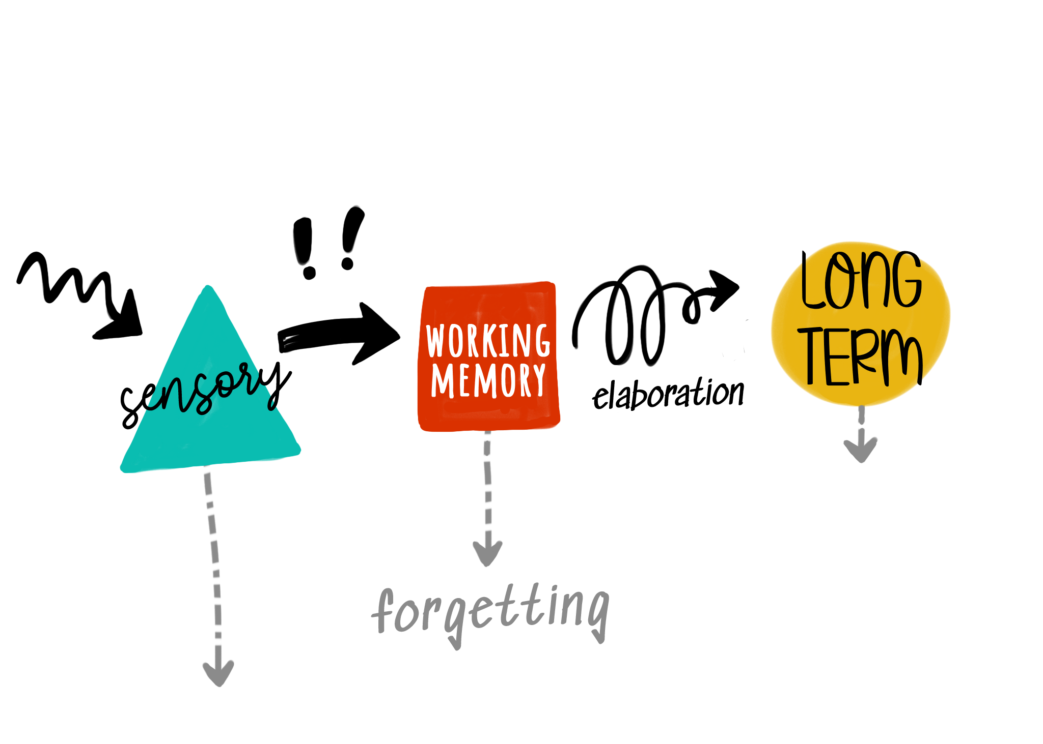
Memory and Learning
Research shows that learners generate understanding of the information they accumulate and extend their knowledge by making logical connections between pieces of information. Learning involves taking existing knowledge and using it to construct new understanding through information processing. For most types of learning, memory is an important foundation. Pieces of information are stored in the brain within neural networks as encoded mental representations (sometimes called “schemas”).
Notes:
National Academies of Sciences, Engineering, and Medicine (NASEM). (2018). How people learn II: Learners, contexts, and cultures. The National Academies Press.

Slide 10
Memory and Learning
As opposed to simple retrieval, deeper memorization involves the reconstruction of exact copies of encoded mental representations of information (NASEM, 2018). These pieces of information are pulled into working memory and reconstructed using existing knowledge. This process allows learners to use the new knowledge to generalize, categorize, and solve problems (NASEM, 2018).
Notes:
National Academies of Sciences, Engineering, and Medicine (NASEM). (2018). How people learn II: Learners, contexts, and cultures. The National Academies Press.

Slide 11
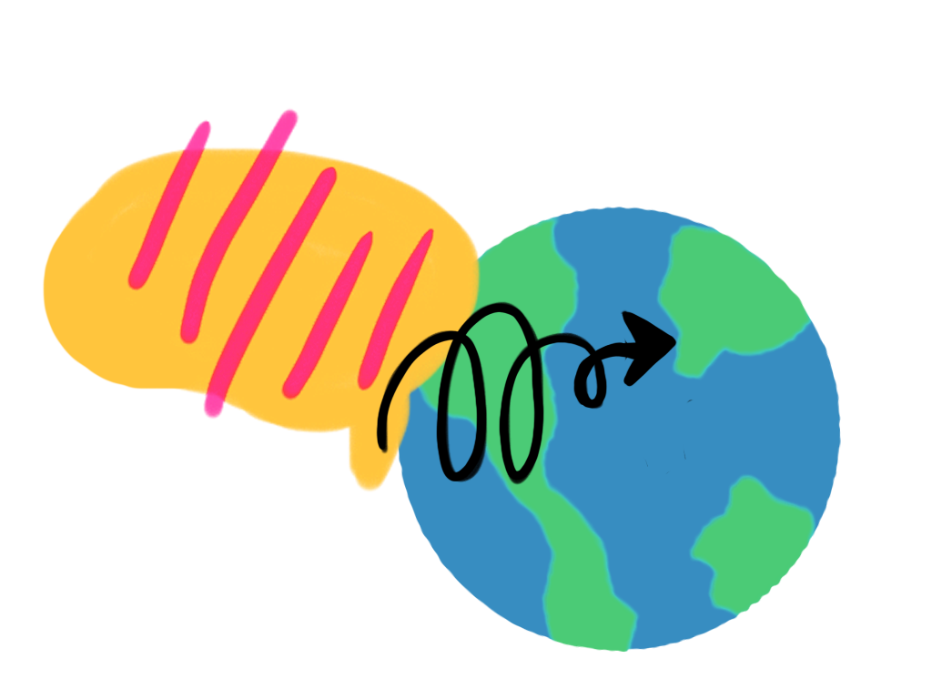
Transfer of Learning
The application of learning to new situations, otherwise known as the transfer of learning, is affected by the degree to which people learn with understanding, rather than the memorization of simple facts or fixed procedures (NASEM, 2018). Research shows that learning with understanding involves the creation of an interconnected network of knowledge that can be retrieved from memory in multiple ways.
Notes:
National Academies of Sciences, Engineering, and Medicine (NASEM). (2018). How people learn II: Learners, contexts, and cultures. The National Academies Press.

Slide 12
Transfer of Learning
Effective learning experiences use organized knowledge structures that encourage learners to elaborate on and apply specific pieces of knowledge in varying contexts. This process enriches the neural network and provides more ways to process new information, resulting in deeper, more complex mental representations.
Notes:
National Academies of Sciences, Engineering, and Medicine (NASEM). (2018). How people learn II: Learners, contexts, and cultures. The National Academies Press.

Slide 13
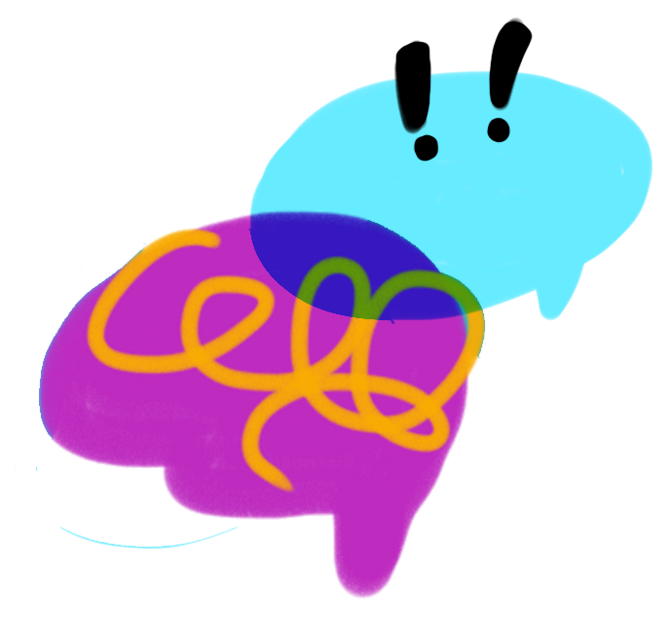
Cues and Integration
Learners constantly integrate many types of learning, both deliberately and unconsciously, in response to the circumstances and challenges encountered in their social and physical environments (NASEM, 2018). The cues in a learner’s environment are critical to the learner’s ability to recall information and integrate new information as knowledge.
Notes:
National Academies of Sciences, Engineering, and Medicine (NASEM). (2018). How people learn II: Learners, contexts, and cultures. The National Academies Press.

Slide 14
Cues and Integration
These cues provide the conditions in which learners attempt to retrieve knowledge in a learning situation and consequently influence learning outcomes. The learning environment and classroom culture are part of this cueing mechanism. Therefore, interactions in the classroom constitute their own community and become cultural activities in their own right.

Slide 15
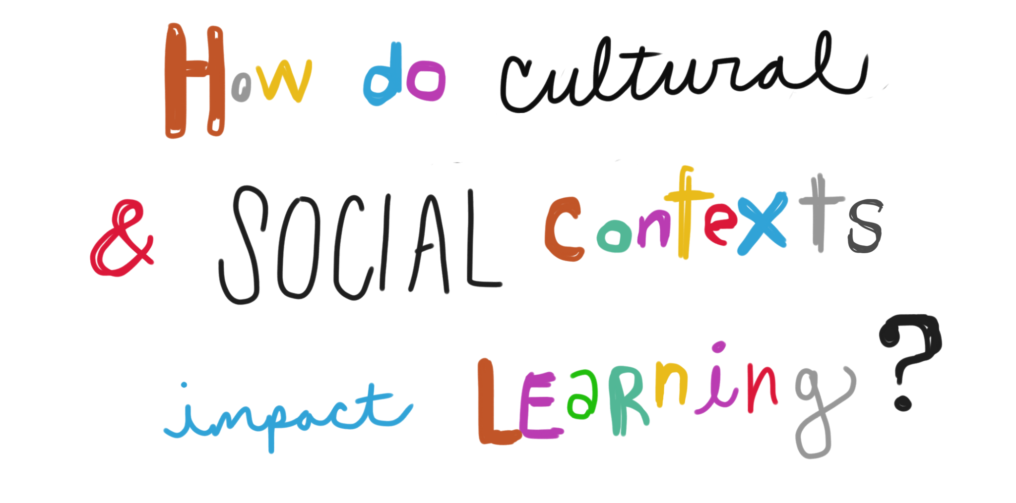
Culture and Contexts
Learning is a social process infused with a system of cultural meaning (NRC, 2009). Each learner develops a unique set of knowledge and cognitive resources based on the interplay of their formal and informal educational, cultural, and social experiences.
Understanding the developmental, cultural, contextual, and historical diversity of learners is central to understanding how people learn.
Notes:
National Research Council (NRC). (2009). Learning science in informal environments: People, places, and pursuits. The National Academies Press.

Slide 16
Culture and Contexts
In addition to experiences acquired through formal and informal education, cultural knowledge is part of the long-term memory of each individual and contributes to their understanding of an instructional activity. If instructional activities include social interaction through collaboration, learners can bring their cultural and social experiences to the learning process by retrieving and sharing ideas that encourage knowledge integration.
Notes:
National Research Council (NRC). (2009). Learning science in informal environments: People, places, and pursuits. The National Academies Press.

Slide 17

Beach Ball Talk and Toss
Color | Question
Red | Which part(s) of your ideal classroom promote the principles of how people learn?
Orange | What would you add to your ideal classroom to support a student-centered learning environment?
Yellow | At which station(s) did you recognize memory and learning? How?
Green | At which station(s) did you recognize the transfer of learning? How?
Blue | At which station(s) did you recognize cues and integration? How?
White | At which station(s) did you recognize culture and context? How?
Notes:
K20 Center. (n.d.). Beach ball talk and toss. Strategies. https://learn.k20center.ou.edu/strategy/147

Slide 18

Authentic Learning Framework
As you read, use the Categorical Highlighting strategy to mark the following:
Conceptual Definition—Defines or describes the practice being discussed
Application—Describes how the practice is implemented in the classroom
HPL Connections—Describes the principles of how people learn
Notes:
Presenter’s Note: Highlight the bold words in the color that you would like participants to use when highlighting those sections.
K20 Center (n.d.) Categorical highlighting. Strategies. https://learn.k20center.ou.edu/strategy/192

Slide 19
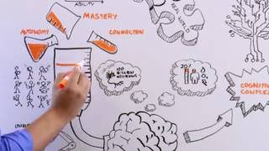
How We Learn
https://youtu.be/wlaG99awCD8
Notes:
Forney ISD. (2016, October 24). How we learn [Video]. YouTube. https://www.youtube.com/watch?v=wlaG99awCD8

Slide 20

Triangle-Square-Circle
What are three important points from today’s session?
What “squares” with your thinking? What ideas align with your own understanding and viewpoints?
What questions or ideas are still “circling” your mind?
Notes:
K20 Center. (n.d.). Triangle-circle-square. Strategies. https://learn.k20center.ou.edu/strategy/65

Slide 21
Instructional Strategy Reflection
Reflect on the following strategies used in the session:
Vision Boards
Gallery Walk
Chat Stations
Beach Ball Talk and Toss
Jigsaw
Triangle-Square-Circle
How can you use these strategies in your classroom to create real-world connections?

