Slide 2
Establishing Norms
How to Ensure Successful Collaboration

Slide 3
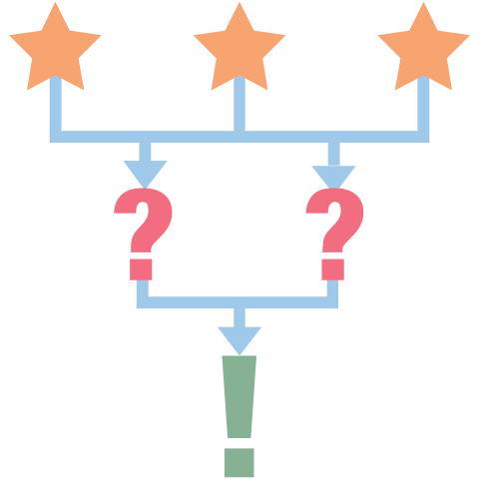
3-2-1
On a piece of paper, write the following:
3 things you hope to gain from this book study
2 concerns you have about the upcoming book study
1 approach you have for mitigating those concerns
Share what you wrote with others in your small group.
Notes:
K20 Center. (n.d.). 3-2-1. Strategies. https://learn.k20center.ou.edu/strategy/117

Slide 4
Essential Questions
What are team norms we can create that will ensure that this book study is a success?
How should we enforce those norms?

Slide 5
Activity Objectives
Reflect on instances in which you have collaborated successfully with others as well as when collaboration has been ineffective.
Collaborate to establish norms that can be used over the course of the book study.
Determine how these norms can be enforced during the book study.
Notes:
The facilitator will ensure that everyone has an opportunity to participate and will make sure that the final norms are based upon consensus. The recorder will record all of the ideas.

Slide 6
Affinity Process (Part 1)
Take 2 yellow sticky notes and write on each a reason why you have collaborated successfully when working in groups in the past.
Take 2 blue sticky notes and write on each a pet peeve/behavior that reduces your productivity and/or hinders personal relationships when working with groups.
Notes:
K20 Center. (n.d.). Affinity process. Strategies. https://learn.k20center.ou.edu/strategy/87
What are effective behaviors that promote productivity in your workspace?
What are guidelines or rules when implemented that will help people regulate behaviors and promote productivity? What are some that influence how employees treat each other and assess individual productivity?

Slide 7
Affinity Process (Part 2)
With your group, arrange the sticky notes on the table or a nearby wall.
Identify some broad categories into which the positive and negative behaviors can be grouped (theming and coding).
Notes:
K20 Center. (n.d.). Affinity process. Strategies. https://learn.k20center.ou.edu/strategy/87

Slide 8
Affinity Process (Part 3)
Review the categories with your groups and discuss what you see.
Take turns justifying your reasons for grouping the sticky notes as you did.
If you feel it’s necessary, rearrange the sticky notes.
Notes:
K20 Center. (n.d.). Affinity process. Strategies. https://learn.k20center.ou.edu/strategy/87

Slide 9
Affinity Process (Part 4)
Use your affinity maps to come to a group consensus of 3-5 norms for the larger book study group.
Write these on sticky notes and be prepared to share them with the larger group.
Notes:
K20 Center. (n.d.). Affinity process. Strategies. https://learn.k20center.ou.edu/strategy/87

Slide 10
Affinity Process (Part 5)
Place the sticky notes listing your proposed norms on the wall.
Read carefully through them all and search for similarities.
If your group agrees that the norms need to be regrouped, you can rearrange them.
Notes:
K20 Center. (n.d.). Affinity process. Strategies. https://learn.k20center.ou.edu/strategy/87

Slide 11
Affinity Process (Part 6)
Take one final look at the affinity map your group has put together.
Make sure you agree that the map has been categorized properly.
If necessary, make some final, minor adjustments.
You will use this map as a reference for establishing norms that can be used in your book study group.
Notes:
K20 Center. (n.d.). Affinity process. Strategies. https://learn.k20center.ou.edu/strategy/87

Slide 12
Proposing Norms
With your group, decide on the norms you’ll be using.
As you do so, keep in mind the successes and pet peeves you’ve discussed.
Your group should come up with 3-5 norms along with some verbal and visual cues that could be used to determine if these norms are ever broken.

Slide 13
Examples of Visual Cues
Someone holds up a stuffed animal.
Someone raises a hand.

Slide 14
Examples of Verbal Cues
Someone utters an agreed-upon word.
A participant politely asks a someone about a norm in question.
Group members discuss the norm outside of the meeting with the leader of the group.

