Slide 1
5E Lesson Writing
Action Research in Authenticity
Notes:
James
Day 1: 8am–3pm
8:00–11:30…Together
11:30–12:30…Lunch
12:30–3:00..…Tracks
Day 2: 8am–3pm
8:00–11:30…GBL & Tracks
30 min GBL
10 min Break after GBL
11:30–12:30…Lunch
12:30–3:00..…Tracks
Day 3: 8am–11:30am
8:00–11:30…AI Session
9:30–11:00…Reflect/Debrief
11:00–11:30…CS time

Slide 2
Welcome!
Presenter introductions go here

Slide 3




K20 GEAR UP Programs
2023–2030
Serving 27 suburban school districts in Oklahoma.
Serving 7 suburban school districts in Oklahoma.
Serving 24 rural school districts in Oklahoma.
Serving Oklahoma City Public Schools.
2018–2025
Notes:
As we mentioned in our introductions, we represent the three GU grants at the K20 Center, and we thank you for representing these grants as well.
As you can see from these descriptions, K20 has the privilege of working with schools from all over the state.
All three grants belong to the GU family, which is a federal grant that aims to increase PSE and CCR in public schools.

Slide 4
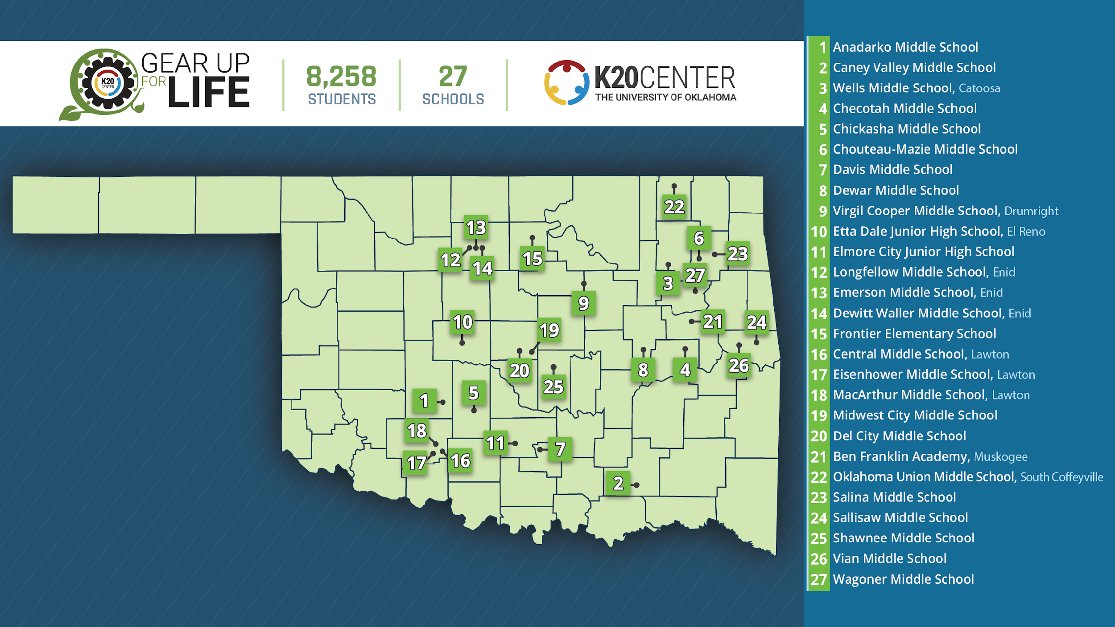
Notes:
page 9 in booklet
LIFE stands for Learning and Investigating Future Education.

Slide 5
Getting to Know You…
Create a name tent that includes:
Your name
Where you teach
Which grade(s) and specific content you teach
Your senior superlatives
Notes:
Ask for a few participants to share out, focus on name, where they teach, what grade/subject.

Slide 6
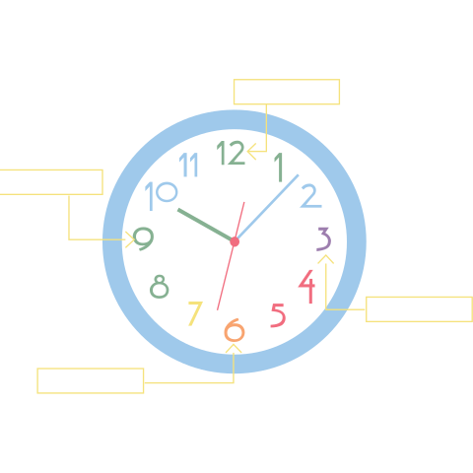
Appointment Clocks
This strategy gets learners thinking, collaborating, and discussing together in a short amount of time.
It can also be used to pair learners and easily keep record of who worked with whom.
Notes:
Students pair up by setting up "appointment times" with their classmates.
The activity below uses only four "appointment times," but it can be altered to have more or fewer.
Another way to use this strategy is to have students store their clocks after the activity and use them to pair students more easily in the future.
K20 Center. (n.d.). Appointment clocks. Strategies. https://learn.k20center.ou.edu/strategy/124

Slide 7
Appointment Clocks
12 o’clock: Find a teacher who
is the opposite of you:
  e.g., a veteran teacher with an early career teacher!
3 o’clock: Find someone who teaches on a DIFFERENT grant than you.
6 o’clock: Find someone who has a similar Sonic order as yours.
9 o’clock: Find someone who has the same severe weather outlook/procedures as you.
Notes:
You can only be one person’s partner for each time of day!!!! Don’t lose this, we will be using this over the next three days
9 o’clock- Stand on your front porch, watch David Payne, get in your shelter, put on a bike helmet… etc.
K20 Center. (n.d.). Appointment clocks. Strategies. https://learn.k20center.ou.edu/strategy/124

Slide 8
Essential Questions
How is authenticity incorporated into the development of 5E lesson plans?
How can educators effectively craft 5E lesson plans to enhance student engagement and learning outcomes?
Notes:
Identify key components of the 5E instructional model and analyze authentic lesson plans from diverse subjects.
Develop strategies to adapt existing lesson materials to align with the 5E framework authentically.
Create authentic 5E lesson plans that integrate meaningful learning experiences and engage diverse learners.

Slide 9
Learning Goals
Identify key components of the 5E instructional model and analyze authentic lesson plans from diverse subjects.
Develop strategies to adapt existing lesson materials to align with the 5E model authentically.
Create authentic 5E lesson plans that integrate meaningful learning experiences and engage diverse learners.

Slide 10

Fiction in the Facts
There are 5 posters, around the room, each with three statements.
Examine the statements on each poster and see if you can determine which statement is false.
Place your sticker next to the statement you believe is false.
Be prepared to share out your reasoning.
Notes:
K20 Center. (n.d.). Fiction in the facts. Strategies. https://learn.k20center.ou.edu/strategy/60
Explain that these are all taken from different snapshots, none are incorrect, they are just in the wrong spot.

Slide 11
Fiction in the Facts: Share Out
Take a moment to look around the room.
Did everyone place their sticker on the same statement?
Why did you place your
sticker there?
Notes:
K20 Center. (n.d.). Fiction in the facts. Strategies. https://learn.k20center.ou.edu/strategy/60
Have participants (2-3) to a poster and then select someone to share out. Summary of their posters, which is correct and why, where would the other two go.

Slide 12

Break
Notes:
Online Timer Option: https://timer.k20center.ou.edu/
K20 Center. (2021, September 21). K20 Center 10 minute timer. [Video]. YouTube. https://youtu.be/9gy-1Z2Sa-c?si=fK21CHcK4DKbD50m

Slide 13

Synectics
This instructional strategy
enables learners to draw on
their existing knowledge to complete fill-in-the-blank analogies about the content.
It also provides an opportunity to assess the prior knowledge that learners bring as they connect what they already know to the lesson's concepts.
Notes:
K20 Center. (n.d.). Synectics. Strategies. https://learn.k20center.ou.edu/strategy/120

Slide 14
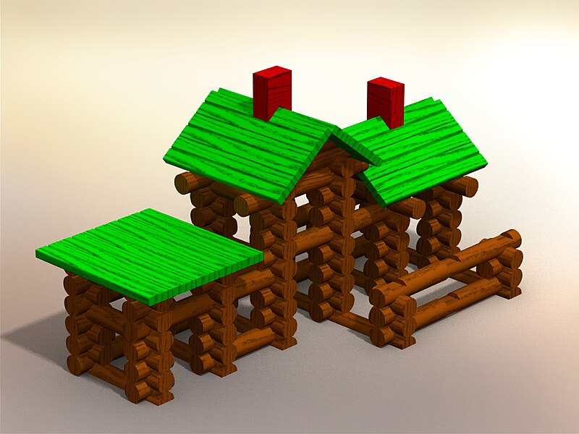
Synectics: 5E
Synectics Example: Construction
of knowledge is like a set of Lincoln
Logs: students take previous knowledge and new knowledge and fit the pieces together to create a new understanding.
On 5 different sticky notes, write your synectics statement about each of the 5 E’s.
  Engage is like ________, because ________.
Notes:
Participants will do synectics on 5 different sticky notes different then friends and then place them on the posters
Hesoto. (2011, September 16). Gregory Lincoln log house [Image]. Wikimedia Commons. https://commons.wikimedia.org/wiki/File:Gregorylincolnloghouse.jpg
K20 Center. (n.d.). Synectics. Strategies. https://learn.k20center.ou.edu/strategy/120

Slide 15

Gallery Walk
Place your synectics statements
on the corresponding posters.
Walk around the room reading each other’s statements.
Find a statement you did not create that you would like to share with the whole group.
Notes:
K20 Center. (n.d.). Gallery walk / carousel. Strategies. https://learn.k20center.ou.edu/strategy/118

Slide 16

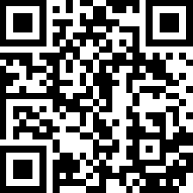
Wakelet: 5E Model
Scan the QR code to learn more
about the 5E model.
  Or go to: bit.ly/5EModelW.
Use your Wakelet Note Catcher as you read one of the articles. Be ready to share your takeaways.
Then use your Note Catcher to take notes on any new information as you listen to others share out.
Notes:
Jigsaw/Wakelet different sources for participants to read and discuss? What stands out? What is different from your existing perceptions? Each table is assigned an article to read and analyze (jigsaw), share out.
https://lesley.edu/article/empowering-students-the-5e-model-explained
https://nearpod.com/blog/5e-lesson-plan/
https://www.hmhco.com/blog/5e-instructional-model
https://www.edutopia.org/article/how-use-5e-model-your-science-classroom/
K20 Center. (n.d.). Wakelet. Tech Tools. https://learn.k20center.ou.edu/tech-tool/2180

Slide 17

5E Video
Notes:
Show video and talk up the K20 YouTube

Slide 18
Engage

Slide 19
Explore

Slide 20
Explain

Slide 21
Extend

Slide 22
Evaluate

Slide 23
Break
Notes:
Online Timer Option: https://timer.k20center.ou.edu/
K20 Center. (2021, September 21). K20 Center 10 minute timer. [Video]. YouTube. https://youtu.be/9gy-1Z2Sa-c?si=fK21CHcK4DKbD50m

Slide 24
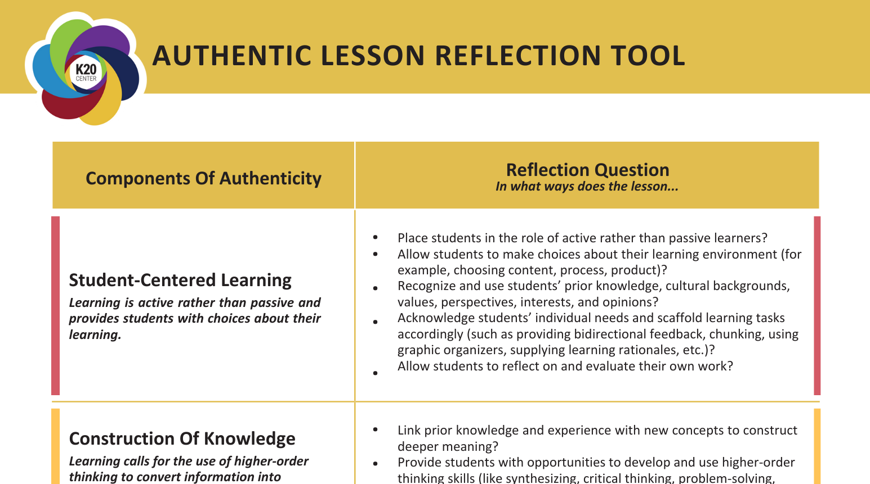
Categorical Highlighting
Using the Authentic Lesson
Reflection Tool, identify the
component(s) of authenticity in the lesson snapshots.
Highlight the portion of the snapshot using the color corresponding to the component of authenticity:
  Red: Student-Centered Learning
  Yellow: Construction of Knowledge
  Green: Inquiry-Based Learning
  Blue: Real-World Connections
  Purple: Anything that is counter to what is on the reflection tool
Notes:
Margaret Create (X) different lessons using Magic School; have participants evaluate them using rubric.
Magic School AI Create 5E Lessons and then critique them against the Authenticity Rubric
WE create lessons on Magic school, participants will use those lessons using the critique the bot strategy and compare to published learn lessons using Authentic charts.
Mention later language matters, these were not great because of what we entered.
Strategy to debrief
Snapshot for CDP, look for things that match on the chart, flag anything that looks wrong. Star thing
K20 Center. (n.d.). Categorical highlighting. Strategies. https://learn.k20center.ou.edu/strategy/192

Slide 25
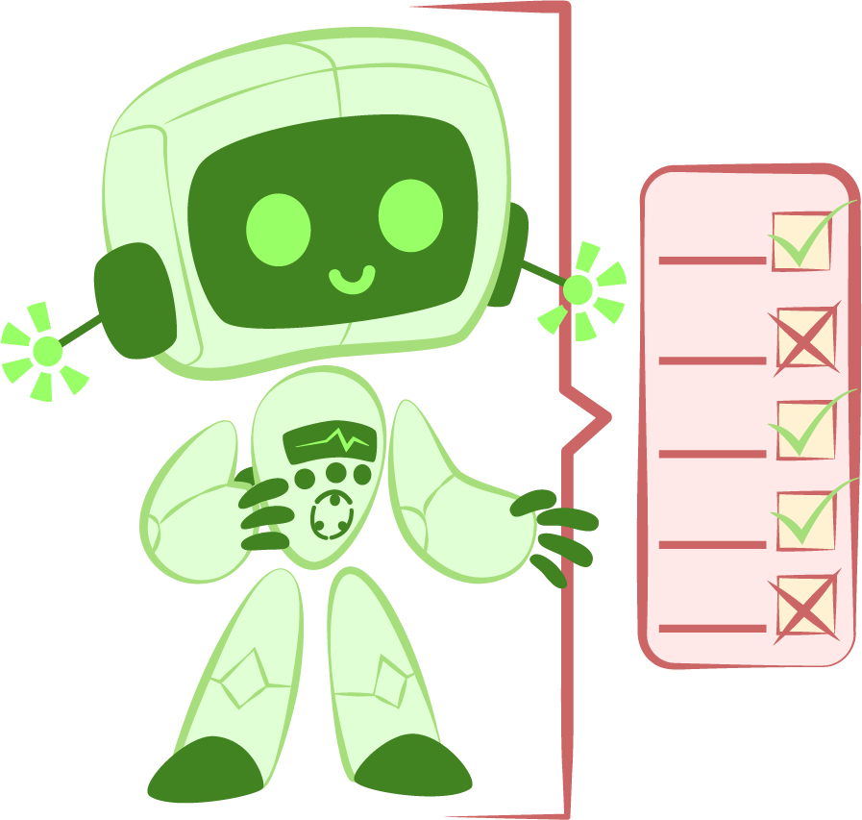
Critique the Bot
This strategy encourages learners
to critically examine text written
by artificial intelligence.
Using AI to generate a short story, essay, lab report, script, or other text, learners evaluate the generated text as if it were written by a peer.
This allows teachers to leverage the power of AI by quickly creating custom-tailored text.
Notes:
Now reveal that the snapshots were AI generated
K20 Center. (n.d.). Critique the bot. Strategies. https://learn.k20center.ou.edu/strategy/3491

Slide 26

Reflection
What is something that you want to
take away from today’s session?
Go to Menti.com.
Enter Join Code: CODE GOES HERE
OR
Scan the QR code. QR CODE GOES HERE
Notes:
https://www.mentimeter.com/app/presentation/bl3wi7pbuqoo9unrgdfbrgq78mmfcikh/16urgzxjsa1e/edit
K20 Center. (n.d.). Mentimeter. Tech Tools. https://learn.k20center.ou.edu/tech-tool/645

