Slide 2
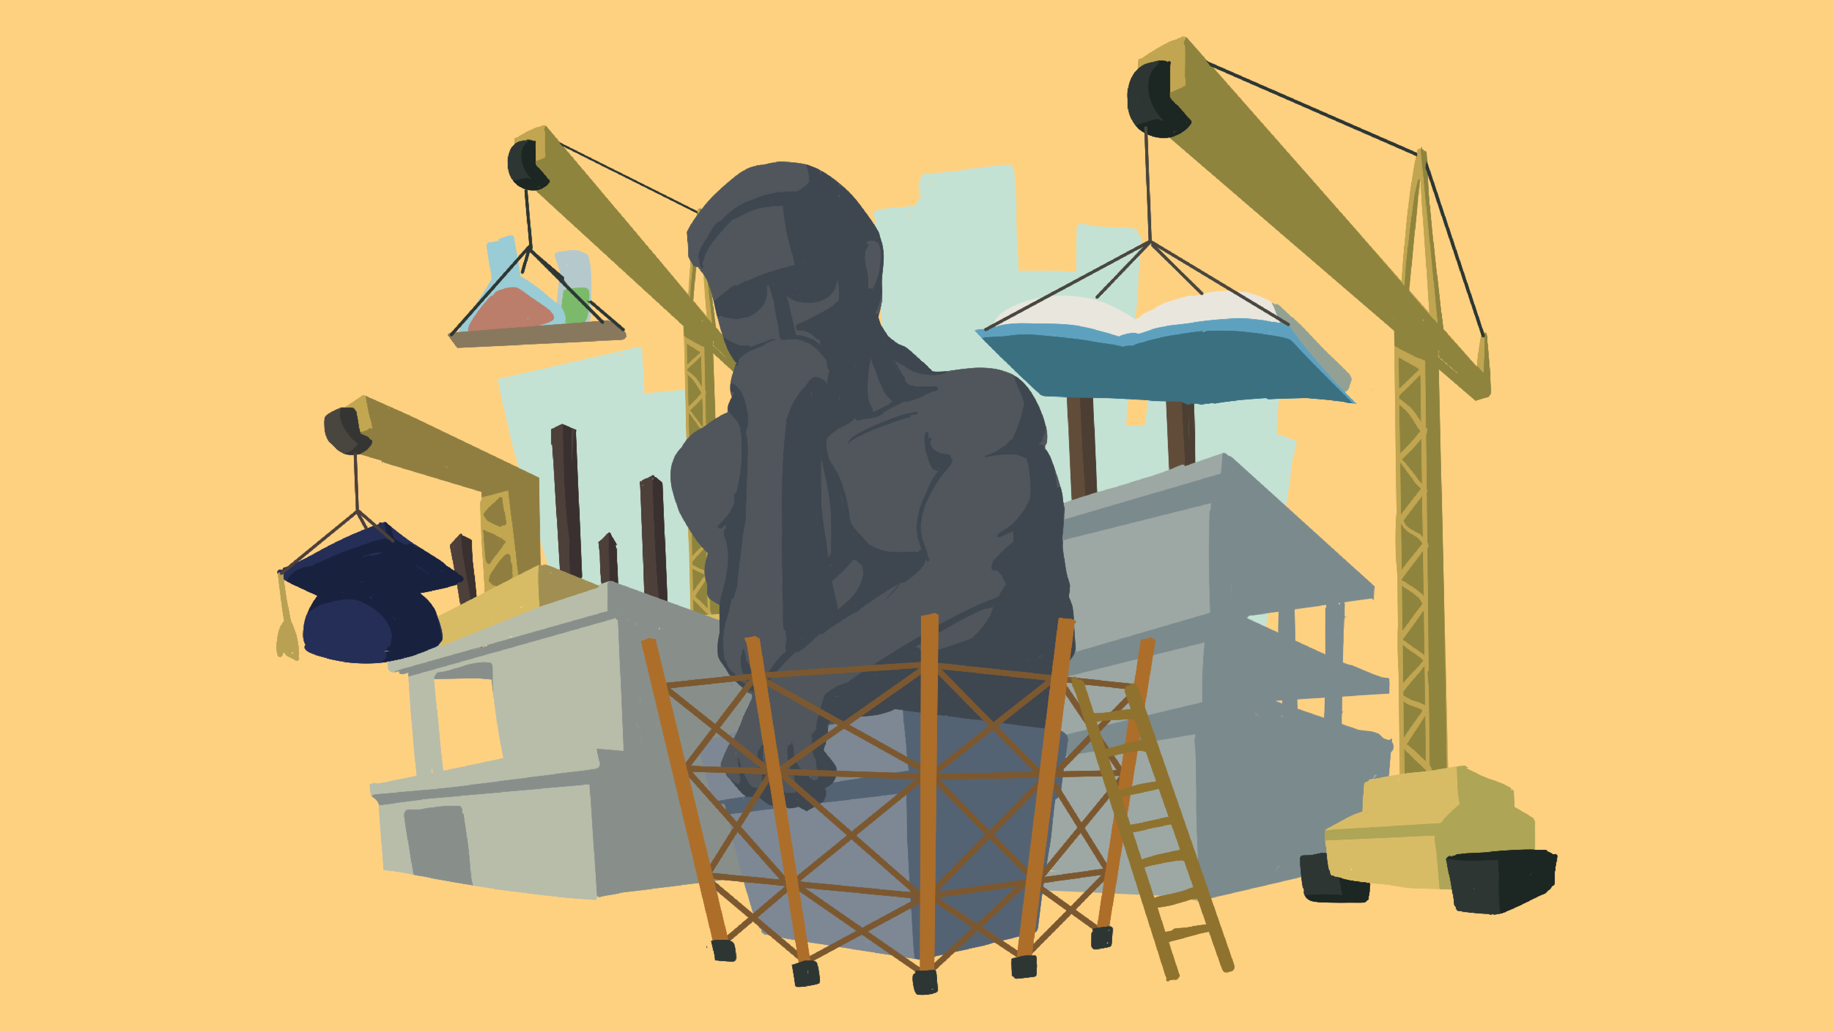
Bridging Minds: Connecting Experiences to New Concepts for Higher-Order Thinking
Construction of Knowledge

Slide 3
Prior Knowledge
Why is it important to determine your student’ prior knowledge about a topic?
How do you currently assess student’s prior knowledge?

Slide 4


Prior Knowledge: Inside Out
Respond to the following prompt in the innermost circle of your handout:
  What do you know about gauging students’ prior knowledge?
1 Minute Timer
Notes:
K20 Center. (n.d.) Inside out. Strategies. https://learn.k20center.ou.edu/strategy/93
K20 Center. (2021, September 21). K20 Center 1 minute timer [Video]. YouTube. https://www.youtube.com/watch?v=6ilD555O_RE

Slide 5

Prior Knowledge: Inside Out
Find a partner.
Share your response to the prompt with your partner.
Write any new ideas in the middle circle under the prompt “What I learned from the discussion with my partner.”
3 Minute Timer
Notes:
K20 Center. (n.d.) Inside out. Strategies. https://learn.k20center.ou.edu/strategy/93
K20 Center. (2021, September 21). K20 Center 3 minute timer [Video]. YouTube. https://www.youtube.com/watch?v=iISP02KPau0

Slide 6
Essential Question
How can we use students’ prior knowledge and critical thinking skills to assist them in developing a higher level of understanding?

Slide 7
Learning Objectives
Recognize the importance of connecting students’ prior experiences to new concepts.
Apply higher-order thinking skills to solve complex problems and analyze methods to teach students how to use those skills to make informed decisions.

Slide 8

Card Sort
In your small groups, read the provided cards.
Match each standard to the prior knowledge required.
Discuss how you grouped cards together and why.
Come to an agreement on how the cards are organized.
Notes:
K20 Center. (n.d.). Card sort. Strategies. https://learn.k20center.ou.edu/strategy/147

Slide 9
Academic Standards
Visit [insert state standards website link here]
Find and review the framework for your content area.
Look for recommendations, resources, and examples on the site that may help clarify the standards for you.
After reviewing the site, adjust your card groupings as necessary.
Share out how you organized your cards.
Notes:
Facilitator’s Note: Insert the link to your standards website on the slide before presenting. Consider using a shortened URL to help participants navigate easily to the site.

Slide 10
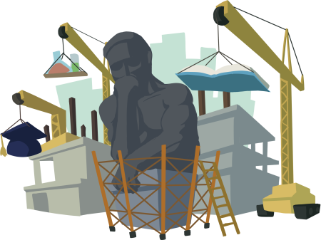
Construction of Knowledge
Read the Components of Authenticity: Construction of Knowledge research brief.
Notes:
K20 Center. (n.d.). Components of authenticity: Construction of knowledge—K20 IDEALS. The IDEALS Framework. https://k20center.ou.edu/wp-content/uploads/2023/07/Construction-of-Knowledge_COA.pdf

Slide 11
Construction of Knowledge: Frayer Model
Define How would you define “construction of knowledge”? | List the characteristics List 3–5 essential characteristics of this component.
Draw a visual representation Sketch a scene or symbol that represents this component. | Reflect: How does this look in your class? Give an example of how COK looks in your class.
Construction of Knowledge
Notes:
K20 Center. (n.d.). Frayer model. Strategies. https://learn.k20center.ou.edu/strategy/126

Slide 12
[ENTER LESSON NAME]
Read the provided 5E lesson and discuss the following questions in your small group. Prepare to share out.
What prior knowledge do your students need to be able to understand the lesson?
How does the lesson encourage students to use Construction of Knowledge?
How would you plan your delivery of this lesson? Would you need to scaffold, modify, etc.?
Notes:
Facilitator’s Note: Prior to the session, insert the name of the lesson you plan to present into the slide title.

Slide 13
Prior Knowledge: Inside Out
Reflect on what you learned about the construction of knowledge in this session.
Fill in the final circle on your Inside Out handout with what you learned in this session.
Notes:
K20 Center. (n.d.) Inside out. Strategies. https://learn.k20center.ou.edu/strategy/93

Slide 14
Instructional Strategy Reflection
Reflect on the following instructional strategies:
Card Sort
Frayer Model
Inside Out
How can you use these strategies in your classroom to foster the construction of knowledge?

