Slide 2
Wisdom in Action: Crafting Authentic Real-World Learning
Real-World Connections

Slide 3
Chain Notes Round 1
On your paper, write three thoughts you have on the following prompt:
Where do students see the importance of your content-based skills in the real world?
Pass your paper to the person on your left when time is called.
Notes:
K20 Center. (n.d.). Chain Notes. Strategies. https://learn.k20center.ou.edu/strategy/52

Slide 4
ELA Chain Notes Round 1
On your paper, write three thoughts you have on the following prompt:
Where do students see the importance of reading and writing skills in the real world?
Pass your paper to the person on your left when time is called.
Notes:
K20 Center. (n.d.). Chain Notes. Strategies. https://learn.k20center.ou.edu/strategy/52

Slide 5
Math Chain Notes Round 1
On your paper, write three thoughts you have on the following prompt:
Where do students use math skills in the real world?
Pass your paper to the person on your left when time is called.
Notes:
K20 Center. (n.d.). Chain Notes. Strategies. https://learn.k20center.ou.edu/strategy/52

Slide 6
Science Chain Notes Round 1
On your paper, write three thoughts you have on the following prompt:
Where do students see science skills or science and engineering practices in the real world?
Pass your paper to the person on your left when time is called.
Notes:
K20 Center. (n.d.). Chain Notes. Strategies. https://learn.k20center.ou.edu/strategy/52

Slide 7
Social Studies Chain Notes
Round 1
On your paper, write three thoughts you have on the following prompt:
Where do students see or make use of social studies content in the real world?
Pass your paper to the person on your left when time is called.
Notes:
K20 Center. (n.d.). Chain Notes. Strategies. https://learn.k20center.ou.edu/strategy/52

Slide 8
Chain Notes Round 2
Read the three points written by the previous person.
Choose one of the points. Draw an arrow down and add an additional thought, idea, or connection through words or a drawing.
Pass the handout to the person on your left.
Notes:
K20 Center. (n.d.). Chain Notes. Strategies. https://learn.k20center.ou.edu/strategy/52

Slide 9
Chain Notes Round 3
Read the points written by your peers.
Choose one of the points. Draw an arrow down and add an additional thought, idea, or connection through words or a drawing.
Pass the paper to the person on your left.
Notes:
K20 Center. (n.d.). Chain Notes. Strategies. https://learn.k20center.ou.edu/strategy/52

Slide 10
Chain Notes Round 4
Read the points written by your peers.
Choose one of the points. Draw an arrow down and add an additional thought, idea, or connection through words or a drawing.
Pass the paper to the person on your left.
Notes:
K20 Center. (n.d.). Chain Notes. Strategies. https://learn.k20center.ou.edu/strategy/52

Slide 11
Chain Notes: Reflection
Take a moment to review the comments you received on your paper.
Once everyone has finished reviewing their papers, take a moment as a group to summarize what everyone's thoughts are.
Be prepared to share out.
Notes:
K20 Center. (n.d.). Chain Notes. Strategies. https://learn.k20center.ou.edu/strategy/52

Slide 12
Essential Question
How can students translate content to real-world application?

Slide 13
Learning Goals
Identify skills that students gain from connecting real-world experiences to their learning.
Relate real-world scenarios to content and college & career readiness lessons.

Slide 14
ELA AI in the Classroom: Friend or Foe?
Access the Wakelet by scanning the QR code at the right or going to k20.ou.edu/elai
Read the article assigned to your number:
Embracing Artificial Intelligence in the Classroom
ChatGPT & Writing in the Secondary ELA Classroom
ChatGPT: Is AI Beneficial or Dangerous in the ELA Classroom?

Slide 15
ELA AI in the Classroom: Friend or Foe?
After everyone has had time to read their article, take turns sharing your key takeaways with the group. Consider the following:
What are the main points the article makes?
What is a feature or strategy the article discusses that you are interested in?
What are your thoughts/opinions on the main points of the article?
Notes:
K20 Center. (n.d.). Jigsaw. Strategies. https://learn.k20center.ou.edu/strategy/179

Slide 16
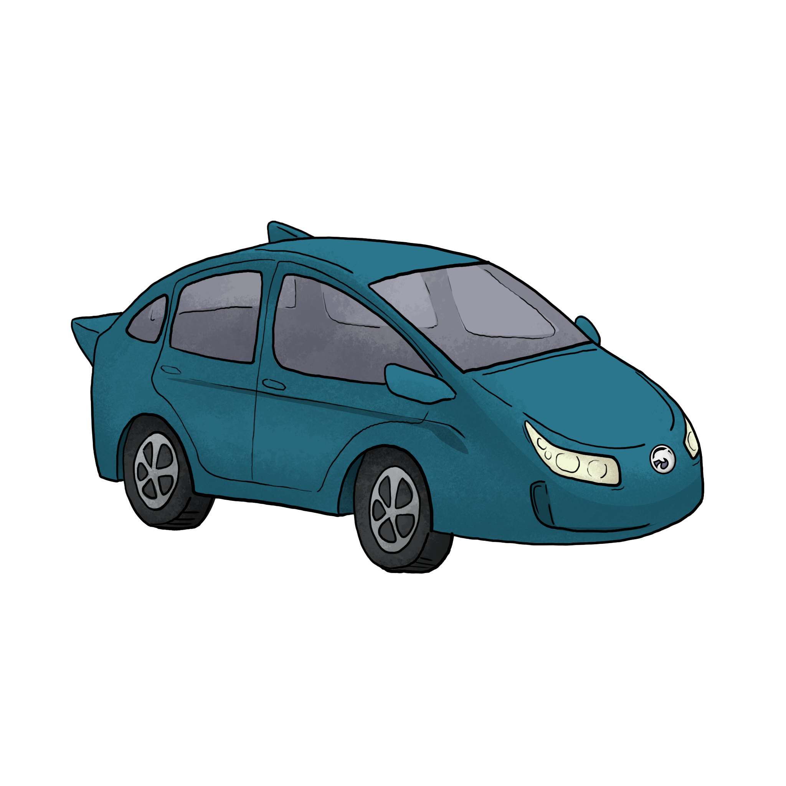
Math Car Activity
Jordan wants to earn money to buy a car. How long will it take for Jordan to earn enough money?
Use the information on the handout to help you answer the question.

Slide 17
Science Phenomena Deep Dive
Access the Wakelet by scanning the QR code at the right or going to k20.ou.edu/phenom
Visit one or more of these sites to find a phenomenon for either a:
7th grade standard
8th grade standard

Slide 18
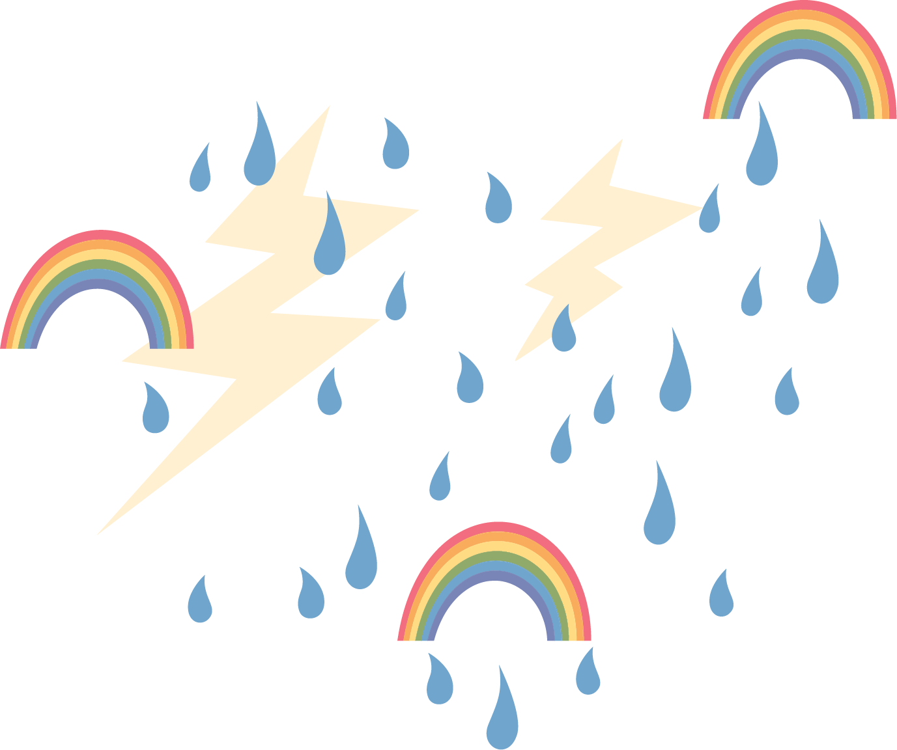
Science Phenomena Deep Dive Reflection
What standard did you choose?
What is the significance of using a phenomenon to start a unit?
Based on this information, how well does your chosen real-world phenomenon support student learning?

Slide 19
Social Studies Honeycomb Harvest:
U.S. History
First, read all the cards with your partner.
Organize and arrange the hexagons so that the sides of related topics are touching to create a honeycomb effect.
Be prepared to justify and explain your decisions.
Nationalism
Alliances
Causes of WW1
Imperialism
Militarism
Notes:
K20 Center. (n.d.). Honeycomb harvest. Strategies. https://learn.k20center.ou.edu/strategy/61

Slide 20
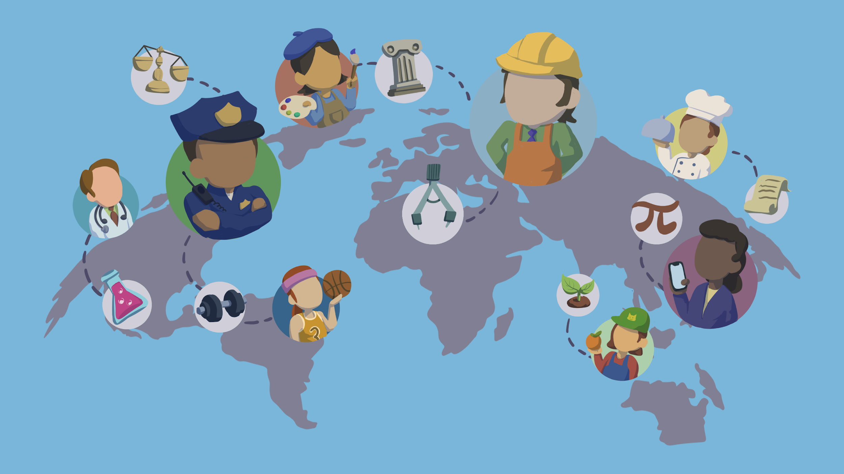
Real-World Connections (RWC)
Read the Components of Authenticity: Real-World Connections research brief.

Slide 21
Real-World Connections: Frayer Model
Define Describe RWC in your own words. | List the characteristics List 3–5 essential characteristics of RWC.
Draw a visual representation Sketch a scene or symbol that represents RWC. | Reflect: How does this look in your class? Give an example of how RWC looks in your class.
Real-World Connections
Notes:
K20 Center. (n.d.). Frayer Model. Strategies. https://learn.k20center.ou.edu/strategy/126

Slide 22
Model Lesson
Review the provided lesson and materials.
As you review the lesson, consider how it authentically incorporates the principles of real-world connections.

Slide 23
ELA: A Way with Words
Notes:
A Way With Words video available at this link: https://www.youtube.com/watch?v=QAn9e5s8AMM

Slide 24
Math: Stats on the Sideline
Notes:
Stats on the Sideline video available at this link: https://www.youtube.com/watch?v=rGI8PX4UbNI

Slide 25
Science: Feelin’ the Phenomena
Notes:
Feelin’ the Phenomena video available at this link: https://www.youtube.com/watch?v=2arUwaluIV8

Slide 26
Social Studies: Impacts of Industrialization on Workers
Notes:
Impacts of Industrialization on Workers video available at this link: https://www.youtube.com/watch?v=XPpiKKsClTY

Slide 27
Real-World Connections Reflection
Why is it valuable for students to understand how their education can be relevant to their future professions?
In what ways can you help students relate what they were learning in class to real-life situations?
How are real-world connections relevant to the development of knowledge?

Slide 28
Instructional Strategy Reflection
Recall the following strategies from the session:
Chain Notes
Frayer Model
How can you use these strategies in your classroom with real-world connections?

