Slide 2
Imagining Possible Future Selves
The Importance of Postsecondary Campus Visits

Slide 3
Essential Question
Why are postsecondary campus visits important for middle school and early high school students?
What are the essential components of a campus visit?

Slide 4
Lesson Objectives
Understand the importance of a postsecondary education campus visit.
Discuss the essential components of a campus visit to plan future events.

Slide 5
Mental Time Travel
Imagine one positive event that could take place in your future. Think of as many details as possible, including the emotions you would feel.

Slide 6
Mental Time Travel
Find a partner sitting near you.
Share your event with your partner.
Include the emotions and details.
Where did the details of your event come from? Past experiences? Details you have witnessed in the lives of others? Social media?
Switch roles and listen to your partner describe their event.

Slide 7
Positive mental time travel is shown to increase happiness and decrease anxiety.
-Quoidbach et al., 2009
Notes:
Quoidbach, J., Wood, A. M., & Hansenne, M. (2009). Back to the future: The effect of daily practice of mental time travel into the future on happiness and anxiety. The Journal of Positive Psychology, 4(5), 349–355. https://doi.org/10.1080/17439760902992365

Slide 8
Thinking Notes
As you read through the research brief, mark the following:
The main idea(s)—Mark with a star ⭐
Your favorite parts—Mark with exclamation points ❗
Questions—Mark with question marks ❓
Student benefits—Mark with a heart 💛
Notes:
K20 Center. (n.d.). Thinking notes. Strategies. Retrieved from https://learn.k20center.ou.edu/strategy/178

Slide 9
What Did You Discover?
Share what you marked as you read.
The main idea(s)—Mark with a star ⭐
Your favorite parts—Mark with exclamation points ❗
Questions—Mark with question marks ❓
Student benefits—Mark with a heart 💛
Notes:
K20 Center. (n.d.). Thinking notes. Strategies. Retrieved from https://learn.k20center.ou.edu/strategy/178

Slide 10
Why Campus Visits?
Think about the following:
What is the purpose of a campus visit?
Can there be more than one purpose?
Does grade level affect the purpose?

Slide 11
Purpose
The main purpose of campus visits is to focus on the benefits of postsecondary education.
Campus visits can also focus on:
Career or degree options
Extracurricular activities, making connections, and social belonging
Scholarships and grants
Admission and application requirements

Slide 12
Plan
At your table, look over the Campus Visit Checklist.
Discuss: what are some best practices we can use to make planning a campus visit more manageable?
Pick a spokesperson for your group.
Be prepared to share two ideas your table discussed.
Notes:
K20 Center. (2021, September 21). K20 Center 5 minute timer. YouTube. https://www.youtube.com/watch?v=EVS_yYQoLJg

Slide 13
Personalize: Large Tours vs. Small Tours
Large Tours | Small Tours
Limit one-to-one interaction | Allow students to get to know their tour guides
Can discourage students from asking questions | Can provide students with a safe space to ask questions
 | Create a better feel for the community

Slide 14
Practical & Playful
Help students imagine themselves at the university. Focus on things they would be interested in, including:
Stadium tours
Recreational or fitness centers
Esports
Hands-on labs or programs
Favorite student spots
Unique features for that campus

Slide 15
Provisions
T-shirts help easily identify students as minors on campus and can help you locate your group.
Eat on campus at the main dining hall.

Slide 16
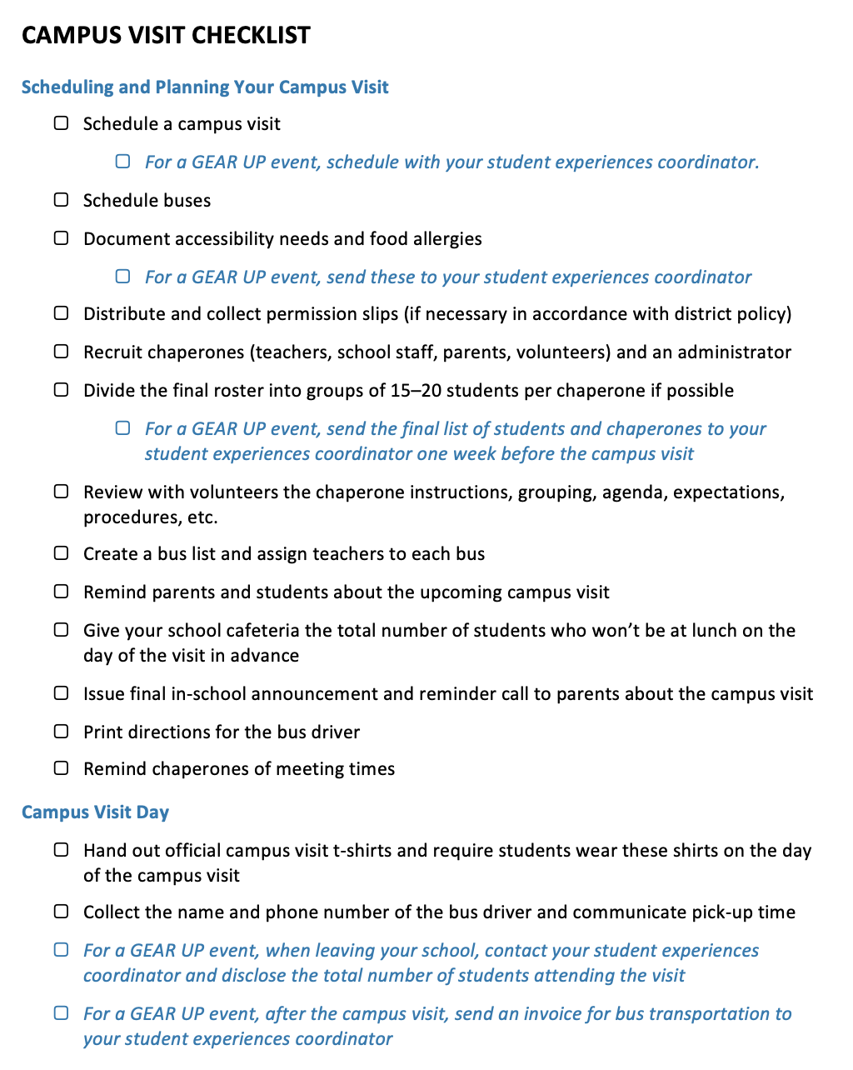
Campus Visit
Checklist

Slide 17
Where Should We Go?
Working with a colleague from your school, brainstorm a few recommendations for campus visit locations for 8th grade through 11th grade.
Pick one for each category.
Location Type
Career tech center
Community college or junior college (regional two-year)
Regional four-year college
Four-year research institution
Minority Serving Institutions

Slide 18
Where Should We Go?
Navigate to the Padlet: insert padlet link
Under each column, add a note with your school’s name and a location you recommend.
Location Type
Career tech center
Community college or junior college (regional two-year)
Regional four-year college
Four-year research institution
Minority Serving Institutions

Slide 19
MVP: Most Valuable Point
What is the most valuable and important piece of information you learned today?
Notes:
K20 Center. (n.d.). MVP: most valuable point. Strategies. https://learn.k20center.ou.edu/strategy/3034

