Slide 2
Partnering With Families for Student Success

Slide 3
Essential Question
How can our school partner with families to support students’ postsecondary pathways?

Slide 4
Objectives
Reflect on your areas of strength and growth related to family engagement.
Identify strengths and challenges of families to support them in their understanding of postsecondary pathways.
Examine research and identify a strategy to increase family engagement in your school.

Slide 5
Family Engagement Assessment
Reflect on your own school.
Navigate to http://k20.ou.edu/family.
Complete the online assessment.
After completing the assessment, bookmark the results page and fill in your Note Catcher.
Notes:
Flamboyan Foundation. Family Engagement Assessment Tool. https://assess.flamboyanfoundation.org/#take-the-tool

Slide 6
Family Engagement Assessment
Navigate to https://www.menti.com/.
Enter the join code:
Respond to the Menti with your area of strength and growth.
Notes:
K20 Center. (n.d.). Mentimeter. Tech Tool. https://learn.k20center.ou.edu/tech-tool/645

Slide 7
Family Scenarios
With your group, you will work through all five scenarios.
You will have a different task with each scenario.
As you rotate, keep in mind how each family could play a role in their child’s success.

Slide 8
Family Scenarios, Rotation 1
Silently read through your scenario.
After reading the scenario, without speaking to your group, list or draw the family’s strengths or assets.
Notes:
K20 Center. (n.d.). Chalk talk. Strategies. https://learn.k20center.ou.edu/strategy/197
YouTube. K20 Center 3 minute timer. YouTube. https://www.youtube.com/watch?v=iISP02KPau0&list=PL-aUhEQeaZXLMF3fItNDxiuSkEr0pq0c2&index=5

Slide 9
Family Scenarios, Rotation 2
Rotate to the next scenario.
Silently read through your scenario.
After reading the scenario, discuss with your group the strengths that have already been identified.
Star the strengths you agree with and add any that were not previously listed.
Notes:
K20 Center. (n.d.). Chalk talk. Strategies. https://learn.k20center.ou.edu/strategy/197
YouTube. K20 Center 2 minute timer. YouTube. https://www.youtube.com/watch?v=HcEEAnwOt2c&list=PL-aUhEQeaZXLMF3fItNDxiuSkEr0pq0c2&index=4

Slide 10
Family Scenarios, Rotation 3
Rotate to the next scenario.
Silently read through your scenario.
After reading the scenario, discuss with your group the strengths that have already been identified.
Star the strengths you agree with and add any that were not previously listed.
Notes:
K20 Center. (n.d.). Chalk talk. Strategies. https://learn.k20center.ou.edu/strategy/197
YouTube. K20 Center 2 minute timer. YouTube. https://www.youtube.com/watch?v=HcEEAnwOt2c&list=PL-aUhEQeaZXLMF3fItNDxiuSkEr0pq0c2&index=4

Slide 11
Family Scenarios, Rotation 4
Rotate to the next scenario.
Silently read through your scenario.
After reading the scenario, without speaking to your group, list or draw challenges the family is experiencing that could impact the student’s postsecondary readiness.
Notes:
K20 Center. (n.d.). Chalk talk. Strategies. https://learn.k20center.ou.edu/strategy/197
YouTube. K20 Center 3 minute timer. YouTube. https://www.youtube.com/watch?v=iISP02KPau0&list=PL-aUhEQeaZXLMF3fItNDxiuSkEr0pq0c2&index=5

Slide 12
Family Scenarios, Rotation 5
Rotate to the next scenario.
Silently read through your scenario.
Once you have read the scenario, discuss with your group the challenges that have already been identified.
Star the challenges you agree with and add any that were not previously listed.
Notes:
K20 Center. (n.d.). Chalk talk. Strategies. https://learn.k20center.ou.edu/strategy/197
YouTube. K20 Center 2 minute timer. YouTube. https://www.youtube.com/watch?v=HcEEAnwOt2c&list=PL-aUhEQeaZXLMF3fItNDxiuSkEr0pq0c2&index=4

Slide 13
Family Scenarios, Rotation 6
Return to your original scenario.
As a group, review the strengths and challenges listed for your scenario.
Using the handout provided, discuss and determine which of the five essential roles the family members can play to assist their child in postsecondary readiness.
Notes:
K20 Center. (n.d.). Chalk talk. Strategies. https://learn.k20center.ou.edu/strategy/197

Slide 14
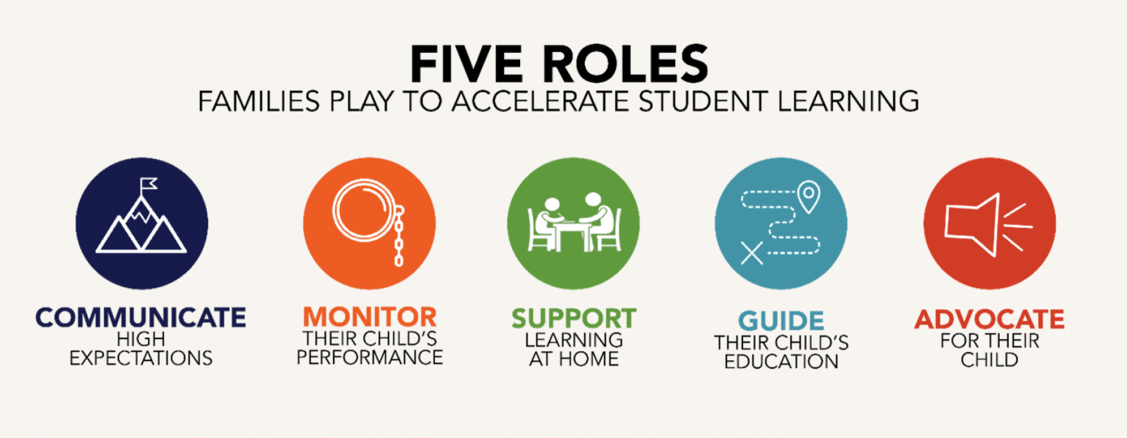
Notes:
YouTube. K20 Center 8 minute timer. YouTube. https://www.youtube.com/watch?v=R-21YM7Ey7k&list=PL-aUhEQeaZXLMF3fItNDxiuSkEr0pq0c2&index=10
About real family engagement. Family Engagement Assessment Tool. https://assess.flamboyanfoundation.org/about-real-family-engagment/

Slide 15
I Think, We Think
Read through the research brief.
As you read, focus on what you think is the most important information.
After reading, use the “I Think” column of the Note Catcher to record the most important information you learned.
Notes:
K20 Center. (n.d.). I think / we think. Strategies. https://learn.k20center.ou.edu/strategy/141

Slide 16
I Think, We Think
Find a partner sitting near you.
Discuss what you wrote in the “I Think” column of your Note Catcher.
As a pair, decide on the most important information from the brief and record it in the “We Think” column.
Notes:
K20 Center. (n.d.). I think / we think. Strategies. https://learn.k20center.ou.edu/strategy/141

Slide 17
Two Stars and a Wish
Reflect on the family engagement domains from the assessment:
Write two examples of successful family engagement strategies you have implemented from your area of strength.
Write one family engagement strategy you would like to try to support your area of growth.
Notes:
K20 Center. (n.d.). Two stars and a wish. Strategies. https://learn.k20center.ou.edu/strategy/83

Slide 18
How will you leverage your area of strength to address your area of growth?

