Slide 2
Instructional Strategies to Support Student Engagement

Slide 3
Essential Questions
What does positive classroom culture look like?
How can we modify and scaffold strategies to support meaningful learning experiences?

Slide 4
Objectives
Describe indicators of student engagement.
Connect student engagement to positive classroom culture.
Adapt instructional strategies to support student engagement.

Slide 5
Painting a Picture: Classroom Culture
How would you describe your classroom culture?
Draw a picture of what classroom culture looks like based on your discussion.
How do you build classroom culture?

Slide 6
Always, Sometimes, or Never True
Let’s categorize statements about student engagement as always, sometimes, or never true.
As each statement is presented, select the answer you feel is most correct.
Notes:
https://docs.google.com/document/d/1EpJ3NYhOhoLWAAhXf5JFrLL8dGK78_ePsS07uG7i-ko/copy

Slide 7
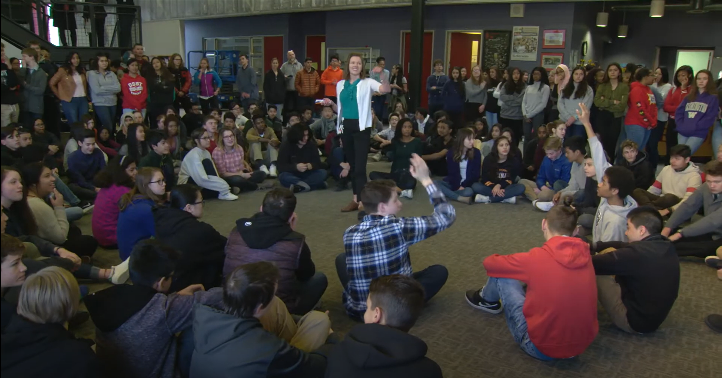
The Power of Positive School Culture
Notes:
https://www.youtube.com/watch?v=zb3JRvOoMGs

Slide 8
Shake It Up
How does classroom culture support strategies and activities that go outside your students’ comfort zone?

Slide 9
Modifying and Scaffolding Strategies

Slide 10
Commit and Toss
What is the most effective way to group students for collaborative work?

Slide 11
Student Groups: Meaningful Roles
The Big Ideas Person pulls the group back to the purpose of the activity.
The Clarifier monitors everyone’s comprehension about one or two key terms.
The Questioner asks probing questions during the activity. These folks listen for questions posed by other group members and makes sure the whole group hears and entertains questions from everyone.
The Skeptic tries to strengthen the group’s work by probing for weaknesses in the developing explanation.
The Progress Monitor asks others to periodically take the measure of the group’s progress.
The Peacekeeper monitors airtime of people in the group, ensuring that everyone gets a chance to talk and that everyone takes time to listen.
Notes:
Big ideas person. The BI person pulls the group (occasionally) back to the purpose of the activity (often a group will get too wrapped up in the rote execution of the directions).
• Asks “How does X (something we are studying, reading, investigating, observing, etc.) relate to The Big Idea?”
• Asks: “How does X change the way we’re thinking about The Big Idea?”
• Asks: “What is the Big Idea we are trying to understand? Why are we seeking?
Clarifier. This is a role of monitoring everyone’s comprehension about one or two key terms.
• Asks: “Do we know what the word ____ refers to?”
• Asks: “Can we put it into our own words?”
Questioner. This person asks probing questions during the activity. These folks listen for questions posed by other group members and then re-voice the questions to make sure that the whole group takes a moment to hear and entertain questions from everyone. This is not a role that students find easy, so it helps to provide them with question stems such as :
• Asks: “What does it mean that ____?”
• Asks: “How do we know that_____?”
• Paraphrases what other have said: “So, what I think you are saying is… Is that right?”
• Asks: “What would happen if we changed ____?”
• Asks: “What’s your evidence?”
Skeptic. This person tries to strengthen the group’s work by probing for weaknesses in the developing explanation or model.
• Says: “Here’s an alternative explanation—is this just as good as the one we have now?”
• Asks: “Does it always work this way (the explanation)?”
• Asks: “How does our idea match up with what we’ve just learned?”
Progress monitor. This person asks others to periodically take the measure of the group’s progress.
• Asks: “What can we say we’ve accomplished so far?”
• Asks: “What do we still need to know/do to accomplish this task?”
• Asks: “What can we now add to our explanation that we didn’t have before?”
• When you stop by a table to listen in on a group, you should expect this person to be able to communicate the ideas of the group members AND attribute ideas to particular people (giving credit where it is due).
Peacekeeper. This person monitors airtime of people in the group— this person is allowed to control who has “the floor” with the goal of ensuring that everyone gets a chance to talk and that everyone takes time to listen.

Slide 12
Fold the Line

Slide 13
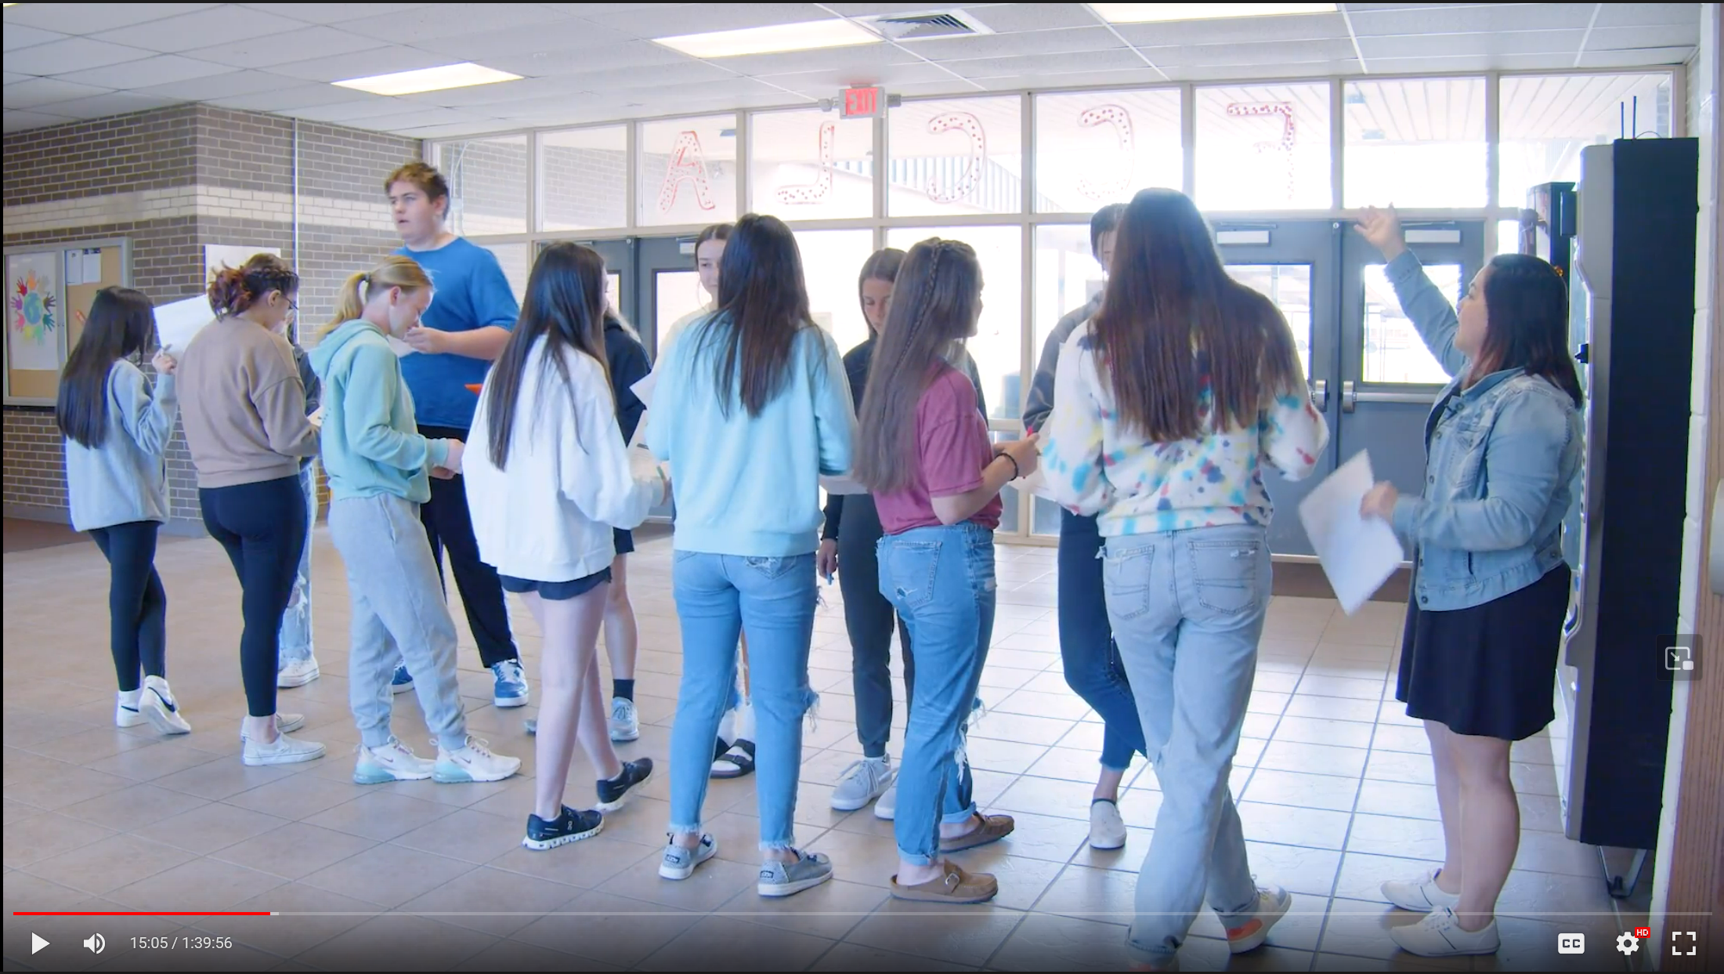
Fold the Line
Notes:
https://drive.google.com/file/d/1kPAcEseuF84lAnFV19zxQnWgKNzF5kbg/view
Play from 13:35 – 15:35

Slide 14
30-Second Expert
In pairs, one watches a brief video; one reads an article.
When you have finished watching the video or reading the article, fill the left side with what you think are all of the steps in the process of screen printing.
When you have finished your analysis, take thirty seconds to listen to what your partner found. Write anything they have that you don’t in the right column.
Repeat this process, so they can do the same.
Notes:
Article: https://www.metmuseum.org/about-the-met/collection-areas/drawings-and-prints/materials-and-techniques/printmaking/screenprint
Video: https://www.youtube.com/watch?v=KnL_Kj74G8c

Slide 15
Strategy Debrief
In what ways could these strategies support positive classroom culture?
In what ways could positive classroom culture contribute to the effectiveness of the strategies?

Slide 16
Strategy Harvest
What strategy did you like but would need/want to modify or scaffold?

