Slide 2
CER Instructional Strategy
Claim Evidence Reasoning Strategy Across Content Areas

Slide 3

English Language Arts
Argument is Everywhere
https://learn.k20center.ou.edu/lesson/233
Notes:
This CER activity is found in the Extend portion of the Argument is Everywhere K20 Lesson. https://learn.k20center.ou.edu/lesson/233

Slide 4
Directions
,
Show slide 5 to go more in depth about the rhetorical situation. Analyze and discuss the graphic.
Explain the meaning of the sentences that omit the Oxford Comma versus the sentences where it is used.

Slide 5
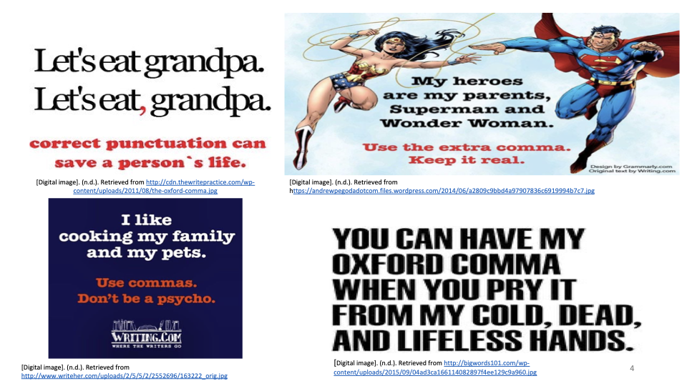

ELA Example – The Oxford Comma
A Smart Move: Responding to the Rhetorical Situation
Notes:
Watch the YouTube video: "A Smart Move: Responding to the Rhetorical Situation." (1:51)

Slide 6
ELA Example – The Oxford Comma
Notes:
Show slide 6 as a guided practice example. Discuss with students how the Oxford comma is an on-going argument in the field of composition. Share your own experiences learning/using it: Do you have a preference? Have students share their own experiences using it: Do they have a preference?
Discuss how the memes on the slide approach the argument about the Oxford comma.
What is their CLAIM? (The Oxford comma is necessary to understanding sentence meanings. )
What are their EXAMPLES? (The sample memes provide examples of sentences that include or do not include the comma.)
What is their REASONING? (Sentences that do not include the Oxford comma are often prone to misunderstandings.)
Who is their AUDIENCE? (People who do not use the Oxford comma.)
What is the PURPOSE? (To stress the importance of using the Oxford comma to clarify meaning.)
What is the CONTEXT surrounding the argument? (The Oxford (or serial) comma is the final comma in a list of things. Use of the Oxford comma is stylistic, meaning that some style guides demand its use while others don’t. Unless you’re writing for a particular publication or drafting an essay for school, whether or not you use the Oxford comma is generally up to you.)

Slide 7
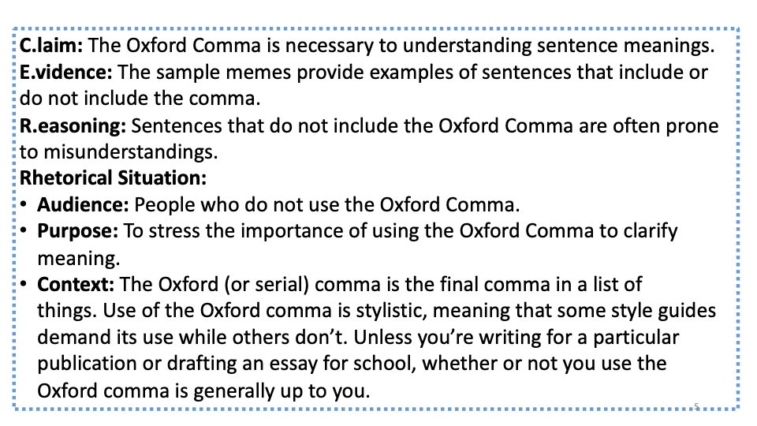
Notes:
Review slide 7 to show how the argument about the Oxford comma fits into the C.E.R. and rhetorical situation framework. This is the framework example of what students will do with their own argument examples.

