Slide 2
CER Across Content Areas
Claim Evidence Reasoning Strategy Across Content Areas

Slide 3

Fist to Five
Closed Fist: I haven’t heard of it.
One Finger: I have heard of it but haven’t used it.
Two Fingers: I have used it once or twice.
Three Fingers: I have used it a few times.
Four Fingers: I have used it many times.
Five Fingers: I have used it extensively.
Notes:
K20 Center. (n.d). Fist to Five. Strategies. https://learn.k20center.ou.edu/strategy/68

Slide 4
Essential Question
How can the Claim-Evidence-Reasoning (CER) instructional strategy be effectively modified and integrated into any content area to better prepare students for college entrance exams?

Slide 5
Learning Objectives
Apply the CER instructional strategy to multiple content areas at different parts of a lesson.
Explain how the CER instructional strategy supports the skills needed to be successful on College and Career Readiness exams.
Construct a CER for your content area.

Slide 6

CER Instructional Strategy
Claim? The answer to a posed question.
Evidence? Material, sentences, and research to support the claim.
Reasoning? Explanation of why the data/evidence supports the claim.
Notes:
K20 Center. (n.d.). Claim, Evidence, Reasoning (CER). Strategies. https://learn.k20center.ou.edu/strategy/156

Slide 7
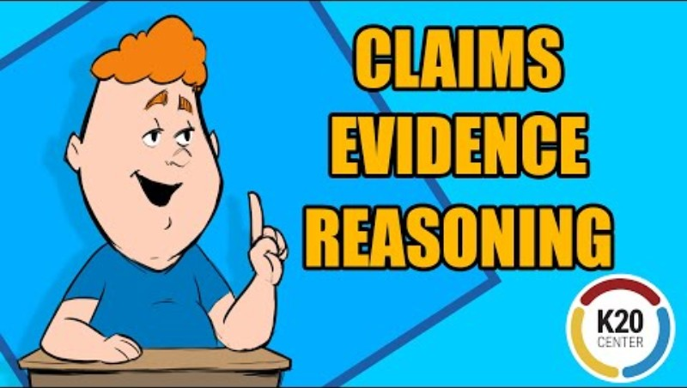
Claims, Evidence, and Reasoning.
Notes:
Source: https://www.youtube.com/watch?v=JGOxVIgmGWE

Slide 8

Core Classes
English Language Arts: k20.ou.edu/cerela
Math: k20.ou.edu/cermath
Science: k20.ou.edu/cersci
Social Studies: k20.ou.edu/cerss

Slide 9
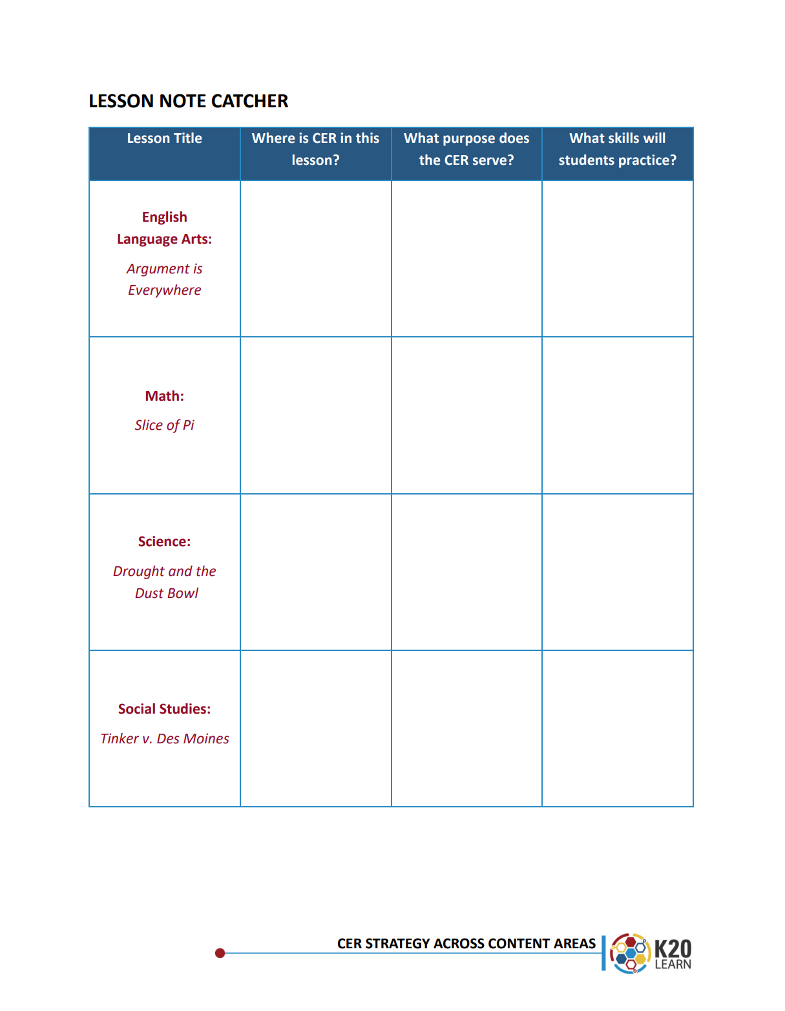
Lesson Note Catcher
Where in the lesson was the strategy used?
(the beginning, middle, or end)
What instructional purpose is the CER strategy serving in the lesson?
(eg. to gain interest, elicit prior knowledge, as an argument analysis tool, to assess learning, or something else?)
What skills will students practice as they participate in the CER strategy?

Slide 10

English Language Arts
Argument is Everywhere
https://learn.k20center.ou.edu/lesson/233
Notes:
This CER activity is found in the Extend portion of the Argument is Everywhere K20 Lesson. https://learn.k20center.ou.edu/lesson/233

Slide 11
Directions
,
Show slide 5 to go more in depth about the rhetorical situation. Analyze and discuss the graphic.
Explain the meaning of the sentences that omit the Oxford Comma versus the sentences where it is used.

Slide 12
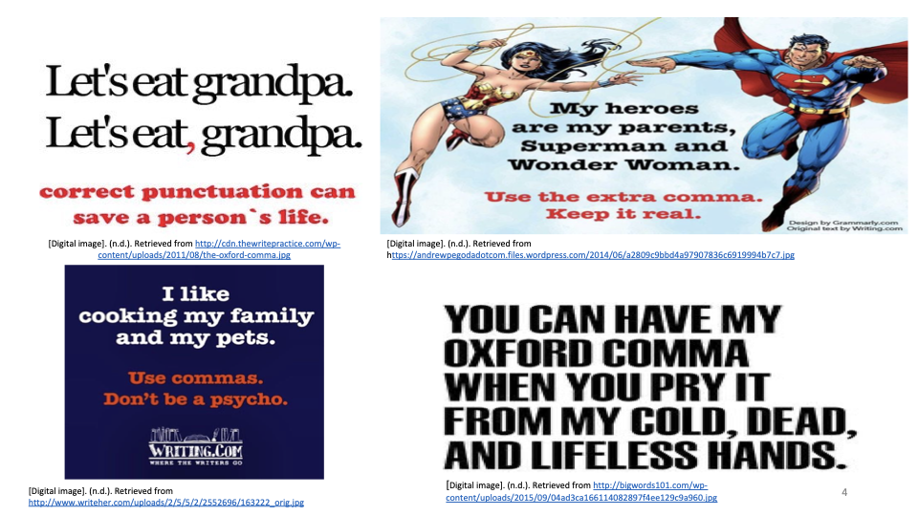
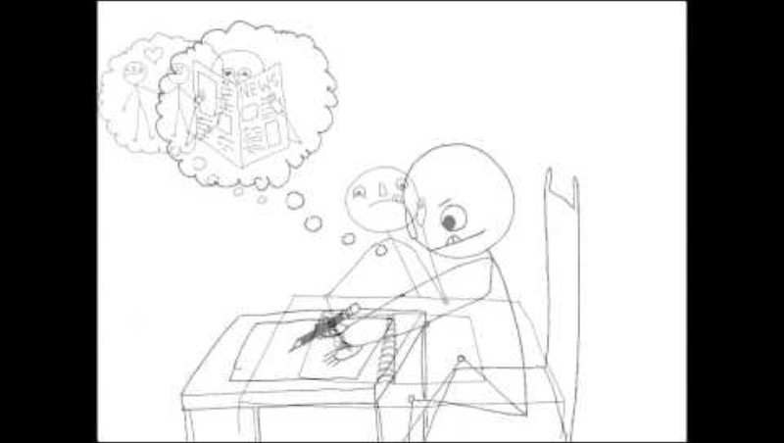
ELA Example – The Oxford Comma
A Smart Move: Responding to the Rhetorical Situation
Notes:
Watch the YouTube video: "A Smart Move: Responding to the Rhetorical Situation." (1:51)

Slide 13
ELA Example – The Oxford Comma
Notes:
Show slide 6 as a guided practice example. Discuss with students how the Oxford comma is an on-going argument in the field of composition. Share your own experiences learning/using it: Do you have a preference? Have students share their own experiences using it: Do they have a preference?
Discuss how the memes on the slide approach the argument about the Oxford comma.
What is their CLAIM? (The Oxford comma is necessary to understanding sentence meanings. )
What are their EXAMPLES? (The sample memes provide examples of sentences that include or do not include the comma.)
What is their REASONING? (Sentences that do not include the Oxford comma are often prone to misunderstandings.)
Who is their AUDIENCE? (People who do not use the Oxford comma.)
What is the PURPOSE? (To stress the importance of using the Oxford comma to clarify meaning.)
What is the CONTEXT surrounding the argument? (The Oxford (or serial) comma is the final comma in a list of things. Use of the Oxford comma is stylistic, meaning that some style guides demand its use while others don’t. Unless you’re writing for a particular publication or drafting an essay for school, whether or not you use the Oxford comma is generally up to you.)

Slide 14
The Oxford Comma
C.laim: The Oxford Comma is necessary to understanding sentence meanings.
E.vidence: The sample memes provide examples of sentences that include or do not include the comma.
R.easoning: Sentences that do not include the Oxford Comma are often prone to misunderstandings.
Rhetorical Situation:
  Audience: People who do not use the Oxford Comma.
  Purpose: To stress the importance of using the Oxford Comma to clarify meaning.
  Context: The Oxford (or serial) Comma is the final comma in a list of things. Use of the Oxford Comma is stylistic, meaning that some style guides demand its use while others don’t. Unless you’re writing for a particular publication or drafting an essay for school, whether or not you use the Oxford Comma is generally up to you.

Slide 15

Geometry Example
Slice of Pi:
Area and Circumference
of a Circle
https://learn.k20center.ou.edu/lesson/1411
Notes:
The following CER activity comes from the Slice of Pi: Area and Circumference of a Circle lesson.
https://learn.k20center.ou.edu/lesson/1411

Slide 16
What’s the Ratio?
Create a CER (Claim, Evidence, Reading) statement about the situation.
Write a 1-2 sentence claim based on the statement: “No matter the size of a circle, its ratio is the same.”
Show your evidence and work from the measurements at each station.
Write a 3-4 sentence conclusion, providing explanations for why the data you chose counts as evidence and supports your claim.
C
E
R
Notes:
K20 Center. (n.d.). Claim, Evidence, Reasoning (CER). Strategies. https://learn.k20center.ou.edu/strategy/156

Slide 17
Directions
Write the Claim in the Circles Ration CER handout.
Use the string and ruler to measure each of the three circles. You may use your own or use the examples on slide 6. Write this on the Evidence section of your CER handout.
Write your Reasoning on the appropriate section of your CER handout.

Slide 18
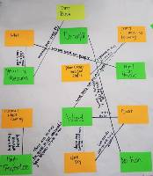
Science
Drought and the Dust Bowl: Climate, Ecosystems, and Human Impact.
https://learn.k20center.ou.edu/lesson/555
Notes:
This CER activity is from the Evaluate section of K20 lesson Drought and the Dust Bowl: Climate, Ecosystems, and Human Impact. https://learn.k20center.ou.edu/lesson/555

Slide 19
Directions
Review the information on the charts from Oklahoma’s temperature, precipitation, and dust, slides 5-9.
Complete the Engage section on your CER & Rubric handout.

Slide 20
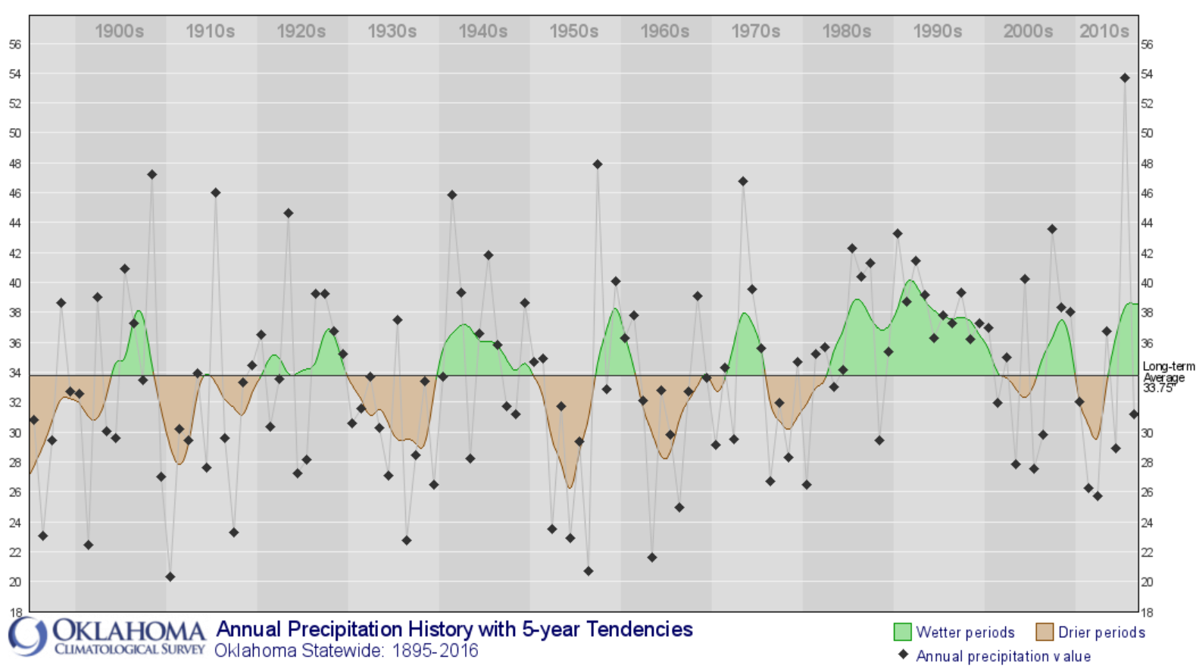

Slide 21
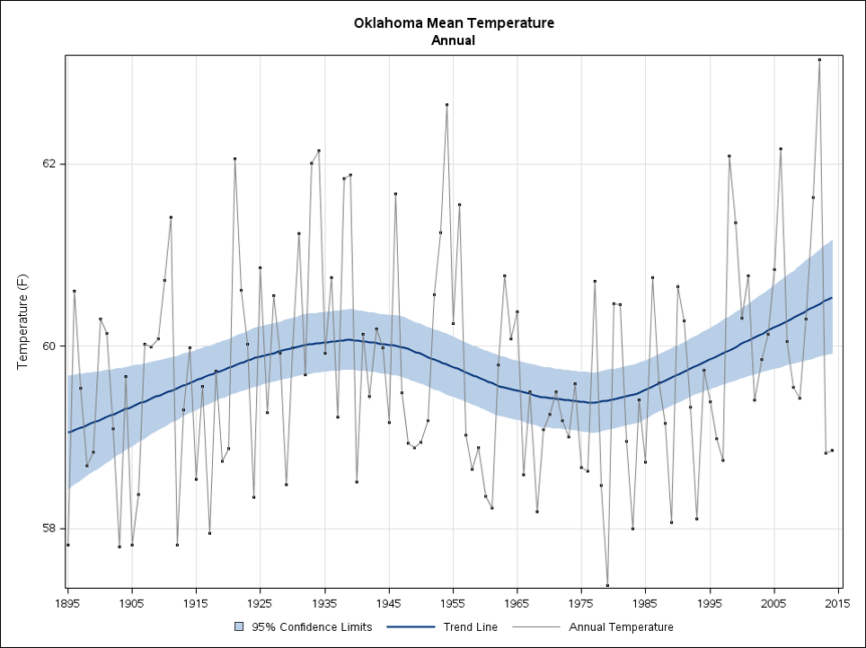

Slide 22
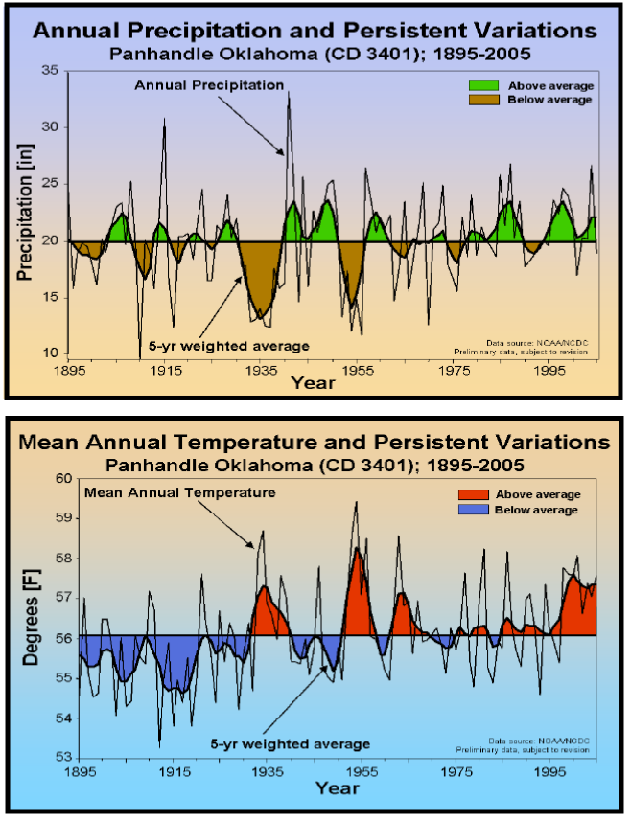

Slide 23

1932-1936

Slide 24

National Drought Mitigation Center
The Dust Bowl
https://drought.unl.edu/dustbowl/

Slide 25
The Dust Bowl
For each prompt, make a claim and justify it.
What factors caused the Dust Bowl?
How was the Dust Bowl historically documented (e.g., how did people make a record of the event)?

Slide 26

Social Studies
Tinker v. Des Moines and the First Amendment
https://learn.k20center.ou.edu/lesson/1527
Notes:
This CER activity is found in the Explain section of the Tinker v. Des Moines and the First Amendment K20 lesson. https://learn.k20center.ou.edu/lesson/1527
Once students are familiar with the court case, inform them they will use the Claim, Evidence, Reasoning (CER) strategy to dive deeper into the question of “How did this case help to clarify and extend students’ rights?”
Explain to students that they should use their annotations and notes from the Why-Lighting activity to complete this activity. Then, pass out the attached Claim, Evidence, Reasoning (CER) handout. Students should work with their groups to complete the handout, but be sure each student has their own copy.
Display slide 5 to provide students with instructions on how to complete the CER handout if they are not familiar with this strategy. Inform groups they should be prepared to share out what they wrote once they are done. Each group should choose 1–2 individuals to share out.
See the attached CER Sample Student Responses for examples of what students may write on the handout.
After each group has shared, display slide 6 and explain the court’s ruling more in depth. The ruling and an excerpt from the case decision are included on the slide and in the Notes field for you to use as talking points.
First, explain the Supreme Court’s ruling and how it favored the students in a 7–2 decision. This meant it overturned the earlier ruling in the lower courts (which had upheld the Des Moines schools’ ban on students’ armbands). Then, explain how the court concluded that prohibiting students from wearing the armbands at school violated their First Amendment rights. You may also want to review the majority opinion excerpts from the Tinker v. Des Moines (1969) reading to provide reasons why the court ruled in favor of the students.

Slide 27

Why-Lighting
As you read, Tinker v. Des Moines, you will Why-Light any information that helps to answer the following question:
  “How does this case help extend students rights?”
Justify your highlight with notes in the margins that explain your reasoning.
Notes:
K20 Center. (n.d.). Why-Lighting. Strategies. https://learn.k20center.ou.edu/strategy/128

Slide 28

Claim, Evidence, Reasoning (CER)
Use evidence to create a claim, provide evidence, and state your reasoning based on the following question:
How does the landmark decision of Tinker v. Des Moines clarify and extend students rights protected by the First Amendment?
Claim: Create a claim based on the following question.
Evidence: Provide direct evidence from the reading to support your claim.
Reasoning: Explain your reasoning and how the evidence supports it.
Notes:
K20 Center. (n.d.). Claim, Evidence, Reasoning (CER). Strategies. https://learn.k20center.ou.edu/strategy/156

Slide 29
Tinker v. Des Moines Ruling
7-2 Decision in favor of students
“…prohibiting students from wearing armbands to school as a form of protest was violating their first amendment right to freedom of speech.”

Slide 30

Three Stray, One Stays
Sit in groups of 4, one person from each content area.
Share your strategy on the Lesson Note Catcher handout with members of other content areas.
As each member shares, others should take notes on their Note Catcher.
Notes:
K20 Center. (n.d.). Three Stray, One Stays. Strategies. https://learn.k20center.ou.edu/strategy/85

Slide 31
Menti
Using your phone or computer, answer the following question:
In your area/discipline, what skills do your students need to prepare them for college and career readiness exams, such as the ACT/SAT?
Join: Menti.com
Code: #### ####
Paste
QR code
here
Notes:
K20 Center. (n.d.). Mentimeter. Tech tool. https://learn.k20center.ou.edu/tech-tool/645
Facilitation Note: Tech Integration Set up
Link for the Mentimeter: https://www.mentimeter.com/app/presentation/blobzrzygtwu1twj21p5jkct92fjv3vg/o5fbw22brzpd
Copy this presentation to your own account and update the link for your participants prior to facilitating the activity below. To do this, after entering the link above into your browser, select “Copy to your Account.” Once in your account, choose “Share” to get a new join code for your participants. Paste this new join code and QR code into this slide.

Slide 32
ACT Practice Questions
Based on the skills students gain from implementing CER, explain how they could apply those skills to the sample ACT questions for your content area.
ACT

Slide 33
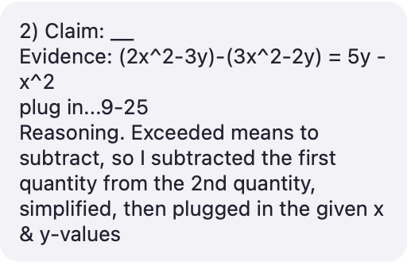
When x = 3 and y = 5, by how much does the value 3x² - 2y exceed the value of 2x² - 3y?

Slide 34
Choice C “Our household might have been described as uncooperative” is correct.
Claim: Our household didn’t run according to a typical schedule.
Evidence: The rule concerns wordy material and appropriate (best) choice.
Reasoning: Choice A is wrong because the word “uncooperative,” which means unwilling to cooperate. Choice B is wrong because there is evidence explaining why mom is focused on her work. Choice D is wrong because of the word “spectacular,” which means extraordinary.

Slide 35

Make your own CER
Open a copy of the CER Template: bit.ly/K20CER
Think of the content you teach. How could you modify the CER strategy for your content?
Create a CER activity to take back to your classroom.

Slide 36

Two Stars and a Wish
✰ What are two benefits of incorporating CER into your lesson?
Wish: What is one area that you will need help with in implementing this strategy?
Notes:
K20 Center. (n.d.). Two Stars and a Wish. Strategies. https://learn.k20center.ou.edu/strategy/83

