Slide 2
CER Instructional Strategy
Claim Evidence Reasoning Strategy in Science

Slide 3
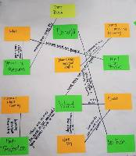
Science
Drought and the Dust Bowl: Climate, Ecosystems, and Human Impact.
https://learn.k20center.ou.edu/lesson/555
Notes:
This CER activity is from the Evaluate section of K20 lesson Drought and the Dust Bowl: Climate, Ecosystems, and Human Impact. https://learn.k20center.ou.edu/lesson/555

Slide 4
Directions
Review the information on the charts from Oklahoma’s temperature, precipitation, and dust, slides 5-9.
Complete the Engage section on your CER & Rubric handout.

Slide 5
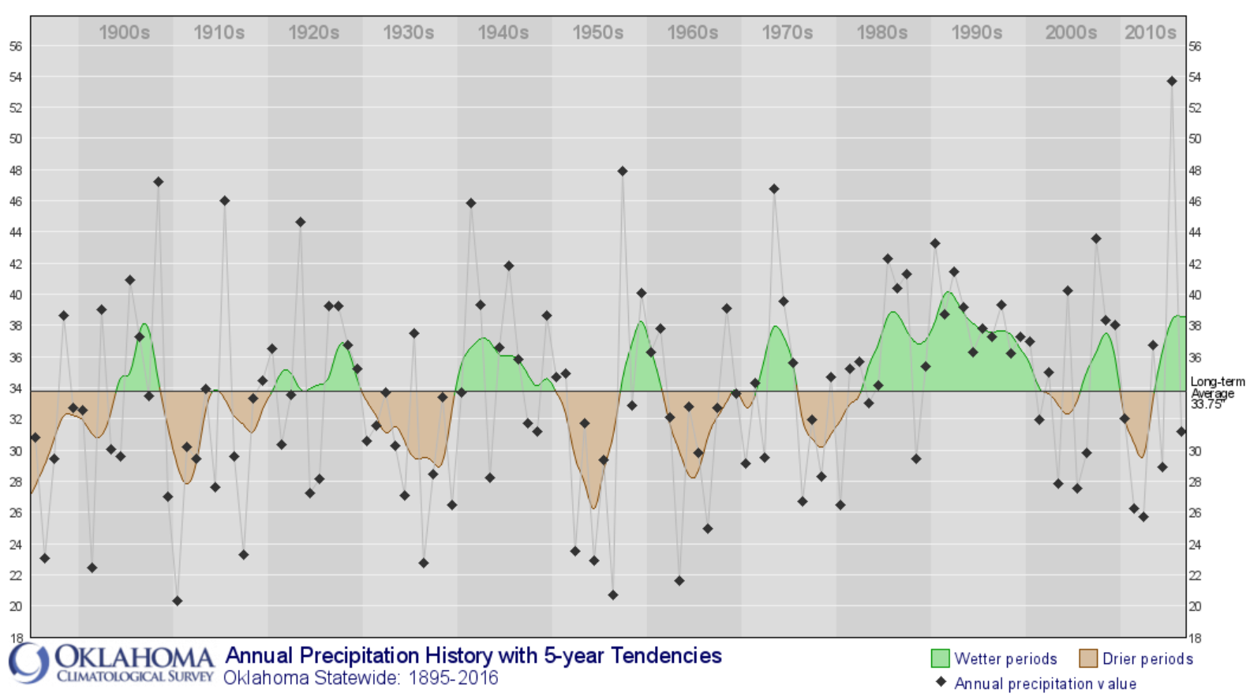

Slide 6
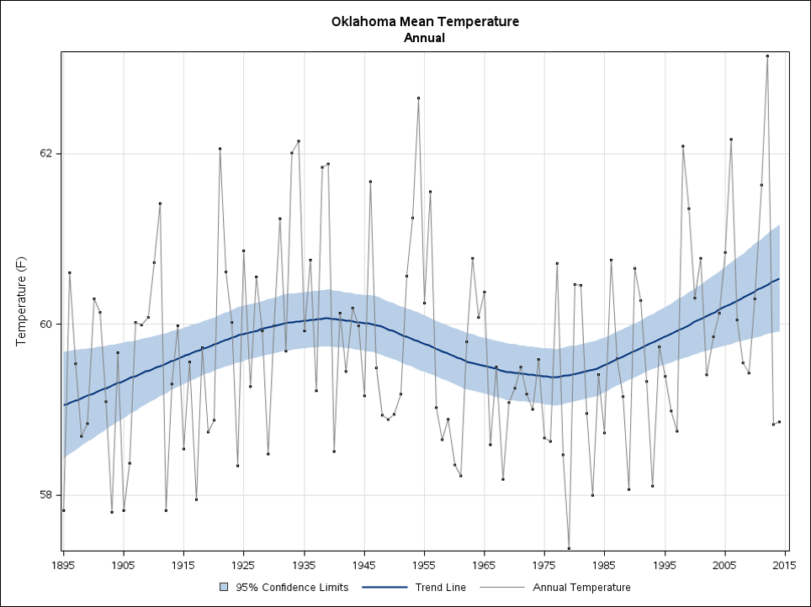

Slide 7
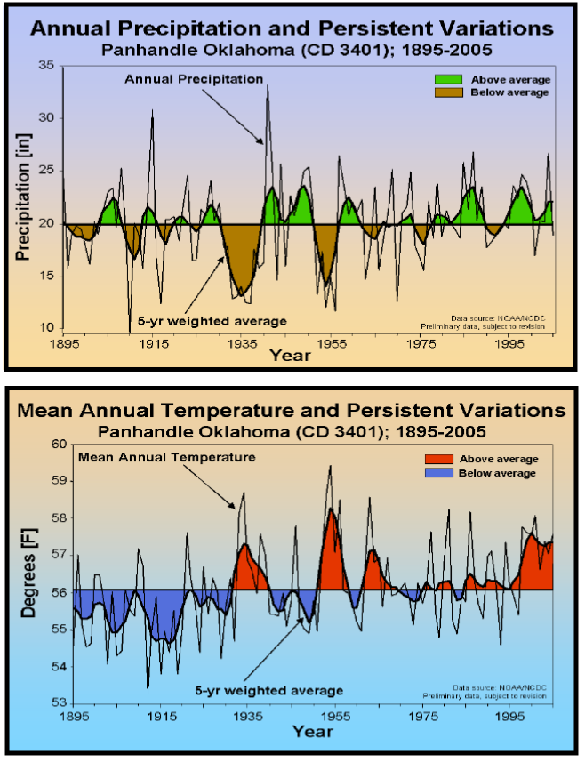

Slide 8
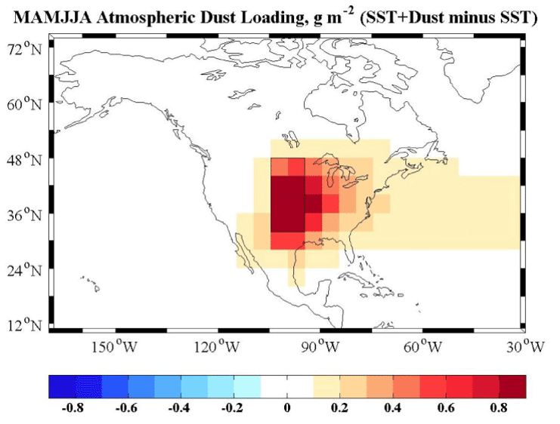
1932-1936

Slide 9
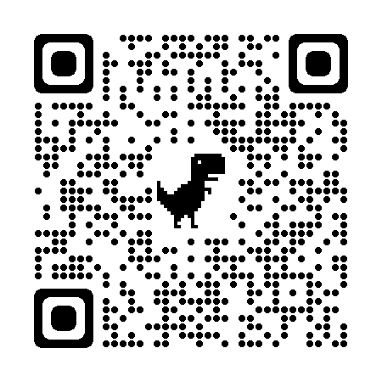
National Drought Mitigation Center
The Dust Bowl
https://drought.unl.edu/dustbowl/

Slide 10
The Dust Bowl
For each prompt, make a claim and justify it.
What factors caused the Dust Bowl?
How was the Dust Bowl historically documented (e.g., how did people make a record of the event)?

