Slide 1
Welcome Back!
Day 2

Slide 2

Game-Based Learning (GBL)
Let’s welcome the GBL team!

Slide 3


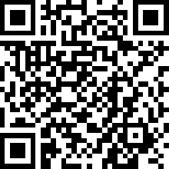
GBL Lessons Exploration
Scan the QR code to check out
some of our GBL lessons.
Or go to: bit.ly/PiktochartGBL.
Notes:
Give participants 10-15 minutes. Could you use any of these in your classroom?
We show first one; they explore the rest. Piktochart
The Benefits of Postsecondary Education (PSE)
State of AWAREness
Do Placebos Kill Minotaurs?
Be ProACTive
Life in a Petri Dish
Life Is a Bell Curve
Something's Rotten in the City of Verona
What Lies Beyond Talent?
K20 Center. (n.d.). Piktochart. Tech Tools. https://learn.k20center.ou.edu/tech-tool/2394

Slide 4

Instructional Strategies Based on Games
Think about a familiar game that could
be adapted into an instructional strategy.
Forbidden Phrases (like Taboo)
Paper Telephone (like Telestrations)
Vocabulary Charades
Password
Notes:
-Pictionary
-Guess Who? (Historical Mingle)
- 20 Questions
- Mingle
- Pick a Card, Any Card
- Puzzled
- Scavenger Hunt Notes
- Tic Tac Tell
Create collaborative padlet
K20 Center. (n.d.). Padlet. Tech Tools. https://learn.k20center.ou.edu/tech-tool/1077

Slide 5
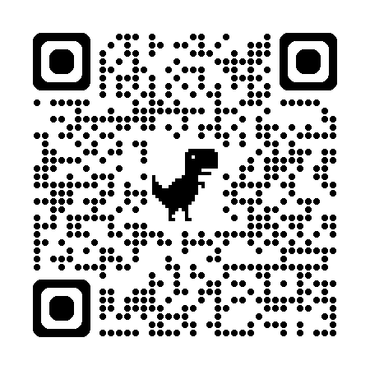
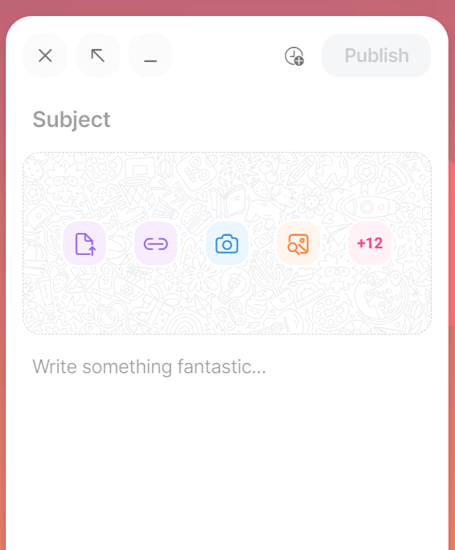
Game-Based Strategies
Go to k20.ou.edu/5eLw-gbs-f2f or scan the QR code.
Click the + button.
Type the name of the game
for the subject.
Then enter a description of how you would use the game in your classroom below.
Game Name
Description
Notes:
-Pictionary
-Guess Who? (Historical Mingle)
- 20 Questions
- Mingle
- Pick a Card, Any Card
- Puzzled
- Scavenger Hunt Notes
- Tic Tac Tell
Create collaborative padlet

Slide 6

Break
Notes:
Online Timer Option: https://timer.k20center.ou.edu/
K20 Center. (2021, September 21). K20 Center 10 minute timer. [Video]. YouTube. https://youtu.be/9gy-1Z2Sa-c?si=fK21CHcK4DKbD50m

Slide 7
Essential Questions
How is authenticity incorporated into the development of 5E lesson plans?
How can educators effectively craft 5E lesson plans to enhance student engagement and learning outcomes?
Notes:
Identify key components of the 5E instructional model and analyze authentic lesson plans from diverse subjects.
Develop strategies to adapt existing lesson materials to align with the 5E framework authentically.
Create authentic 5E lesson plans that integrate meaningful learning experiences and engage diverse learners.

Slide 8
Learning Goals
Develop strategies to adapt existing lesson materials to align with the 5E model authentically.
Create authentic 5E lesson plans that integrate meaningful learning experiences and engage all learners.
Notes:
Identify key components of the 5E instructional model and analyze authentic lesson plans from diverse subjects.
Develop strategies to adapt existing lesson materials to align with the 5E framework authentically.
Create authentic 5E lesson plans that integrate meaningful learning experiences and engage diverse learners.

Slide 9

5E Deep Dive
At your table, there are several snapshots, each for the same phase of a 5E lesson.
Pick up your favorite snapshot from that table.
Then move clockwise to the next table.
  Only take your selected snapshot to the
  next table. Leave everything else.
Repeat Step 1 until you have
5 snapshots—one for each phase.
Notes:
James

Slide 10
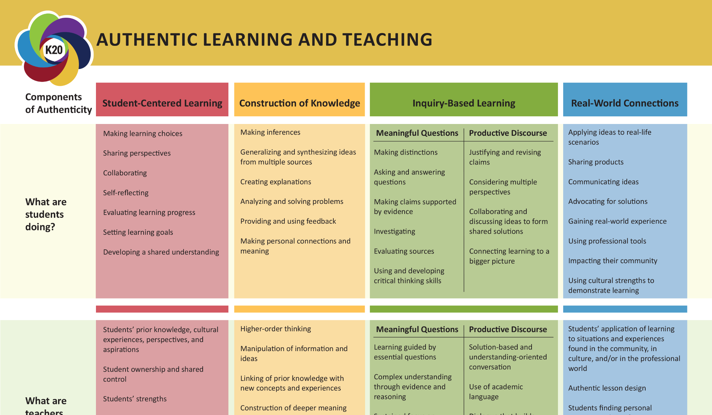
5E Deep Dive
Return to your original seat.
Use your Authentic Learning
and Teaching chart to analyze the snapshots.
  Is the snapshot supporting Inquiry-Based Learning? Real-World Connections? etc.
Paperclip each snapshot to the corresponding column of your chart to indicate which component of authenticity that you think it best represents.

Slide 11
5E Deep Dive: Reflection
Ask yourself the following questions:
  Do you notice any trends or patterns?
  Did you favor one aspect of authenticity over others?
  Were there any similarities between the activities?
Take a picture of your chart for later reference.

Slide 12
5E Deep Dive
Find your 6 o’ Clock partner and trade charts.
Examine how your partner sorted their snapshots.
  Could each snapshot support a different component of authenticity?
Move at least 3 of the snapshots to a different component of authenticity that you think it also represents.

Slide 13

5E Deep Dive: Reflection
Trade charts back with the original owner.
Use your picture to compare their work with yours.
Discuss with your partner:
  How are you feeling?
  What are you thinking?
Notes:
K20 Center. (n.d.). How am I feeling? What am I thinking? Strategies. https://learn.k20center.ou.edu/strategy/187

Slide 14
5E Deep Dive: Share Out
What did the student do that represented that component?
What did the teacher do?

Slide 15
Developing 5E Lessons
There are many approaches, but many follow a similar flow:
Inspiration
  Why are you writing THIS lesson?
  What are you excited about?
Brainstorming
  How can we ensure student engagement?
  What do we expect students to learn because of this new content?

Slide 16
Developing 5E Lessons: Expectations
This year you will be expected to create a standards-based, 5E lesson for each semester that will be published on LEARN and taught by you.
You might create a lesson in quarter 1 to teach during quarter 2.

Slide 17
Developing 5E Lessons: Inspiration
Is there something from a favorite TV show, cryptid, trivia fact, subject, song, time period, image, etc. that could be engaging for students?
Is there a standard that you know students struggle with?
Do you have an existing lesson that could be developed into a full 5E lesson?

Slide 18
Developing 5E Lessons: Brainstorming
Now you want to connect a topic with a standard or a standard with a real-world application or engaging element.
If you need a starting point, consider starting with the Evaluate of the lesson—how will you know students have learned?

Slide 19
Yes, AND…
This is a brainstorming strategy where the first person begins with an idea, then the next player must respond with “Yes, and…” statements.
This strategy encourages supportive brainstorming and can help lead to unexpected cross-curricular ideas.
Notes:
Board Frayer Model model it twice, then participants come up and model this structure, then they go to their groups and complete a frayer model as a group
Lesson Improv Frayer model several models
-Content Top Right
-Content Top Left
-Standard(s) Middle
-Output Bottom Right
-Strategies/Activities Bottom Left
K20 Center. (n.d.). Yes, because… Strategies. https://learn.k20center.ou.edu/strategy/193

Slide 20
Lesson Improv
Topic 1 | Topic 2
Strategies/Activities | Student Output
Content/Objective
Notes:
Board Frayer Model model it twice, then participants come up and model this structure, go to their groups, and complete a frayer model as a group
Lesson Improv Frayer model several models
-Content Top Right
-Content Top Left
-Standard(s) Middle
-Output Bottom Right
-Strategies/Activities Bottom Left
K20 Center. (n.d.). Frayer model. Strategies. https://learn.k20center.ou.edu/strategy/126

Slide 21

Lesson Ideas: Brain Dump
Go to LINK TO BRAIN DUMP SLIDESHOW.
Click on one of the Rename # tabs at the bottom and claim it by renaming it with your name.
Now dump all of the ideas from your brain into your sheet.
  You need at least 4 ideas in each column: Standards–Topics–Readings–Skills–Media.
  Stretch yourself to come up with as many ideas as you can!
Notes:
-align it to a standard
-bonus if it can cross curricular
-Share out best idea wins
K20 Center. (n.d.). Collective brain dump. Strategies. https://learn.k20center.ou.edu/strategy/111

Slide 22
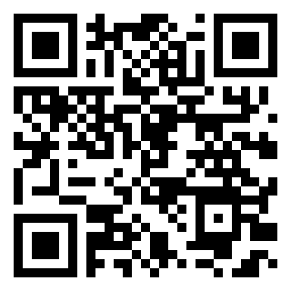
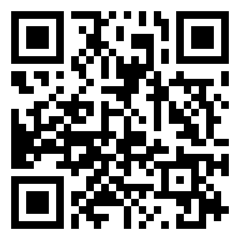
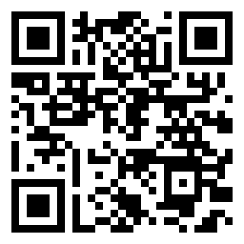
TREK Evaluation: Day 2 AM
GUMS | FUTURE | OKC
trek.k20center.ou.edu/ survey/55420267 | trek.k20center.ou.edu/ survey/67745222 | trek.k20center.ou.edu/ survey/20577771

