Slide 1
Welcome Back!
Session 3

Slide 2
Squiggles Activity
Drawing is a great way to develop ideas when one is feeling overworked.
On a sticky note, draw a small squiggly line or shape.
Pass your note to the person on your right.
Look at the new note in front of you and turn the squiggly line or shape into a recognizable image.
Notes:
K20 Center. (n.d.). Squiggles. Strategies. https://learn.k20center.ou.edu/strategy/936

Slide 3
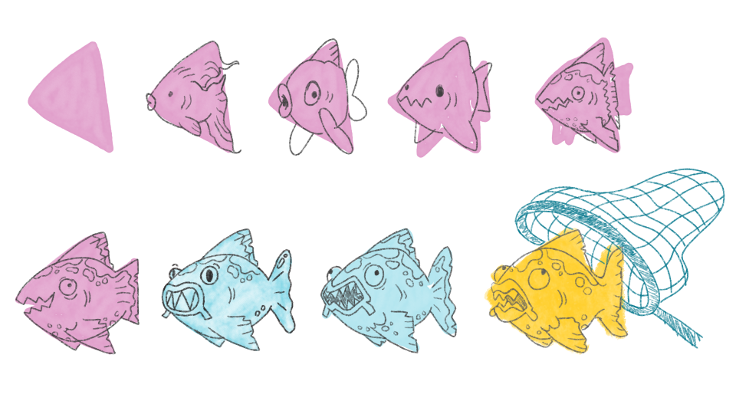
Squiggles Example
Notes:
*this is a K20-created graphic
K20 Center. (n.d.). Squiggles. Strategies. https://learn.k20center.ou.edu/strategy/936

Slide 4
Squiggles Activity
Place all of the sticky notes in the center of the table.
Select one that you think could be the theme of the lesson.
Add that to the Brain Dump as a possible theme.
Notes:
K20 Center. (n.d.). Squiggles. Strategies. https://learn.k20center.ou.edu/strategy/936

Slide 5
5E Lesson Writing
So you have an idea. Now what?
You will collaborate with your curriculum specialist and serve as the subject-matter expert (SME) for the lesson.
You will then be partnered with an instructional designer (ID).

Slide 6
Instructional Design Team
The K20 Center has a team of instructional designers (IDs) who can help with:
brainstorming and developing activities,
tech integration and development,
authenticity and 5E model alignment,
communicating your ideas for another teacher to use,
and more!
Notes:
Video interview with Instructional Designer, Matt: https://www.youtube.com/watch?v=dleTaR5fbuo&list=PL-aUhEQeaZXKPmSbLrbvPJxzdPlV4RkmY&index=4

Slide 7
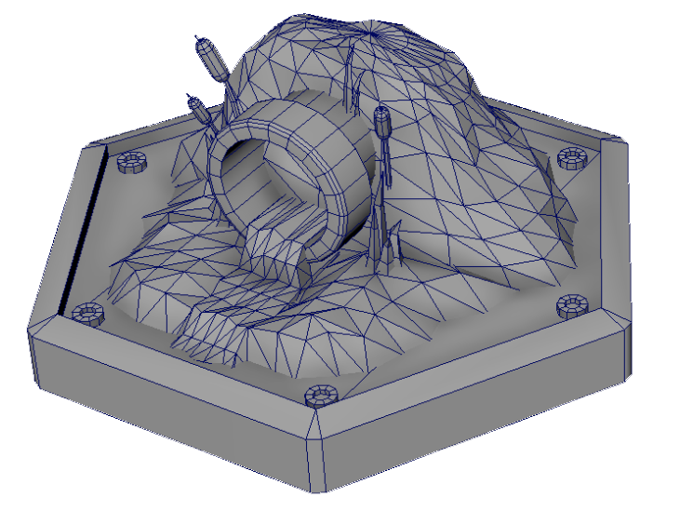
Art Team
The K20 Center has a team of graphic artists who can help with
creating custom graphics,
formatting for accessibility and consistency,
branding,
and more!
Notes:
Video interview with artist, Charlie: https://www.youtube.com/watch?v=luer0qhYV1E&list=PL-aUhEQeaZXKPmSbLrbvPJxzdPlV4RkmY&index=3

Slide 8
Writing Team
The K20 Center has a team of technical and creative writers who can help with
developing ideas for written texts,
writing a story, passage, or body of text,
copy editing (for both clarity and consistency),
finding just the right words and phrases,
checking sources and assisting with citations,
and more!
Notes:
Video interview with writer, Taylor: https://www.youtube.com/watch?v=W5q5IfghAb0&list=PL-aUhEQeaZXKPmSbLrbvPJxzdPlV4RkmY&index=2

Slide 9
Fair Use
When publishing material to LEARN, we need to keep in mind copyright laws and how they are different outside of a classroom setting.
Keep track of your sources.
Where did you find that short story, math problem, video, diagram, or graphic?
We can draw inspiration from but likely cannot use paid-for materials: PD resources, TPT content, etc.
Notes:
Fair Use Video: https://www.youtube.com/watch?v=7Z0n_VYekyg&list=PL-aUhEQeaZXKPmSbLrbvPJxzdPlV4RkmY&index=1

Slide 10
4–2–1 Graphic Organizer
Return to your Lesson Ideas Brain Dump: k20.ou.edu/5eLw-bd-f2f.
List your favorite ideas in the rectangles in the top row of your handout.
In pairs, share your ideas, then work together to narrow your 4 ideas down to 2.
Write those 2 ideas in the rectangles in the middle row.
Notes:
Ask participants to revisit their Collective Brain Dump from earlier in the day. Ask them to list out their four favorite ideas across the top row of a graphic organizer like so:
https://docs.google.com/document/d/1mofOsf2tiBBK47YIQc1PvV2P25tsfdcm/edit?usp=sharing&ouid=101224050889907425651&rtpof=true&sd=true
After listing their favorite ideas, participants will get into groups of two and share their responses. As a team, they will work to help pare each list of four items down to two items on the second row.
Participants will get into groups of four and share their responses from the second row. As a team, they will work to help pare each list of two items down to one item on the third row.
K20 Center. (n.d.). 4-2-1. Strategies. https://learn.k20center.ou.edu/strategy/142

Slide 11
4–2–1 Graphic Organizer
In small groups, share your 2 ideas, then work together to narrow your 2 ideas down to 1.
Write that 1 idea in the rectangle in the last row.
Notes:
Ask participants to revisit their Collective Brain Dump from earlier in the day. Ask them to list out their four favorite ideas across the top row of a graphic organizer like so:
https://docs.google.com/document/d/1mofOsf2tiBBK47YIQc1PvV2P25tsfdcm/edit?usp=sharing&ouid=101224050889907425651&rtpof=true&sd=true
After listing their favorite ideas, participants will get into groups of two and share their responses. As a team, they will work to help pare each list of four items down to two items on the second row.
Participants will get into groups of four and share their responses from the second row. As a team, they will work to help pare each list of two items down to one item on the third row.
K20 Center. (n.d.). 4-2-1. Strategies. https://learn.k20center.ou.edu/strategy/142

Slide 12
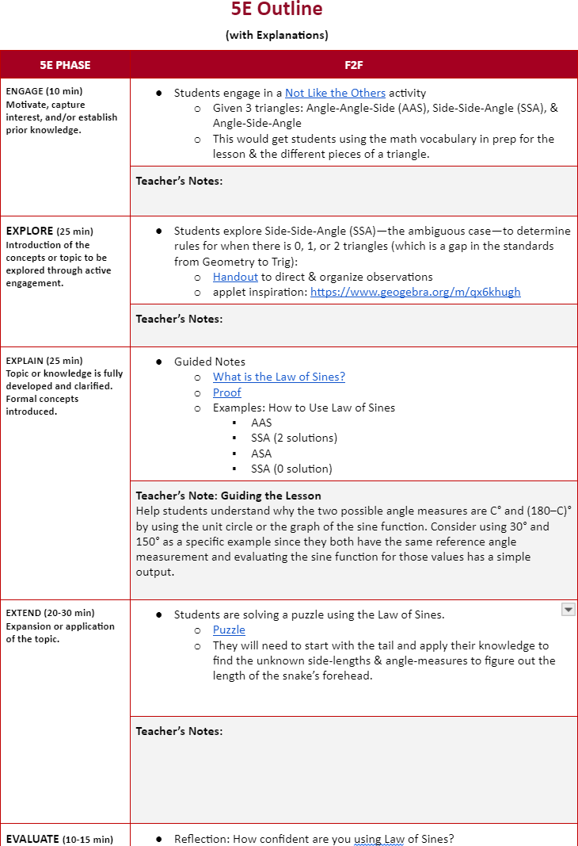
Content Development Plan (CDP)
Now that you have your idea, let’s start developing your lesson plan.
Use your 5E Lesson Outline handout to start making a plan.
Write the snapshot ideas in the 5E Phases section.

Slide 13
CDP: Share Out
Share with the whole group a brief summary of your snapshot.

Slide 14
Break
Notes:
Online Timer Option: https://timer.k20center.ou.edu/
K20 Center. (2021, September 21). K20 Center 10 minute timer. [Video]. YouTube. https://youtu.be/9gy-1Z2Sa-c?si=fK21CHcK4DKbD50m

Slide 15
LEARN Resources: Instructional Strategies
Which strategies might fit your needs?
Is there a strategy that you would like to try out?
How could you use a strategy in different phases of the 5E lesson?
Example: Honeycomb Harvest
Could you modify a strategy to better fit your needs?
Surprising, Interesting, Troubling → Surprising, Interesting, Takeaways
Four Corners → Two Corners

Slide 16
Into LEARN
Go to LEARN.K20Center.OU.edu.
Click the “Sign In” button.
Follow the prompts to sign in or create an account.
Select the “Create” tab.
Click the “Create 5E Lesson” button.

Slide 17
Lesson Writing Time
Use this dedicated time to take your ideas and draft your 5E outline.
Notes:
K20 Center. (2021, September 21). K20 Center 30 minute timer. [Video]. YouTube. https://youtu.be/yxGM6oVHqFc?si=Yswm2FhUIUQuuWmY

Slide 18
Lesson Reflection
Rose: What part of the lesson feels
the most developed and certain so far?
Bud: What part are you excited about working to develop further?
Thorn: What struggles or questions have you encountered that you need support on?
Notes:
K20 Center. (n.d.). Rose, bud, and thorn. Strategies. https://learn.k20center.ou.edu/strategy/2224

Slide 19
Reflection
On a sticky note, write your responses.
Crystal Clear
Of everything we have discussed about standards-based, 5E lessons, what do you feel the most confident about?
What do you think is the clearest?
Muddiest Point
What do you feel the least confident about?
What do you think is the most confusing (muddiest)?
Notes:
K20 Center. (n.d.). Muddiest point. Strategies. https://learn.k20center.ou.edu/strategy/109

Slide 20
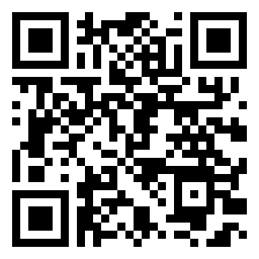
TREK Evaluation: Day 2 PM
GUMS | FUTURE | OKC
trek.k20center.ou.edu/ survey/16753194 | trek.k20center.ou.edu/ survey/85081623 | trek.k20center.ou.edu/ survey/03815319

