Slide 1
Embedded Literacy Across All Disciplines
Sarah Brewer, M.Ed. & Morgan Myers, M.Ed.
January 6th, 2020
Notes:
Start at 9:30. Sarah & Morgan introduce selves.

Slide 2
Outcomes
By the end of this session, participants will be able to…
identify components of content-specific literacy.
analyze the significance of each literacy component.
select literacy instructional strategies that are applicable to their discipline.
Notes:
Morgan - 9:30

Slide 3
Content-specific literacy is the ability for students to…
READ and understand complex content-specific text.
LISTEN and learn from others.
SPEAK and ELABORATE about content topics or ideas.
WRITE CRITICALLY about content-related topics.
(Chauvin & Theodore, 2015)
Notes:
Explain that for math students writing critically might mean correctly creating a written algebraic expression. This is the rationale for what we are doing today.
Morgan - 9:30-9:35

Slide 4

Sticky Bars Strategy
Think of a student activity that is important to your content and relates to one of these literacy components.
Write your name, what you teach, and that activity on a sticky note and place in the appropriate column.
Reading Listening Speaking Writing
Notes:
Ask participants to think critically about their discipline and determine which literacy element--reading, listening, speaking, or writing-- is very important in their classroom. Ask participants to think about something that students need to do in their content that pertains to one of these elements. You may need to give an example. For example in Social Studies, students will read primary historical documents so students may need some reading strategies to understand what they are reading.
Morgan - 9:35-9:45

Slide 5
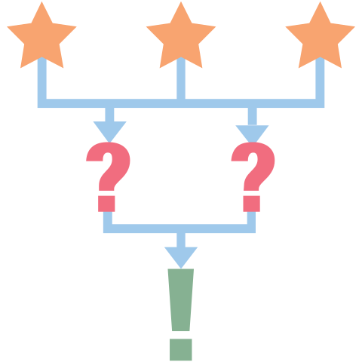
3-2-1 Strategy Handout
3 literacy approaches the teacher used
2 possible applications for your discipline
1 obstacle to overcome
Notes:
Pass out the 3-2-1 Handout and explain the directions. Participants are to jot down literacy approaches that they observe.
Sarah - Start at 9:45

Slide 6
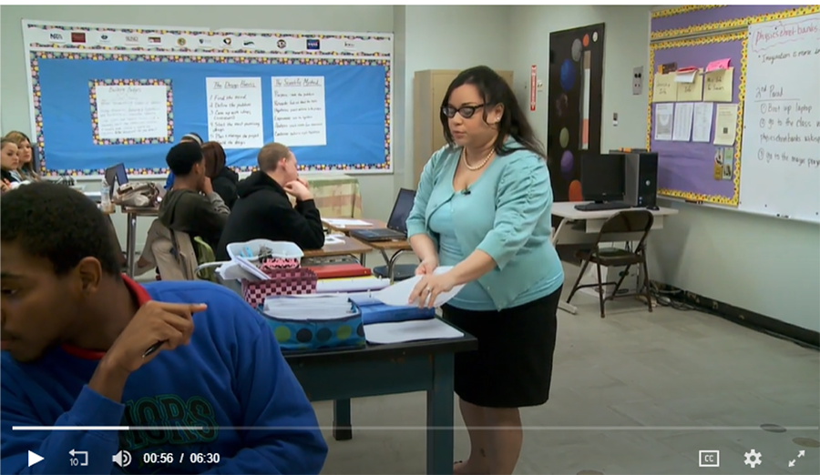
Literacy in High School Science
Notes:
Note: To save space, videos are not embedded. Video is linked in both the image and the title above the image. You will need an Internet connection to play this video. This physics teacher employs the following literacy skills: students read a journal article from the discipline, students working in partners to identify unfamiliar vocabulary, scanning the information, discussing the information with a partner, and determining how the journal article relates to their topic and implementation of building bridges. The teacher also introduces primary source text.

Slide 7
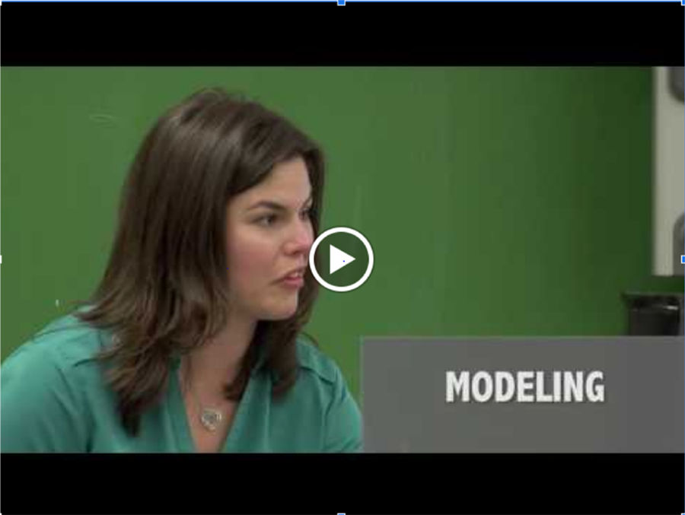
Literacy in Middle School Science
Notes:
This science teacher uses the literacy skills of summarizing and paraphrasing. She teaches these skills through think-alouds and modeling. Students are allowed to work as partners using these skills.
Video is 7:49.
Sarah - move on from this slide around 9:55.

Slide 8
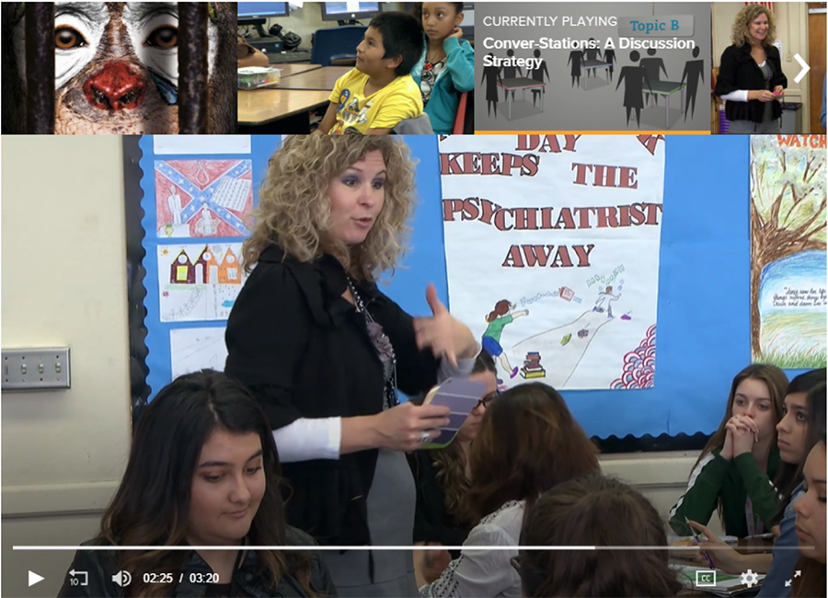
Literacy Conver-stations in ELA
Notes:
Students begin a conversation with their groups and take notes. Then two people from each group rotate and share information with the next group. This uses the literacy skills of speaking and listening with content-specific text. Students are also involved in writing through making notes from what they hear.

Slide 9
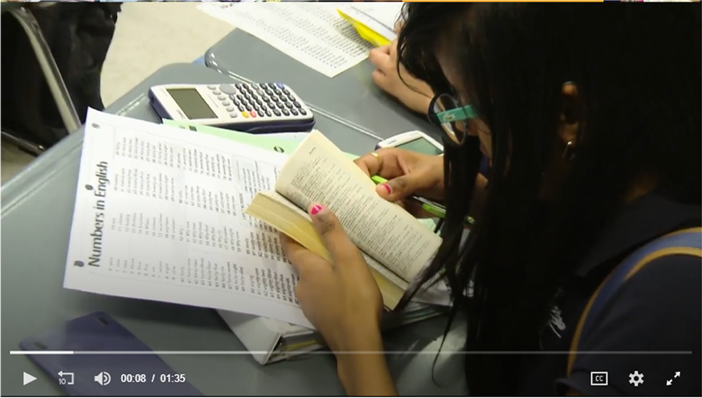
Write About Math
Notes:
This teacher uses a variety of sentence frames like Claim, Evidence, and Reasoning to have students write about math experiences. She places students in pairs to talk about what they wrote, uses a word bank wall for critical math words, and has students use dictionaries as a reference for understanding. Students speak and discuss before they write.
Video is 1:35.
Sarah - move on at 10:00

Slide 10
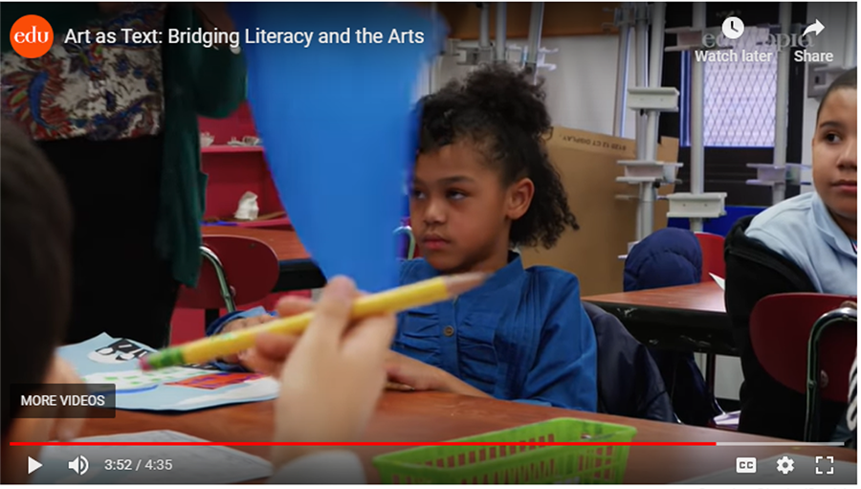
Using Art as Literacy (Elementary)
Notes:
This art teacher asks students to read the visuals of the artwork and explain what the artist might have intended. Students use inferencing, predicting, and finding meaning in the components of the artwork. This is often used as cross curricular instruction. Students might be study urban living in social studies and then reviewing or creating artwork that reflects urban living.
Video is 4:35.
Skip this video if running short on time. Sarah - move on at 10:05

Slide 11
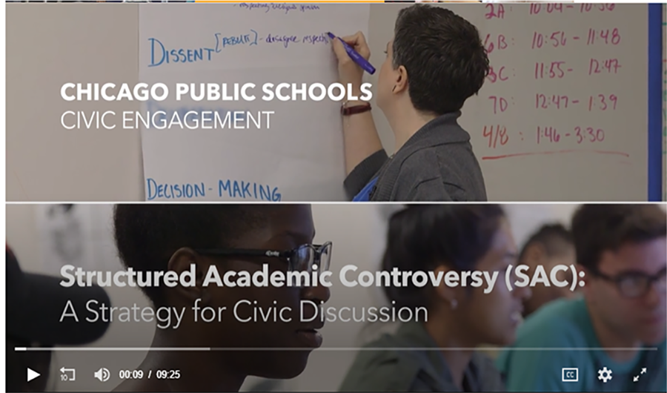
Structured Academic Conversations (SAC)
Notes:
Structured academic controversy is an instructional strategy where both sides of textual evidence of a topic are presented. Students read one topic viewpoint and share with other members of a small group who read the opposite viewpoint. Their job is to summarize and get important elements of the topic across to students who read opposing text. Then students deliberate the merits of both sides. Eventually the entire class is polled for their viewpoint on the topic and reasoning for it. Through discussion, the goal is for others to see different viewpoints of the same topic and deliberate about it together.

Slide 12
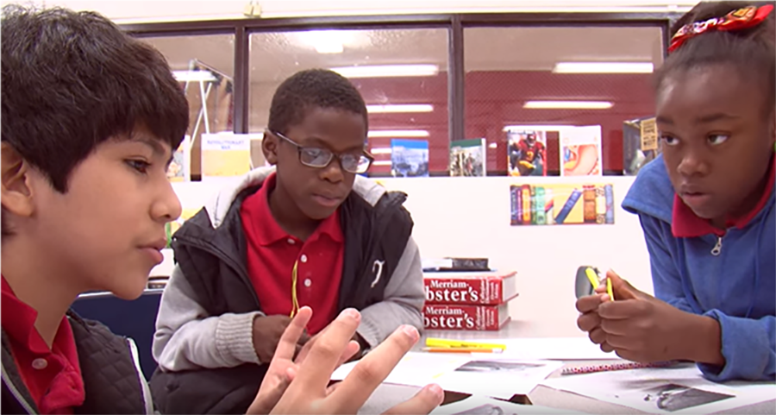
Middle School Literacy Project
Notes:
This is actually an entire middle school literacy project The middle school intentionally increased the variety of texts in the classroom, increased writing across the contents, promoted literacy strategies such as circling unfamiliar words, predicting what text will say, clarifying and expanding information through writing, increasing discussion and debate. Literacy coaches were employed to teach similar literacy strategies across the contents.

Slide 13
3-2-1 Table Talk
With your table group, discuss:
3 literacy approaches the teacher(s) used
2 possible applications for your discipline
1 obstacle to overcome
Notes:
Pause after each video and allow time for table talk. Ask groups to share out one literacy approach they saw, a possible application for the classroom, and one obstacle to overcome.
Sarah - start at 10:05. Allow 10 minutes in group. 5 minutes whole-group. Move on at 10:25.

Slide 14


LEARN Strategy Reflection
Sticky Bars Strategy
3-2-1 Strategy
a literacy approach from a video
Notes:
Pass out the instructional strategy note sheet. Allow time for participants to reflect and complete their LEARN Strategy Reflection on the Instructional Strategy Notes handout.
Sarah - 10:25-10:30

Slide 15

Jigsaw Reading Groups
Find your content on a poster around the room.
If your content is not represented, choose a discipline that most represents similar student needs.
Notes:
Place chart tablet around the room with the heading of Social Studies, Math, Science, English, Electives. If someone feels that their content is best represented in a certain group, they should join that group. Beside each group poster, have the appropriate reading for that content, pens, and highlighters.
Break 10:30 -10:35
Morgan 10:35 - 10:40

Slide 16

CUS and Discuss
CIRCLE any content-specific literacy strategies.
UNDERLINE why literacy is important to your content.
STAR a quote or sentence that is important to remember.

Slide 17

Why-lighting
Highlight parts of the reading that include:
Why literacy is important to your content
Specific literacy strategies or approaches
Jot in the margins WHY you highlighted them.
Notes:
This is an alternative close reading strategy. Explain that when middle school students start highlighting, they may highlight everything.
Morgan - 10:40-11:00

Slide 18
Window Notes Poster
Fold your chart tablet into four quadrants.
Come to a consensus about these questions:
How is literacy important for your content?
What quote from the reading stood out?
What are examples of content-specific literacy strategies?
Create a visual representation of what you read.
Notes:
Allow time for participants to create a poster about the content they read. Each window can be bullet points (except for the visual representation). Have participants choose one spokesperson for their poster and share with all participants.
Morgan - 11:00-11:30. 15 minutes to make the poster. 15 minutes to share out. If running out of time, share out only one quadrant.

Slide 19
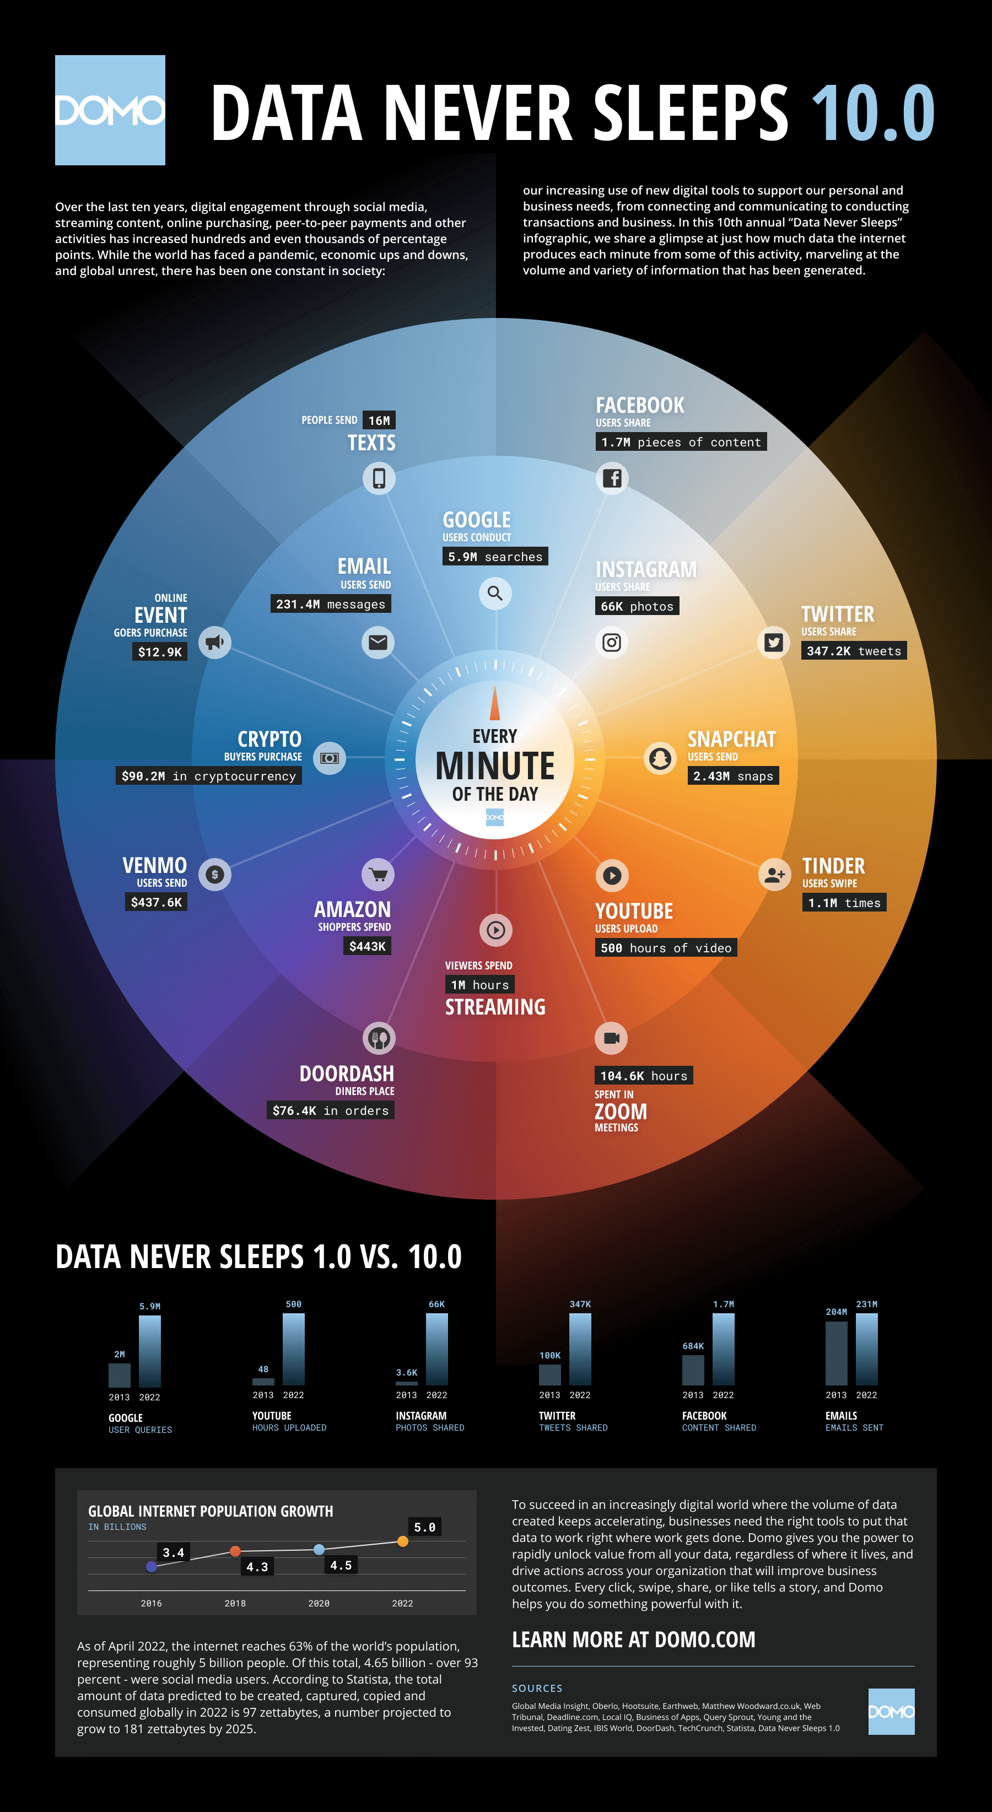
What is the impact of digital information on our world today?
Source: https://web-assets.domo.com/miyagi/images/product/product-feature-22-data-never-sleeps-10.png
Notes:
DO NOT show Tweet Up yet. Allow them to discuss for a few minutes, then move on to the next slide
Sarah - 11:30-11:35

Slide 20

Tweet Up
# = Main idea / Message of infographic
Tweet = What is a teacher’s responsibility to students in response to data abundance?
Notes:
All groups get the infographic, then do Tweet Up on legal paper or giant post-its
have the hashtag come first (main idea or theme), then give a few opinions/thoughts *remind them that tweets can be thesis statements

Slide 21
LEARN Strategy Reflection
Jigsaw
Thinking Notes (option 1)
Why-Lighting (option 2)
Window Notes
Tweet Up
Notes:
Allow the participants time to complete their LEARN Strategy Reflection on the Instructional Strategy Notes handout.
Sarah - 11:35-11:40

Slide 22
Exit Ticket
Choose ONE question and write a response. Consider the literacy approaches you currently use or will use.
How will your students READ and understand complex content-specific text?
How will your students LISTEN and learn from others?
How will your students SPEAK and ELABORATE about content topics or ideas?
How will your students WRITE CRITICALLY about
content-related topics?
Adapted from: Chavin R., Theodore, K.(2015). Teaching content-area literacy and disciplinary literacy. SEDL insights. American institutes for research.
Notes:
Remind participants that these are the critical elements for literacy and are higher order thinking skills.
Sarah - 11:40-11:50. Share with group. Keep or turn in (participant choice).

Slide 23

School email
(No Participant ID is required.)
trek.k20center.ou.edu/oe/19644
Notes:
***This slide MUST be edited with the correct TREK web address.***
Click on the link in the orange box to edit the numbers at the end and the QR code.

Slide 24
TREK Rapid Feedback
Go to: trek.k20center.ou.edu/today
Sign in. (No participant ID required)
Tell us how we did!
Insert QR Code Here
Notes:
Sarah - 11:50
Have participants complete the Rapid Feedback on TREK.

Slide 25
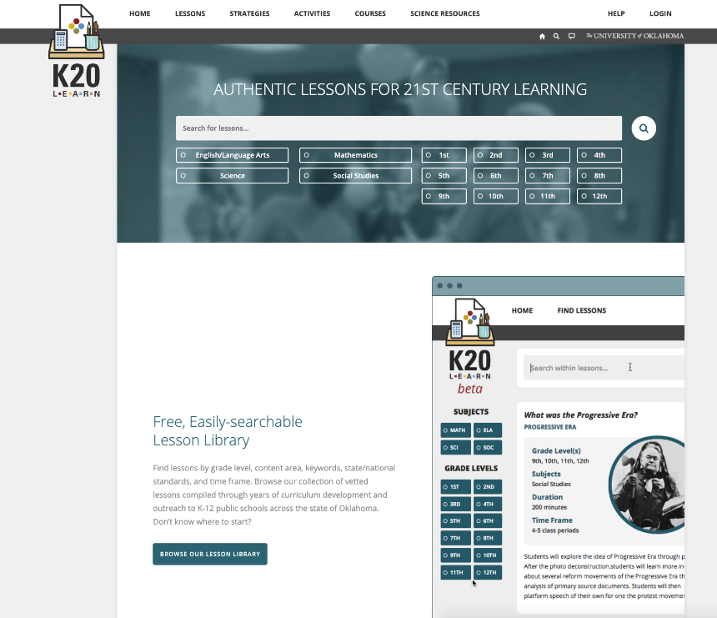
K20 LEARN
learn.k20center.ou.edu
Notes:
Sarah

