Slide 1
From Knowledge to Action
Turning Insights Into Practice

Slide 2
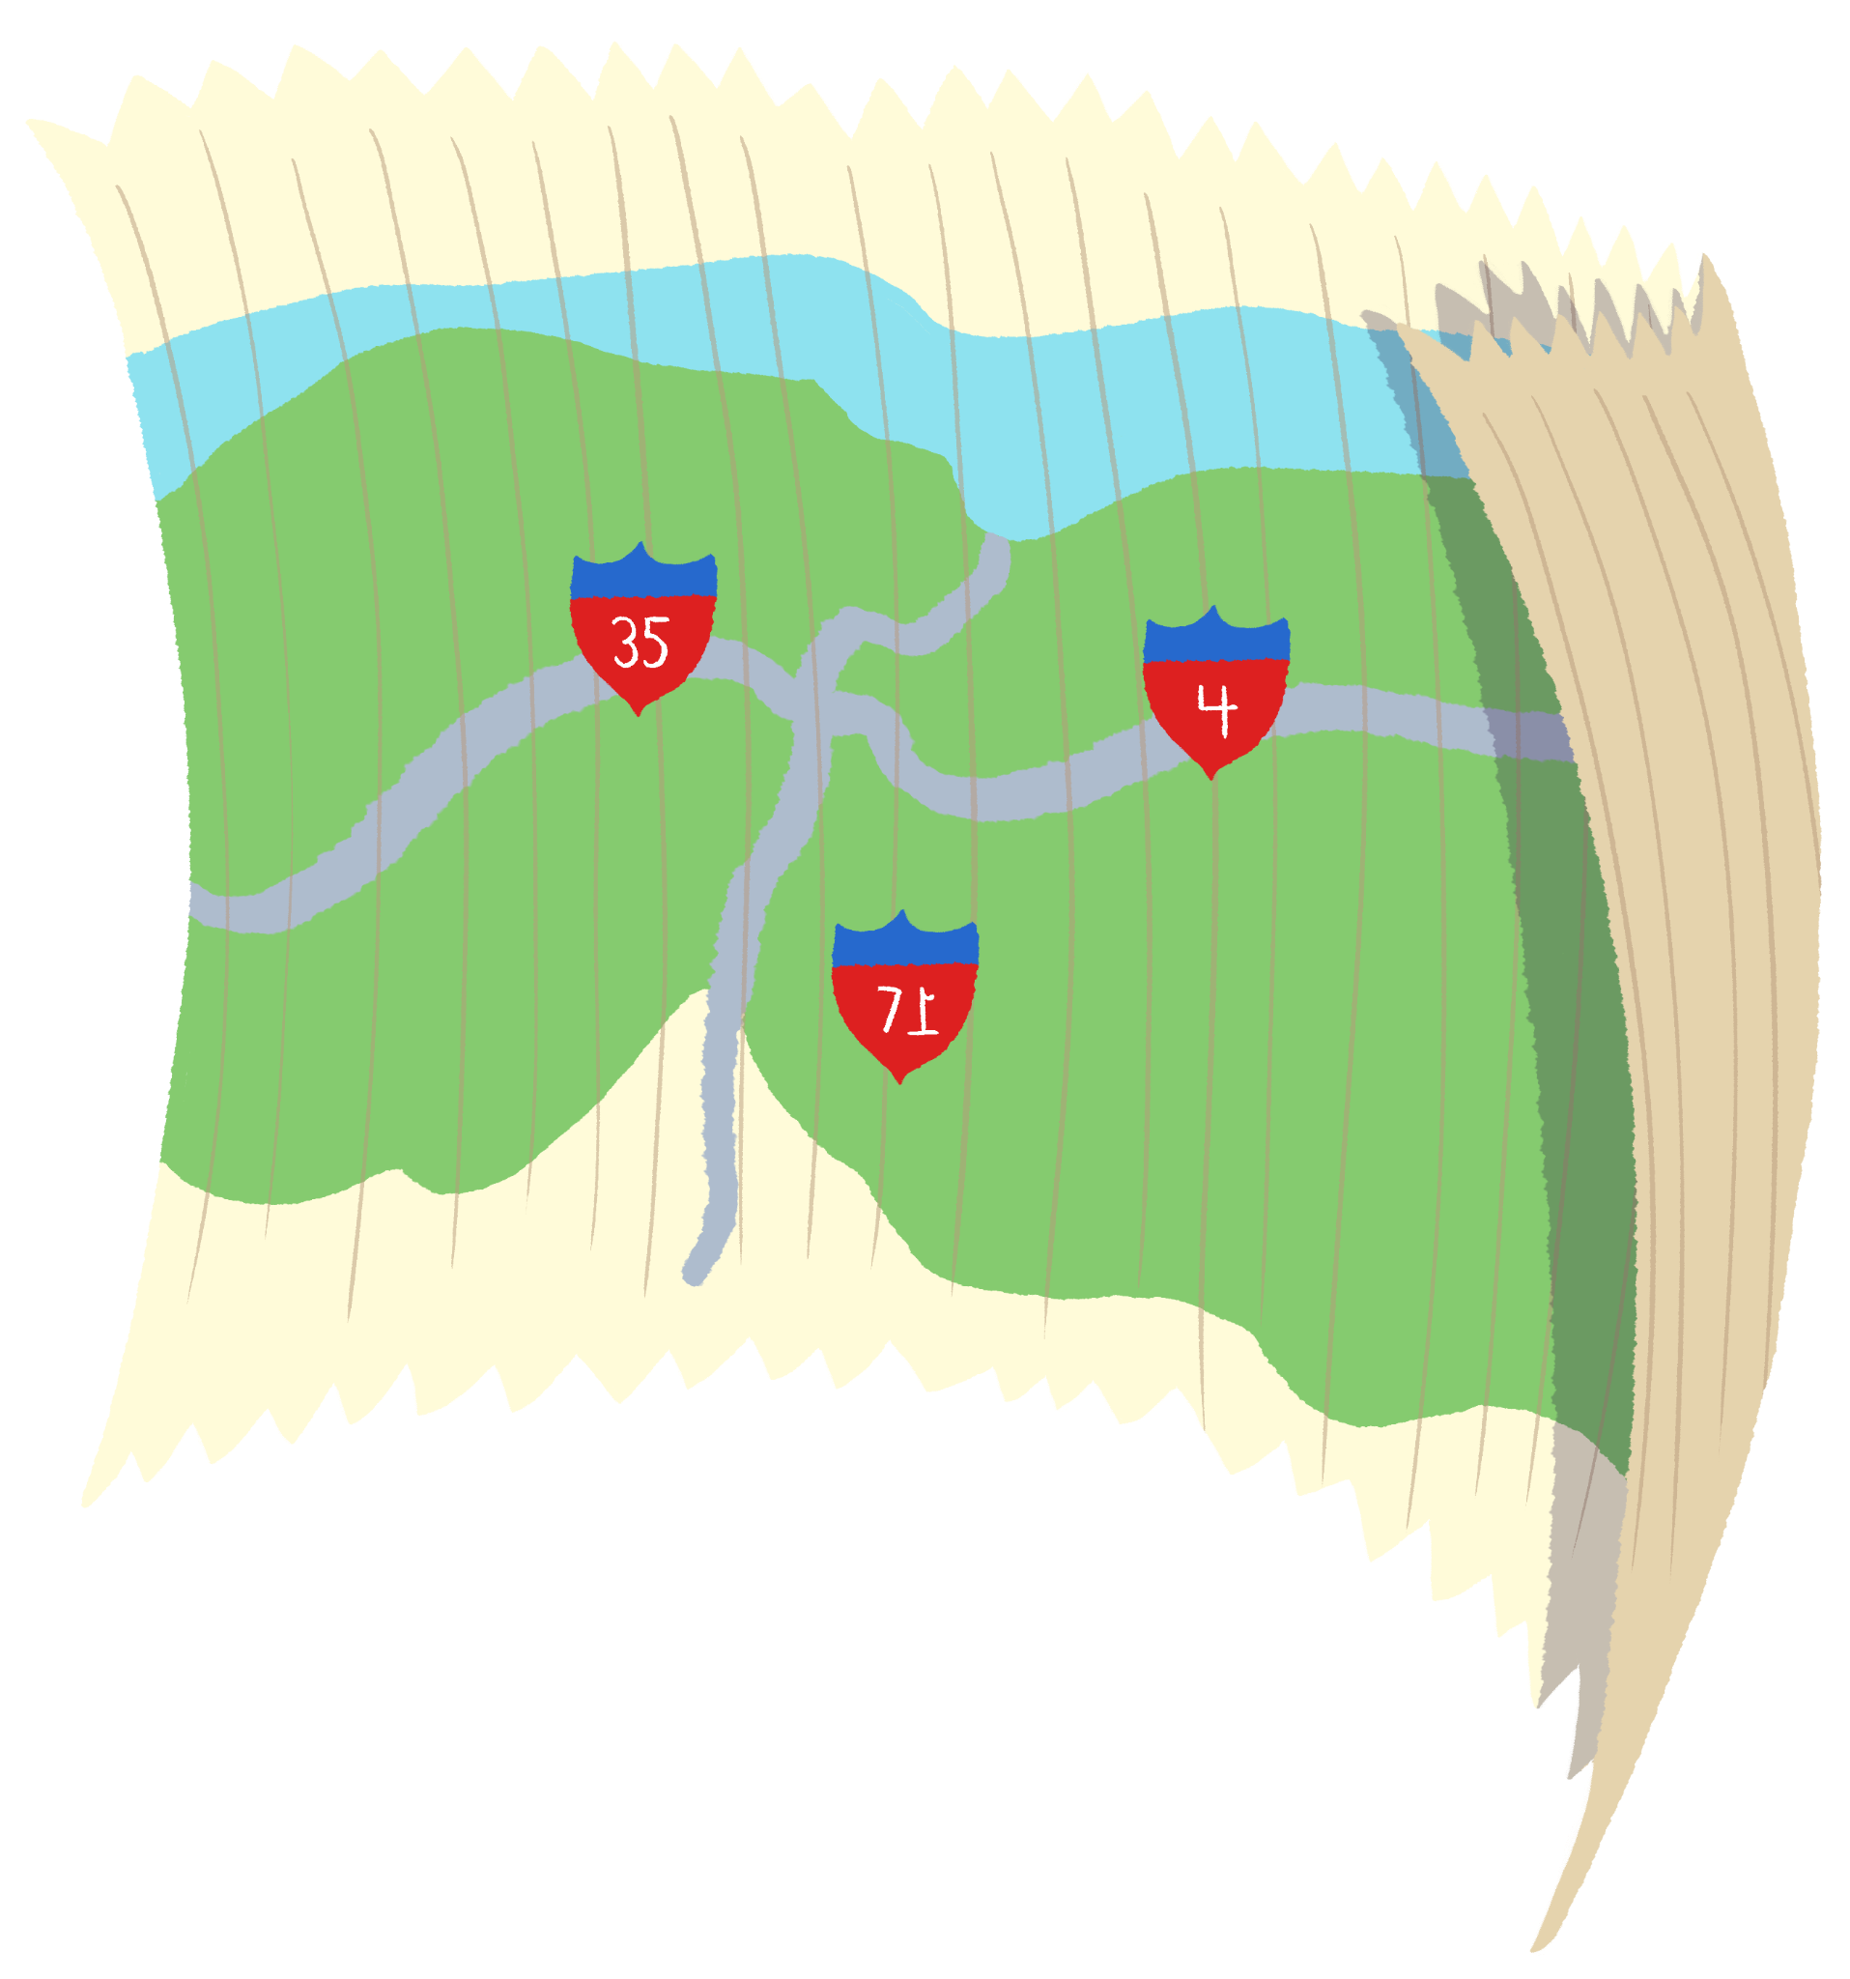
Roadmap to Success
Take what you learned and turn it into a plan of action.
Choose 5 of the following 8 slides to complete.
  Slide #3 is required, the others are optional.
Replace the questions on each slide with the text and images to answer them.
Delete the slides you don’t want and feel free to add your own.

Slide 3

Destination
Where do you want to go?
What’s your goal?
Notes:
Questions:
Where do you want to go (what’s your goal)?

Slide 4
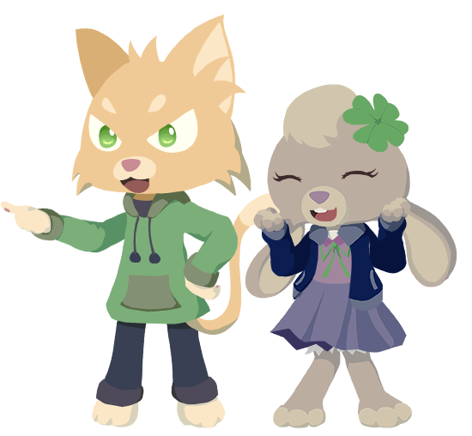
Travel Partners
Who are your travel partners?
What is each person’s role?
  record keeper (note taker)
  travel guide (someone to keep us on task)
  guard (keeps an eye out for roadblocks)
What is each person’s responsibility?
Notes:
Questions:
Who are your travel partners?
What is each person’s role?
record keeper (note taker)
travel guide (someone to keep us on task)
guard (keeps an eye out for roadblocks)
What is each person’s responsibility?

Slide 5

Packing List
What do you need to reach your goal?
  materials and supplies
  financial resources
  human resources
Notes:
What do you need to reach your destination (goal)?
materials and supplies
financial resources
human resources

Slide 6

Pitstops
What are the major milestones on your journey to success?
How long should it take to reach each milestone?
Notes:
What are the major milestones on your journey to success?
How long should it take to reach each milestone?

Slide 7

Travel Diary
How will you track progress?
What reflection strategies will you use to determine if an adjustment to your plans is needed?
Notes:
How will you track progress?
What reflection strategies will you use to determine if an adjustment to your plans is needed?

Slide 8

Roadblock
What roadblocks do you anticipate?
How will you overcome them?
Notes:
What roadblocks do you anticipate?
How will you overcome them?

Slide 9

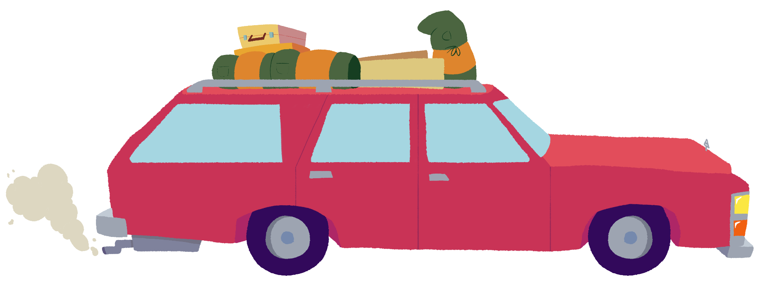
Excursions
What do want to happen when you reach your goal?
  What are the outcomes you want to see as a result of your actions?
  What impact will your actions have on your classroom or school?
What do you want others to be able to do?
Notes:
What do want to happen when you reach your destination?
What are the outcomes you want to see as a result of your actions?
What impact will your actions have on your classroom or school?
What do you want others to be able to do?

Slide 10

Scrapbook
What does success look like?
How will you know when you are successful?
Notes:
What does success look like?
How will you know when you are successful?

