Slide 2
From Knowledge to Action
Turning Insights Into Practice

Slide 3

What did you learn?
Write a short summary consisting of
the main idea of the whole book
three key takeaways
Notes:
K20 Center. (n.d.). What? So What? Now What?. Strategies. https://learn.k20center.ou.edu/strategy/95
Have learners write a response, then share with a partner. Ask for a few volunteers to share with the whole group.

Slide 4
So What?
Why is the information in this book important and why does it matter?
How does this relate to our work?
Notes:
K20 Center. (n.d.). What? So What? Now What?. Strategies. https://learn.k20center.ou.edu/strategy/95
Have learners write a response, then share with a partner. Ask for a few volunteers to share with the whole group.

Slide 5
Now What?
What implications does this have?
How can we use this new knowledge?
Notes:
K20 Center. (n.d.). What? So What? Now What?. Strategies. https://learn.k20center.ou.edu/strategy/95
Have learners write a response, then share with a partner. Ask for a few volunteers to share with the whole group.

Slide 6
Essential Questions
Why is the information in this book important to enhancing our work?
How will we implement new practices to drive positive change?

Slide 7
Learning Objectives
Summarize the main idea and key takeaways.
Create an action plan to apply your new knowledge.
Generate questions and determine the strengths of each presentation.

Slide 8
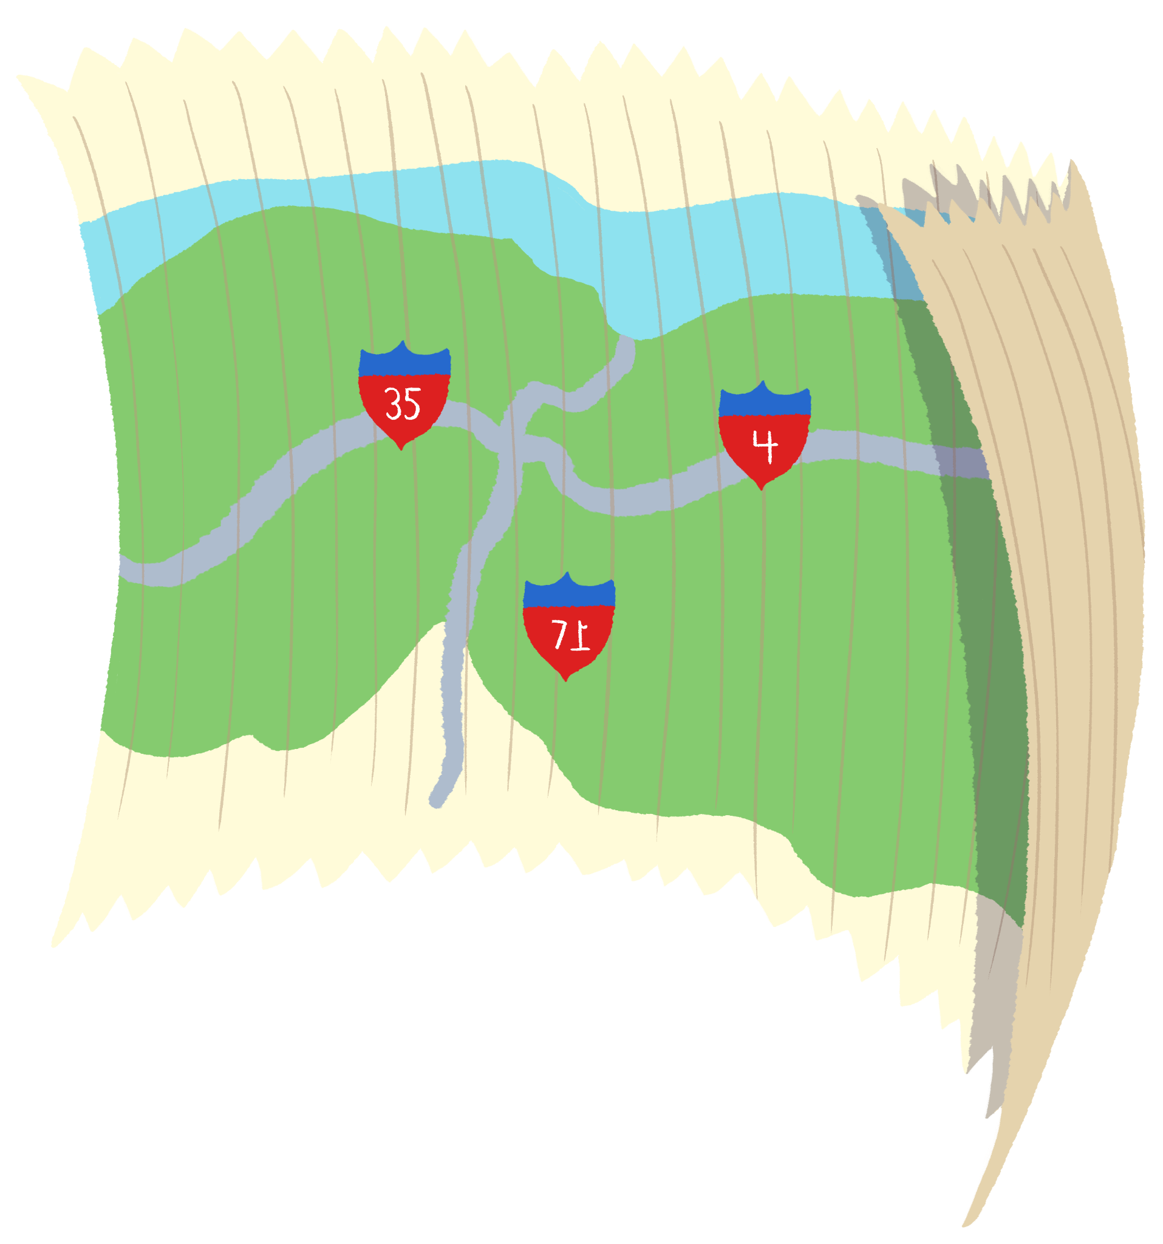
Roadmap to Success
Create a plan using the provided Roadmap to Success template.
Complete at least 5 of the 8 slides.
  Slide #3 is the only required slide
  Replace the text and images on each slide with your response to the questions.

Slide 9
Roadmap to Success
Take what you learned and turn it into a plan of action.
Choose 5 of the following 8 slides to complete.
  Slide #3 is required, the others are optional.
Replace the questions on each slide with the text and images to answer them.
Delete the slides you don’t want and feel free to add your own.

Slide 10

Destination
Where do you want to go?
What’s your goal?
Notes:
Questions:
Where do you want to go (what’s your goal)?

Slide 11
From Knowledge to Action
Turning Insights Into Practice
Why is the information in this book important to enhancing our work?
How will we implement new practices to drive positive change?

Slide 12

Exclaim and Question!
As each group shares their roadmap, think about:
A strength – make an exclamation about their plan
A question – ask a question you have about their plan

