Slide 2
Rubrics
Assessing Authentic Learning Tasks

Slide 3
Learning Objectives
Participate in hands-on activities to evaluate the “whys” of rubrics.
Brainstorm connections between the use of rubrics and designing authentic instruction in the classroom.
Create a T-chart to illustrate the connections between the why and how of rubrics in the classroom.

Slide 4
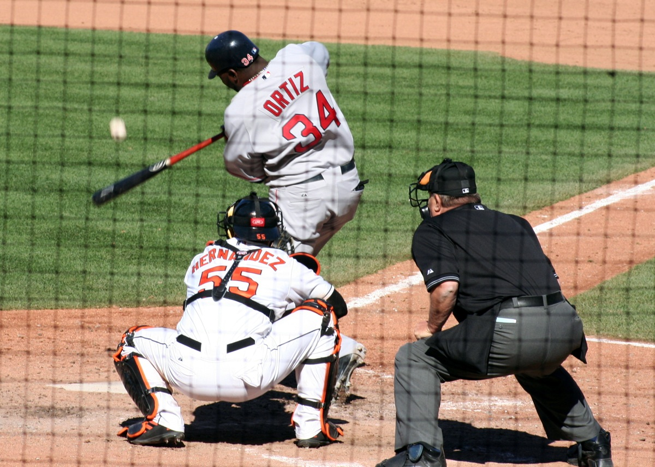
Strike out!
In your small group, make a list of why teachers use rubrics.
Your group list must contain at least seven items.
Pass your list to the group on your right.
Evaluate the new list you received and strike out one of the least important items on the list.
Notes:
Jaquith, W. (2006). Descrizione: David Ortiz tenta un bunt. Wikimedia Commons. https://commons.wikimedia.org/wiki/File:Bunt.jpg

Slide 5
Why we use rubrics
Reprinted from Educause. For educational use.
Notes:
Reprinted from Lombardi, M. M. (2008, January). Making the grade: The role of assessment in authentic learning (ELI Paper 1: 2008, p. 6). https://library.educause.edu/~/media/files/library/2008/1/eli3019-pdf.pdf. Copyright 2008 by Educause. For educational use.

Slide 6
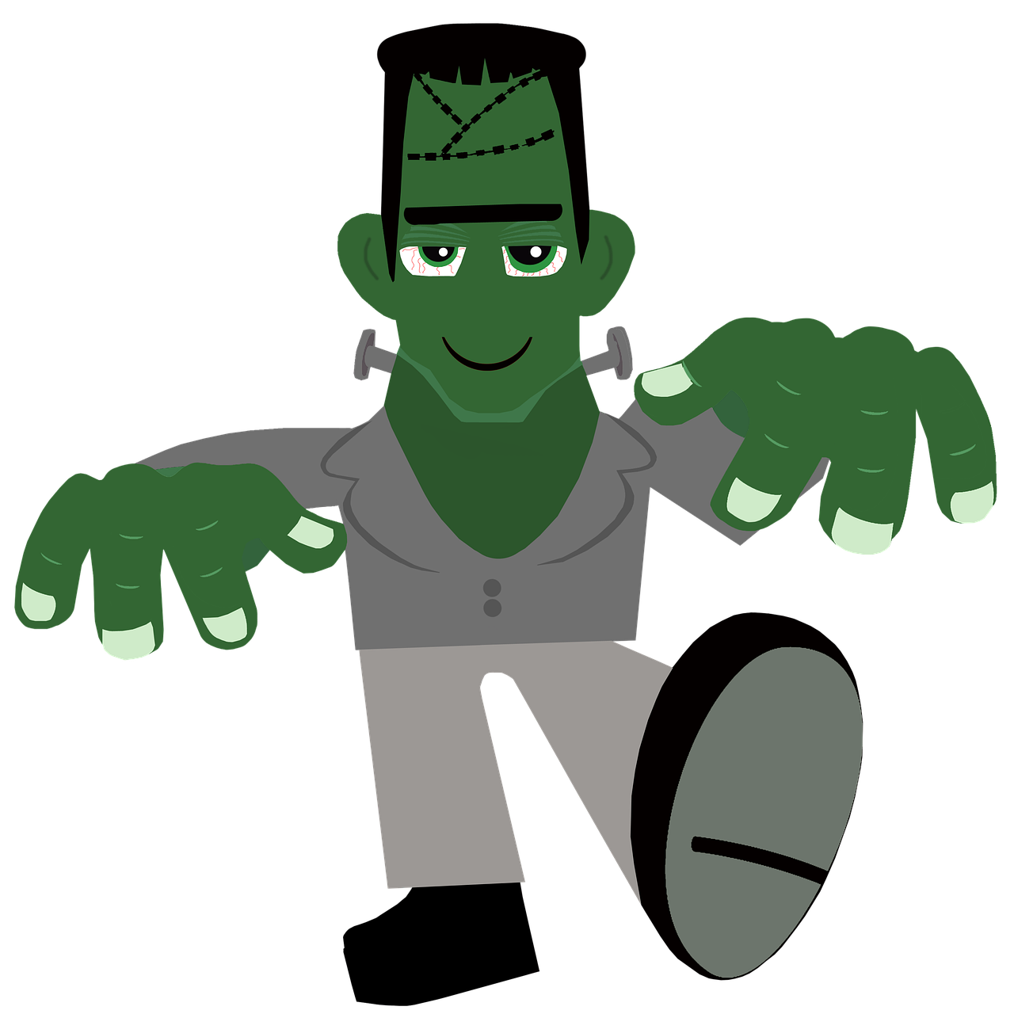
It’s alive!
Based upon elements of authentic assessment, bring one item back to life.
Notes:
GingerMarie12. (n.d.). Frankenstein monster Halloween Frankenstein royalty-free stock illustration. Pixabay. https://pixabay.com/illustrations/frankenstein-monster-halloween-6518249/

Slide 7
Why we use rubrics
Reprinted from Educause. For educational use.
Notes:
Reprinted from Lombardi, M. M. (2008, January). Making the grade: The role of assessment in authentic learning (ELI Paper 1: 2008, p. 6). Retrieved from https://library.educause.edu/~/media/files/library/2008/1/eli3019-pdf.pdf. Copyright 2008 by Educause. For educational use.

Slide 8
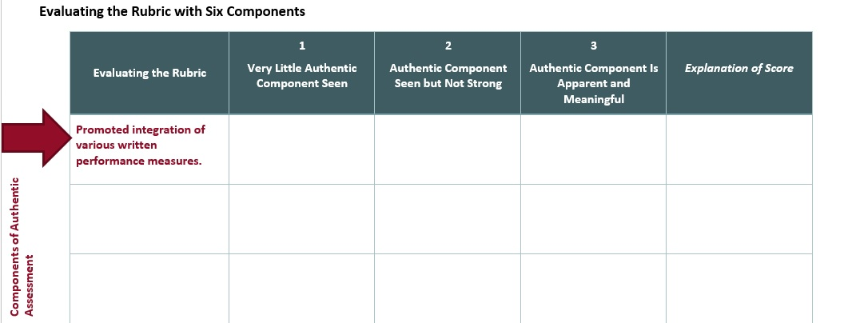
Building It Together

Slide 9
Attributes of Authentic Assessment
Task Clarity | Relevance | Potential for Success
Students clearly understand the learning goal and know how teachers will evaluate their learning
Students think the learning goals and assessments are meaningful and worth learning
Students believe they can successfully learn and meet the evaluative expectations
(McTighe & O’Connor, 2005)
Notes:
McTighe, T., & O’Conner, K. (2005, November). Seven practices for effective learning. Educational Leadership, 63(3), 10–17.

Slide 10

Four Corners
Statement:
“The use of rubrics guarantee more authentic learning.”
Notes:
K20 Center. (n.d.). Four Corners. Strategies. https://learn.k20center.ou.edu/strategy/138

Slide 11


Dropout statistics show that numerous so-called normal students are not succeeding because they are not treated as individuals.
Students find new and creative ways to solve problems, achieve success, becoming life-long learners when educators show them that there are different ways to learn.
What does the research say?
There is a correlation between high truancy rates and low academic expectations.
Active learning embraces teaching and learning strategies that engage and involve students in the learning process.
Reimer, M. S., & Smink, J. (2005). Fifteen effective strategies for improving student attendance and truancy prevention. Clemson, SC: National Dropout Prevention Center/Network.
Notes:
Reimer, M. S., & Smink, J. (2005). Fifteen effective strategies for improving student attendance and truancy prevention. Clemson, SC: National Dropout Prevention Center/Network.

Slide 12

Beware the Rubric Traps
Self-justification
Replacement for number grades
Quick and efficient
Kohn, A. (2006). The trouble with rubrics. English journal, 95(4), 12–15.
Notes:
Skitterphoto. (2017). Brown wooden mouse trap with cheese bait on top. Pexels. https://www.pexels.com/photo/brown-wooden-mouse-trap-with-cheese-bait-on-top-633881/

Slide 13
Why and How T-Chart
“When the how’s of assessment preoccupy us, they tend to chase the why’s back into the shadows.” – Alfie Kohn
Why?
How?
Notes:
Kohn, A. (2006, March 15). The trouble with rubrics. English Journal, 95(4). https://www.alfiekohn.org/article/trouble-rubrics/

Slide 14
Authentic Teaching
Higher
Order
Thinking
Disciplined Inquiry
Value
Beyond
School
Implicit
View of
Students

Slide 15
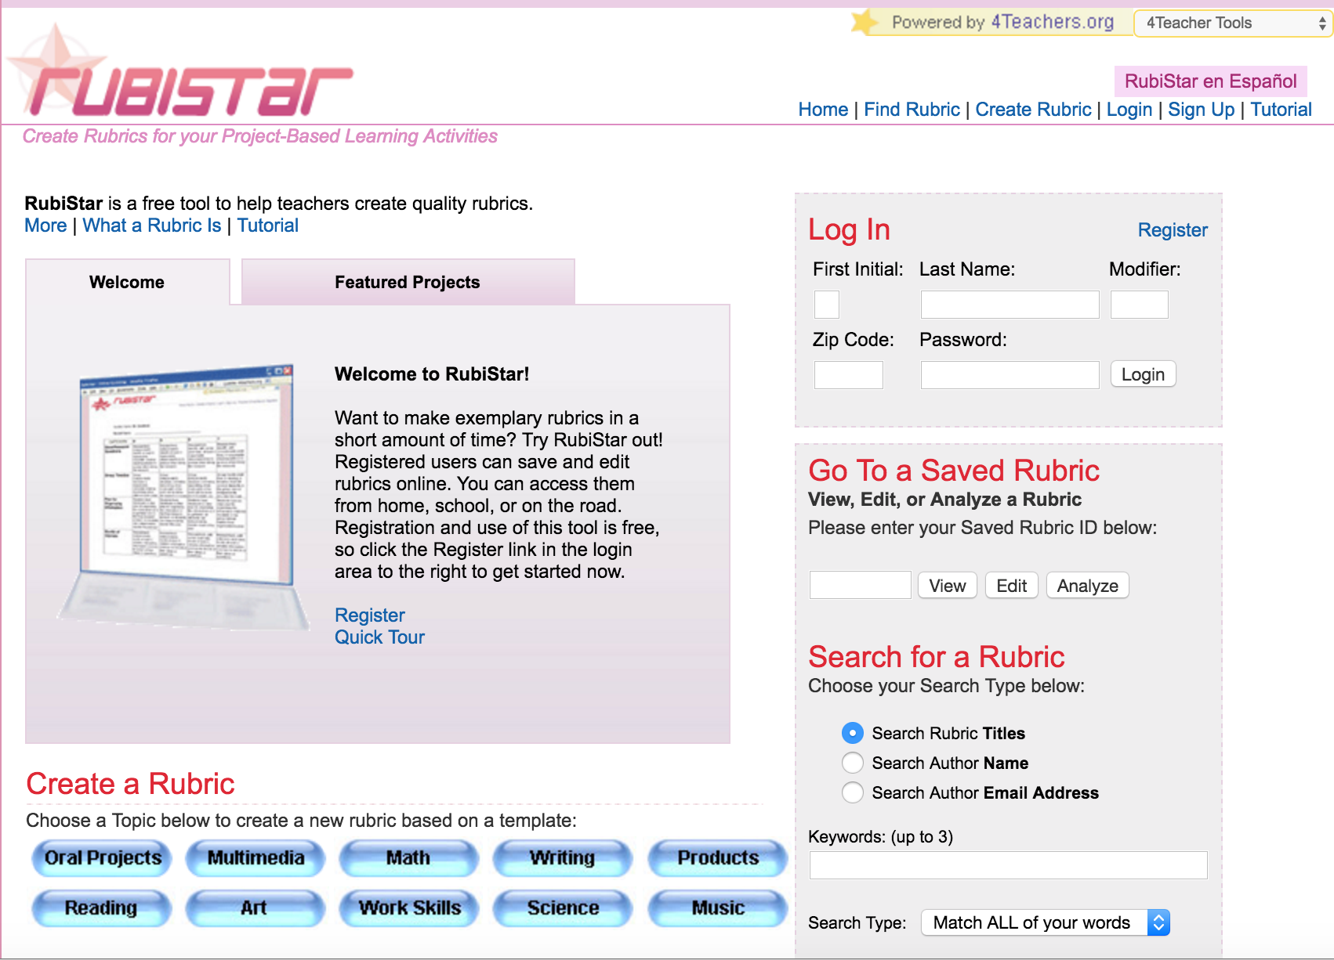
Rubistar
http://rubistar.4teachers.org
Notes:
Rubistar. (2008). Rubistar: Create rubrics for your project-based learning activities. Rubistar. http://rubistar.4teachers.org/index.php

Slide 16
Reflect and Write:
3 important takeaways from today’s session.
2 questions they still have about writing or creating rubrics.
1 lesson that lends itself to the use of rubric.

Slide 17
Follow Up

Slide 18
SCORE
What is one Strategy you used to support authentic teaching and learning?
What was successful and needs to be Celebrated?
What Obstacle did you face and overcome?
What might you Refine in the future when using this strategy?
Extra notes or ideas?

