Slide 2
Future U
Navigating Enrollment with Confidence

Slide 3
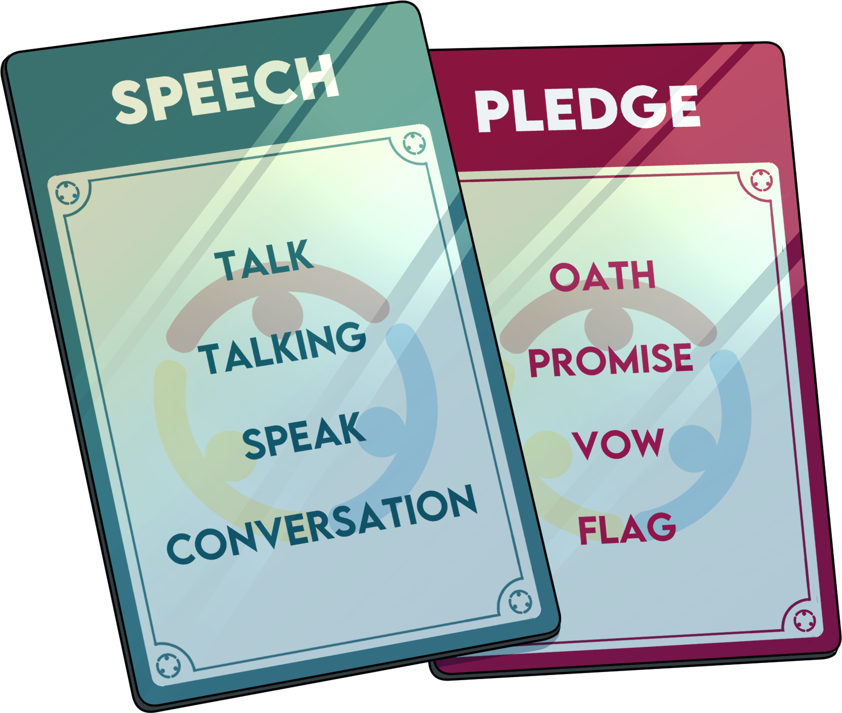
Forbidden Phrases
Using the 5-6 cards provided, play Forbidden Phrases at your table.
Each person choose 1 card.
WITHOUT using the forbidden words/phrases listed, try to get your tablemates to guess your word at the top of the card.
1 min. time limit per person.
Notes:
K20 Center. (n.d.). Forbidden Phrases. Strategies. https://learn.k20center.ou.edu/strategy/3342

Slide 4
Forbidden Phrases: What do students need to know when enrolling in a PSI?
There are 5-6 blank cards on your table.
At the top of the card write a topic that answers the question.
Below the topic word, identify 4 “forbidden” phrases that cannot be used to identify the topic.
When all cards are filled, trade cards with another table.
Notes:
If given extended time for the PD, have participants fill in the blank cards instead of using the printed cards using this slide for instructions.
K20 Center. (n.d.). Forbidden Phrases. Strategies. https://learn.k20center.ou.edu/strategy/3342

Slide 5
Essential Questions
What is needed to host a successful “Future U: The Enrollment Adventure” mock enrollment event?
What are the benefits of hosting a “Future U: The Enrollment Adventure” mock enrollment event?

Slide 6
Lesson Objectives
Experience a modified version of the “Future U: The Enrollment Adventure.”
Discuss the challenges of implementing the game.
Develop a plan for implementing a “Future U: The Enrollment Adventure” activity at your own location.

Slide 7
Play Future U: The Enrollment Adventure
Each player should have a clipboard, ledger, and an award letter that states the type of PSI attending and financial aid received.
You will have an opportunity to rotate through a few of the stations from the game and record your expenses and ledger balance.
Watch out for the Chance Wheel!
Notes:
Pass out the scholarship letter and the ledger
Instruct participants through putting their name on the Ledger, record if they are at a Career tech or a college. Then read through your scholarship letter, recording the amount of the award and identifying the parameters of your scholarship (things you must do or can’t use it for).
You are visiting a few of the 9 booths as a sample of the experience.

Slide 8
How Am I Feeling? What Am I Thinking?
Record on a sticky note what you are thinking and feeling after experiencing this activity.
Notes:
K20 Center. (n.d.). How Am I Feeling? What Am I Thinking? Strategies. https://learn.k20center.ou.edu/strategy/187

Slide 9
Card Sort
Read the research statements on the provided mat.
Place the Chance card scenarios on the mat where you feel it best relates.
Notes:
K20 Center. (n.d.). Card Sort. Strategies. https://learn.k20center.ou.edu/strategy/147

Slide 10
Exclaim and Question
As a table, write an:
Exclaim - positive attribute for implementation of the activity
Question - question you still have about the activity
Notes:
K20 Center. (n.d.). Exclaim and Question. Strategies. https://learn.k20center.ou.edu/strategy/94

Slide 11
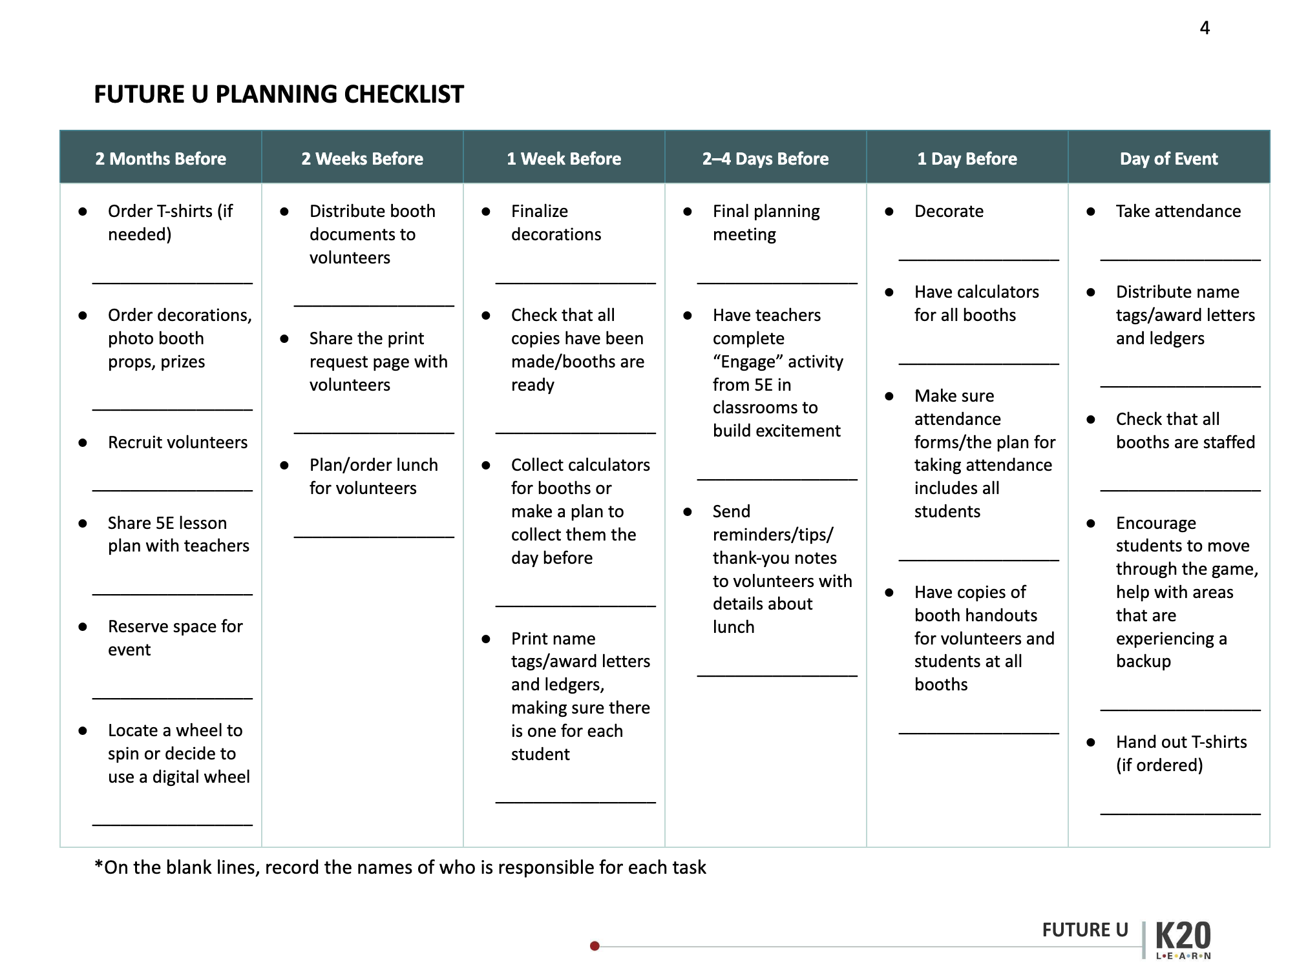
Event Set Up
Use this organizer and the scheduled event date to backwards plan your Future U: The Enrollment Adventure event.
Identify who and what you need to make it happen on time!

Slide 12
LEARN Strategies and Future U: The Enrollment Adventure
Paste
QR code
here
https://learn.k20center.ou.edu/educator-resource/3839
Notes:
- Participants will read the Engage and Evaluate
Shorter session - 3 minutes just show published resource.
Longer session - 30 minutes
All of these resources can be accessed on LEARN > Educator Resources (really Postsecondary Education Activities) - https://learn.k20center.ou.edu/educator-resource/1710
Participants will explore the Event version of Future U published on LEARN. They will review the handouts and begin thinking about what their next steps.

Slide 13
Share Out: Planning Doc Q&A
Notes:
Image Source: https://pixabay.com/vectors/question-mark-sign-question-ask-350168/

Slide 14
Exit Ticket
How does the “Future U: The Enrollment Adventure” help students understand how to prepare for enrolling in a PSI?
Notes:
K20 Center. Bell Ringers and Exit Tickets. Strategies. https://learn.k20center.ou.edu/strategy/125

