Slide 2
Lessons LEARNed
[type facilitator name/s here]

Slide 3
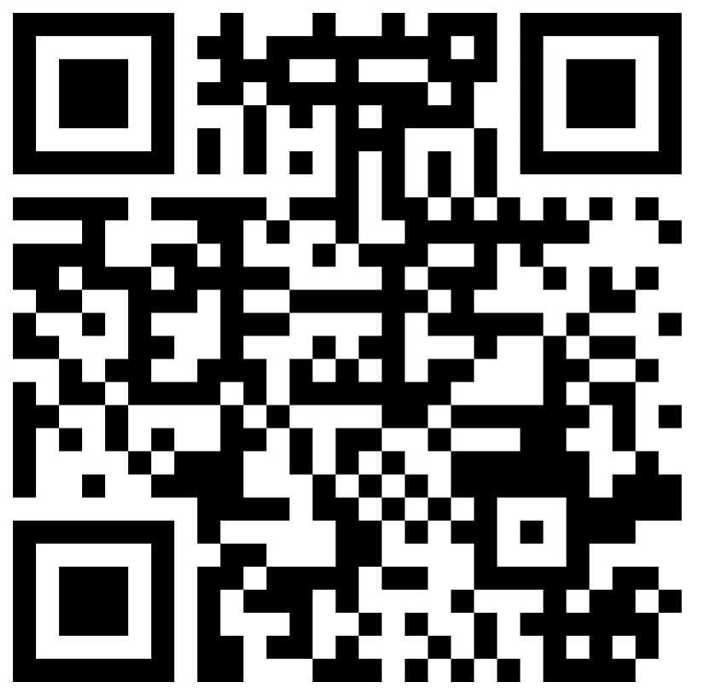
Guess the Acronym
Go to menti.com
Code: 9529 3459
What does LEARN stand for?
Notes:
Right answer: Lessons and Engaging Activities Repository Network
LEARN is K20's open access database of lessons, strategies, activities and resources for all stakeholders.
K20 Center. (n.d.). Timer [Webapp]. https://timer.k20center.ou.edu/

Slide 4
Essential Question
How can LEARN support authentic teaching and learning practices?

Slide 5
Session Objective
Identify LEARN resources that can enhance and support current lessons and instructional practices.

Slide 6
Lessons and
Engaging
Activities
Repository
Network
K20's open access database of lessons, strategies, activities and resources for all stakeholders.
Notes:
Right answer: Lessons and Engaging Activities Repository Network
LEARN is K20's open access database of lessons, strategies, activities and resources for all stakeholders.

Slide 7
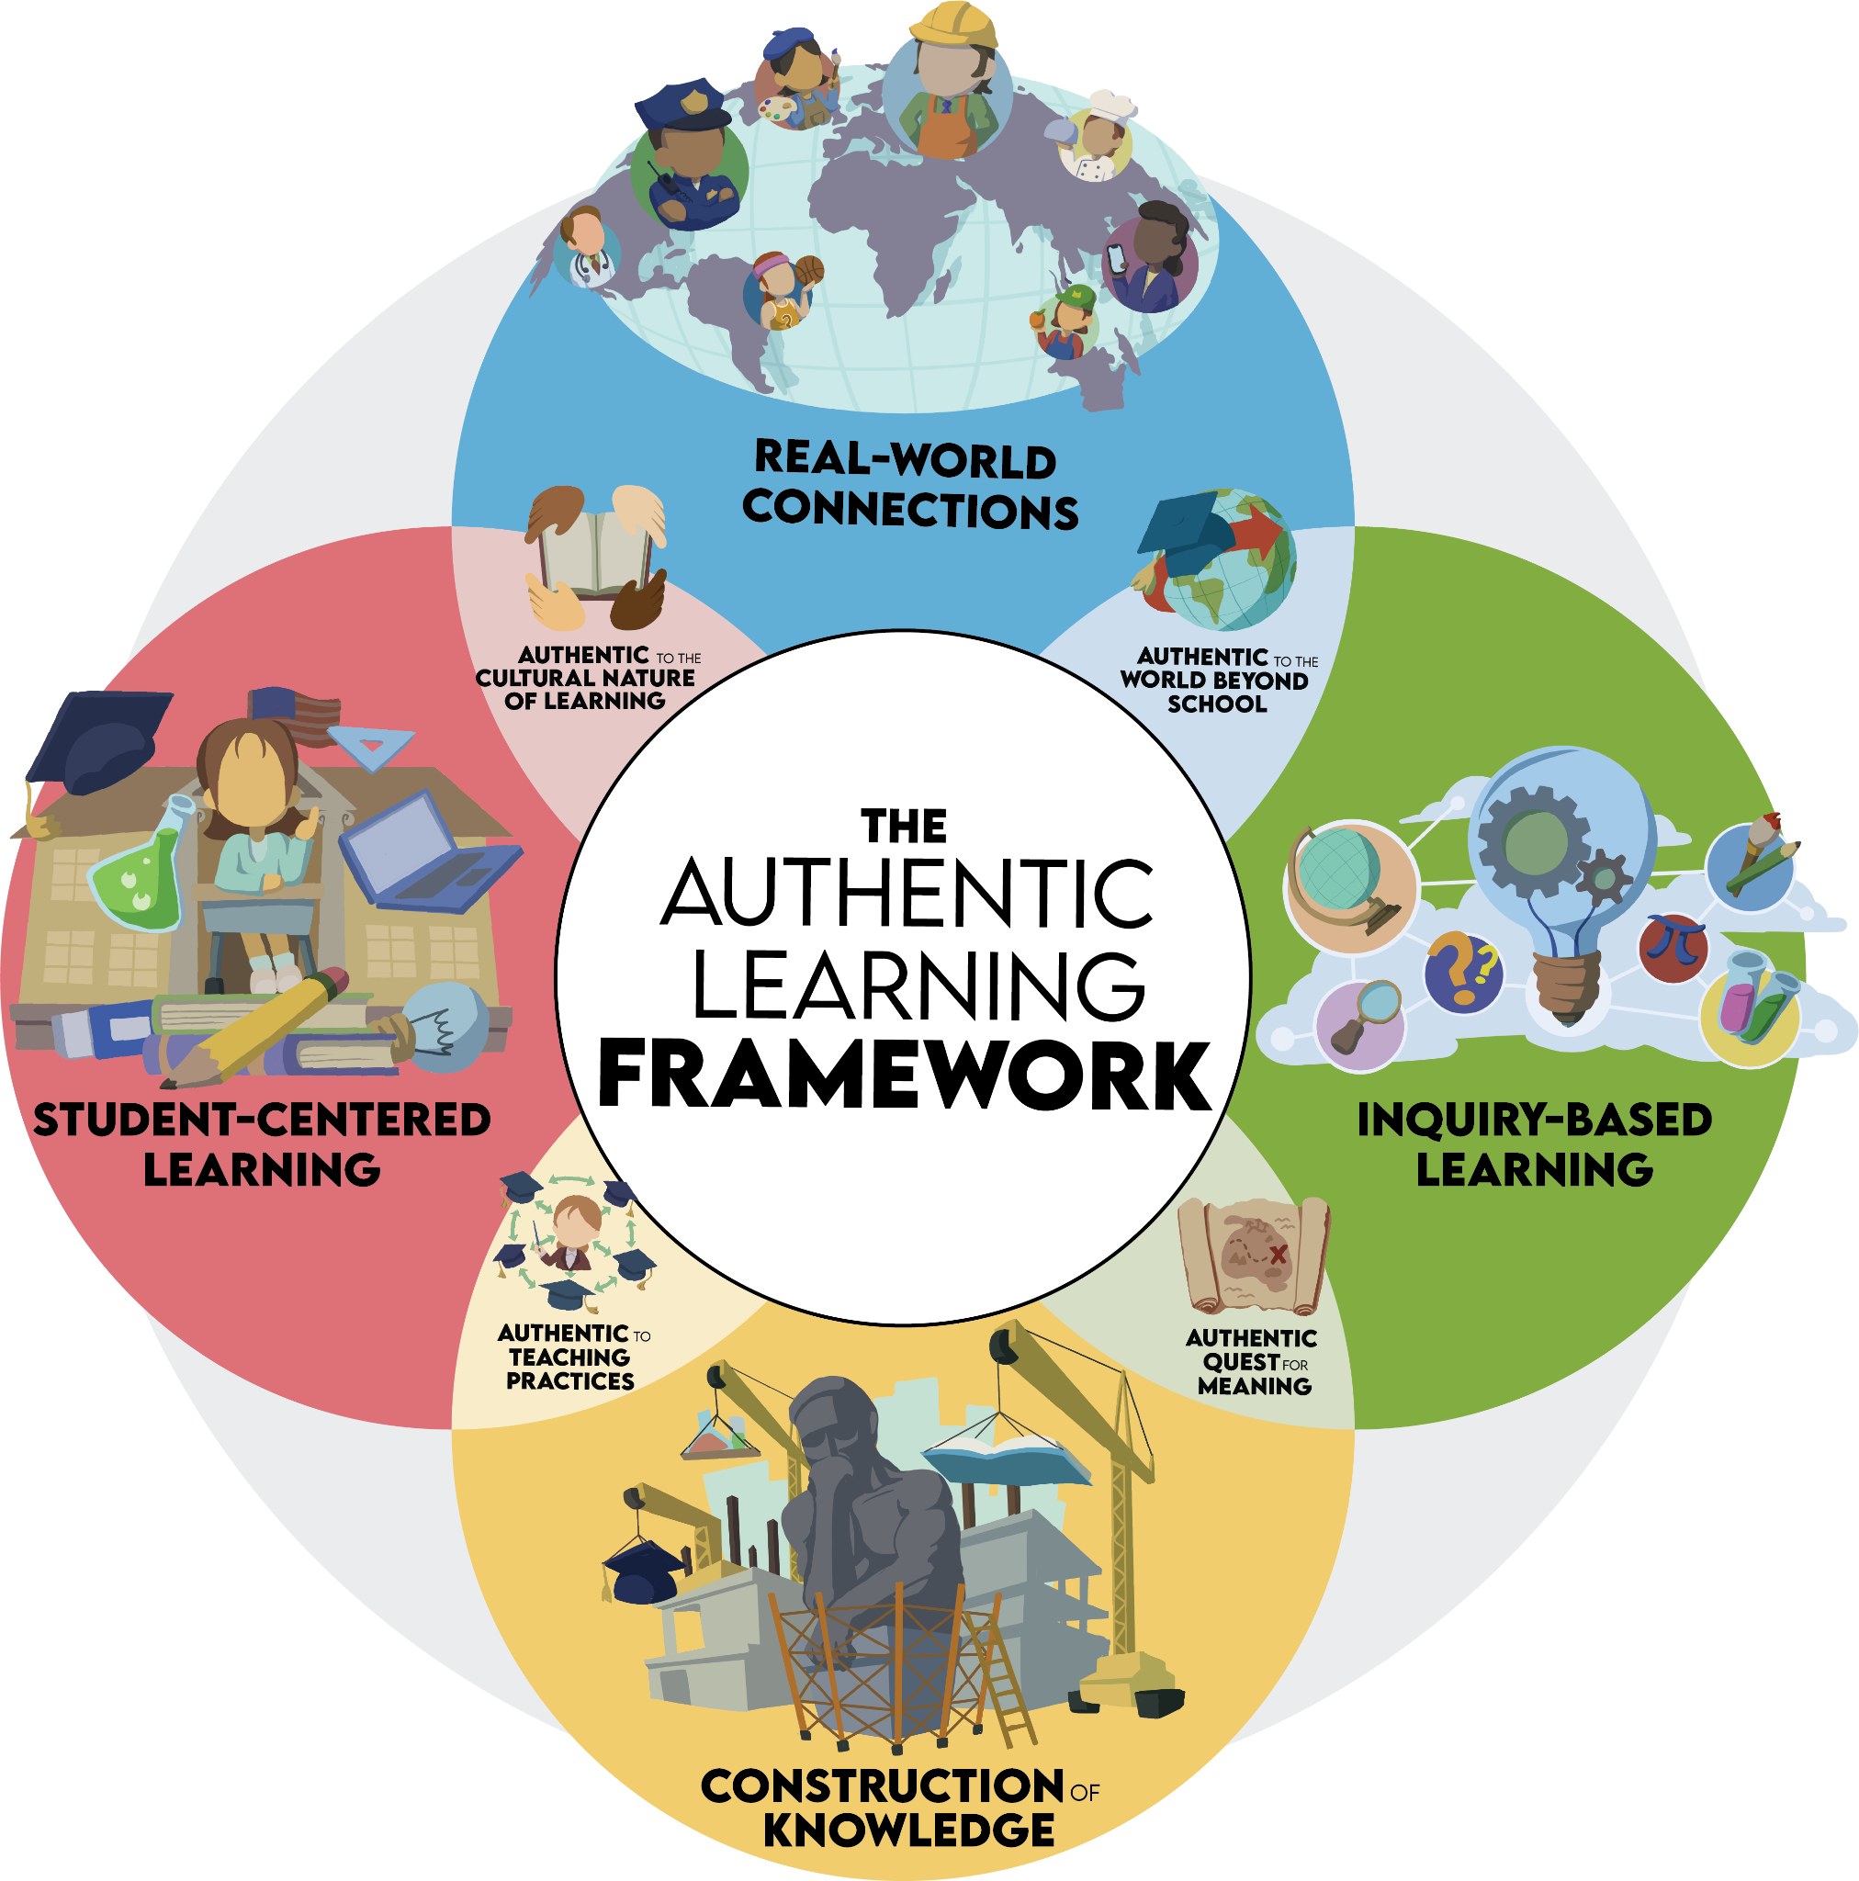
Student-centered Learning
Construction of Knowledge
Inquiry-based Learning
Real-world connections

Slide 8
learn.k20center.ou.edu

Slide 9
Window Notes
Use your handout and explore four different instructional strategies.
Share out your favorite of the four.
Use the space at the bottom to write down any share-outs that catch your interest.
Strategy that starts with your middle initial
Strategy that was published during your birth month
Strategy with a background that’s your favorite color
Strategy that you have never heard of before
Notes:
K20 Center. (n.d.). Timer [Webapp]. https://timer.k20center.ou.edu/

Slide 10
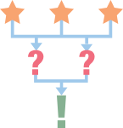
LEARN Lessons
Find a lesson from your content area.
Complete the 3-2-1:
3 things I noticed
2 things I found effective
1 question I have
Notes:
K20 Center. (n.d.). Timer [Webapp]. https://timer.k20center.ou.edu/

Slide 11
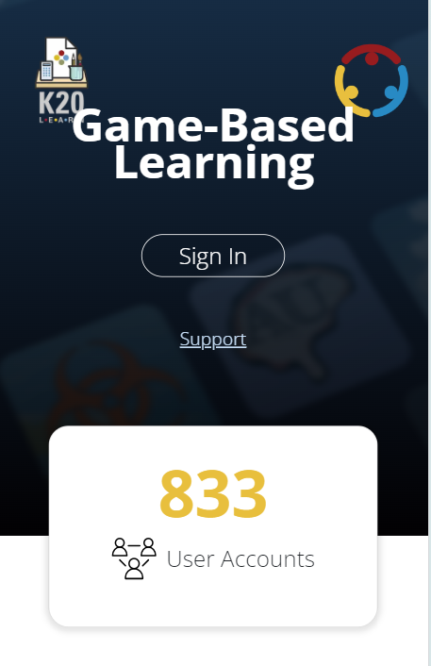
Game-Based Learning
Go to the Games tab on LEARN.
Find a game that fits your content area.
Discuss it with your elbow partner.

Slide 12
Ctrl + T
Go back to the LEARN homepage.
Choose another tab to explore: Educator Resources, Professional Learning, Tech Tools, Family Resources, or Student Resources.
Take 5 minutes to find another resource that would be helpful for your students.
Share out at your table.
Notes:
K20 Center. (n.d.). Timer [Webapp]. https://timer.k20center.ou.edu/

Slide 13
Rose, Bud and Thorn
Rose: What new strategies, lessons or games from this session would you like to try in your class?
Bud: What adjustments or additions could you make to integrate the concepts from the session into your curriculum?
Thorn: What barriers are still in the way of implementing new strategies or lessons?

Slide 14
LEARN Strategy Reflection
Mentimeter
Window Notes
3-2-1
Elbow Partners
Rose, Bud, and Thorn

