Slide 2
Micro-Credentials:
Professional Development, but Fun-Sized

Slide 3

Think, Pair, Share
What barriers prevent you from seeking professional learning opportunities outside of school hours?
Notes:
K20 Center. (n.d.). Think-Pair-Share. Strategies. https://learn.k20center.ou.edu/strategy/139

Slide 4
Essential Question
How can micro-credential courses benefit teachers?

Slide 5
Learning Objectives
Discuss the pluses and deltas of micro-credentialing.
Identify the steps to enroll in, access, and complete a micro-credential course.
Reflect on how micro-credential courses could inform your practice.

Slide 6

Micro-Credentialing Overview
Notes:
K20 Center. (n.d.). What is micro-credentialing? [Video].

Slide 7
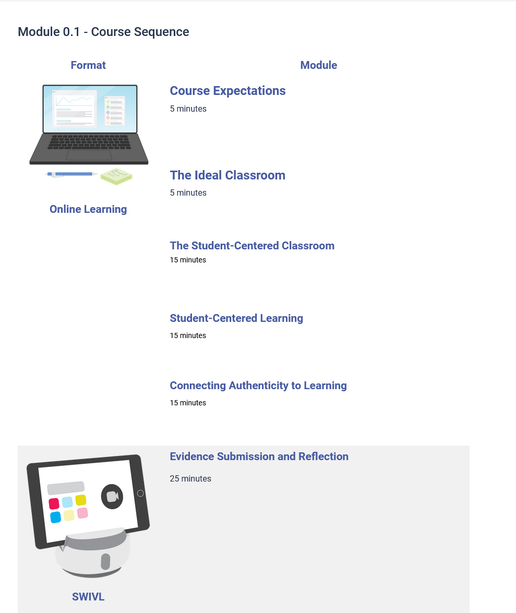
Notes:
K20 Center. (n.d.). Course sequence [Micro-credential course]. In How People Learn. eKadence. https://k20.ekadence.com/faculty-portal/classes/179844/homepage

Slide 8
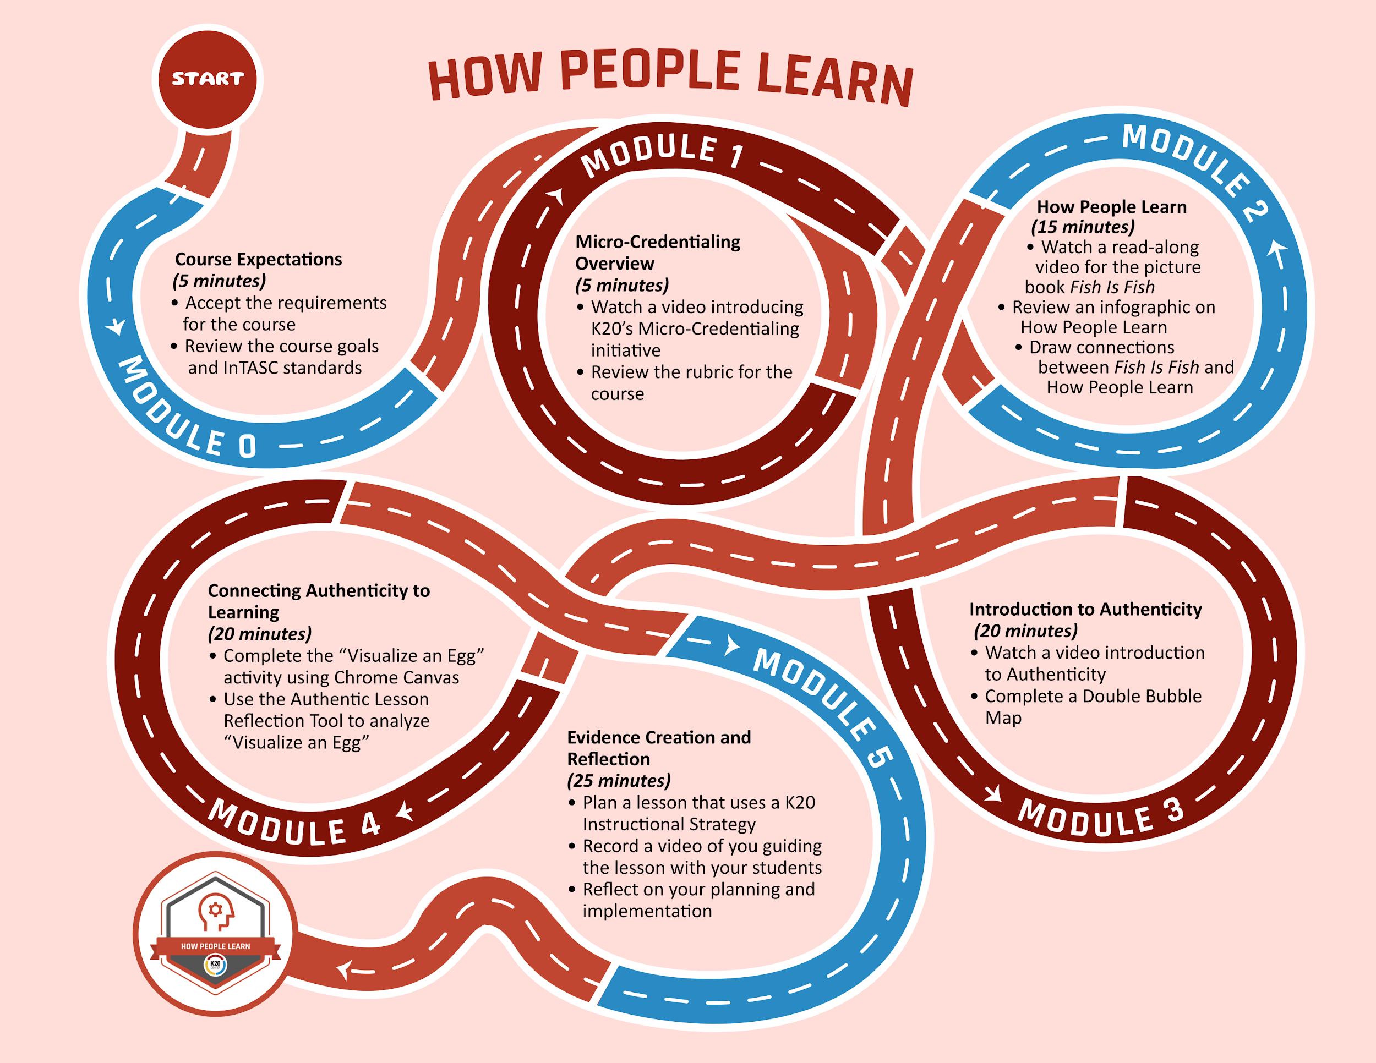
Notes:
K20 Center. (n.d.). Course module map [Micro-credential course]. In How People Learn. eKadence. https://k20.ekadence.com/faculty-portal/classes/179844/homepage

Slide 9


Plus Delta Chart
Write one “plus” of micro-credentialing on one color of sticky note.
Write one “delta” of micro-credentialing on the other color of sticky note.
Notes:
Teacher’s Note: Replace the highlighted text with the colors of sticky notes you chose for this activity prior to the session.
K20 Center. (n.d.). Plus delta chart. Strategies. https://learn.k20center.ou.edu/strategy/2904
K20 Center. (2021, September 21). K20 Center 3 minute timer [Video]. YouTube. https://www.youtube.com/watch?v=iISP02KPau0

Slide 10
Plus Delta Chart
Place each sticky note in the appropriate column on the chart.
Notes:
K20 Center. (n.d.). Plus delta chart. Strategies. https://learn.k20center.ou.edu/strategy/2904

Slide 11
Additional Pluses and Deltas
Pluses
Self-paced
10–30-minute microlearning sessions and projects
$200 stipend
Counts toward PD clock hours
Earn a badge you can add to your resume, CV, or LinkedIn.
Recording accounts and technology are provided by the K20 Center.
Deltas
Does not offer one-on-one time like in-person PD opportunities
Requires self-motivation
Completely asynchronous with little collaboration and discussion (could be a plus for some!)
Requires some level of
comfort with technology
Notes:
K20 Center. (n.d.). Plus delta chart. Strategies. https://learn.k20center.ou.edu/strategy/2904

Slide 12


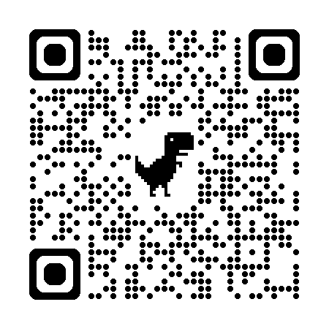
Card Sort
Scan the QR code or access http://k20.ou.edu/microsort
Read each of the 10 steps listed on the 10 cards.
Sort the cards in chronological order (from first to last) of the steps that must be completed to earn a micro-credential badge.
Notes:
K20 Center. (n.d.). Card sort. Strategies. https://learn.k20center.ou.edu/strategy/147
K20 Center. (2021, September 21). K20 Center 5 minute timer [Video]. https://www.youtube.com/watch?v=EVS_yYQoLJg

Slide 13
Re-Sort
With your table partner, compare and discuss your responses.
Re-sort your cards if you believe it is necessary.
Prepare to share the reasoning behind your order and any changes you made to your card sort.
Notes:
K20 Center. (n.d.). Card sort. Strategies. https://learn.k20center.ou.edu/strategy/147

Slide 14
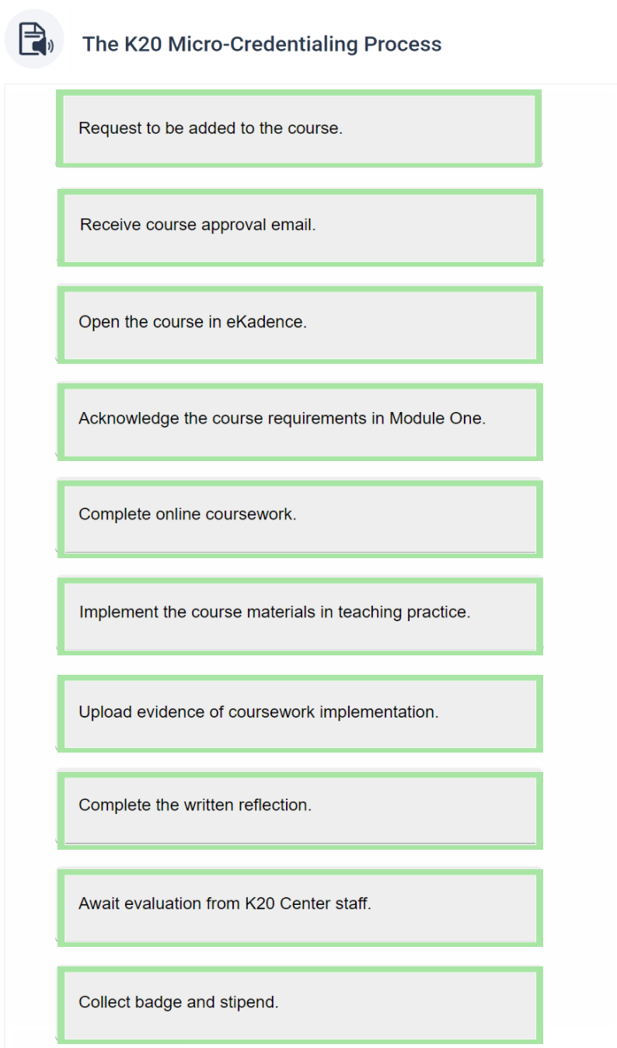
Answers!
Notes:
K20 Center. (n.d.). Card sort. Strategies. https://learn.k20center.ou.edu/strategy/147

Slide 15

Notes:
K20 Center. (2025, August 11). Micro creds testimony [Video]. YouTube. https://www.youtube.com/watch?v=yokb3XMHOqg

Slide 16
Micro-Credential Courses
Review the available micro-credential courses.

Slide 17

Mirror, Microscope, Binoculars
Review the How People Learn Course Flowchart and respond to the following prompts on your handout:
Mirror (internal reflection)
How has my view on micro-credentials changed from before the session?
Microscope (close inspection)
How can I apply my knowledge about micro-credentialing?
Binoculars (global reflection)
How can micro-credentials affect my school environment?
Notes:
K20 Center. (n.d.). Mirror, microscope, binoculars. Strategies. https://learn.k20center.ou.edu/strategy/3020

Slide 18
Mirror, Microscope, Binoculars
Share your responses!
Notes:
K20 Center. (n.d.). Mirror, microscope, binoculars. Strategies. https://learn.k20center.ou.edu/strategy/3020

Slide 19
Course Interest Form
Complete the Micro-Credentialing Course Interest Form to:
  ask a question about micro-credentialing
  express interest in a current course
  suggest a course to be developed

