Slide 2
Welcome!
Subject
School
Name
Favorite Fall Treat
Looking forward to…
Make a Name Tent

Slide 3
Reflecting on Professional Development
Facilitator/s: [type name/s here]

Slide 4
Essential Questions
How can LEARN support teaching and learning practices?
How can teacher leaders effectively use reflection to strengthen professional development and create lasting impact at their school sites?

Slide 5
Session Objective
Determine how PD reflection supports the PD Cycle.

Slide 6
Fold the Line
How many PDs have you facilitated?
No PDs Yet
All the PDs
Notes:
Can be any PDs whether with LEAD or other PDs

Slide 7
Fold the Line
Introduce yourself.
Do you prefer spontaneous trips or planned vacations?
About how many PDs have you facilitated?
Digital or paper planner?
What is your favorite part of leading PD?
What’s your favorite event to go to (movies, concerts, sporting events, etc.)?
How has LEAD helped you grow so far?

Slide 8
Sit with your partner
Experience the Lessons LEARNed PD (Teacher Hat)
Then we will reflect using two different methods
SCORE Reflection: that you can use with your teachers
LEAD Debrief: that you do with us after the PD

Slide 9
Lessons LEARNed

Slide 10
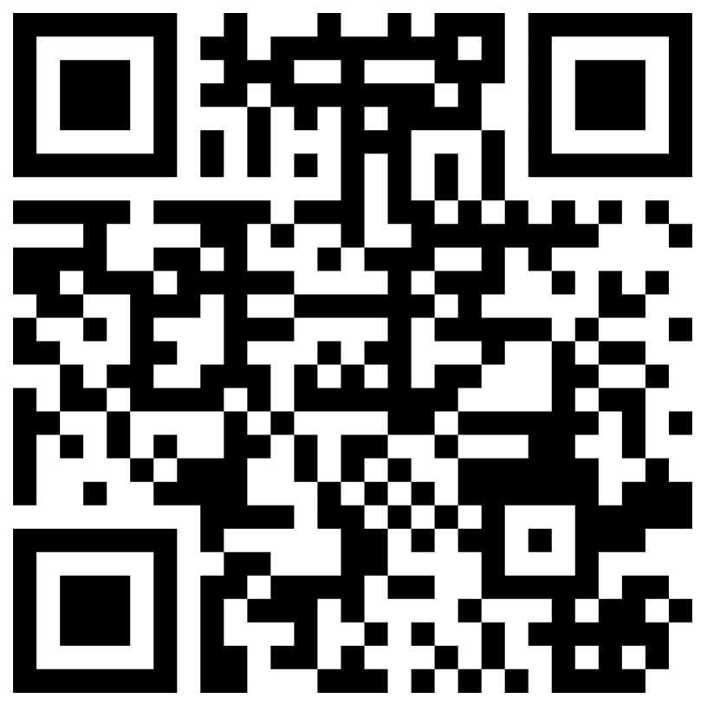
Guess the Acronym
Go to menti.com
Code:9529 3459
What does LEARN stand for?
(wrong answers only)
Notes:
Right answer: Lessons and Engaging Activities Repository Network
LEARN is K20's open-access database of lessons, strategies, activities, and resources for all stakeholders.

Slide 11
Essential Question
How can LEARN support teaching and learning practices?

Slide 12
Session Objective
Identify LEARN resources that can enhance and support current lessons and instructional practices.

Slide 13
Guess the Acronym
Lessons and
Engaging
Activities
Repository
Network
K20's open access database of lessons, strategies, activities and resources for all stakeholders.
What does LEARN stand for?
Notes:
Right answer: Lessons and Engaging Activities Repository Network
LEARN is K20's open-access database of lessons, strategies, activities, and resources for all stakeholders.

Slide 14
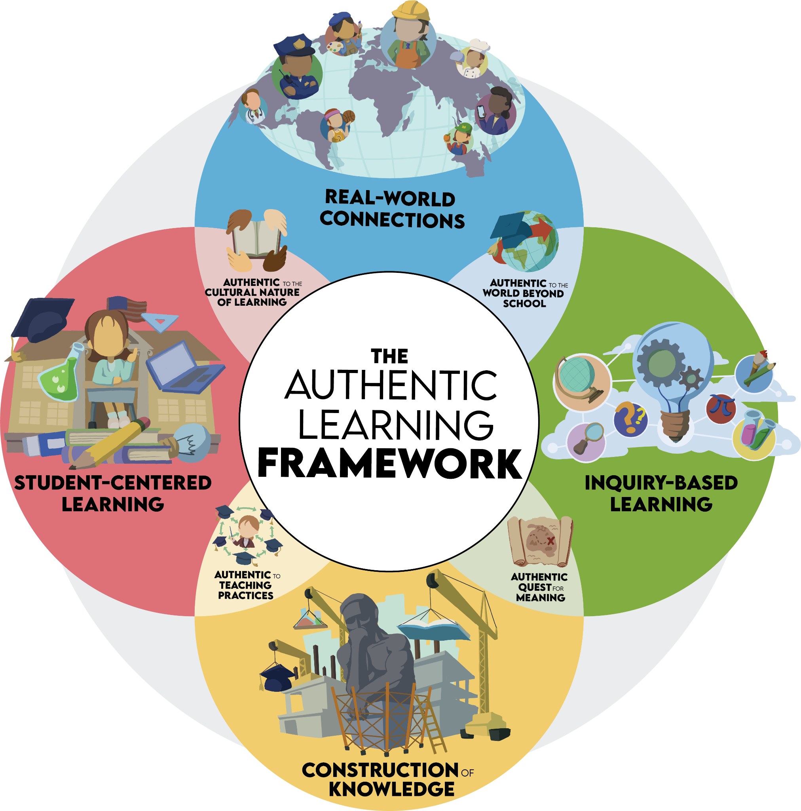
Student-centered Learning
Construction of Knowledge
Inquiry-based Learning
Real-world connections

Slide 15
learn.k20center.ou.edu

Slide 16
Window Notes
Use your handout and explore four different instructional strategies.
Share out your favorite of the four.
Use the space at the bottom to write down any share-outs that catch your interest.
Strategy that starts with your middle initial
Strategy that was published during your birthday month
Strategy with background that’s your favorite color
Strategy that you have never heard of before

Slide 17
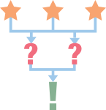
LEARN Lessons
Find a lesson from your content area
Complete the 3-2-1:
3 Things I Noticed
2 Things I Found Effective
1 Question I Have
Notes:
K20 Center. (n.d.). Timer [Webapp]. https://timer.k20center.ou.edu/

Slide 18
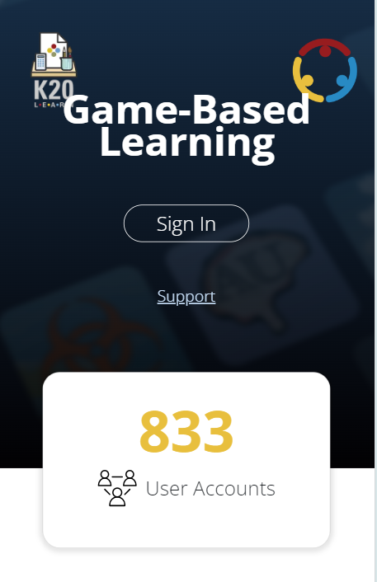
Game-Based Learning
Go to the Games tab on LEARN.
Find a game that fits your content area.
Discuss it with your elbow partner.

Slide 19
Ctrl + T
Go back to the LEARN homepage.
Choose another tab to explore: Educator Resources, Professional Learning, Tech Tools, Family Resources, or Student Resources.
Take 5 minutes to find another resource that would be helpful for your students.
Share out at your table.
Notes:
K20 Center. (n.d.). Timer [Webapp]. https://timer.k20center.ou.edu/

Slide 20
Rose, Bud, and Thorn
Rose: What new strategies, lessons or games from this session would you like to try in your class?
Bud: What adjustments or additions could you make to integrate the concepts from the session into your curriculum?
Thorn: What barriers are still in the way of implementing new strategies or lessons?

Slide 21
LEARN Strategy Reflection
Fold the Line
Window Notes
3-2-1
Rose, Bud, and Thorn

Slide 23
Role Play—SCORE Reflection
Partner with less PD experience goes first:
Strategy
Celebration
Obstacles
Refinements
Extra Notes
Switch partners
Notes:
K20 Center. (n.d.). Timer [Webapp]. https://timer.k20center.ou.edu/

Slide 24
I Notice, I Wonder
What did you notice and wonder about connections between the PD SCORE Reflection tool and the PD Cycle?

Slide 25
Group Debrief
Find and join another pair.
We will use the LEAD PD Cycle Debrief questions to reflect on the PD.
Notes:
K20 Center. (n.d.). Timer [Webapp]. https://timer.k20center.ou.edu/

Slide 26
T-Chart
In your groups, discuss how each type of reflection supports the PD Cycle.
SCORE Reflection
LEAD PD Cycle Debrief
Notes:
K20 Center. (n.d.). Timer [Webapp]. https://timer.k20center.ou.edu/

Slide 27
Supporting Continued Development
You are a support structure for growth.
You can follow up with teachers to help foster continual learning.
Remember to invite teachers to watch “new” strategies or technology you are using with your students.

Slide 28
Mirror, Microscope, Binoculars
Mirror What does PD currently look like at your school?
Microscope What specifically is going well with PD at your school?
Binoculars How can you influence or improve PD at your school?

Slide 29
LEARN Strategy Reflection
SCORE Reflection
I Notice, I Wonder
T-Chart
Mirror, Microscope, Binoculars

