Slide 2
Prework: Instructional Focus Strategy Harvest
Create an account on learn.k20center.ou.edu using your Google/school email.
Identify Instructional Strategies on LEARN that align with your instructional focus.
Link to Newer Strategy List: bit.ly/m/LEAD2025
Favorite these strategies.

Slide 3
Supporting School Improvement
[Type facilitator/s name/s here]

Slide 4
How have you grown this year?
[place QR code here]
Or go to
Menti.com
Code:
#### ####
Notes:
Be sure to place the QR code and access code numbers for the Menti you created on to this slide before the session.

Slide 5
Exquisite Facilitator/Participant
Use the provided poster to illustrate what each one looks like, sounds like, etc.
Use words and/or illustrations.
Notes:
30 minutes - As we go through today, think about your role as both facilitator and participant.
Session Engage
Draw half the image of someone you believe is an exquisite facilitator, and on the opposite side, draw someone who you believe is an exquisite PD participant. Or draw the qualities that make them exquisite.
Give the audience around 15 minutes before you table share, then whole-group share. Remind them that they have 15 minutes to color, so they should use it all and not finish in two minutes.

Slide 6
Essential Question
How can we, as professional learning facilitators, authentically support school improvement through effective instructional strategies?

Slide 7
Learning Objectives
Identify the ideal qualities of a professional learning facilitator and participant.
Connect modeled and selected strategies to authentic practices.
Create a plan for implementation and support of newly learned strategies.

Slide 8
L.E.A.R.N.
STRATEGY CAFE

Slide 9
OBJECTIVES
Explore lesser-known LEARN instructional strategies used to engage, formatively assess, and give closure.
Evaluate how to use instructional strategies in different contexts
Plan how to use strategies in your role.

Slide 10
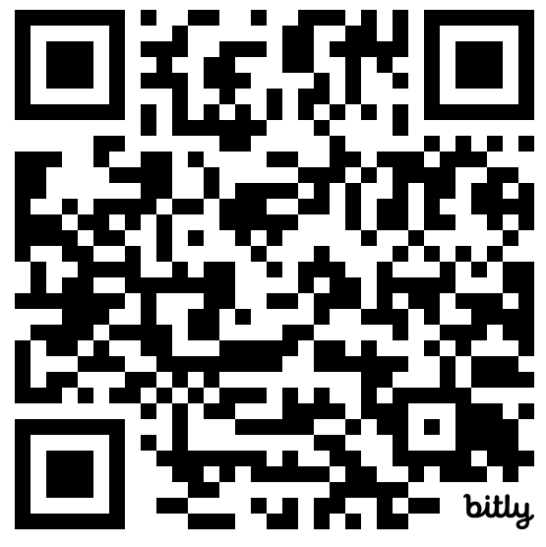
Use the printed menu or click on Strategy Menu at this link.
bit.ly/m/LEAD2025

Slide 11
STICKY BARS
Place a sticky on the strategy you’d like to order during each course of our meal.
Notes:
10 min

Slide 12
STICKY BARS MENU
Appetizers
Commit & Toss
Paper Telephone
Take a Chance
Main Course
Detective Board
Thinking Hats
Picture Yourself
Desserts
Aha! Huh? Uh-uh.
Give, Get, Reflect
List of 8
Notes:
Update according to participants’ sticky bar votes. (Delete the strategies that were not picked.)

Slide 13
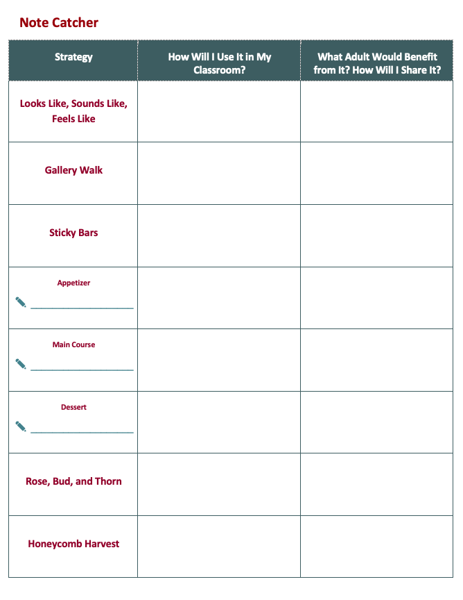
NOTE
CATCHER

Slide 14
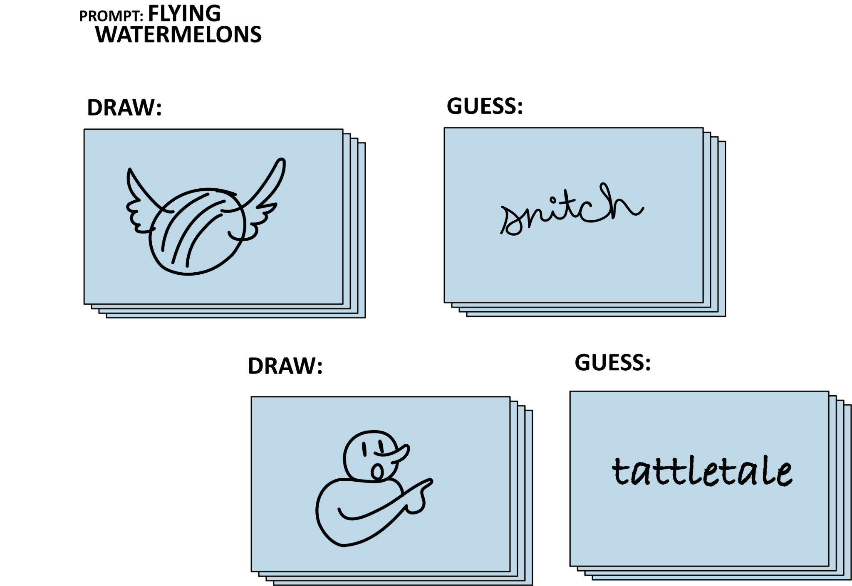
APPETIZERS
COMMIT & TOSS
PAPER TELEPHONE
TAKE A CHANCE

Slide 15
COMMIT & TOSS
Learners are presented a prompt, then write their response on a paper, crumple it, and toss it across the room. Another learner will pick it up and read it.

Slide 16
COMMIT & TOSS
On a sticky note, write down your answer to this question:
What is freedom?

Slide 17
PAPER
TELEPHONE
It’s like the whispering game and pictionary made a baby.

Slide 18
TAKE A CHANCE
This strategy is used to help participants synthesize their thoughts.
Participants roll a die to determine how many words to use in order to answer a question.

Slide 19
TAKE A CHANCE
Procedures:
Divide into groups of 3.
Your group will have two dice or one double die.
Read the question provided together as a group and think about it individually.
When it is your turn, roll the die, add the numbers, and say the sum. The number represents the total number of words you can use to answer the question.
Continue until all members of the group have answered the question.

Slide 20
TAKE A CHANCE
1st Question : If you could teach a class on any subject, what would it be, and why are you passionate about it?
2nd Question: If you could snatch one prop from any movie set, which prop would you choose and why?

Slide 21
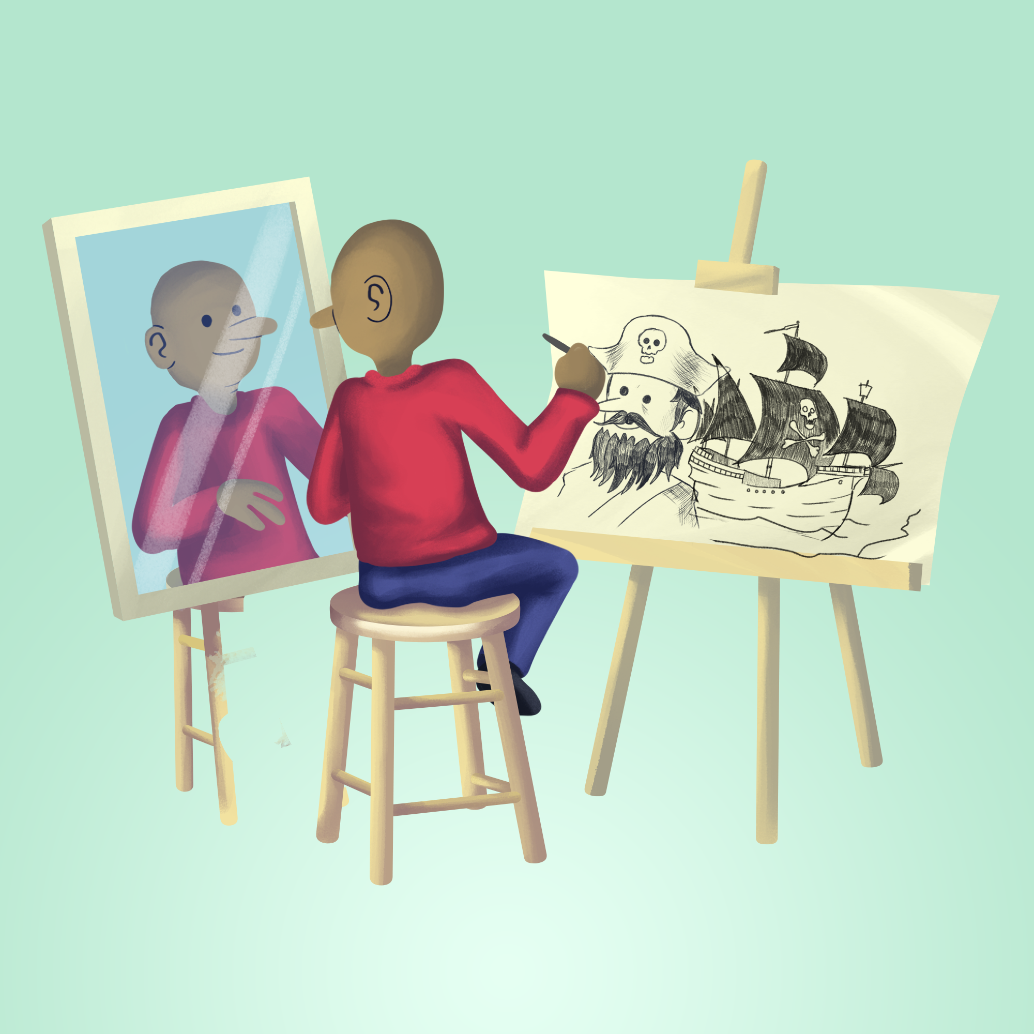
MAIN COURSES
DETECTIVE BOARD
THINKING
HATS
PICTURE YOURSELF
Notes:
20 min

Slide 22
DETECTIVE BOARD
A tangled, three-dimensional visualization of connections across multiple topics.

Slide 23
DETECTIVE BOARD: Part 1
Create Posters
To create groups, everyone count off, 1–5.
Start at the poster with your group number.
Make a poster of how, as a presenter, you make your E engaging
List strategies, characteristics of facilitation,
Components of Authenticity, etc.
Notes:
10 minutes
https://timer.k20center.ou.edu/

Slide 24
DETECTIVE BOARD: Part 2
Connections
Starting with group 1, share one item on the chart paper.
If that is on another poster, string will be provided to connect the two.
The next group shares a different item and connections made.
This continues as time allows.
Notes:
https://timer.k20center.ou.edu/

Slide 25
THINKING HATS
Get in groups of 6 and assign one of these colors to each member: White, Green, Yellow, Red, Black, Blue
Notes:
Everyone in a group of six, pick colors first.
Each group has a partner group.

Slide 26
THINKING HATS
TAKE A FEW MOMENTS TO PUT ON YOUR HATS
The detective (white hat) - values facts
The creative (green hat) - no-bad-ideas attitude
The optimistic (yellow hat) - champions others’ ideas
The thoughtful (red hat) - considers feelings
The cautious (black hat) - identifies risks
The conductor (blue hat) - summarizes ideas.
Notes:
Have groups set up fishbowl style. One group will discuss using these roles and another group will observe and take notes. First group watches while the other group observes, then swap.

Slide 27
THINKING HATS
PROMPT #1
DISCUSS WHAT YOU LEARNED ABOUT PROFESSIONAL DEVELOPMENT AND SUPPORTING YOUR SCHOOL THROUGH THIS PROGRAM.
Notes:
Have groups set up fishbowl style. One group will discuss using these roles and another group will observe and take notes.
2–5 minutes
https://timer.k20center.ou.edu/

Slide 28
THINKING HATS
DEBRIEF
What did you notice?
Notes:
The observation group will share what they noticed about the conversation. Did every hat have a chance to speak? Could they easily tell who was wearing which hat?

Slide 29
THINKING HATS
PROMPT #2
BRAINSTORM ISSUES STUDENTS MIGHT WANT TO ADDRESS WITH A SCHOOL ADMINISTRATOR.
WRITE A MOCK PROPOSAL.
Notes:
Groups will swap roles for the second conversation.
2–5 minutes
https://timer.k20center.ou.edu/

Slide 30
THINKING HATS
DEBRIEF
How did the group organize their conversation?
How did having roles enrich the process?
Notes:
The observation group will share what they noticed about the conversation.
How did the group arrive at a their decision?
What process did they use in order to gather information, expertise, what reasoning?
How did having the roles enrich the decision making process?

Slide 31
PICTURE
YOURSELF
Team up with someone who is from a different role/school/background.

Slide 32
PICTURE YOURSELF
Gather a piece of paper and art supplies.
Draw a picture of yourself as an early-career teacher experiencing a K20 PD for the first time.
You and your partner discuss your drawings with each other, and how you could support that teacher.
Revise your drawing based on the discussion.

Slide 33
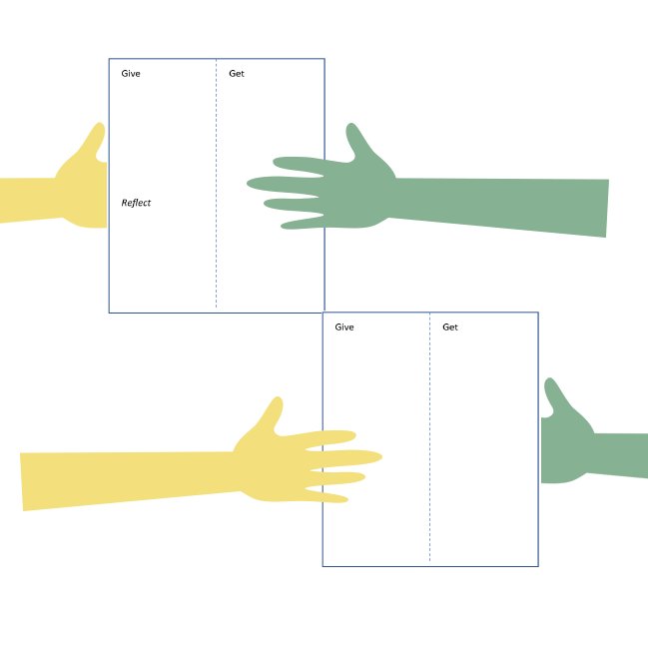
DESSERTS
AHA! HUH? UH-UH.
GIVE, GET, REFLECT
LIST OF 8
Notes:
10 mins each

Slide 34
AHA! HUH? UH-UH.
Reflect on the Authenticity Reading.

Slide 35
AHA! HUH? UH-UH.
Read your component of the Authenticity Reading (printed or found at bit.ly/m/LEAD2025).
Using sticky notes, jot down your thoughts in each category:
Aha! → Moments of insight or clarity
Huh? → What was confusing or unclear
Uh-uh. → Ideas that don’t sit well with you
Notes:
5–10 minutes to read and write reflections, 5–10 minutes to discuss.
https://timer.k20center.ou.edu/

Slide 36
GIVE, GET, REFLECT
Share ideas, discuss with peers, and reflect on new perspectives.

Slide 37
GIVE, GET, REFLECT
Read your component of the Authenticity Reading (printed or found at bit.ly/m/LEAD2025)
Under the “Give” section of your notes, highlight key ideas to share about the component.
Notes:
If the “main dish” selection is “Detective Board”: use this slide

Slide 38
GIVE, GET, REFLECT
Pair up with someone who has a different component.
Share your “Gives” with each other.
As you share, record your takeaways from the other component under “Get.”
Switch partners and repeat until you have all 4 components between your “Gives” and “Gets.”
Notes:
If the “main dish” selection is “Thinking Hats”, use this slide

Slide 39
GIVE, GET, REFLECT
Now use the space at the bottom of the page to reflect on your partners’ answers:
How can I support my colleagues with the development of authentic teaching and learning practices?
Share out 1 idea from your reflection with your table.
Notes:
If the “main dish” selection is “Picture Yourself”: use this slide

Slide 40
LIST OF 8
Collaborate with a team to answer prompts quickly and accurately; show what you know!

Slide 41
LIST OF 8
Game rules:
Each team member responds in turn to a prompt.
Teams compete in timed rounds where every player must either give an answer to the prompt or pass.
First team with 8 answers wins the round.
Notes:
If any teams have a hard time getting to 8, let the other teams fill them in before moving to the next prompt.
In class you could also keep score:
Teams receive penalty points after each round for incorrect answers, incomplete responses, or for not answering in participant order.
The lowest score wins!

Slide 42
LIST OF 8
Name 8 strategies you use in your classroom.
Remember to answer sequentially in your group; pass if you can’t think of an answer.

Slide 43
LIST OF 8
List 8 Characteristics of Leadership.

Slide 44
LIST OF 8
List 8 body systems.

Slide 45
Rose, Bud, and Thorn
Rose: What strategies are you already using that work great?
Bud: What new strategies would you like to try?
Thorn: What barriers are still in the way of implementing new strategies?

Slide 46
Notes:
10 minutes

Slide 47
Clue HS Scenarios
Identify one instructional strategy that would help for each scenario.
Write a rationale for each.
Notes:
Image created using Copilot.
Prompt: “Make a vintage sepia style image for the characters from the Clue board game for the following prompt" (add scenario prompt)
Microsoft. (2025). Copilot (GPT-4) [Large language model]. https://copilot.microsoft.com

Slide 48
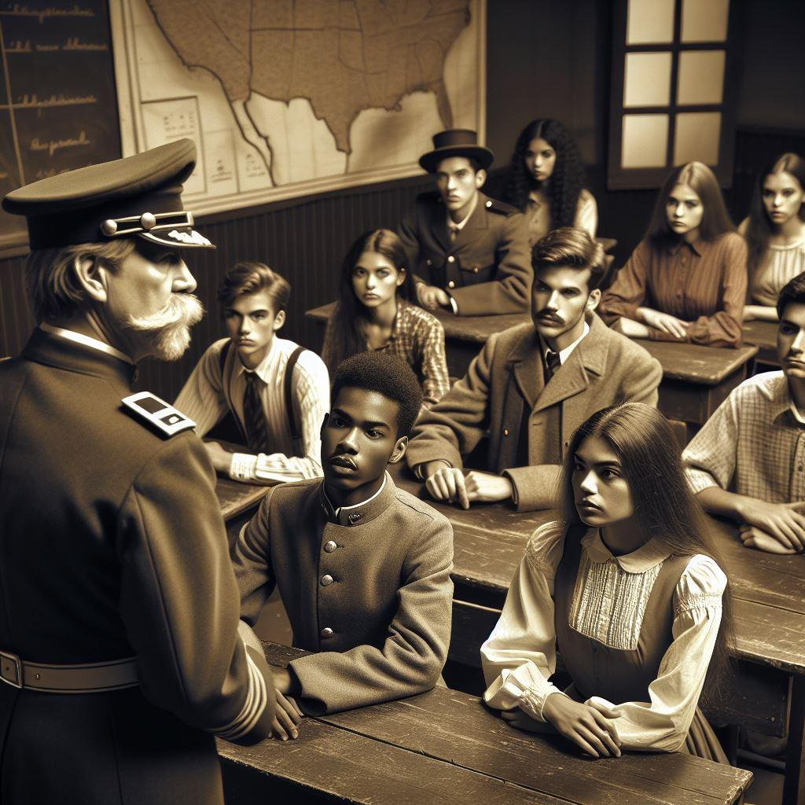
1) Colonel Mustard with the lecture
In Colonel Mustard's history class, he notices students becoming restless during a long lecture on the Civil War.

Slide 49
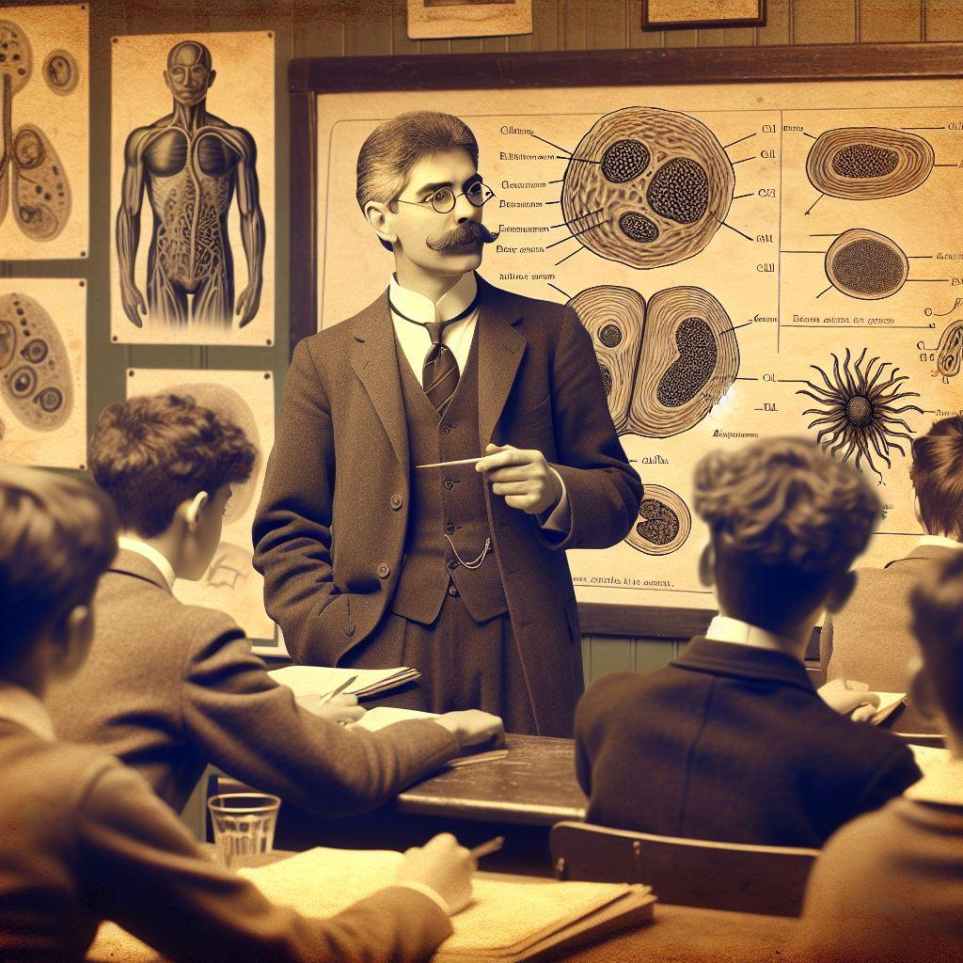
2) Professor Plum in the science class
Professor Plum just wrapped up a lesson on the parts of a cell in his science class. He's unsure if all students understood the content.

Slide 50
3) Miss Scarlet with the lesson objectives
Miss Scarlet wants to end her math lesson in a way that reinforces the day’s learning objectives and prepares students for the next lesson

Slide 51
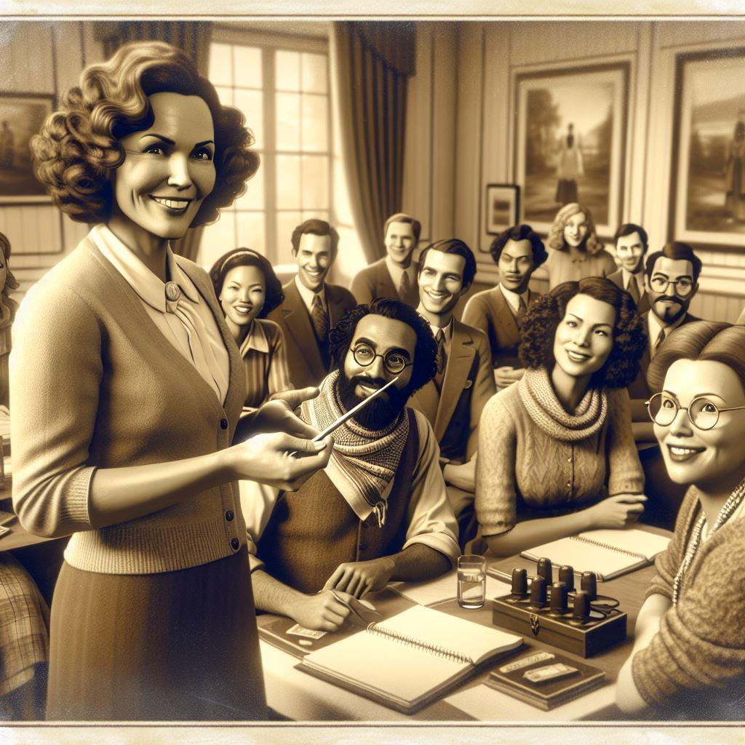
4) Ms. White with the AI PD
Ms. White is leading a PD on innovative teaching and a new AI tool, and wants to make the session interactive and engaging for participants.

Slide 52
5) Mrs. Peacock with the District Initiative
Mrs. Peacock is facilitating a department meeting to discuss a new district-wide initiative. She wants to ensure all voices are heard and the meeting is efficient.

Slide 53
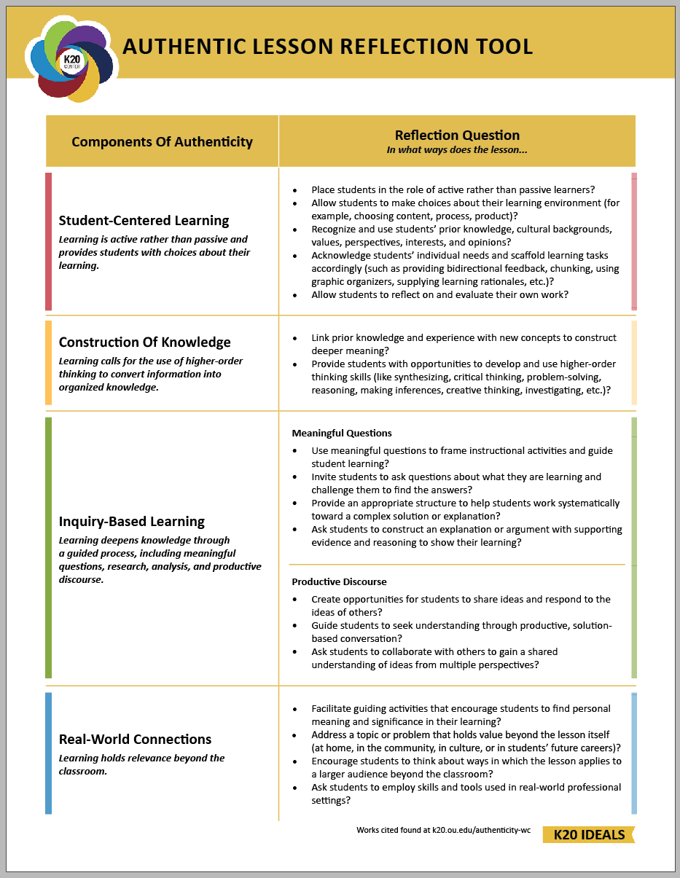
Authenticity and Honeycomb Harvest
Authenticity Job Aides are printed or found on bit.ly/m/LEAD2025

Slide 54
Note Catcher
Looks Like, Sounds Like, Feels Like
Gallery Walk
Sticky Bars
Appetizer
Main Course
Dessert
Rose, Bud, and Thorn
Honeycomb Harvest

Slide 55
Notes:
change

Slide 56
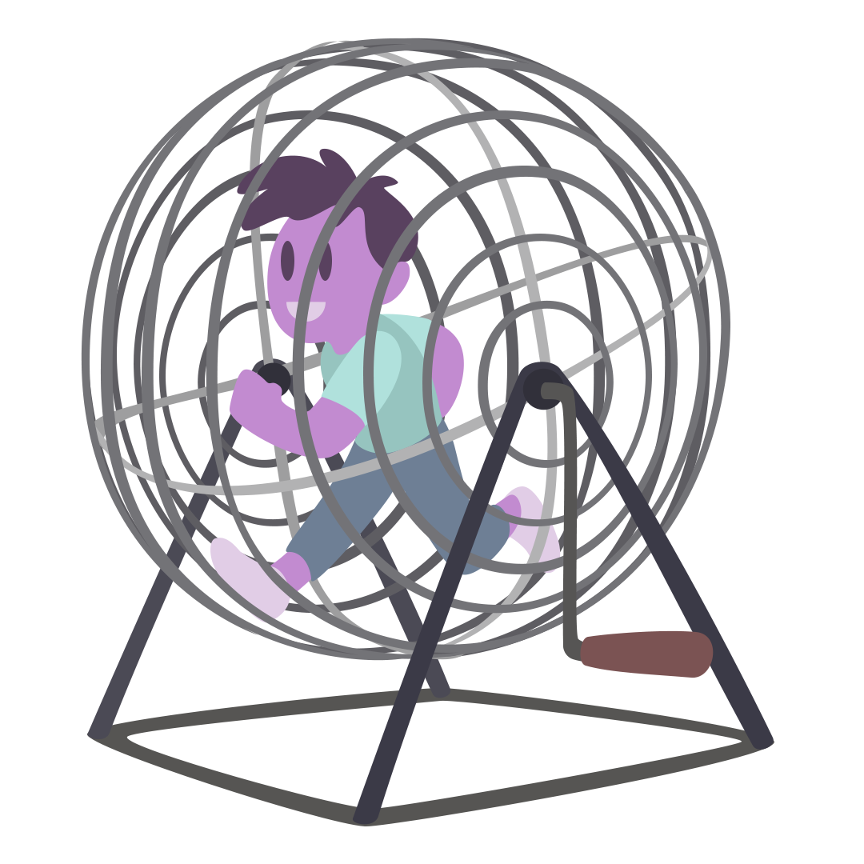
Human BINGO
Move around the room and find a person who has or can do something written in one of the squares.
Have each person write their first name legibly in the BINGO square they claim.
You can only have someone write their name ONE TIME on your BINGO card.
Be prepared to share out for each square you sign.

Slide 57
Move to your instructional focus
In your group share why you selected this focus.
Fostering Student Engagement
Supporting Teacher/Student Relationships
Creating Data-Driven Instruction/Formative Assessments
Supporting Intentional Student Conversations

Slide 58
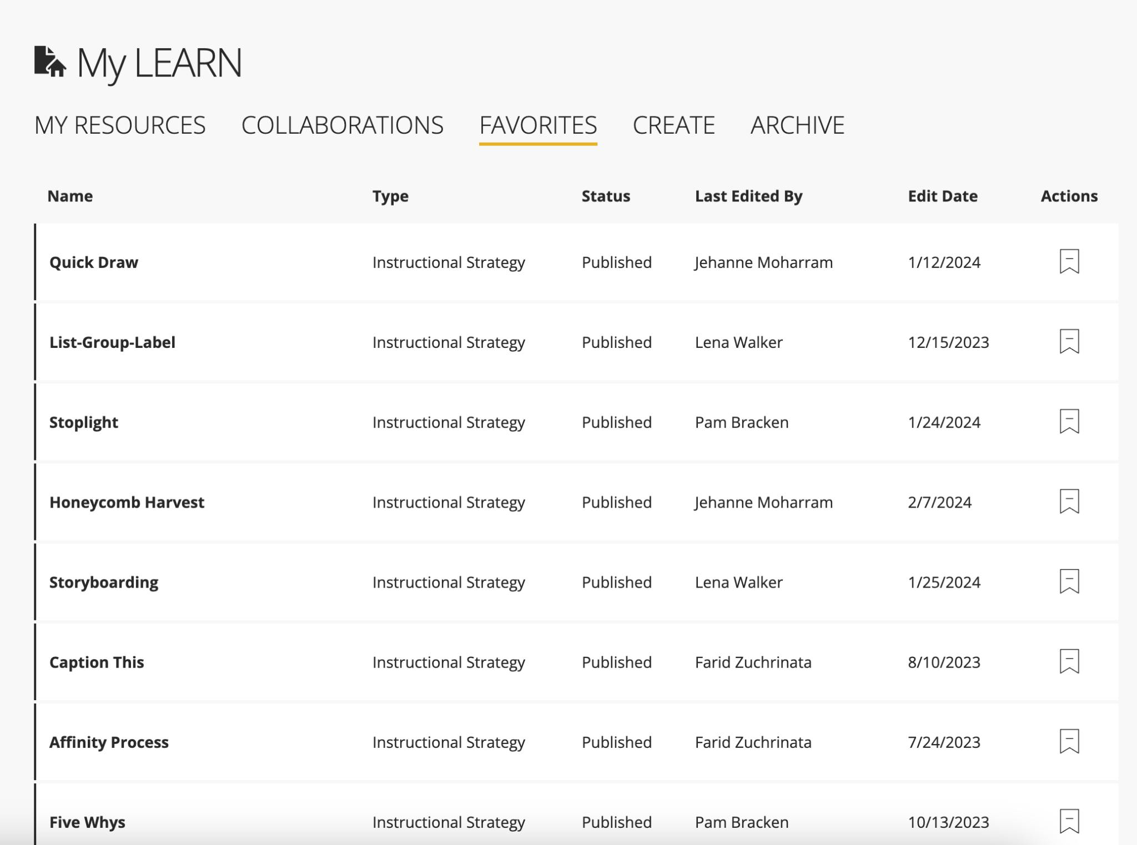
Find your Favorites on learn.k20center.ou.edu
Notes:
They will need to be signed in first.

Slide 59
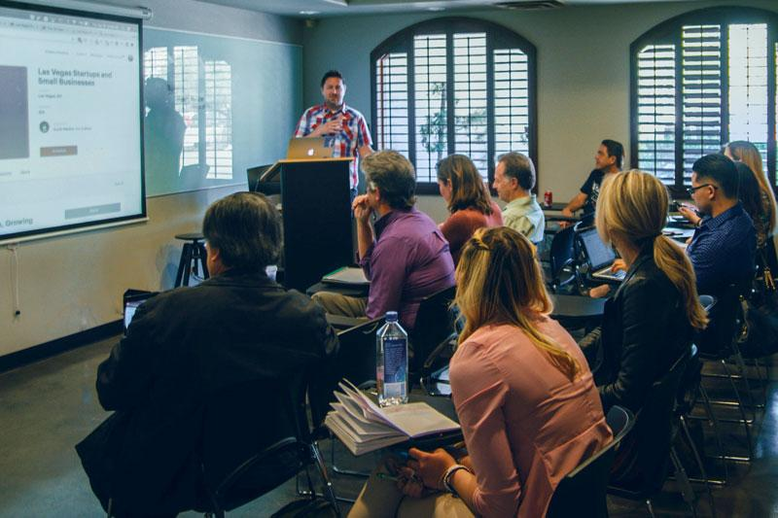
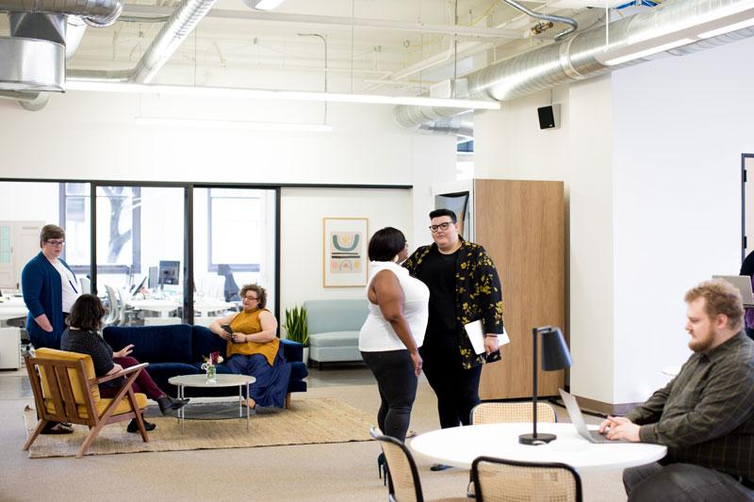
Work Time: Plan and Develop
Select one of the instructional strategies.
Develop a short instructional activity that models this strategy. Think of what you could take back to your site and share with colleagues.
Add your model to the Strategy Café Slides.

Slide 60
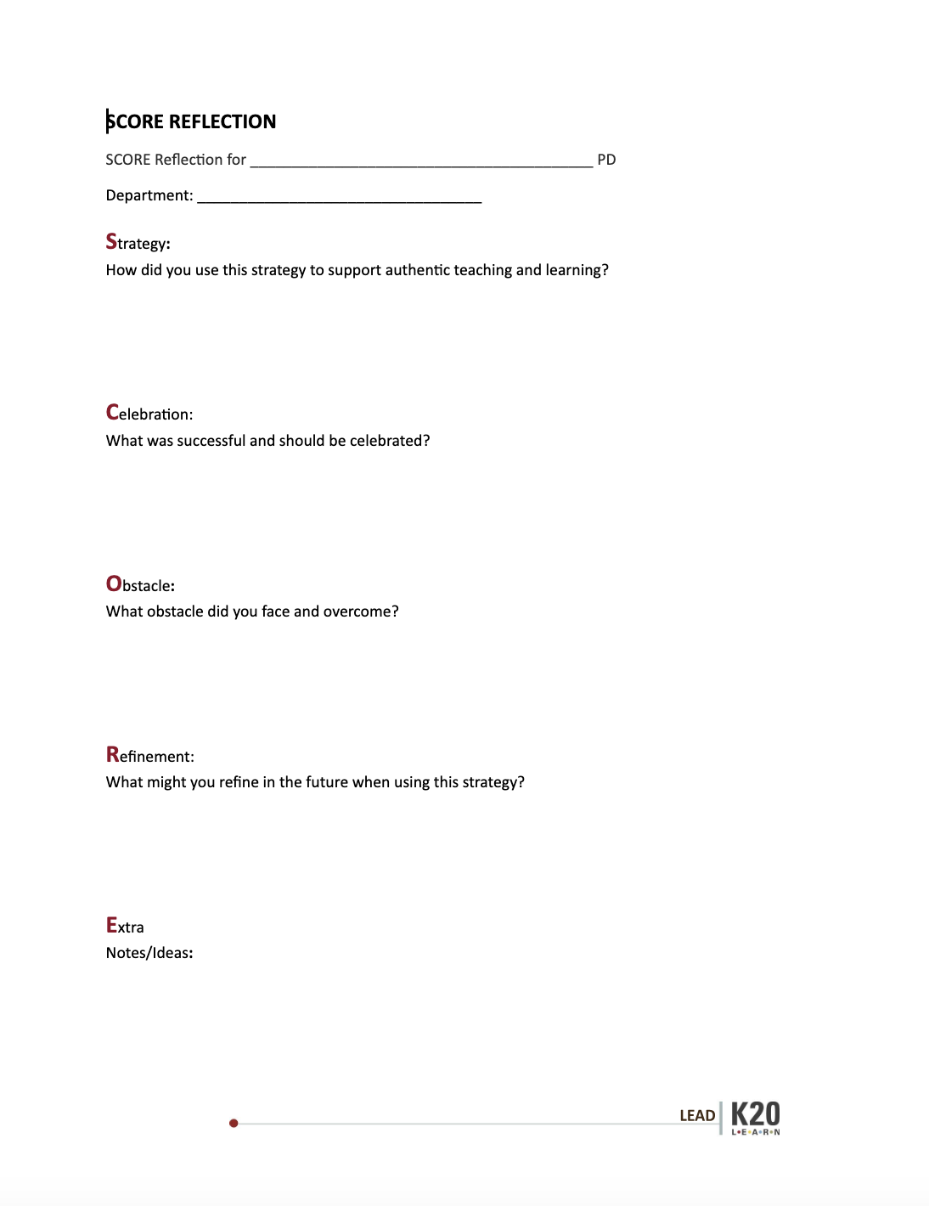
Facilitate Strategies
In small groups:
Facilitate your strategy.
Have a reflective conversation using the SCORE sheet.
bit.ly/m/LEAD2025
Notes:
30 mins for each small group
10 mins per person in each group (8 mins to facilitate and 2 mins for star and wish)

Slide 61
Pick 3 strategies from the Strategy Café Slides to add to your note catcher
(beside 1.,2., 3.)
bit.ly/m/LEAD2025

Slide 62
Whole-group debrief
What strategy did you use to support your targeted instructional focus?
What went well during the supported practice?
What would you do differently?
How will you plan to share this with your colleagues (PLC, 1:1, whole-staff PD, etc.)?
Notes:
20 mins

Slide 64
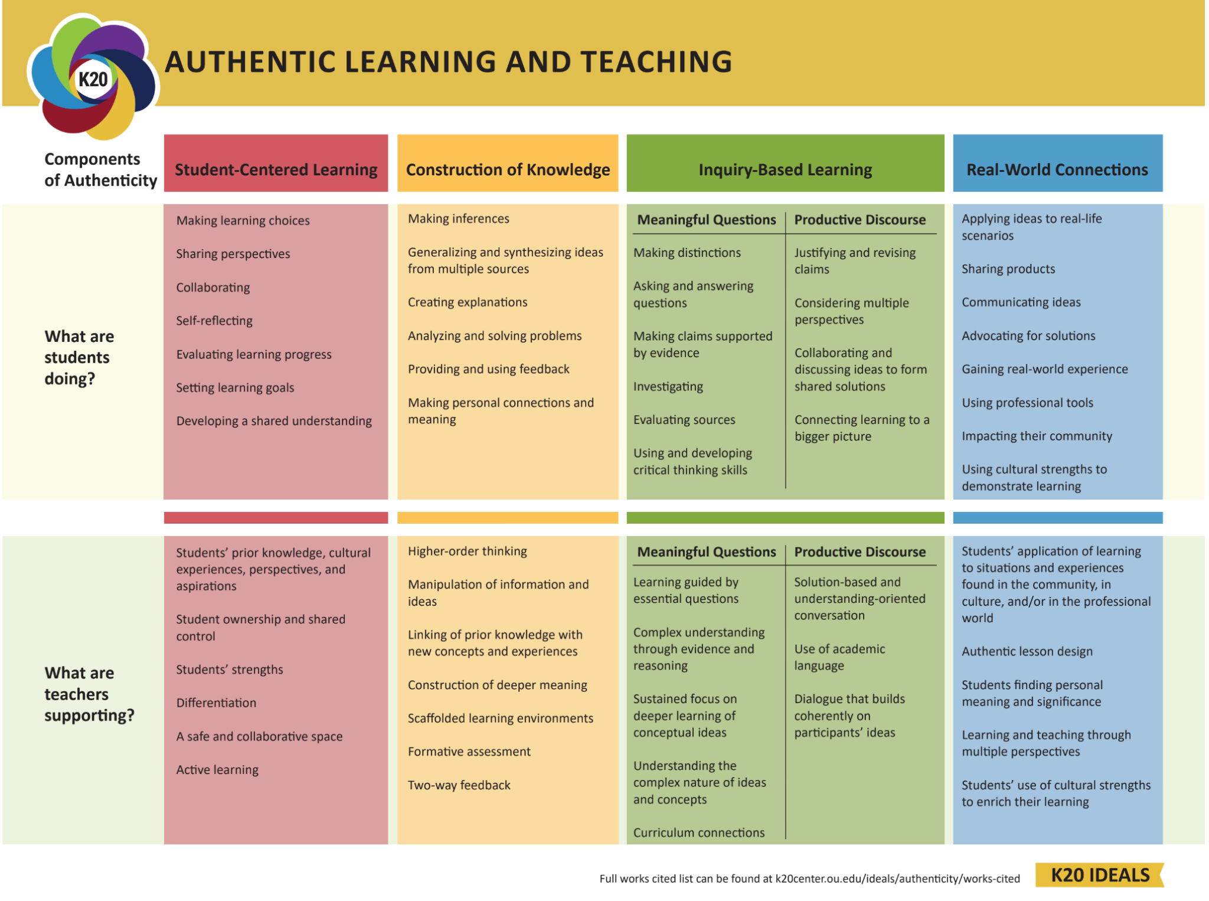
Notes:
Think of everything we’ve done today. How have we done these things? Surprise: PDs are also authentic.

Slide 65
Quick Write
Reflect on your experience today and with LEAD.
How can you continue to support any of the following items at your site going forward?
College Readiness
Career Readiness
Authentic Teaching
Student Engagement

Slide 66
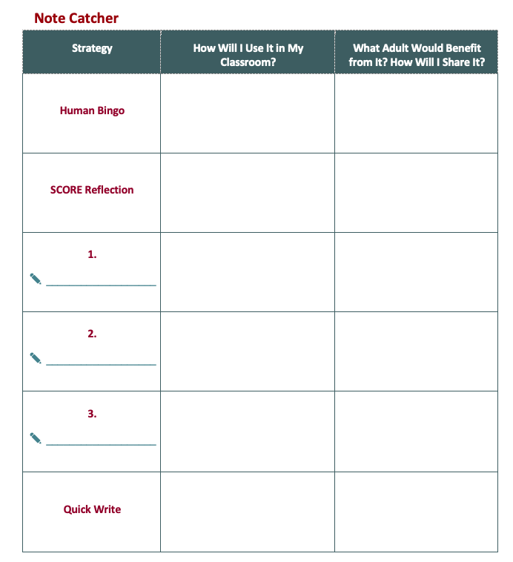
Note Catcher
Human Bingo
SCORE Reflection
Strategy Café Slides
Quick Write

Slide 67
Next Steps
Continue to work with teachers and share details with us.
LEAD SWOT meeting: coming soon.
Consider how you are going to continue to support GEAR UP.
Notes:
Image:
Pellicciotto, J. (n.d.) Journey. The Noun Project. (CC BY 3.0) https://thenounproject.com/browse/icons/term/journey

