Slide 2
Embracing Genius and Joy
Unveiling the HILL Model for Culturally Responsive Pedagogy

Slide 3
Culturally relevant teaching honors the students’ sense of humanity and dignity. Their complete personhood is never doubted. Self-worth and self-concept is promoted in a very basic way, by acknowledging the individual’s worthiness to be part of a supportive and loving group.
-Dr. Gloria Ladson-Billings
Notes:
K20 Center. (n.d.). Chain notes. Strategies. https://learn.k20center.ou.edu/strategy/52

Slide 4
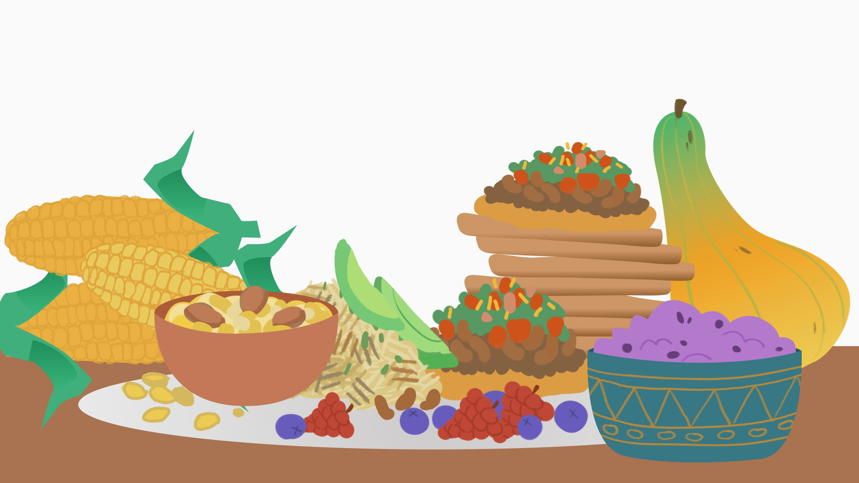
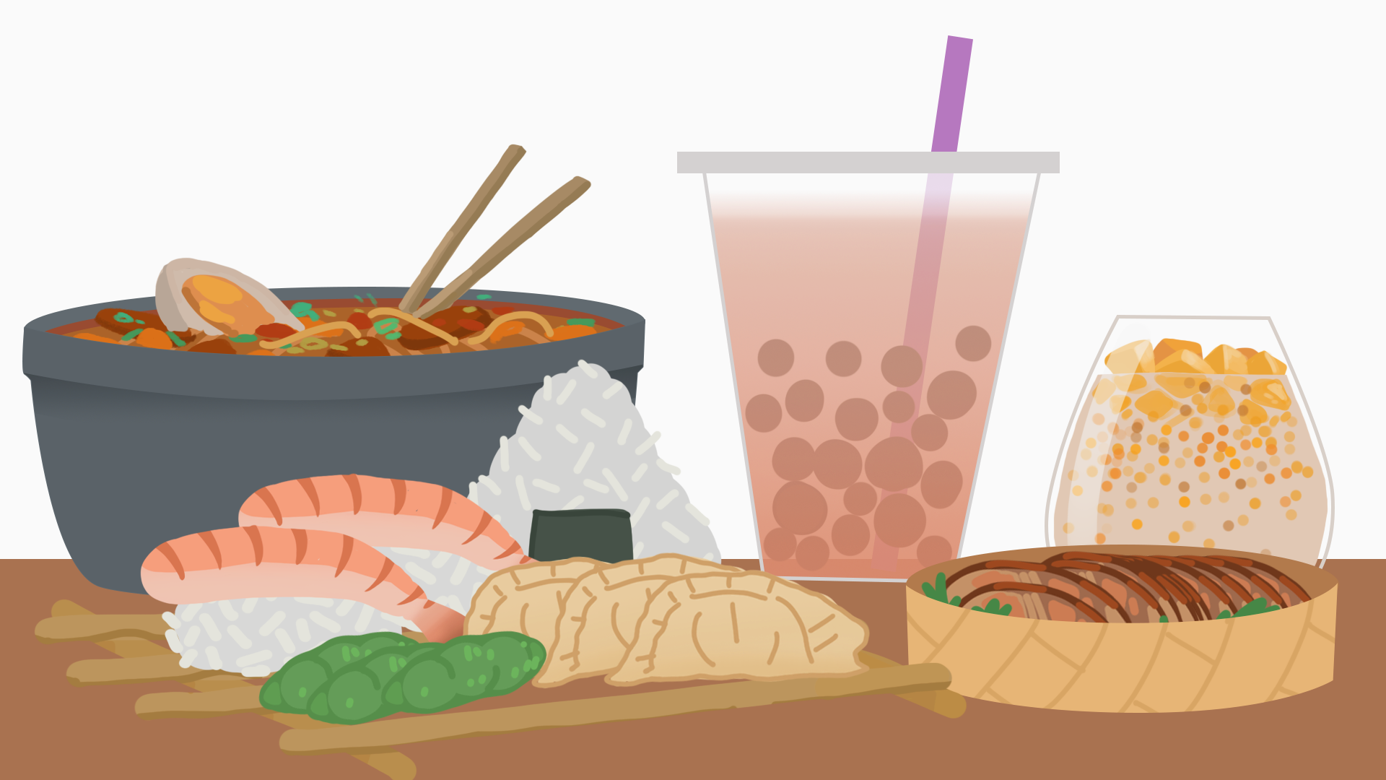
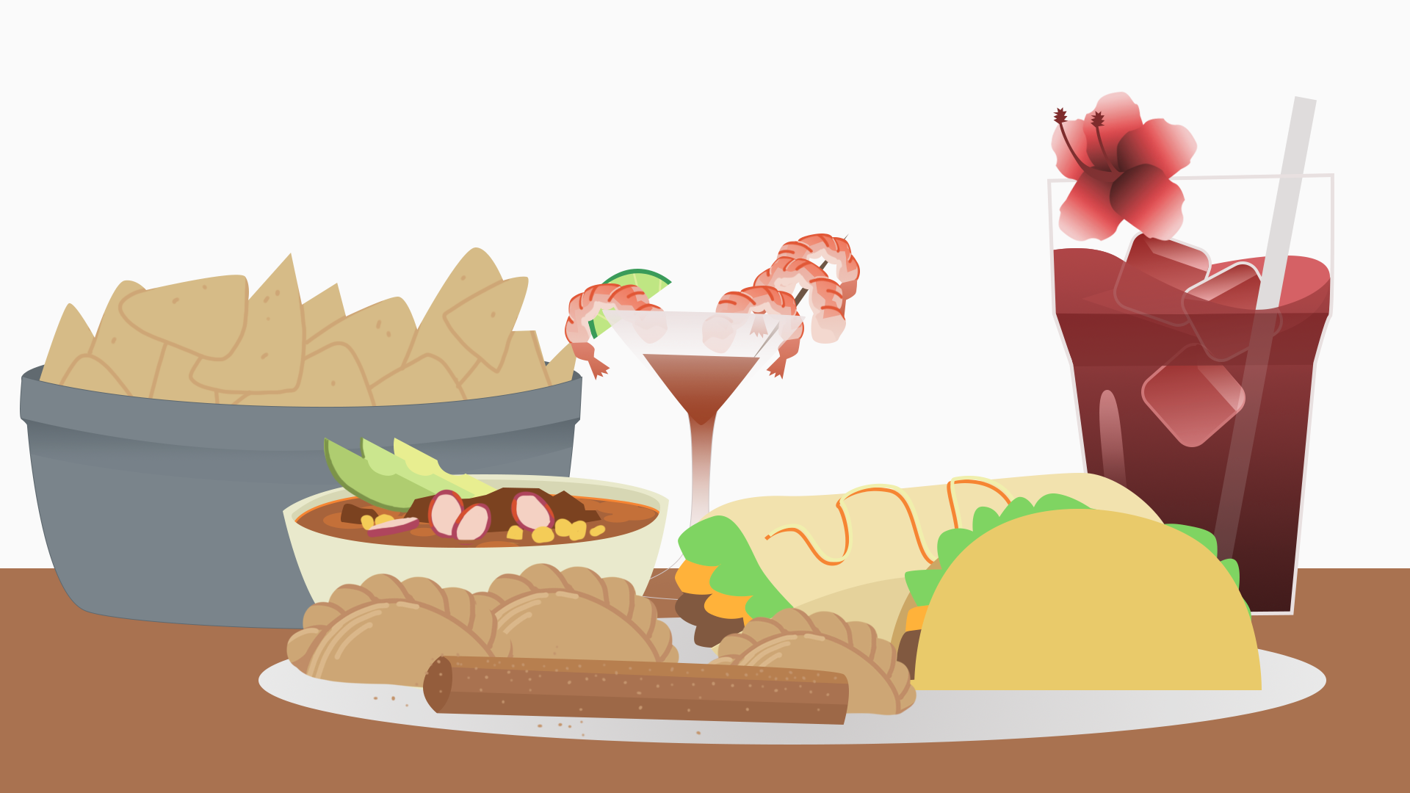
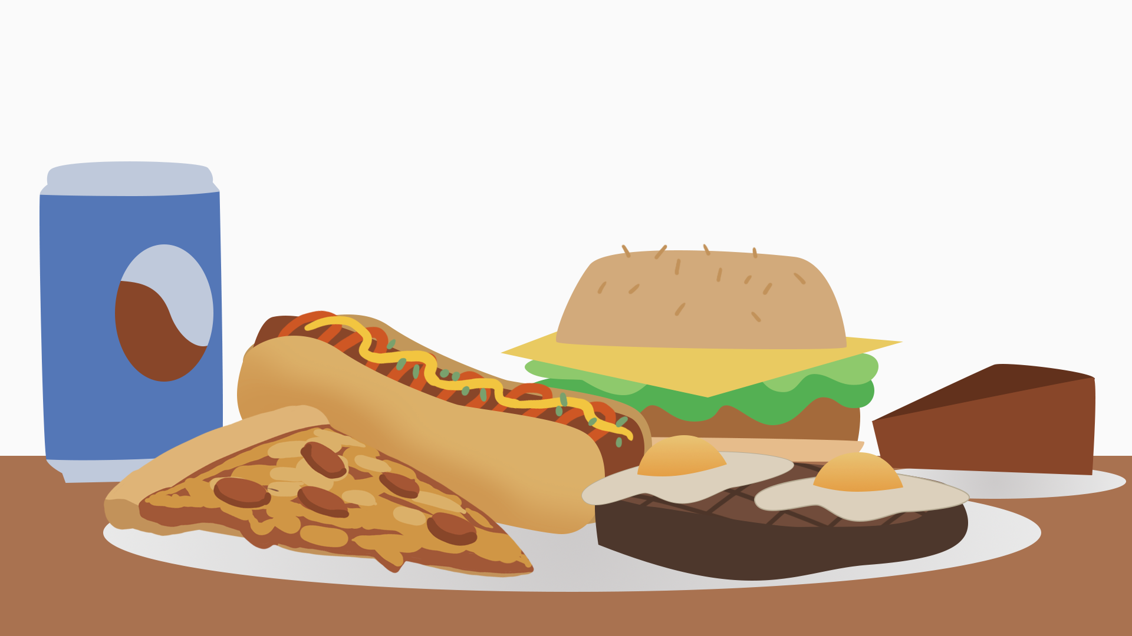
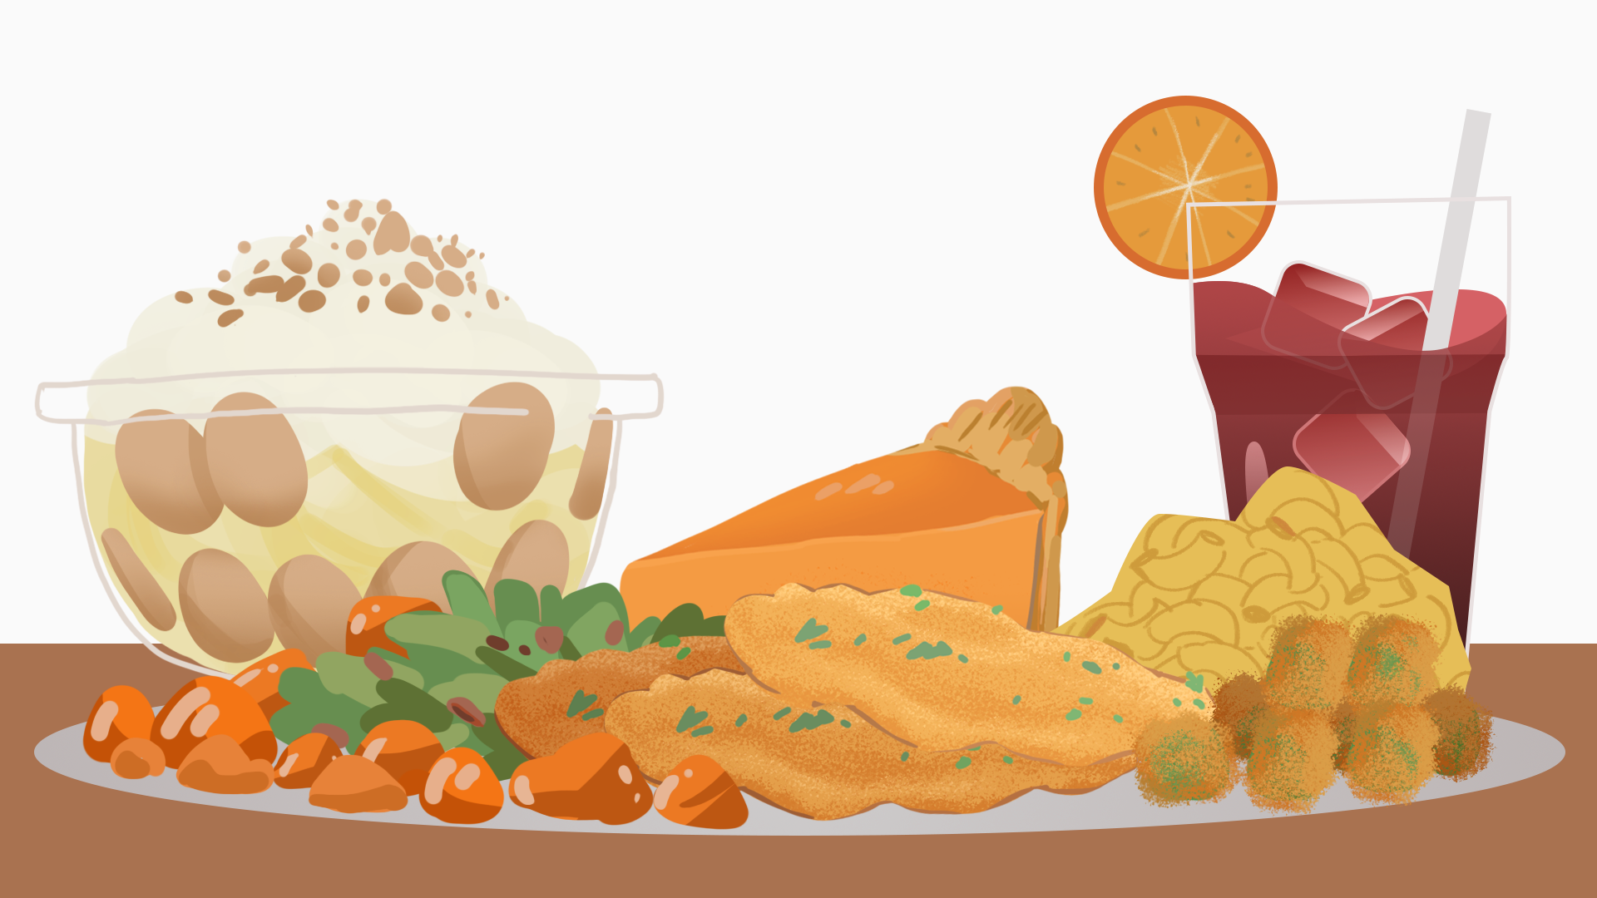
Magnetic Statements
Examine each image and move to the one that most attracts you.
Discuss your choice with the other participants gathered around the same image.
Prepare to share out why that image attracted you.
Notes:
K20 Center. (n.d.). Magnetic statements. Strategies. https://learn.k20center.ou.edu/strategy/166

Slide 5
Essential Question
How can educators intentionally incorporate students’ cultural identities and life experiences into the curriculum to foster joy, engagement, and academic excellence?

Slide 6
Learning Objectives
Understand the significance of recognizing genius and incorporating joy in learning.
Critique the education system by assessing its current effectiveness of embodying joy.
Using the HILL Model, create a lesson outline integrating the five pursuits.

Slide 7
Dr. Gholdy Muhammad, PhD
Dr. Gholdy Muhammad is the author of the books “Cultivating Genius” and “Unearthing Joy.” Dr. Muhammad's work is focused on cultivating students’ identities, skills, intellect, and criticality, while also embracing the importance of joy in learning.
Known for her innovative approaches to literacy and culturally responsive teaching, Dr. Muhammad’s contributions have helped educators rethink how to create meaningful, empowering, and joyful learning experiences for all students.

Slide 8
Cultivating Genius in Learning
Educators don’t need to instill GENIUS or brilliance in youth—it’s already there.
Students’ GENIUS is waiting to be cultivated. To cultivate genius, reach back into students’ histories.
Explore students’ cultures to nurture and enhance their existing GENIUS.
What is GENIUS?

Slide 9
Genius is the brilliance, intellect, ability, cleverness, and artistry that have been flowing through their minds and spirits across generations.
—Dr. Gholdy Muhammad, PhD

Slide 10
The Role of Joy in Learning
JOY connects students to themselves, their communities, and the world.
JOY is not just about happiness or fun; it is about creating opportunities for students to experience fulfillment, cultural pride, and intellectual growth.
JOY in education is found in moments where students feel seen, heard, and valued.
What is JOY?

Slide 11
Joy is the ultimate goal of teaching and learning, not test prep or graduation.
—Dr. Gholdy Muhammad, PhD

Slide 12
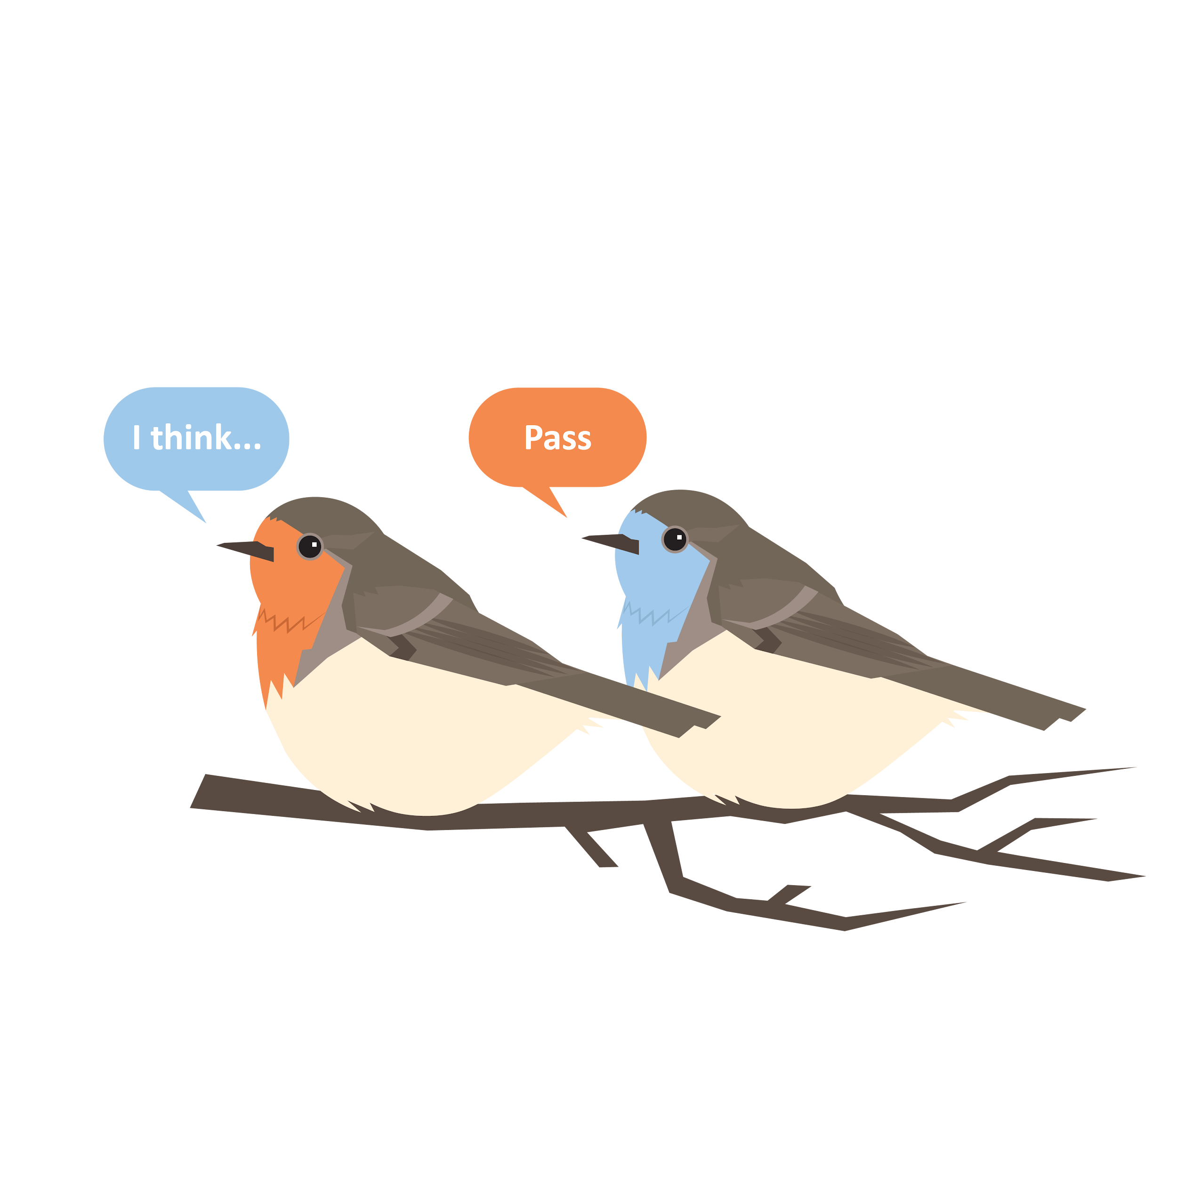
Round Robin
Develop and share short responses to the prompt below without explaining, questioning, or elaborating upon your ideas.
With your group members, critique these five parts of “the system.”
Learning standards
Curriculum
Assessments and standardized tests
Teacher and leader evaluations
Teacher education programs
Notes:
K20 Center. (n.d.). Round robin. Strategies. https://learn.k20center.ou.edu/strategy/2183

Slide 13
Round Robin
Do these parts of the system capture, express, and build genius and joy?
Is there a lack of culturally and historically responsive education? Explain.
Notes:
K20 Center. (n.d.). Round robin. Strategies. https://learn.k20center.ou.edu/strategy/2183

Slide 14
The HILL Model
An instructional framework consisting of five pursuits:
Identity
Skills
Intellect
Criticality
Joy
These pursuits respond to diverse students’
Histories, Identities, Literacies, and Liberation.

Slide 15
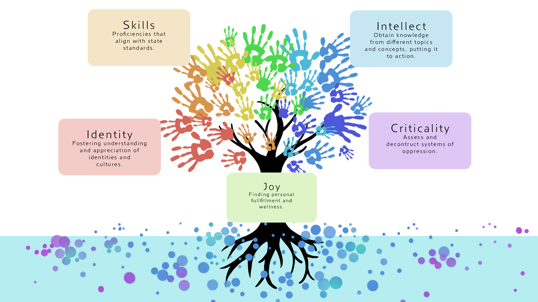
Gram It
Draw or find an image that represents your understanding of the HILL Model.
Summarize your understanding using a hashtag.
Prepare to share out.
Notes:
K20 Center. (n.d.). Gramit. Strategies. https://learn.k20center.ou.edu/strategy/2554

Slide 16
Creating Spaces for Genius and Joy
Harvest: Gathering substances from the rich Earth that are needed to move forth life.
“I consider all the beautiful, creative ideas and experiences we have with children in and around schools…like a harvest of genius and joy.”
-Gholdy Muhammad
How can the HILL Model best be used in your learning space to produce a harvest?

Slide 17
The HILL Model

Slide 18
Using the HILL Model: Sample Lesson
6th–8th Grade Social Studies Lesson: The Three Sisters
IDENTITY | Students will discuss the cultural and practical significance of the Three Sisters planting technique and reflect on how it maintains cultural identity and connection to the land.
SKILL | Students will plant the Three Sisters (corn, bean, and squash) in a small pot and explain the unique role each plant plays in the system.
INTELLECT | Students will research traditional agricultural practices adapted to specific environments and explain how they reflect the culture of the people using them.

Slide 19
Using the HILL Model: Sample Lesson
6th–8th Grade Social Studies Lesson: The Three Sisters
CRITICALITY | Students will compare the Three Sisters method with modern monoculture and discuss the methods’ environmental impacts and lessons from Indigenous practices.
JOY | Students will create an artistic representation of the Three Sisters using materials of their choice then display their works to celebrate creativity.

Slide 20
Using the HILL Model: Sample Lesson
9th–12th Grade Lesson: The Warmth of Other Suns Featured Teaching Artist: Isabel Wilkerson
IDENTITY | Students will write a journal entry about a time they or someone they knew moved to a new place. What motivated the move? What challenges and opportunities did the move bring?
SKILL | Students will annotate passages, focusing on how Wilkerson uses language to convey emotions and historical context.
INTELLECT | Students will research different cities that were key destinations during the Great Migration and present their findings.

Slide 21
Using the HILL Model: Sample Lesson
9th–12th Grade Lesson: The Warmth of Other Suns Featured Teaching Artist: Isabel Wilkerson
CRITICALITY | Students will discuss the challenges faced by people of color during the Great Migration and compare these challenges to issues today. How do systemic barriers persist in different forms?
JOY | Students will create a playlist of songs that represent the journey and emotions of the characters in the book. Discuss why they chose specific songs and how music connects to migration, culture, and resilience.

Slide 22
Create a Lesson Outline
IDENTITY
SKILL
INTELLECT
CRITICALITY
JOY
Work with your group to create a lesson that incorporates the five pursuits of the HILL Model.
Prepare to share your lesson with the group.

Slide 23
I Used to Think…But Now I Know…
Compare your initial thoughts about culturally responsive pedagogy to your thoughts after the session.
Record your thoughts on the handout.
Prepare to share out.
Notes:
K20 Center. (n.d.). I used to think . . . but now I know. Strategies. https://learn.k20center.ou.edu/strategy/137

