Slide 2
Authentic Use of Technology
K20 Center

Slide 3
Instructional Strategy Note Sheet and Agenda
Please take notes as we progress throughout the day.

Slide 4
Preflection
What’s the purpose of technology?
Follow the link and write a sentence or phrase about this question:
https://padlet.com/
Notes:
Some potential purposes:
Communication
Make things easier
Connections to the world
Collaboration
Convenience
In a Padlet, teachers will create responses to the question “What’s the purpose of technology?”

Slide 5
Essential Question
How can an authentic, technology-enriched learning environment increase student engagement and academic performance?
Notes:
How can an authentic, technology-enriched learning environment increase student engagement and academic performance? How can it prepare students for post-secondary opportunities?

Slide 6
Learning Objectives
Participants will experience an authentic activity integrating technology and reflect on this experience to determine the relevant components of authenticity.
Participants will differentiate types of assignments that fit into SAMR model.
Participants will apply their understanding of the modeled technology and use a chosen tool in the creation of a classroom activity.
Notes:
How can an authentic, technology-enriched learning environment increase student engagement and academic performance? How can it prepare students for post-secondary opportunities?

Slide 7
Authenticity
In groups, read your assigned component of the Authenticity Frameworks reading.
Notes:
Jigsaw the authenticity reading in small groups.

Slide 8
Sentence, Phrase, Word: Authenticity
From the reading, identify one each:
Sentence
Phrase
Work
Record these in the shared Google document
Notes:
Participants will use the Sentence, Phrase, Word strategy to generate important points from the reading. These are recorded in a Google document.

Slide 9
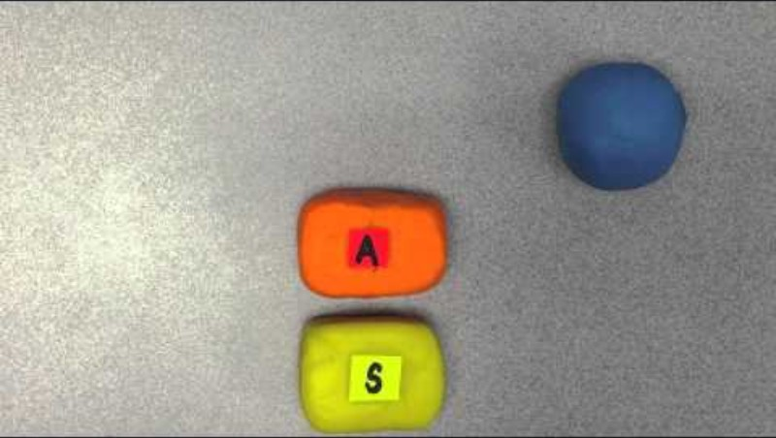
SAMR Video
As you watch the video, use a sticky note to record a sentence, phrase, and word.
SAMR in 120 Seconds
Notes:
Common Sense Education. (2016). What is the SAMR model? [Video]. YouTube. https://www.youtube.com/watch?v=us0w823KY0g

Slide 10
Sentence, Phrase, Word: SAMR
Record your sentence, phrase, and word in the shared Google document.
Notes:
Learners will synthesize what they’ve learned about the SAMR model into a sentence, phrase, and word and post it in the Google doc.

Slide 11
Self SAMR Model
Brainstorm concrete topics that you know well.
Simplest Form
Almost anyone could recognize this form.
Most Complex Form
Requires a far deeper understanding.

Slide 12
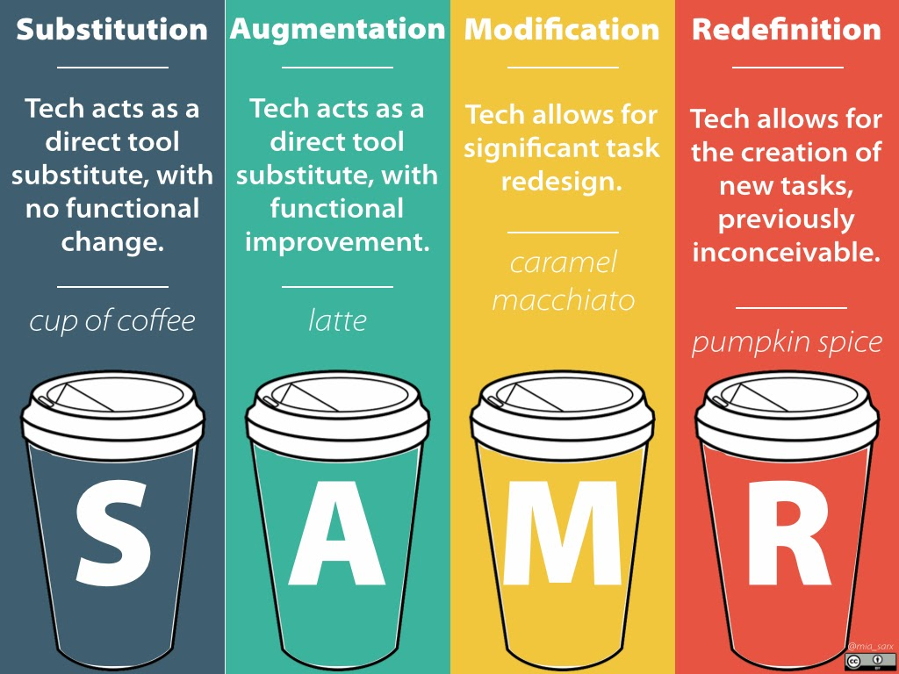
Notes:
Brubaker, J. (2013). SAMR: Model, metaphor, mistakes. Tech Tips for Education. http://techtipsedu.blogspot.com/2013/11/samr-model-metaphor-mistakes.html

Slide 13
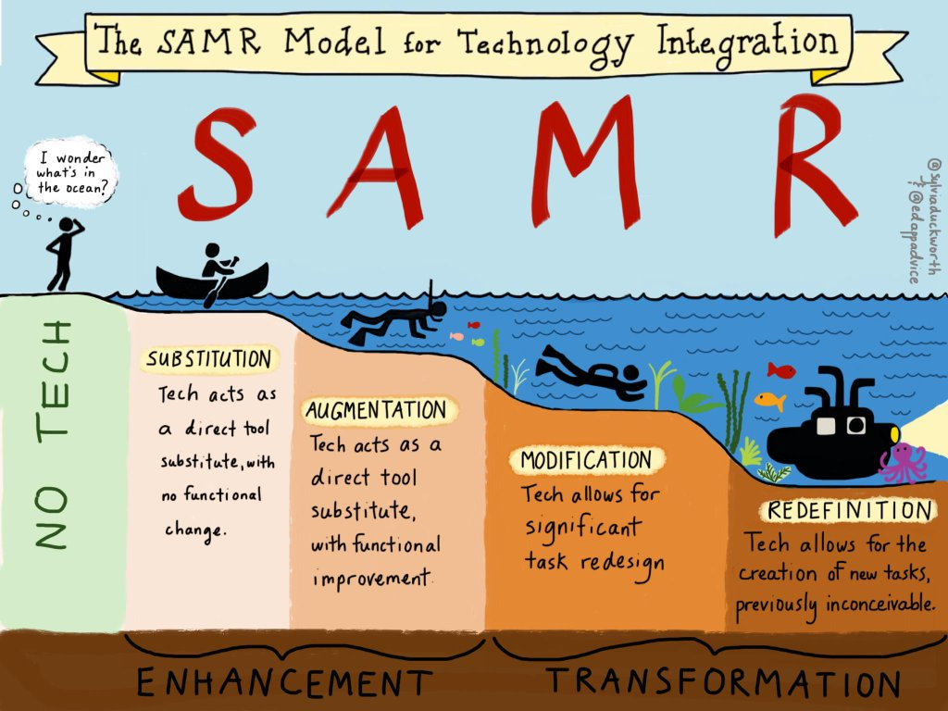
Doing what you’ve always done, but with technology
Doing what can’t be done without technology
Notes:
State of Rhode Island Department of Education. (2015, Dec 3). The SAMR Model for Technology Integration. https://ride.ri.gov/students-families/education-programs/virtual-learning/reimagining-teaching-learning

Slide 14

SAMR Card Sort
https://padlet.com
Notes:
Sort these activities that use technology into the areas you feel they best fit within the SAMR model.
K20 Center. (n.d.). Card Sort. Strategies. https://learn.k20center.ou.edu/strategy/14

Slide 15
Word Splash: Authenticity and SAMR
Notes:
Use a word cloud generator such as this one: http://www.abcya.com/word_clouds.htm

Slide 16
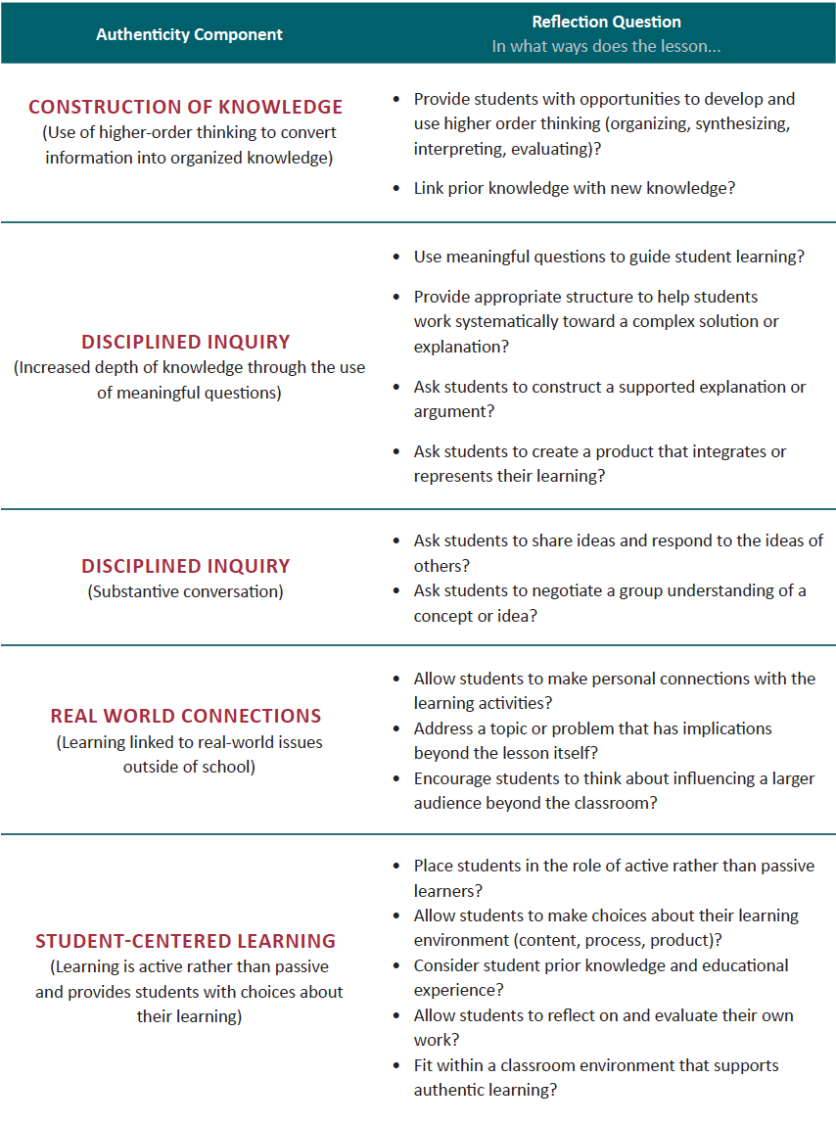
Authentic Lesson Reflection Tool

Slide 17


LEARN Strategy/Tech Tool Reflection
Padlet
Sentence, Phrase, Word
Cart Sort
Word Splash
Notes:
K20 Center. (n.d.). Jigsaw. Strategies. https://learn.k20center.ou.edu/strategy/179

Slide 18
Upcoming Content
Select a lesson snapshot sample for your content area.
Using the color-coded SAMR chart, we will design activities with your content as the focus.
Use the SAMR and DoK chart to design a task for each of the four SAMR levels.
Notes:
http://www.schrockguide.net/bloomin-apps.html
How can you these online resources support SAMR when designing lesson activities?

Slide 19
Level 1: Substitution
With the topic you chose, design a task for your classroom at the Substitution level.

Slide 20
Level 2: Augmentation
With the topic you chose, design a task for your classroom at the Augmentation level.

Slide 21
Level 3: Modification
With the topic you chose, design a task for your classroom at the Modification level.
Use the shared tools document to help you find tech tools that provide opportunities for higher level integration.

Slide 22
Level 4: Redefinition
With the topic you chose, design a task for your classroom at the Redefinition level.

Slide 23
Evaluate
Revisiting the Essential Question:
  How can an authentic, technology-enriched learning environment increase student engagement and academic performance?
Which of the preflections support such an environment?

