Slide 2
Simulations and Models: More than a Pretty Face
Heather Shaffery, Lead Science Curriculum Specialist
Alex Parsons, Lead Math Curriculum Specialist
Notes:
Context
This PD is designed with math and science teachers in mind. The science task for El Niño and La Niña would also be appropriate for Geography. While it can be completed in 2 hours, a 3 hour PD is preferred to give teachers sufficient time to work through the models.
However, as written it will not be inherently useful to ELA or History teachers, unless they have specific units or lessons which would align with weather and climate. Even in that case, the exercises would still be a stretch for their content.
Facilitation
Facilitators introduce themselves, their relation to the grant and teachers, and their background (briefly) if participants haven’t met them previously.

Slide 3
Objectives and Goals
Participants will apply research-based practices to support the use of simulations and models in curriculum.
Participants will design a standard-based activity they plan to teach that includes simulations or models.
Notes:
Context
Some teachers see simulations and models as difficult or frivolous to incorporate into instruction, but there is a legitimate research supporting simulations as effective instructional tools in science. Likewise, they can be integrated fairly easily into lessons without significant extra planning on the part of the teacher. The simulation chosen for this PD is complex and offers many applications across grade levels. Most simulations for science instruction are much simpler to execute. By developing confidence in a simulation this multifaceted, teachers will be empowered to incorporate simulations of varying complexity into their instruction.
Participants are given time to explore additional simulations in the Extend and set a goal for when and how they will use one in their own classroom.

Slide 4
Photo Deconstruction
How does this photo make you feel?
How likely are you to experience something like this in person?
What is this photo providing you that you didn’t have without it?
Notes:
Context
This PD helps participants feel comfortable with using simulations or models to provide deeper, richer access to content that can’t be provided in an average classroom setting. Photos are not models, but this Engage activity is intended to orient them toward the idea of providing inaccessible experiences for learning.
Facilitation
Present each question one at a time (animations will progress them one at a time)
With each question, read it aloud, then ask participants to discuss their thoughts with their elbow partners.
Finish this slide by contextualizing that this is just a picture, not even a full simulation or model.

Slide 5
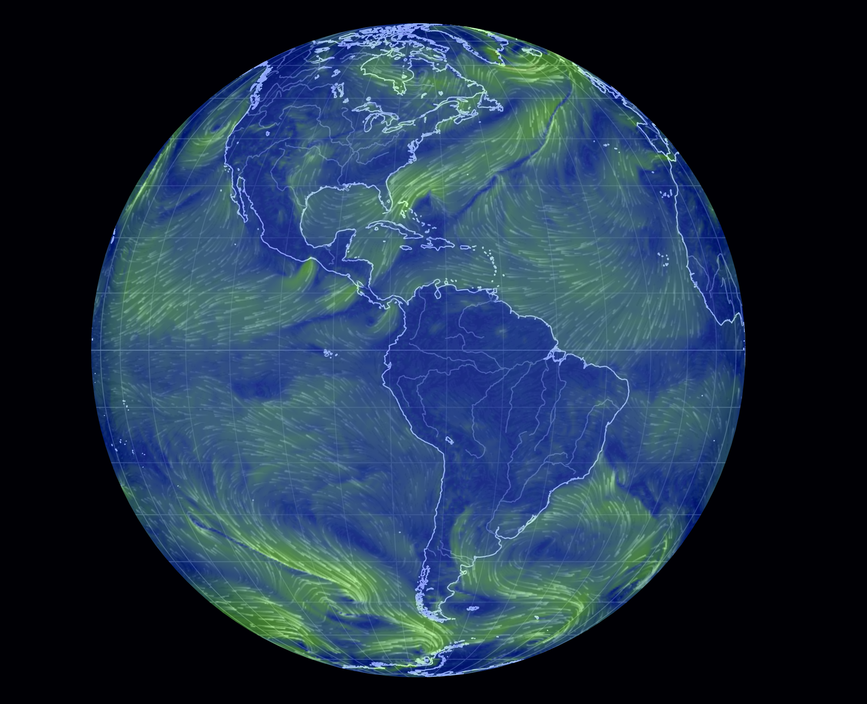
Exploring a Simulation
Notes:
Context
The earth simulation participants will use is a collection of near-real time atmospheric and oceanic models. Data come from a variety of sources (e.g., NOAA, Mesonet) as either current measurements and satellite imagery or scientific projection models. Categories of data are grouped as “Modes” in the simulation menu. Within each Mode, specific variables have “Overlays” which visually display the data for each one. These data are updated between once an hour to once every five days depending on their source.
The “About” section of the simulation menu takes you to a new page with information on the data sources, data update frequency, and explanations of the variables. Explanations for variables relevant to this PD are provided on the Simulation Cheat Sheet handout.
Facilitation
earth Simulation
Direct participants to https://earth.nullschool.net/ . The website and basic instructions are included on the back/second page of the Simulations Cheat Sheet handout.
Have participants follow along on their own devices as you demonstrate how to find the basic functions in the menu.
The next slide shows a static image of the menu with these same functions annotated. Work time for the four Explore tasks begins after you transition to the static image slide and point out the annotations to the teachers.
Desmos Graphing
Detailed instructions for handling the basic Desmos functions are included on the Using Desmos handout. When it comes time to use Desmos in a given task, we recommend that one partner/group member has the Desmos graph open on their device while other partner(s) have the simulation on theirs to facilitate plotting data with more ease and efficiency.

Slide 6
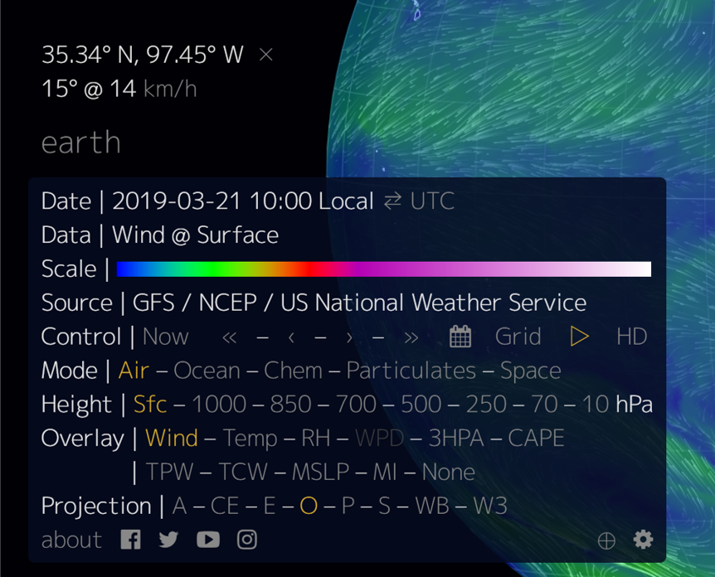
Location Coordinates
Data Value
Change Hour
Change Date
Variable Set
Show Variable Data
Change Day
Notes:
Context
earth Simulation
At minimum, teachers need to know how to select which variables the model displays, change the date and time, and where to find their location and data values.
Location Coordinates: This shows the precise location of where you have selected on the simulation map.
Data Value: Depending on the data set, this may show an additional line of information. The bottom row is always the relevant data for our purposes.
Variable Set (“Mode”): These are the categories of data that can be displayed on the simulation.
Show Variable Data (“Overlay”): This is where you select which data set is displayed (overlaid) on the simulation map.
Desmos Graphing
Detailed instructions for handling the basic Desmos functions are included on the Using Desmos handout. When it comes time to use Desmos in a given task, we recommend that one partner/group member has the Desmos graph open on their device while other partner(s) have the simulation on theirs to facilitate plotting data with more ease and efficiency.
Facilitation
Before showing these annotations to the teachers and beginning the Explore tasks, be sure to demonstrate the same functions on the actual simulation for the teachers (as noted in the previous slide). After showing the functions on the live model, step through this slide and leave it up during work time for reference.
Note: Teachers tend to forget that there are resources at their disposal. Make sure to remind the whole group of them occasionally, particularly if you hear concerns and questions voiced as they work. They have the Simulation Cheat Sheet for variables and navigating to the earth simulation and Desmos graphing site.
There are four different activities, two for math teachers and two for science teachers. Math and Science each have an Alabama Tornado task and an El Niño La Niña task.
Divide teachers into four content-specific groups, two math and two science. Both science tasks are designed around 7th grade standards, but math teachers could be divided into grade-level groups as well (7th: Alabama Tornado, 8th: El Niño La Niña).
If the group is small enough, grouping teachers into pairs works well. In this case, you might end up with more than one group working on the same task which is fine. Groups larger than 4 teachers are not manageable for these tasks.
Give only one task to each group. Each participant should have their own sheet.
Teachers may want hard copies of both tasks for their content area, so plan to have extra copies of each task to give them at the end of the workshop.
Give groups enough time work through the task. If the workshop is 3 hours long or more, give teachers at least 30 minutes; if you have less than 3 hours, give them 15-20 minutes.
Move on to the presentation Explain activity after the 15-30 minutes or when participants are done with the tasks, whichever comes first. In a PD less than 3 hours it is unlikely that any participants will complete the task in the allotted time.
Troubleshooting and Important Notes
Data is not available before November 2013.
Occasionally, you will encounter a “no data” situation (almost always when changing the date or time). Since the models are not updated every day for all variables, changing the date or time will typically fix this problem. In cases where changing the date does not solve the “no data” issue, it may be that the variable is not measured at the “Sfc” Height. In the interest of time during a PD, it would be more useful to select a new variable than troubleshoot.

Slide 7
Presenting your Findings
You will make a short presentation over your activity.
Your presentation will include:
1 answer to your prompt (acting as a learner right now)
2 aspects of the simulation you foresee having to scaffold for students (acting as a teacher)
3 ways this simulation can be used in your classroom (acting as a teacher)
Notes:
Context:
At this point, participants will have worked through the simulation task assigned to them.
Note: If the scheduled time is less than 2 hours, it will be likely that the participants will not finish the task. This is OK, since the intention is for transfer to the classroom rather than just completing the task itself. This is especially true for the El Nino/La Nina tasks. If there is a question of whether participants will finish or not, direct the El Nino math participants to think about the answer to question 7; El Nino science participants should try to answer prompt 5 (no matter their overall progress direct them there).
Directions:
Tell participants that they just experienced a simulation as if they were a student, but now they get to share from the perspective of the teacher. And they are going to create a presentation over their experience.
Pass out the 3-2-1 handout (or just present the slide for small groups)
Give groups (same groups as the simulation task) a short time (less than 10 minutes) to make their presentations. How they make their presentations depends on the size and technology constraints of the group. The original format recommended was Slides, but posters or something informal may be appropriate.

Slide 8
Presentations
Notes:
Context:
This slide is blank because this would be when the participants share their presentations. So this slide is acting more as a placeholder rather than an active part of the presentation.
Directions:
Each presentation, for the sake of time, should be limited to 5 minutes, with only a question or two afterwards
Have each presentation shared with lead presenter for easy transition between presentations if using Slides.
Each group will present, with a focus on the 2 aspects and 3 ways.
After presentations, take time to discuss the research foundation for simulations.
Research Points of Note
Simulations fall on a continuum of technology-based instructional tools. Research into these instructional tools finds that, when paired with high quality instruction, students demonstrate increased achievement by using simulations, AR/VR, and videogames (in that order; Merchant, et al. 2014).
Research indicates that the real impact of these technologies is for struggling students. Students already doing fine conceptually aren’t positively or negatively impacted by the integration of simulations, etc., but those who lag behind show significant growth in their comprehension and retention (Lee & Wong, 2014).
Simulations are most effective for content-focused learning versus skills- or process-focused learning. They generate the smallest impact relative to the AR/VR and video games because students inherently spend less time immersed in them figuratively or literally (Merchant, et al. 2014). Given the degree of mental engagement and analysis (unaided by the features of the simulation itself) make this a highly effective simulation (with appropriate scaffolding).
Making sense of the simulation data requires exploration and intentional focus by students on six of the seven crosscutting concepts from the science standards, specifically: patterns; cause and effect; scale, proportion, and quantity; systems and system models, energy and matter; and stability and change.
For schools with touch technology, Smart TVs specifically, the addition of this tactile component pushes the simulation farther along the continuum and closer to an augmented reality experience. Though it seems trivial, the addition of a physical level of engagement with a digital simulation or model makes the experience more immersive and provides an opportunity for more exploratory time on the part of the student. Again, the Smart TV tech itself isn’t effective without high quality instruction (Min & Siegel, 2011)
Another important implication here for Smart TVs specifically is that students need to be given opportunities to physically explore the models and simulations on the technology beyond presentations.

Slide 9
Expanding Ideas to more Simulations
Using the included Simulations Spreadsheet
You have two options:
If you want inspiration, select one of the simulation resources we’ve provided and explore it
If you already use a great simulation resource, add on another row
Answer the questions in the spreadsheet, being mindful of how this would fit in both math and science classrooms
Notes:
Context:
Participant groups will have finished there presentations, so they have ideas of how the earth simulation could be used beyond just the task they were given. This activity is intended to extend this brainstorming of application to the classroom with other simulations and models beyond the one they used.
Directions:
On participant devices - preferably a laptop - direct them to go to the URL listed. Tell them that they are to ‘sign-up’ for one of the resources listed by typing their name in the corresponding cell under ‘Name’. Remind participants that this is a live, collaborative spreadsheet. That is, for them to be mindful of revisions history or if they’re replacing someone else’s content.
This activity is independent, but light talking is allowed
Facilitator walks around and helps with light troubleshooting.

Slide 10
Translating from Here to Classroom
None of this matters unless we commit to trying it out in our classroom.
You have a half-page handout to set goals for trying something you learned today in your classroom.
Notes:
Pass out the goal setting half-sheet. Each participant should get one.
Instruct participants to think about what ‘stuck out’ to them that can be brought into their classroom. Answer each question with the intention of actually implementing in their classroom.

