Slide 2
Community Connections

Slide 3
Essential Questions
How are students learning about careers?
What community connections can you make to help engage students in careers?

Slide 4
Learning Objectives
Identify resources in your community to support student career needs.
Design an activity around career clusters or a specific career.

Slide 5
Career Cards
Read your Career Card.
Stand by the career cluster that your career belongs to.
Share what career you have with others in your career cluster group.

Slide 6
Career Cards
How did you decide which cluster your career belonged to?
What do students know about that cluster?
Is the career from your card common in your community?
Are you familiar with the path to pursue that career?

Slide 7
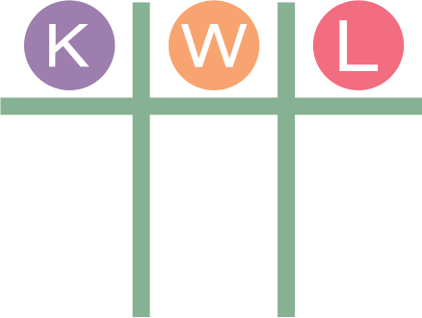
KWL
Known Student Interests | Where do students currently learn about careers? | Learned in this Session
Notes:
K20 Center. (n.d.). KWHL graphic organizer. Strategies. https://learn.k20center.ou.edu/strategy/127

Slide 8
Community Ecosystem
Think about the students at your school.
What are some interests they have?
What resources are available in your community?
How can you connect students to those resources?

Slide 9
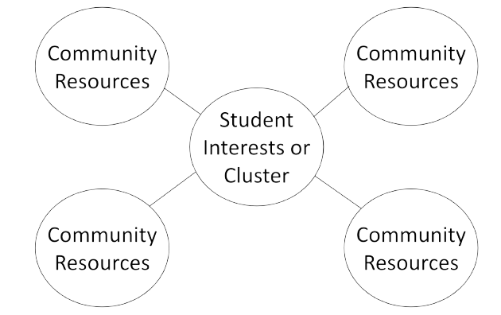
Community Ecosystem

Slide 10
Planning for the Future
What are you already doing in your school to help students?
Read the Career Exploration Event summaries.
Write the purpose of each event.
Exclaim: Write at least one thing you like about the events.
Question: Write any questions you have about the events.
Notes:
K20 Center. (n.d.). Exclaim and question. Strategies. https://learn.k20center.ou.edu/strategy/94

Slide 11
Designing an Activity
Recall the Career Cluster your Career Card belonged to at the beginning of the session.
Imagine that your students are interested in that cluster.
Design an activity for your students based on that information.
Use the resources from this session and existing supports at your school to design your activity.

Slide 12
Aha! Huh? Uh uh.
On your Career KWL Chart, respond to each of the following:
Aha! What is one thing that stood out to you?
Huh? What is one thing you are questioning?
Uh uh. What is one thing you find troubling?
Notes:
K20 Center. (n.d.). Aha! Huh? Uh uh. Strategies. https://learn.k20center.ou.edu/strategy/4414

