Slide 2
While You Wait…
Part 1
Complete this short survey:
<Insert link here>
<Insert QR code here>
Part 2
Complete the “Mix Tape” section of your Impacts of Music handout.
Notes:
Facilitator’s Note: Insert the link and QR code for the Music Survey into this slide prior to presentation.

Slide 3
Poison Rhythm
This game is also known as “Don’t Clap This One Back.”
What skills does this game build?
How could you use this game in your classroom?

Slide 4
Harmonizing Learning
Integrating Music in the Classroom

Slide 5
Music in Everyday Life!
Notes:
Facilitator’s Note: Copy the chart from the response summary of the Music Survey from slide 2 and paste it into this slide.

Slide 6
Elbow Partners
In pairs, discuss the following:
How did the music playing as you entered make you feel? What did it make you think about?
How did you select your walk-up song? What does it reflect about yourself and your personality?
Why is music important in education?
What are some personal experiences you have had with music that influence your own teaching, learning, or life in general?
Prepare to share out.
Notes:
K20 Center. (n.d.). Elbow partners. Strategies. https://learn.k20center.ou.edu/strategy/116

Slide 7
Essential Question
How can teachers use music in the classroom to promote student engagement and emotional regulation?

Slide 8
Session Objectives
Increase student engagement through realizing the benefits of using music in education.
Explore practical ways to integrate music across different subjects.
Develop strategies to enhance student engagement and retention through musical activities.

Slide 9
Music and Mood
As you watch the video, write down 1–2 words that express how the music made you feel in the table provided.
You will hear a total of 7 examples.

Slide 10
Notes:
Lausten, S. [Loud Son]. How music affects film #17: The Lion King [Video]. YouTube. https://www.youtube.com/watch?v=ecYgqLml89c

Slide 11
Musical Manipulation
What did you expect? Why?
What impact did the music have?

Slide 12
Stand Up, Sit Down
Where do you hear music in public places?
What is its purpose?
Notes:
K20 Center. (n.d.). Stand up, sit down. Strategies. https://learn.k20center.ou.edu/strategy/1771

Slide 13
The Mozart Effect
Can listening to Mozart make you smarter?
The answer is no! However, listening to music that has meaning to an individual can improve concentration and focus, and aid short-term memory while studying, which can improve test performance.

Slide 14
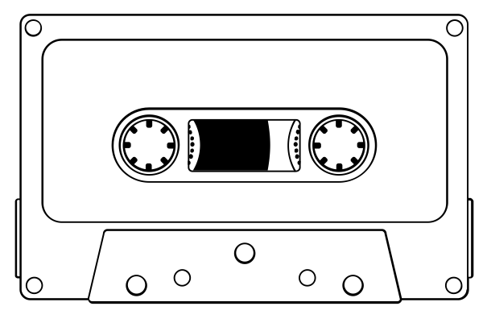
Music Extract Cognitive Comics
Listen to these music extracts.
How does the music make you feel? What does it make you think of?
Draw or write a response to each extract.
Music Extracts
Notes:
K20 Center. (n.d.). Cognitive comics. Strategies. https://learn.k20center.ou.edu/strategy/198
Lev. (2016, November 30). Cassette tape [Illustration]. The Noun Project. https://thenounproject.com/icon/tape-cassette-746747/

Slide 15
Collective Musical Brain Dump
How could you use music extracts in your classroom or for other school activities?
What are some examples of how you could use music in your teaching?
Notes:
K20 Center. (n.d.). Collective brain dump. Strategies. https://learn.k20center.ou.edu/strategy/111

Slide 16
LEARN Instructional Strategy Reflection
Elbow Partners
Stand Up, Sit Down
Cognitive Comics
Collective Brain Dump
Notes:
K20 Center. (n.d.) Cognitive comics. Strategies. https://learn.k20center.ou.edu/strategy/198
K20 Center. (n.d.). Collective brain dump. Strategies. https://learn.k20center.ou.edu/strategy/111
K20 Center. (n.d.). Elbow partners. Strategies. https://learn.k20center.ou.edu/strategy/116
K20 Center. (n.d.). Stand up, sit down. Strategies. https://learn.k20center.ou.edu/strategy/1771

Slide 17
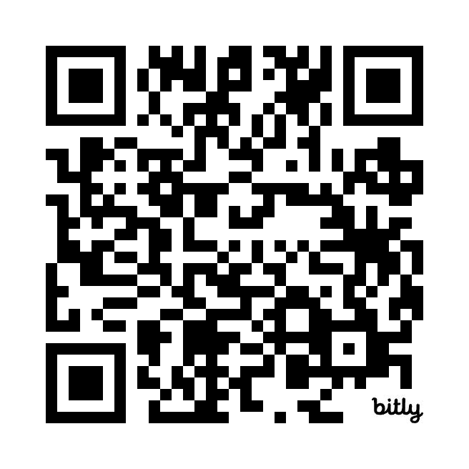
Musical GramIt
Access the Wakelet link: https://bit.ly/4jTGdi7
Read your assigned abstract.
Using large poster paper, visually represent the findings of your research.
Create a 1–3 word summary of your abstract and write it on your poster using a hashtag (#).
For example: #calmingmusic
Notes:
K20 Center. (n.d.). GramIt. Strategies. https://learn.k20center.ou.edu/strategy/2554

Slide 18
Musical Springboard Commit and Toss
How could you start discussion in your subject area using music?
Consider all aspects of music including:
Historical context
Musicians, performers, and the production team
Style and genre
Recording technology
Notes:
Deff Leppard. (2018, December 12). Waterloo sunset [Video]. YouTube. https://www.youtube.com/watch?v=yhqDD1je8PQ
K20 Center. (n.d.). Commit and toss. Strategies. https://learn.k20center.ou.edu/strategy/119

Slide 19
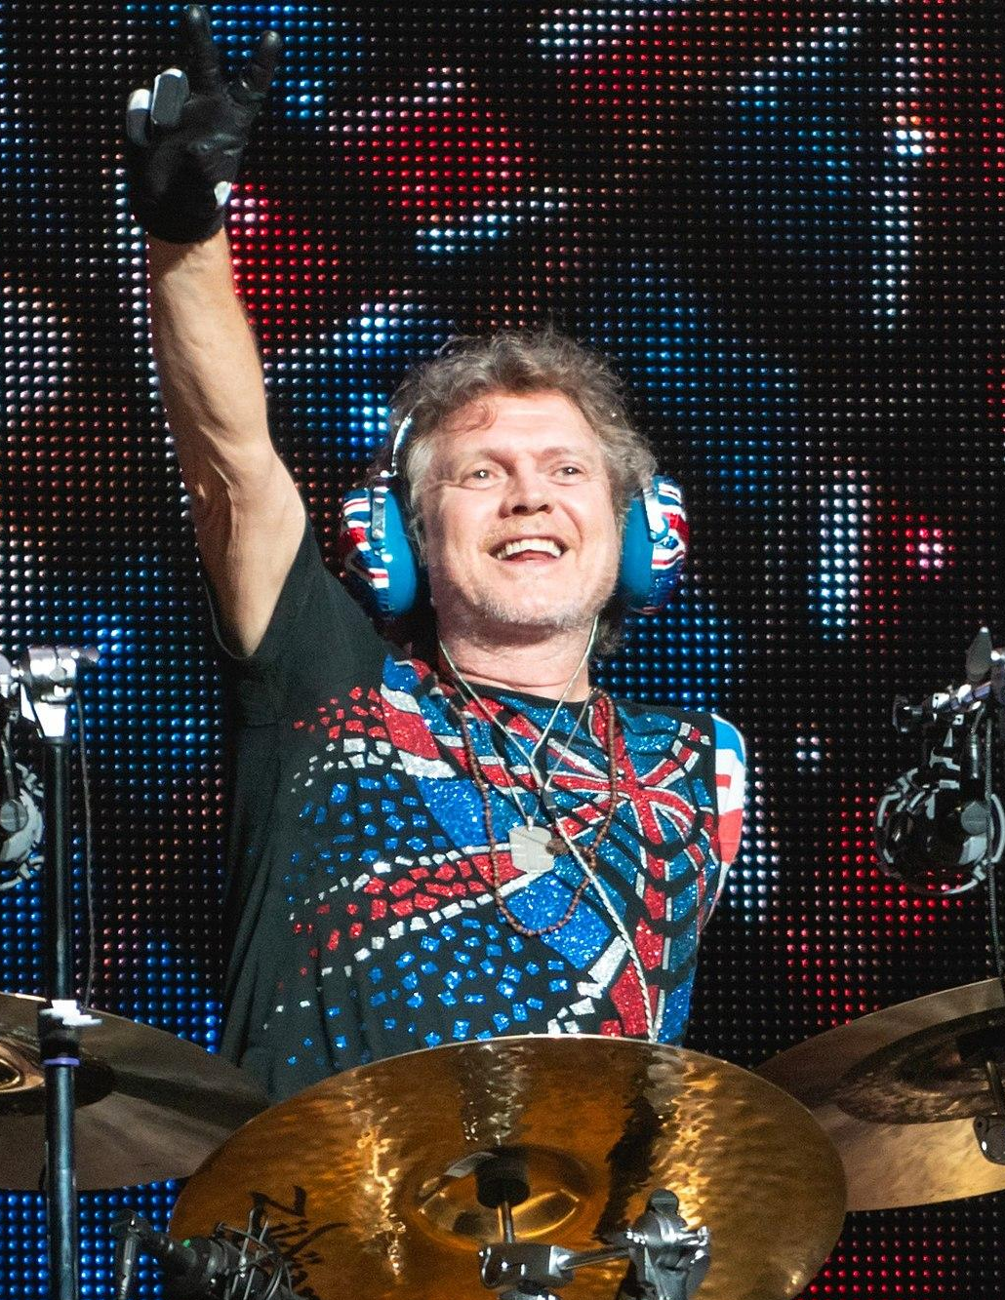
Waterloo Sunset by Def Leppard (2004)
Did you know this is a cover of a 1967 song by The Kinks?
Did you like it? Why? Why not?
What could you hear?
What were the 1960s like?
Who is inspirational to you?
What was the available recording technology? (vinyl/CDs/streaming)
Did you know Def Leppard’s drummer only had one arm after being in a car crash?
How does this show resilience and determination?
Notes:
Ralph_PH. (December 6, 2018). [Photograph of Def Leppard drummer Rick Allen]. Wikimedia Commons. https://commons.wikimedia.org/wiki/File:DefLappardO2061218-51_(49913641228).jpg

Slide 20
Musical Relationships
K20 Center’s LEARN: https://learn.k20center.ou.edu/
Math: The Sound of Polynomials
ELA & Social Studies: Blackbirds in Little Rock
Science: Make Some Waves; Shaping Soundscapes
Instructional Strategies:
Chant It, Sing It, Rap It (See examples on the next slide.)
Blackout Poetry

Slide 21
Chant it, Sing it, Rap it
Notes:
Culhane, T. H. (2007, July 28). Classification rap [Video]. YouTube. https://www.youtube.com/watch?v=6jAGOibTMuU&t=9s
K20 Center. (n.d.). Chant it, sing it, rap it. Strategies. https://learn.k20center.ou.edu/strategy/143
Rambow, O. (2015, October 2). The quadratic formula song – with harmony [Video]. YouTube. https://www.youtube.com/watch?v=VOXYMRcWbF8

Slide 22
Musical Design
In subject-area groups, design a musical activity for use in your classrooms.
Ideas:
Create a short song or jingle to remember key ideas.
Use a piece of music as a springboard to a specific topic.
Create new song lyrics (or create lyrics from an existing textbook) and pair them with an existing melody or song to create a new song.
Use music for reflection, thought, or evaluation.

Slide 23
Final Thoughts
Watch the following video and consider the questions below:
How can you use music more effectively?
What questions do you have?
Notes:
K20 Center. (n.d.). How am I feeling? What am I thinking?. Strategies. https://learn.k20center.ou.edu/strategy/187

Slide 24
Notes:
Chishti, A. (2016, August 30). Educating Yorkshire: Musharaf [Video]. YouTube. https://www.youtube.com/watch?v=XogvI6TP72M

Slide 25
LEARN Strategy Reflection
GramIt
Commit and Toss
How Am I Feeling? What Am I Thinking?
Notes:
K20 Center. (n.d.). Commit and toss. Strategies. https://learn.k20center.ou.edu/strategy/119
K20 Center. (n.d.). GramIt. Strategies. https://learn.k20center.ou.edu/strategy/2554
K20 Center. (n.d.). How am I feeling? What am I thinking?. Strategies. https://learn.k20center.ou.edu/strategy/187

