Slide 1
Educating with Perspective

Slide 2
Educating with Perspective
Notes:
Schools visited by students include the following: Arkansas Pine Bluff, Mississippi Valley State University, Jackson State University, Alcorn State University, and Grambling State University.

Slide 3
How am I Feeling/What am I Thinking
Reflect on the video
How did it make you feel?
What are you thinking?
Notes:
K20 Center. (n.d.). How am I feeling? What am I thinking?. Strategies. https://learn.k20center.ou.edu/strategy/187

Slide 4
Essential Question
What is the benefit of acknowledging students’ culture in a school environment?

Slide 5
Session Objectives
Explore and identify the benefits and advantages of acknowledging students' cultural backgrounds in various school settings.
Learn and discuss practical strategies and techniques for creating an environment that acknowledges and respects students' cultural backgrounds.
Create an implementation plan to acknowledge students' cultural backgrounds in their own school.

Slide 6
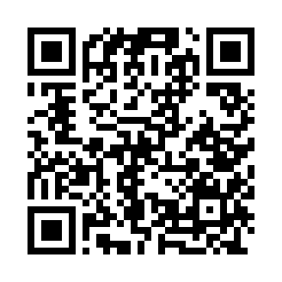
Explore Resources
K20 10 Minute Timer
Go to https://bit.ly/4hosgai
Consider your role in relation to the school you serve.
Select at least one resource to explore that could be used or adapted for that school.
Take notes on the Resources Exploration Notes Organizer.
Notes:
K20 Center (Sept. 2021). 10 minute timer. YouTube [video]. https://www.youtube.com/watch?v=9gy-1Z2Sa-c
K20 Center. (n.d.). Wakelet. Tech tools. https://learn.k20center.ou.edu/tech-tool/2180

Slide 7
Discuss Your Resource
K20 5 Minute Timer
Begin by sharing which resource you reviewed.
What cultural perspectives are recognized in this resource?
How does this resource facilitate discourse and collaboration that allows students to bring in personal perspectives to support their learning and/or school experience?
How does this resource boost student motivation, engagement, self-perceived abilities, or confidence in school?
Notes:
K20 Center (Sept. 2021). 5 minute timer. YouTube [video]. https://www.youtube.com/watch?v=EVS_yYQoLJg

Slide 8
Collective Brain Dump
Now that you have discussed the questions, collectively create a brain dump list with all the themes you recognized in the resources.
Notes:
K20 Center. (n.d.). Collective brain dump. Strategies. https://learn.k20center.ou.edu/strategy/111

Slide 9
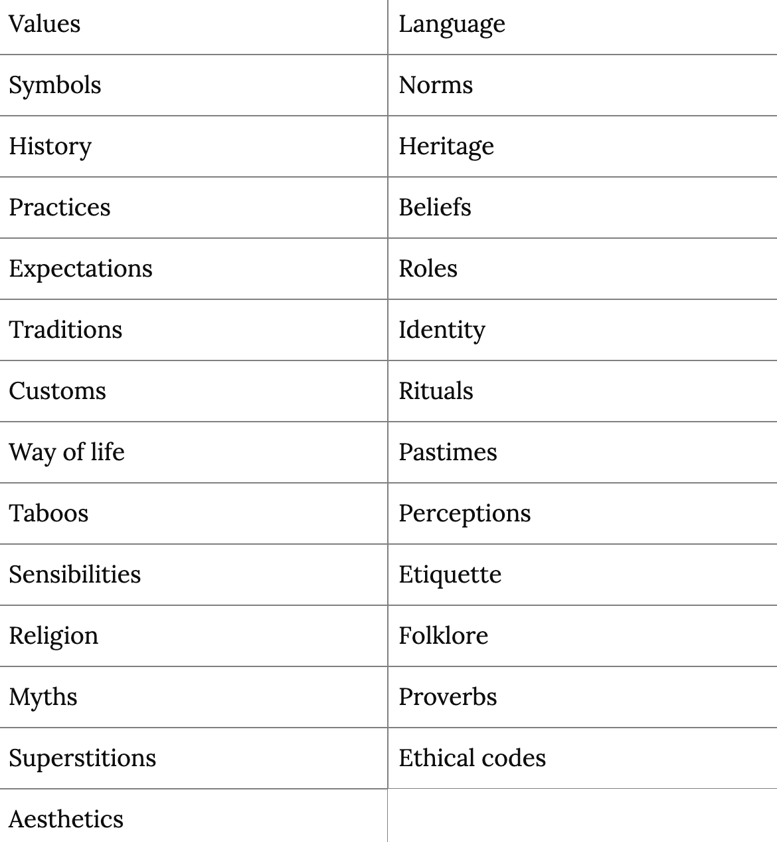
Using this Cultural Perspective List, choose any new examples that are relevant to the resource(s) and add that to your brain dump list.
Notes:
27 examples of cultural perspective. Simplicable. (n.d.). https://simplicable.com/society/cultural-perspective

Slide 10
Stand Up/Sit Down
Narrow your group’s list down to 3 themes.
Select a representative who will stand up and read one item from your list. Mark it off once you have read it.
Other groups will also mark this item off their own list if it’s too similar to something they already have.
Sit down once all of the themes you’ve listed have been said.
Notes:
K20 Center. (n.d.). Stand up, sit down. Strategies. https://learn.k20center.ou.edu/strategy/1771

Slide 11
Culture Inclusive Themes

Slide 12
Culture Inclusive Themes

Slide 13
Culture Inclusive Themes

Slide 14
Reflection
Our collective list reflects possible themes to consider when educating with perspective.
Reflect back to the video. Do you think any of the themes from the list were addressed?
Why is addressing these themes important?

Slide 15
Why-Lighting
As you read the Culture-Inclusive Learning brief, highlight parts of the brief that you deem important.
Keep a mental note of why these pieces were important to you.
Be prepared to discuss your reasoning.
Notes:
K20 Center. (n.d.). Why-lighting. Strategies. https://learn.k20center.ou.edu/strategy/128

Slide 16
Discuss: True for Who?
“
Integrating students’ cultural frameworks into the design of learning experiences leverages a deep well of prior knowledge, motivation, and relevance.
How does this benefit students of the dominant culture?
How does this benefit students of minoritized cultures?
How does this benefit the educator of both these students?

Slide 17
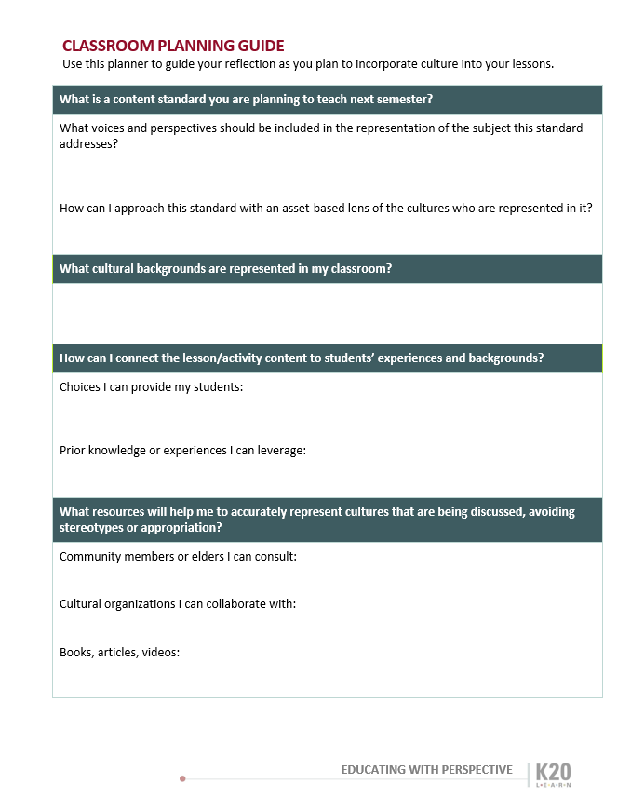
Plan an Activity
Reflect on an activity you will be facilitating soon.
Use the questions in the planning guide to ensure it is inclusive and meaningful for all students/stakeholders.

Slide 18
Point of Most Significance
What was the overall point of most significance for you during today’s session?
Notes:
K20 Center. (n.d.). Poms: point of most significance. Strategies. https://learn.k20center.ou.edu/strategy/101​​​​​​​

