Slide 2
Campus Visits:
Making Sense for Middle Schoolers

Slide 3
Essential Question
Why do campus visits make sense for middle schoolers?

Slide 4
Learning Objectives
Examine how early exposure to college campuses influences middle school students’ aspirations and academic motivation.
Assess online resources for supporting early college awareness and determine how to integrate them into specific schools or programs.

Slide 5
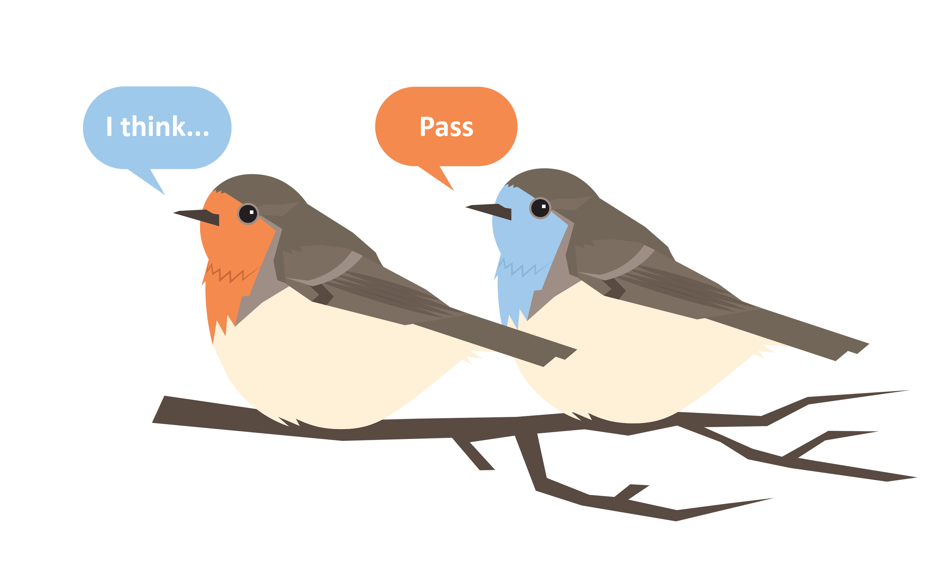
Round Robin
Instructions:
Designate a person in your group to record responses.
In your group, take turns answering the prompt as the recorder writes down the responses.
You will have one minute for each round.
If you don’t have an answer, say “pass.”
Notes:
K20 Center. (n.d.). Round robin. Strategies. https://learn.k20center.ou.edu/strategy/2183

Slide 6
Round Robin
Prompt:
What do middle schoolers think of when they hear “college”?
Notes:
K20 Center. (n.d.). Round robin. Strategies. https://learn.k20center.ou.edu/strategy/2183
K20 Center. (2021, September 21). K20 Center 1 minute timer [Video]. YouTube. https://www.youtube.com/watch?v=6ilD555O_RE

Slide 7
I Notice, I Wonder
In your small groups, read the research brief and the Campus Visit Data.
On your paper, write things you notice and things you wonder about the research brief and the data.
Notes:
K20 Center. (n.d.). I notice, I wonder. Strategies. https://learn.k20center.ou.edu/strategy/180

Slide 8
Campus Visit Activities
Navigate to the K20 LEARN website.
Locate the Middle School Campus Visit Collection in the “Educator Resources” tab.
Scan the resources in the collection.
Complete the I Notice, I Wonder chart under the “LEARN Resources” heading.
Notes:
K20 Center. (2021, September 21). K20 Center 7 minute timer [Video]. YouTube. https://www.youtube.com/watch?v=gWwvdLxwV9c
K20 Center. (n.d.). I notice, I wonder. Strategies. https://learn.k20center.ou.edu/strategy/180

Slide 9
Campus Visit Activities
As the music plays, walk around the room. When the music stops, the person closest to you will be your partner.
With your partner, discuss what you found during your examination of the Campus Visit resources.
Notes:
K20 Center. (n.d.). Mingle. Strategies. https://learn.k20center.ou.edu/strategy/53

Slide 10
Developing a Plan
With the members of your school team, review the steps of the Implementation Plan.
Complete the Implementation Plan using the Campus Visit resources and your knowledge of postsecondary institutions near your school site.

Slide 11
Wrapping Up
Draw a line down the center of a sticky note.
On one side, draw or write how you are feeling after this session.
On the other side, draw or white what you are thinking after this session.
Notes:
K20 Center. (n.d.). How am I feeling? What am I thinking?. Strategies. https://learn.k20center.ou.edu/strategy/187

