Slide 1
As we wait, visit learn.k20center.ou.edu

Slide 2
Make an Escape
Digital Breakouts in ELA
Notes:
Chelsee

Slide 3
Essential Question
How can an authentic, technology-enriched learning environment increase student engagement and academic performance?
Notes:
Margaret

Slide 4
Objectives
Participants will experience and analyze an authentic activity integrating technology and reflect on this experience to determine the relevant components of authenticity.
Participants will be able to identify how tools, such as Google Suite, use a component of authentic teaching.
Participants will apply the technology in their classroom and with their students in authentic instruction.
Notes:
Margaret

Slide 6
Skill Inventory Self Assessment
Using the five question self-assessment tool, read through each statement.
If you can do what the statement describes, give yourself 1 point.
If you cannot do what the statement describes, do not give yourself point.
Total your points.
Notes:
Margaret - handout

Slide 7
Give Me Five
Raise your hand and denote how many points you had from your self-assessment.
Find someone whose points will total 5 when added to yours.
Are you a 2? Find a 3!
Are you a 5? Find a 0!
Are you two 2s? Find a 1!
Notes:
Margaret

Slide 8
ELA
We have created a Digital Breakout for our Slay the Slang lesson on LEARN.
The ideas and concepts from that lesson are on full display.
With your partner, try to “break out.”
tinyurl.com/slaytheslangDB
Use the Digital Breakout handout to help you keep track of the activity.
Notes:
Margaret - Handout
USE THIS LINK: tinyurl.com/slaytheslangDB

Slide 9
Slay The Slang
Standards:
7.3.R.6 - Students will analyze the structures of texts and content by making inferences about texts and use textual evidence to draw simple logical conclusions.
7.7.R.2 - Students will analyze the impact of selected media and formats on meaning.
Notes:
After they complete the breakout, go over these standards that are addressed by the lesson.

Slide 10
Slay The Slang
ISTE Standard (if participating):
Computational Thinker: Students develop and employ strategies for understanding and solving problems in ways that leverage the power of technological methods to develop and test solutions.
Notes:
What is ISTE? The International Society for Technology in Education. They have standards for students, teachers, administrators, and instructional coaches.

Slide 11
Slay The Slang
ISTE Standard (if creating):
Knowledge Constructor: Students critically curate a variety of resources using digital tools to construct knowledge, product creative artifacts, and make meaningful learning experiences for themselves and others.

Slide 13
What Are Digital Breakouts?
Have you ever participated in an escape room?
Think of this as a digital version.
You can purchase kits from Breakout EDU or you can create them for free using GSuite.
Locks
Color Locks
Directional Locks
Word Locks
Date Locks
Emoji Locks
Notes:
Chelsee

Slide 14
Pre-made Options
There is a sandbox with 240 breakouts made by fellow teachers.
Use this link: https://tinyurl.com/y53lkqvf
Additional resources: tinyurl.com/DBIdeas
With your partner, explore these options and take a look at what each breakout offers.
What do you like?
What would you do differently?
Notes:
Chelsee - handout
https://tinyurl.com/y53lkqvf
tinyurl.com/DBIdeas

Slide 16
Create Your Own
Now that we have gone over the basics of digital breakouts, use the organizers to put together your own.
Use the Sites organizer to help you decide on theme and clues.
Use the Locks organizer to help you keep track of lock types, answers, and clues.
Need more guidance or help?
Let us know!

Slide 18
Google Sites
The first step to building your own breakout is creating a Google Site.
To do this…
Sign in to your Google account
Select the waffle button
Find the Site icon
Click “Create”
Do NOT select “Classic”

Slide 19
Google Sites
In the upper left corner, type in your website name.
Example: Mr. Smith’s US History
In the center of the page, type in the name of your page.
Example: Reconstruction Breakout
Using the scroll panel on the right, select different template options for your page.
These will be where you can change the page layouts or add in photos, videos, and/or hyperlinks for the answers to your “locks.”
Want to change the colors and look of your site?
Select the “Themes” tab from the scroll panel.

Slide 20
Google Forms
Forms are the essential part of the digital breakout.
Go back to your Google Drive page & click the waffle button.
Click on the purple “Forms” icon.
Start a new “Blank” form.
“Untitled Form”
Change this to match your Google Site.
“Form description”
Add a description or scenario, if you like.
Example: “You have gone back in time to the Roaring 20s! In order to make it back to your century and avoid wreaking havoc on the historical record, you must use the clues to solve the locks below.”

Slide 21
Google Forms
To properly format the forms, you must…
“Untitled Question”
Change this to your lock and any pertinent information.
Example: “Color Lock (All caps, R=Red, B=Blue, etc.)”
“Multiple Choice”
Change this to short answer.
Toggle the Required button to “on.”
Select the three dots next to this button and click “Response Validation.”
Change “number” to “regular expression”
Change “pattern” to the answer of your lock.
Change “custom error text” to a clue that might help students solve the lock
But don’t make it too easy!
Ready to add more locks?
Select the + on the right side and repeat the above steps.

Slide 22
Conditional Formatting = Color Locks
Want to create a trickier color lock for students?
Consider using Google Sheets and conditional formatting.
An easy way to do this is to create two columns.
Label cell A1 “definitions”
Label cell B1 “terms”
In cell A2, type in “This territory achieved statehood in 1907.”
In cell B2, right click and select “conditional formatting.”
In the new dialog box on the right, change “is not empty” to “text contains.”
In the “value or formula,” type in “Oklahoma.”
Notice the color of the “default” box. This is where you would change colors for different cells.
Click “Done.”
Go back to cell B2 and type in “Oklahoma.”
Tada! You’ve just created a color lock.
Notes:
Chelsee

Slide 23
Okay, But How Do I Force A Copy?
Once you have created a conditionally formatted sheet, copy the shareable link from the Share button.
Paste this in a new browser window, but DO NOT hit enter.
Delete the letters to the forward slash and then type in copy.
Now hit enter.
Use this link as hyperlink in your Google Site.
Notes:
Chelsee

Slide 24
What Can I Use?
Need more ideas for clues and lock answers?
Consider these…
Youtube videos
A keyword can be used as a lock solution.
Brief passages or documents with multiple choice questions
The correct answers can be used as a lock solution.
Maps
Information can be used a lock solution or directional lock solution.
Puzzles
Use Jigsaw Planet and your own images to create puzzles to hyperlink.
Google Draw
Create a document that, when solved, reveals a word that solves a lock.
Notes:
Margaret

Slide 25
How To Hack
Want to use a pre-made digital breakout but don’t know the correct answers?
Right click on the lock form, but not in an answer blank.
Select “View Frame Source.”
Scroll to the bottom of the page past all of the code until you see separated lines and white space.
In the parentheses, you will see the lock titles and the corresponding answers.
Notes:
Chelsee

Slide 27
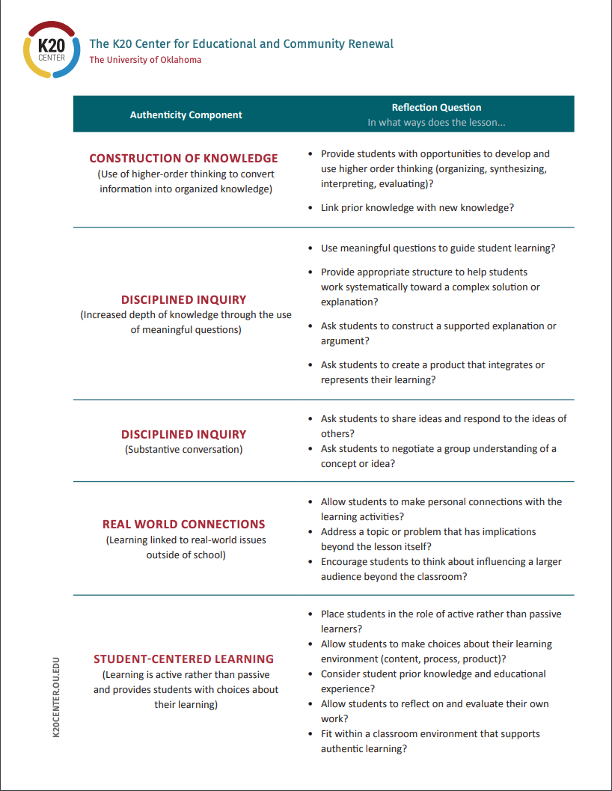
Authentic Lesson Reflection Tool
https://tinyurl.com/yyro3ta7
Notes:
Margaret
https://tinyurl.com/yyro3ta7

Slide 28
Authentic Reflection Tool
Use the lesson reflection tool to think about the ways in which this activity lines up with the components of authenticity.
How could this activity be modified to make it even more authentic?
How could this activity have been done without the use of technology?

Slide 29
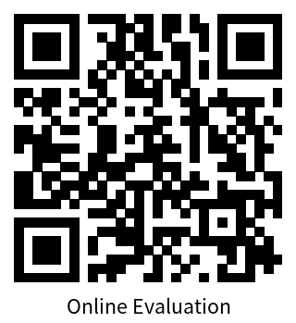
Rapid Feedback Slide
https://trek.k20center.ou.edu/oe/1225
Notes:
https://trek.k20center.ou.edu/oe/1225

