Slide 2
Make an Escape
Digital Breakouts
Notes:
Kristen

Slide 3
Essential Question
How can an authentic, technology-enriched learning environment increase student engagement and academic performance?

Slide 4
Objectives
Participants will experience and analyze an authentic activity integrating technology and reflect on this experience to determine the relevant components of authenticity
Participants will be able to identify how tools, such as Google Suite, use a component of authentic teaching.
Participants will apply the technology in their classroom and with their students in authentic instruction.

Slide 5
Notes:
Adam - 40 minutes

Slide 6
Skill Inventory Self Assessment
Using the five question self-assessment tool, read through each statement.
If you can do what the statement describes, give yourself 1 point.
If you cannot do what the statement describes, do not give yourself point.
Total your points.

Slide 7
Give Me Five
Raise your hand and denote how many points you had from your self-assessment.
Find someone whose points will total 5 when added to yours.
Are you a 2? Find a 3!
Are you a 5? Find a 0!
Are you two 2s? Find a 1!

Slide 8
Social Studies
We have created a Digital Breakout for our Propaganda & the American Revolution lesson on LEARN.
The ideas and concepts from that lesson are on full display.
With your partner, try to “break out.”
tinyurl.com/RevWarBreakout
Use the Digital Breakout handout to help you keep track of the activity.
Notes:
Give them the handout to help process it.
Propaganda & the American Revolution: https://learn.k20center.ou.edu/lesson/bb01792b8b7ae172f01b1c728a036f0c
LEARN: https://learn.k20center.ou.edu/
Breakout: https://tinyurl.com/RevWarBreakout

Slide 9
SS Propaganda & the American Revolution
OAS Standard:
8.1.5 - Analyze the ideological and propaganda war between Great Britain and the colonies including:
points of views of the Patriots and the Loyalists
use of Paul Revere’s engraving of the Boston Massacre

Slide 10
SS Propaganda & the American Revolution
ISTE Standard (if participating):
Computational Thinker: Students develop and employ strategies for understanding and solving problems in ways that leverage the power of technological methods to develop and test solutions.

Slide 11
SS Propaganda & the American Revolution
ISTE Standard (if creating):
Knowledge Constructor: Students critically curate a variety of resources using digital tools to construct knowledge, product creative artifacts, and make meaningful learning experiences for themselves and others.

Slide 12
Notes:
Kristen 30 minutes ish

Slide 13
What Are Digital Breakouts?
Have you ever participated in an escape room?
Think of this as a digital version.
You can purchase kits from Breakout EDU or you can create them for free using GSuite.
Locks
Color Locks
Directional Locks
Word Locks
Date Locks
Emoji Locks

Slide 14
Pre-made Options
There is a sandbox with 240 breakouts made by fellow teachers.
Use this link: https://tinyurl.com/y53lkqvf
Additional resources: tinyurl.com/DBIdeas
With your partner, explore these options and take a look at what each breakout offers.
What do you like?
What would you do differently?
Notes:
Give lock types hand out so they can explore and see what they like and don't like.
https://tinyurl.com/y53lkqvf
http://tinyurl.com/DBIdeas

Slide 15
Notes:
Adam - 1 hour

Slide 16
Create Your Own
Now that we have gone over the basics of digital breakouts, use the organizers to put together your own.
Use the Sites organizer to help you decide on theme and clues.
Use the Locks organizer to help you keep track of lock types, answers, and clues.
Need more guidance or help?
Let us know!
Notes:
30 minutes
Doesn’t have to be purely digital. Can be just a form with clues around the room like in books or centers etc. clues can be on different colors of paper and the final color paper can be the color lock etc. can be personalized however you want. Bulk of PD is done

Slide 17
Notes:
Kristen 30 minutes

Slide 18
Google Sites
The first step to building your own breakout is creating a Google Site.
To do this…
Sign in to your Google account
Select the waffle button
Find the Site icon
Click “Create”
Do NOT select “Classic”
Notes:
Adam - Pass out the handout for planning creating the digital breakout

Slide 19
Google Sites
In the upper left corner, type in your website name.
Example: Mr. Smith’s US History
In the center of the page, type in the name of your page.
Example: Reconstruction Breakout
Using the scroll panel on the right, select different template options for your page.
These will be where you can change the page layouts or add in photos, videos, and/or hyperlinks for the answers to your “locks.”
Want to change the colors and look of your site?
Select the “Themes” tab from the scroll panel.

Slide 20
Google Forms
Forms are the essential part of the digital breakout.
Go back to your Google Drive page & click the waffle button.
Click on the purple “Forms” icon.
Start a new “Blank” form.
“Untitled Form”
Change this to match your Google Site.
“Form description”
Add a description or scenario, if you like.
Example: “You have gone back in time to the Roaring 20s! In order to make it back to your century and avoid wreaking havoc on the historical record, you must use the clues to solve the locks below.”

Slide 21
Google Forms
To properly format the forms, you must…
“Untitled Question”
Change this to your lock and any pertinent information.
Example: “Color Lock (All caps, R=Red, B=Blue, etc.)”
“Multiple Choice”
Change this to short answer.
Toggle the Required button to “on.”
Select the three dots next to this button and click “Response Validation.”
Change “number” to “regular expression”
Change “pattern” to the answer of your lock.
Change “custom error text” to a clue that might help students solve the lock
But don’t make it too easy!
Ready to add more locks?
Select the + on the right side and repeat the above steps.

Slide 22
Conditional Formatting = Color Locks
Want to create a trickier color lock for students?
Consider using Google Sheets and conditional formatting.
An easy way to do this is to create two columns.
Label cell A1 “definitions”
Label cell B1 “terms”
In cell A2, type in “This territory achieved statehood in 1907.”
In cell B2, right click and select “conditional formatting.”
In the new dialog box on the right, change “is not empty” to “text contains.”
In the “value or formula,” type in “Oklahoma.”
Notice the color of the “default” box. This is where you would change colors for different cells.
Click “Done.”
Go back to cell B2 and type in “Oklahoma.”
Tada! You’ve just created a color lock.

Slide 23
Okay, But How Do I Force A Copy?
Once you have created a conditionally formatted sheet, copy the shareable link from the Share button.
Paste this in a new browser window, but DO NOT hit enter.
Delete the letters to the forward slash and then type in copy.
Now hit enter.
Use this link as hyperlink in your Google Site.

Slide 24
What Can I Use?
Need more ideas for clues and lock answers?
Consider these…
Youtube videos
A keyword can be used as a lock solution.
Brief passages or documents with multiple choice questions
The correct answers can be used as a lock solution.
Maps
Information can be used a lock solution or directional lock solution.
Puzzles
Use Jigsaw Planet and your own images to create puzzles to hyperlink.
Google Draw
Create a document that, when solved, reveals a word that solves a lock.
Notes:
Jigsaw Planet: https://www.jigsawplanet.com/

Slide 25
How To Hack
Want to use a pre-made digital breakout but don’t know the correct answers?
Right click on the lock form, but not in an answer blank.
Select “View Frame Source.”
Scroll to the bottom of the page past all of the code until you see separated lines and white space.
In the parentheses, you will see the lock titles and the corresponding answers.

Slide 26
Notes:
Kristen

Slide 27
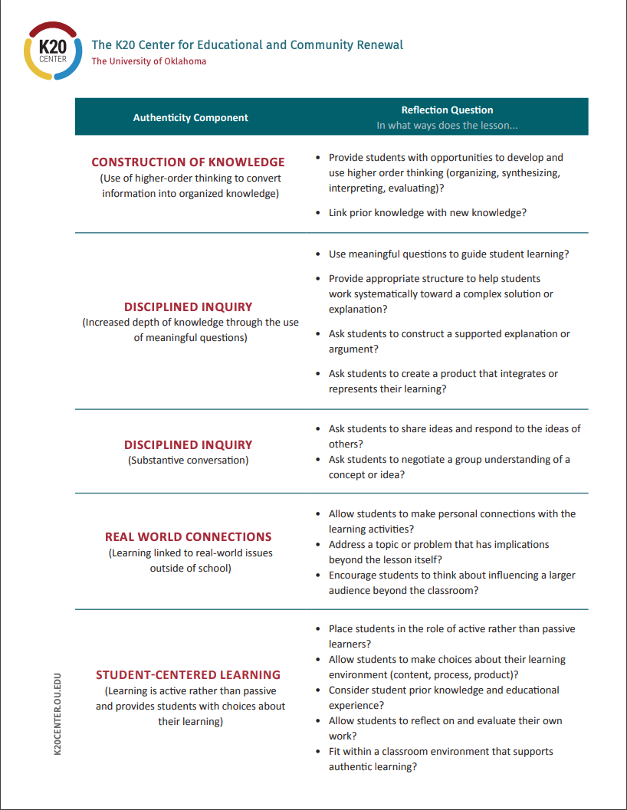
Authentic Lesson Reflection Tool
Notes:
Go through this and see that the breakout alone doesn’t hit all the components so that’s why it’s important to do these in conjunction with a lesson.

Slide 28
Authentic Reflection Tool
Use the lesson reflection tool to think about the ways in which this activity lines up with the components of authenticity.
How could this activity be modified to make it even more authentic?
How could this activity have been done without the use of technology?

Slide 29
Rapid Feedback
Trek.k20center.ou.edu
FUTURE - #1223
Professional Development: Make an Escape Digital Breakout Social Studies
Choose: Evaluation
Notes:
JULY

Slide 30
Rapid Feedback Slide
trek.k20center.ou.edu
GEAR UP for the FUTURE #1223 Professional Development: Make an Escape Digital Breakout Social Studies
Choose: Evaluation
Notes:
Check the trek event and put in the info here

Slide 31
Rapid Feedback Slide
trek.k20center.ou.edu
GEAR UP for the FUTURE #1317 Action Plan: Using PLANS for School Action Plans
Choose: Evaluation
Notes:
Check the trek event and put in the info here

