Slide 2
From Insight to Impact:
Data-Informed Action Planning for Student Success

Slide 3

Beach Ball Talk and Toss
Red: What are some strengths about your school?
Yellow: What’s one school improvement initiative you’re most proud of and why?
White: If you had unlimited resources, what’s the first thing you’d invest in to improve your school?
Green: What’s a small change you’ve seen make a big impact in your school or district?
Blue: If you could have a data analysis team made up of any fictional characters, who would they be?
Orange: If your school day had a soundtrack, what song would kick it off?
Notes:
K20 Center. (n.d.). Beach ball talk and toss. Strategies. https://learn.k20center.ou.edu/strategy/3049

Slide 4

Four Corners
What factor has the greatest impact on high school graduation rates and college and career readiness?
Notes:
K20 Center. (n.d.). Four corners. Strategies. https://learn.k20center.ou.edu/strategy/138

Slide 5

Gallery Walk
Roots: possible causes that can positively or negatively impact each data point.
Routes: ways to improve or continue to positively impact each data point.
Notes:
K20 Center. (n.d.). Gallery walk. Strategies. https://learn.k20center.ou.edu/strategy/118

Slide 6
Objectives
Apply a data-driven decision-making process to identify school needs.
Develop a plan to address the identified school needs.

Slide 7
Essential Question
What role does data-driven decision-making play in ensuring meaningful student outcomes and readiness for life beyond high school?

Slide 8


Data-Driven Decision-Making Jigsaw
Please read your assigned section of the Data-Driven Decision-Making brief.
As you read, highlight sentences or passages that seem important to your understanding of the reading. Write why you highlighted it in the margin.
Notes:
K20 Center. (n.d.). Jigsaw. Strategies. https://learn.k20center.ou.edu/strategy/179
K20 Center. (n.d.). Why-lighting. Strategies. https://learn.k20center.ou.edu/strategy/128

Slide 9
Root Cause Analysis
Purpose: Identifies underlying causes of problems—not just symptoms—to drive lasting, systemic change.
Approach:
Collaborative and data-informed
Uses both quantitative and qualitative data
Impact: Promotes systems thinking and supports data-driven decision-making for targeted improvement.

Slide 10
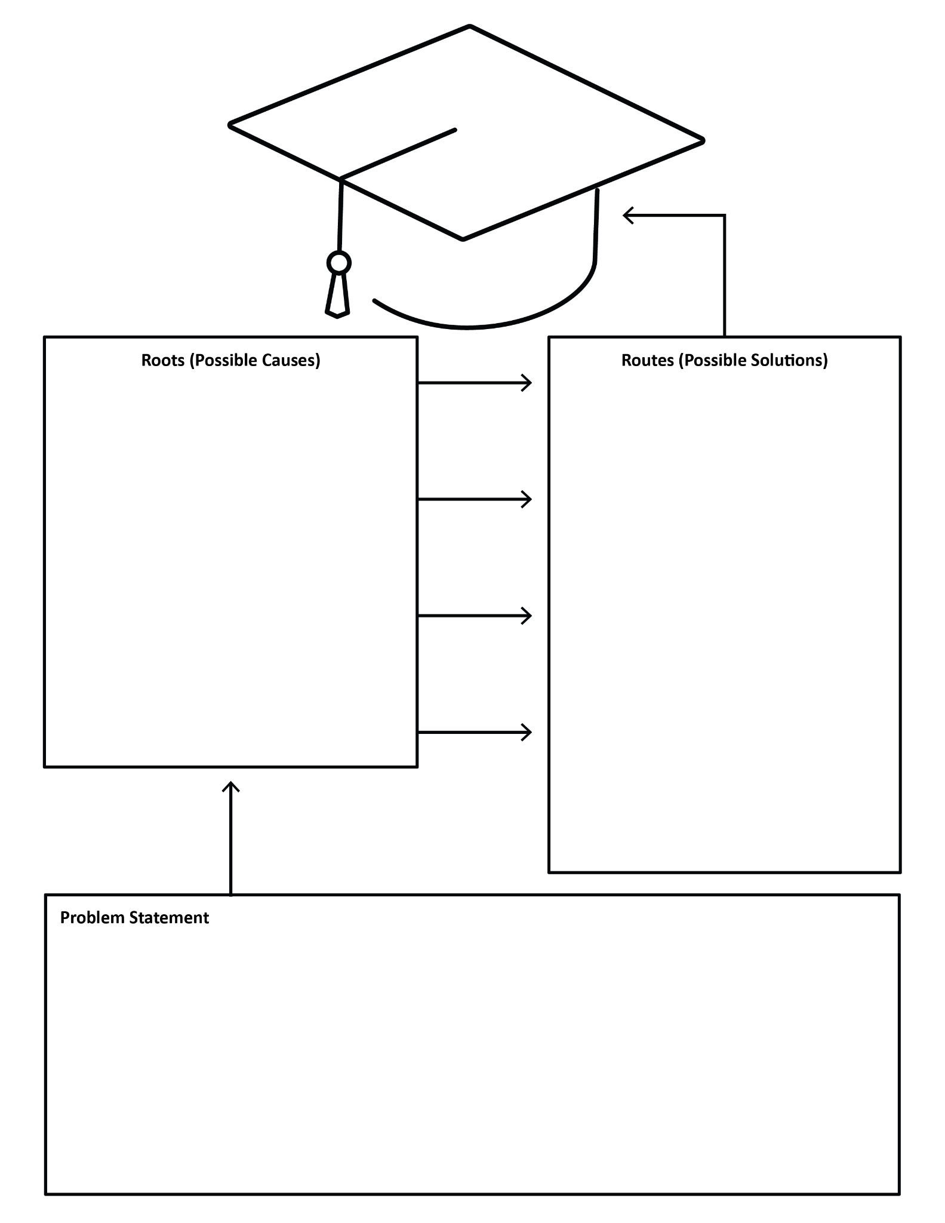
Roots and Routes
Analyze Anywhere School’s data sheets to identify the school’s main problem.
Complete the graphic organizer with a problem statement, possible root cause(s), and possible routes to solutions.
Be prepared to share out with the group.
Notes:
K20 Center. (n.d.). Roots and routes. Strategies. https://learn.k20center.ou.edu/strategy/3743

Slide 11

S-I-T
As you read through your data, consider what you see as:
Strengths (✰)
Interesting (!)
Thought-Provoking (?)
Notes:
K20 Center. (n.d.). S-I-T. Strategies. https://learn.k20center.ou.edu/strategy/926

Slide 12
Crafting the Problem Statement
Take a minute and craft your own problem statement based on what you found in your data.
We are not focused yet on potential solutions, just naming the problem.
Example: 53% of 8th grade students are missing more than five days a year.

Slide 13
S
pecific
What Are SMART Goals?
M
easurable
A
chievable
R
elevant
T
ime bound

Slide 14
SMART Goals
Specific: The goal clearly defines what you want to accomplish, who is involved, and how it will be achieved.
Measurable: The goal includes concrete criteria that allow you to track progress and know when it has been met.
Achievable: The goal is realistic and attainable given available time, resources, and capacity.
Relevant: The goal matters to the work at hand and aligns with broader priorities or objectives.
Time-bound: The goal has a defined deadline or timeframe that creates focus and accountability.

Slide 15
Action Plan SMART Goal Example
By the end of the 2025–2026 school year, boost attendance among targeted 9th grade students from 88% to 95% using a check-in/check-out system and weekly incentives.

Slide 16

3-2-1
What are three potential avenues for your intervention?
What are two ideas you might research further?
What is one obstacle you will still need to address?
Notes:
K20 Center. (n.d.). 3-2-1. Strategies. https://learn.k20center.ou.edu/strategy/117

Slide 17
Next Steps
Create a main goal as a whole group.
Research and decide on a potential intervention.
Start implementation!

