Slide 2
Enhancing School Attendance through Structured Mentoring Programs
An Overview of Check & Connect®

Slide 3
How can stakeholders contribute to Check & Connect® success?

Slide 4
Session Objectives
Examine the roles & responsibilities of all stakeholders in the Check & Connect® program
Explore the data and types of support necessary for Check & Connect® mentors to implement the program effectively.
Determine personal readiness and commitment to support the implementation of the Check & Connect® program.

Slide 5


Student Engagement
On each poster, answer one of the following questions.
  How would you describe an engaged student? What does an engaged student…
    Look like?
    Sound like?
    Feel like?
Respond to each question using words and/or images.
Notes:
K20 Center. (n.d.). Chalk talk. Strategies. https://learn.k20center.ou.edu/strategy/197
K20 Center. (n.d.). Looks like, sounds like, feels like. Strategies. https://learn.k20center.ou.edu/strategy/88

Slide 6
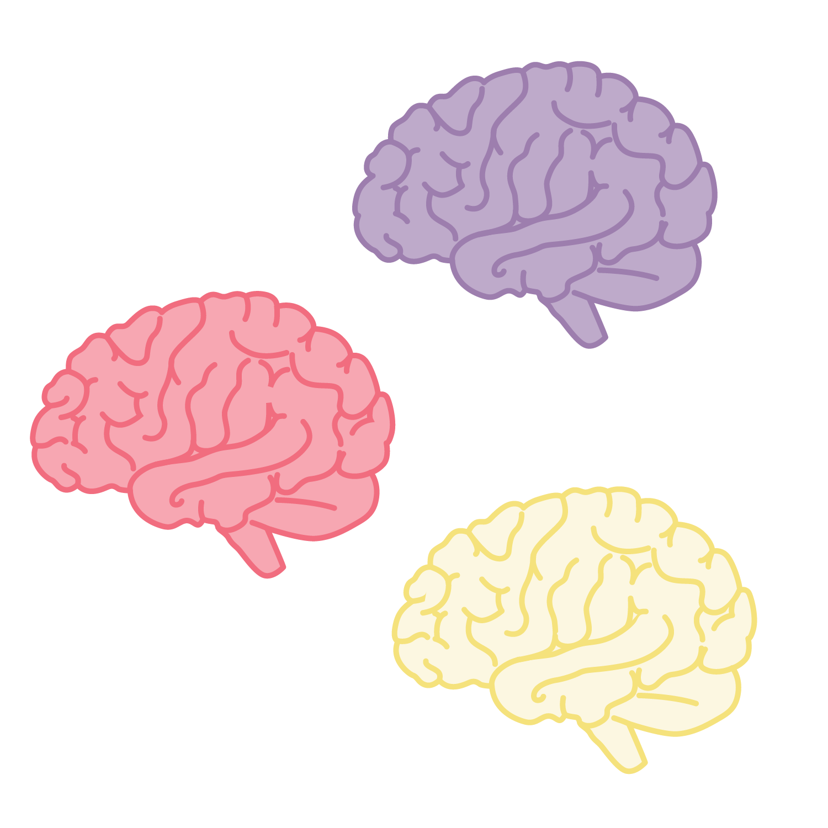
Collective Brain Dump
What factors are likely to lead a student to drop-out of high school?
Notes:
K20 Center. (n.d.). Collective brain dump. Strategies. https://learn.k20center.ou.edu/strategy/111

Slide 7

Static or Dynamic?
Determine whether each factor identified is static or dynamic.
Sort each card under the static or dynamic heading.
  Static = cannot be changed through intervention
  Dynamic = can be improved with targeted support
Notes:
K20 Center. (n.d.). Card Sort. Strategies. https://learn.k20center.ou.edu/strategy/147

Slide 8
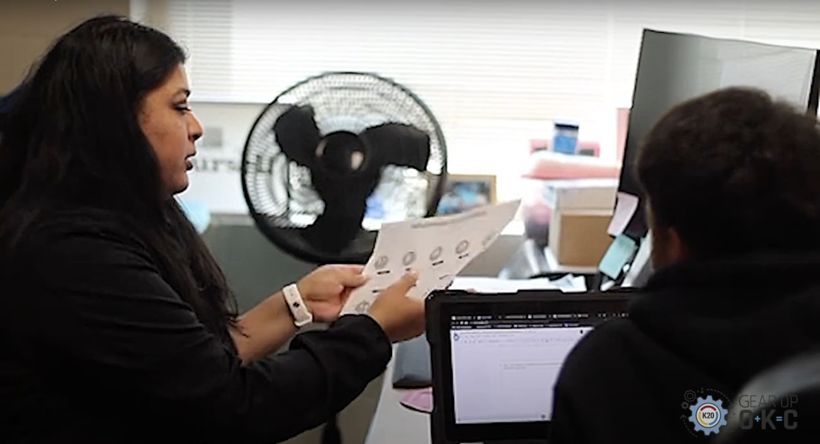
Check & Connect®
Notes:
K20 Center. (2025, July 11). GEAR UP Check and Connect Testimonial [Video]. YouTube. https://youtu.be/UWFasBzMws0?si=_-vKng6pRWP6dxOe

Slide 9





The Check & Connect Program: “Check”
Student Data
Attendance
Behavior
Course Performance
Informed Student Support
Recognize Patterns
Celebrate Success
Timely Interventions
Notes:
[add citation for Check & Connect]

Slide 10






The Check & Connect Program: “Check”
Student’s Needs
& Perspective
“Check” Student’s data
Family Influences &
Circumstances
Available School &
Community Resources
Notes:
Icons from:
https://stock.adobe.com/images/communication-icon/1460565148
https://stock.adobe.com/images/magnifying-glass-line-icon/647357105
https://stock.adobe.com/images/line-style-icons-of-family-and-friend-donor-circles-give-together-badge-donor-team-board-family-encouragement-tag-shared-appointment-icon-donor-buddy-system-file-community-group-donation-host/1481001170
https://stock.adobe.com/images/magnifying-glass-line-icon/647357105
[add citation for Check & Connect]

Slide 11
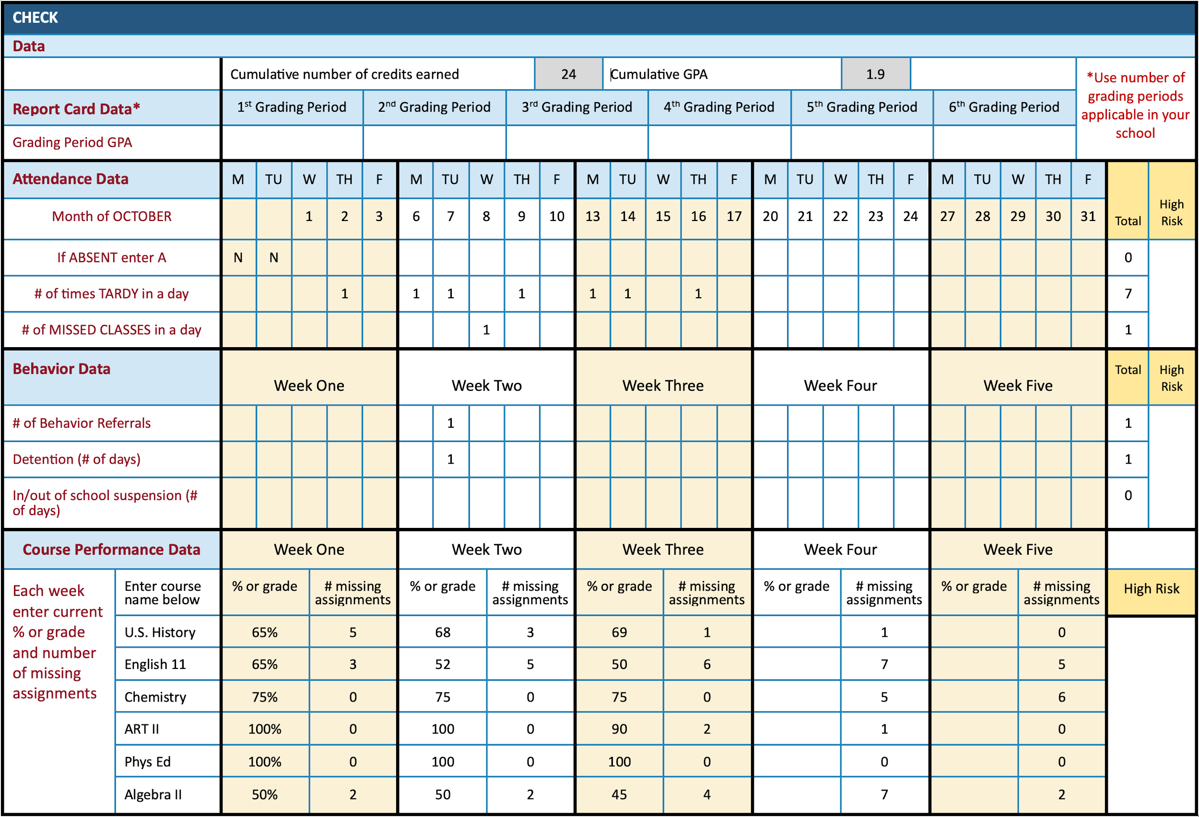
Sample Student Data
Notes:
[add citation for Check & Connect]

Slide 12

I Notice, I Wonder
What do you notice about the data?
Thinking about your role, who else do you need support from to help this student?
  What do you need from them (extra information, data, etc.)?
What do you wonder about how to help this student?
Notes:
K20 Center. (n.d.). I notice, I wonder. Strategies. https://learn.k20center.ou.edu/strategy/180

Slide 13
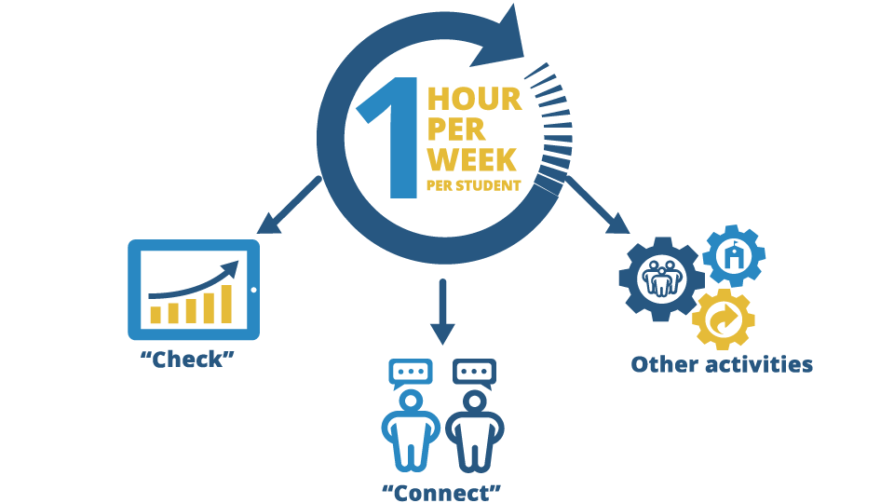
Mentor Tasks and Time
Notes:
[add citation for Check & Connect]

Slide 14

Four Corners
Who do you think has the most important
role in supporting the success of Check & Connect®?
Students
Family/Guardian
Mentors
School Staff
Notes:
K20 Center. (n.d.). Four corners. Strategies. https://learn.k20center.ou.edu/strategy/138

Slide 15

Stakeholder Support
How does each stakeholder support the
success of the Check & Connect® program?

Slide 16

List of 8
In your small groups
Select a scribe
Determine an order for everyone in your group to respond (clockwise, etc.)
Quickly respond to each prompt, one response per person, in the order you determined
Say “pass” if you cannot think of a response, the next person in the determined order can then respond
Notes:
K20 Center. (n.d.). List of 8. Strategies. https://learn.k20center.ou.edu/strategy/3616

Slide 17
List of 8
List 8 characteristics or skills of a good mentor
List 8 roles a mentor plays in the life of a student
List 8 resources a mentor needs to support a student
List 8 ways a family can help a student remain in school
List 8 things a student can do to remain in school
List 8 things school staff can do to help a student remain in school
Notes:
K20 Center. (n.d.). List of 8. Strategies. https://learn.k20center.ou.edu/strategy/3616

Slide 18
What a Mentor is Not
Mentors play an intentional and specific role. However, they are not a
Disciplinarian
Therapist
Counselor
Replacement parent or guardian
Teacher’s assistant
Translator for the school

Slide 19
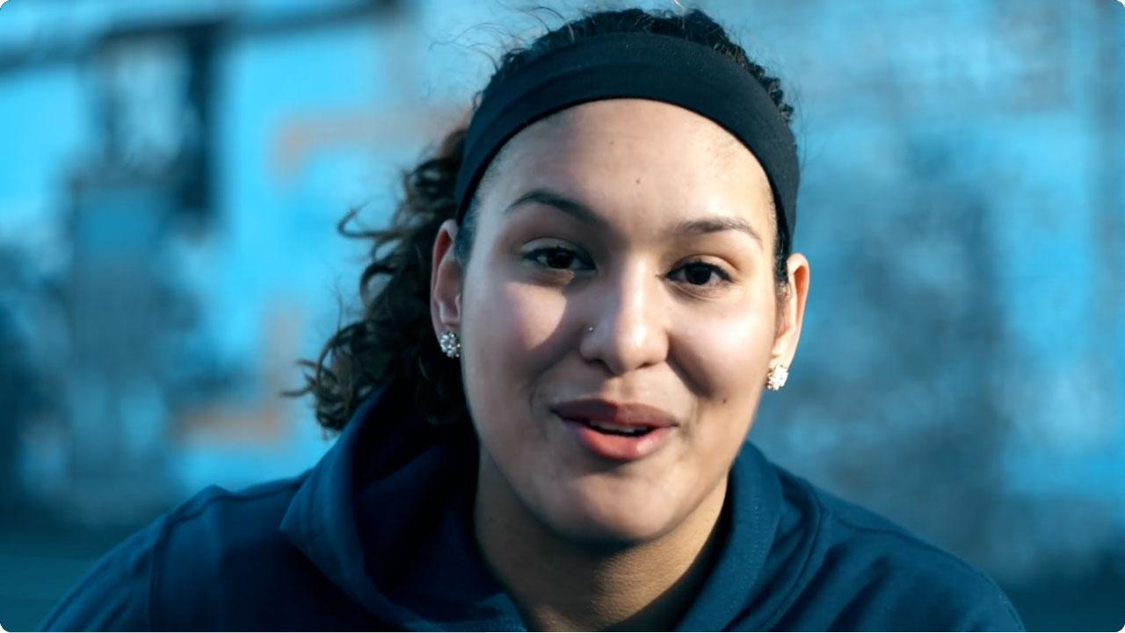
“If You Mentor Me…”
Notes:
@mentoringorg. (2018, January 2). “If You Mentor Me...” https://youtu.be/gcnX-wvp98Q?si=4wM_x_3uF8ZezIxP

Slide 20

How Am I Feeling? What Am I Thinking?
How are you feeling about the Check & Connect® program?
What are you thinking about your role in supporting the Check & Connect® program?
Notes:
K20 Center. (n.d.). How am I feeling? What am I thinking?. Strategies. https://learn.k20center.ou.edu/strategy/187

