Slide 2
Enhancing School Attendance through Structured Mentoring Programs
An Overview of Check & Connect®

Slide 3


Student Engagement
How would you describe an engaged student? What does an engaged student…
    Look like?
    Sound like?
    Feel like?
Respond to each question using words and/or images.
Notes:
K20 Center. (n.d.). Chalk talk. Strategies. https://learn.k20center.ou.edu/strategy/197
K20 Center. (n.d.). Looks like, sounds like, feels like. Strategies. https://learn.k20center.ou.edu/strategy/88

Slide 4
Essential Question
How can stakeholders contribute to the success of Check & Connect®?

Slide 5
Session Objectives
Examine the roles & responsibilities of all stakeholders in the Check & Connect® program.
Explore the data and types of support necessary for Check & Connect® mentors to implement the program effectively.
Determine personal readiness and commitment to support the implementation of the Check & Connect® program.

Slide 6
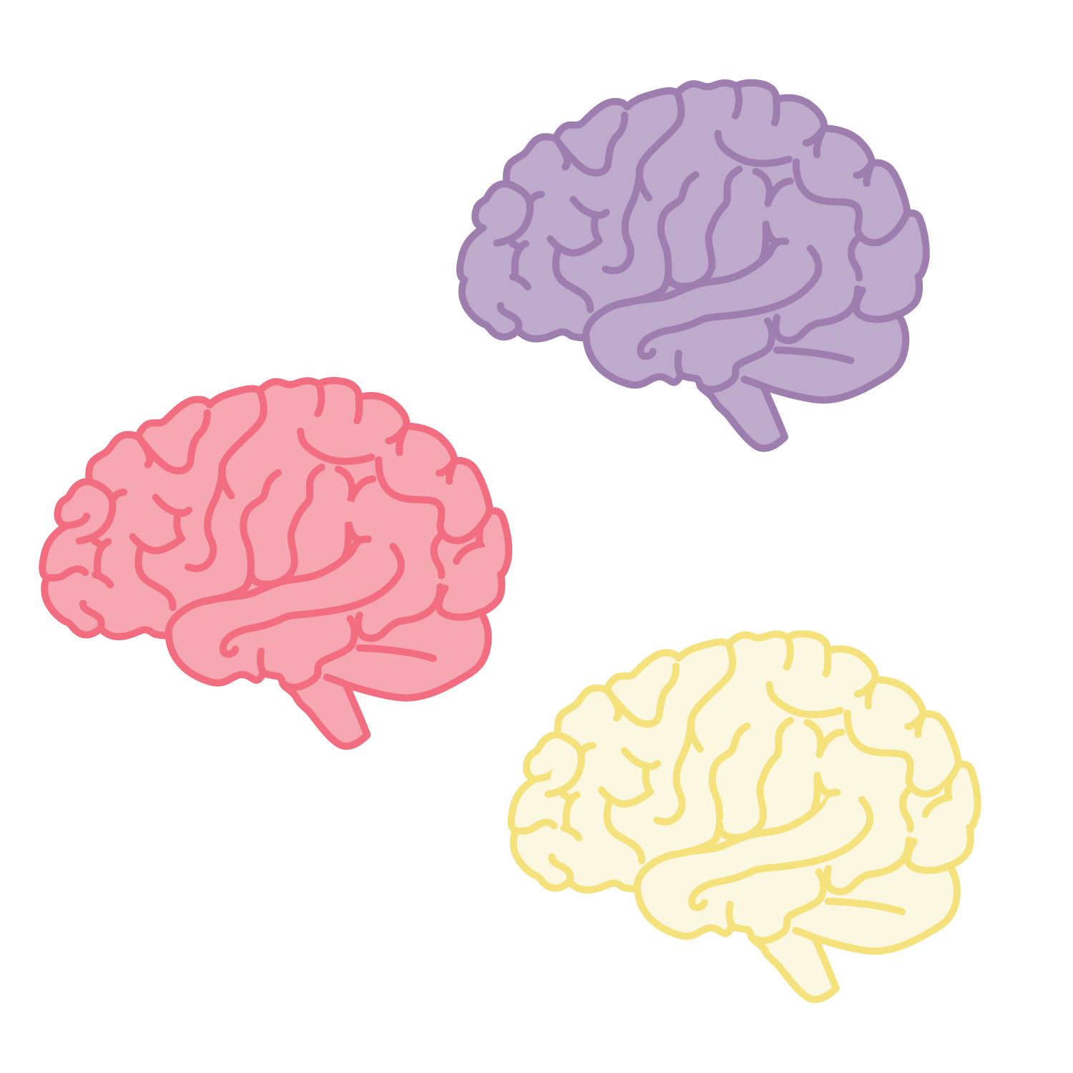
Collective Brain Dump
What factors are likely to lead a student to drop-out of high school?
Notes:
K20 Center. (n.d.). Collective brain dump. Strategies. https://learn.k20center.ou.edu/strategy/111

Slide 7
Top 10 Reasons Students Left High School
10. Physical or medical problems: 3%
9. I was a member of a gang: 4%
8. I got pregnant/gave birth: 11%
7. I got into drugs: 12%
6. I was held back: 14%
5. No one cared whether I attended or not: 18%
4. I had to make money to support my family: 19%
3. School wasn’t relevant to my life: 19%
2. I was bored: 26%
1. I was failing too many classes: 28%
americaspromise.org/
Notes:
Join nonprofit leadership network. America’s Promise Alliance. (n.d.). America's Promise Alliance | Join Nonprofit Leadership Network/

Slide 8

Static or Dynamic?
Determine whether each factor identified is static or dynamic.
Sort each card under the static or dynamic heading.
  Static = cannot be changed through intervention
  Dynamic = can be improved with targeted support
Notes:
K20 Center. (n.d.). Card Sort. Strategies. https://learn.k20center.ou.edu/strategy/147

Slide 9
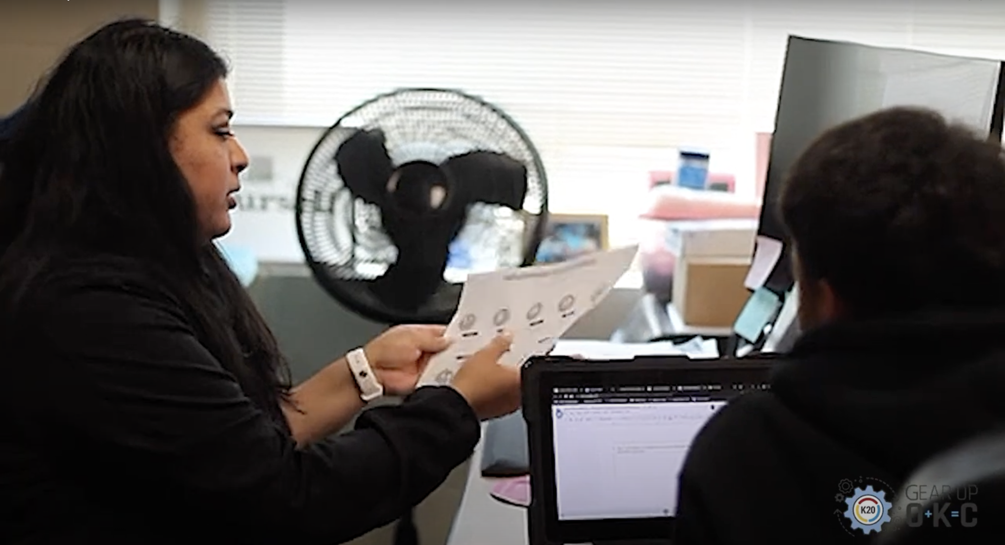
Check & Connect®
Notes:
K20 Center. (2025, July 11). GEAR UP Check and Connect Testimonial [Video]. YouTube. https://youtu.be/UWFasBzMws0?si=_-vKng6pRWP6dxOe

Slide 10





The Check & Connect Program: “Check”
Student Data
Attendance
Behavior
Course Performance
Informed Student Support
Recognize Patterns
Celebrate Success
Timely Interventions
Notes:
Oklahoma GEAR UP. (2020). Check & Connect program overview. https://www.okgearup.org/wp-content/uploads/2020/10/Check-and-Connect-brochure.pdf [okgearup.org]

Slide 11






The Check & Connect Program: “Check”
Student’s Needs
& Perspective
“Check” Student’s data
Family Influences &
Circumstances
Available School &
Community Resources
Notes:
Icons from:
https://stock.adobe.com/images/communication-icon/1460565148
https://stock.adobe.com/images/magnifying-glass-line-icon/647357105
https://stock.adobe.com/images/line-style-icons-of-family-and-friend-donor-circles-give-together-badge-donor-team-board-family-encouragement-tag-shared-appointment-icon-donor-buddy-system-file-community-group-donation-host/1481001170
https://stock.adobe.com/images/magnifying-glass-line-icon/647357105
Oklahoma GEAR UP. (2020). Check & Connect program overview. https://www.okgearup.org/wp-content/uploads/2020/10/Check-and-Connect-brochure.pdf [okgearup.org]

Slide 12
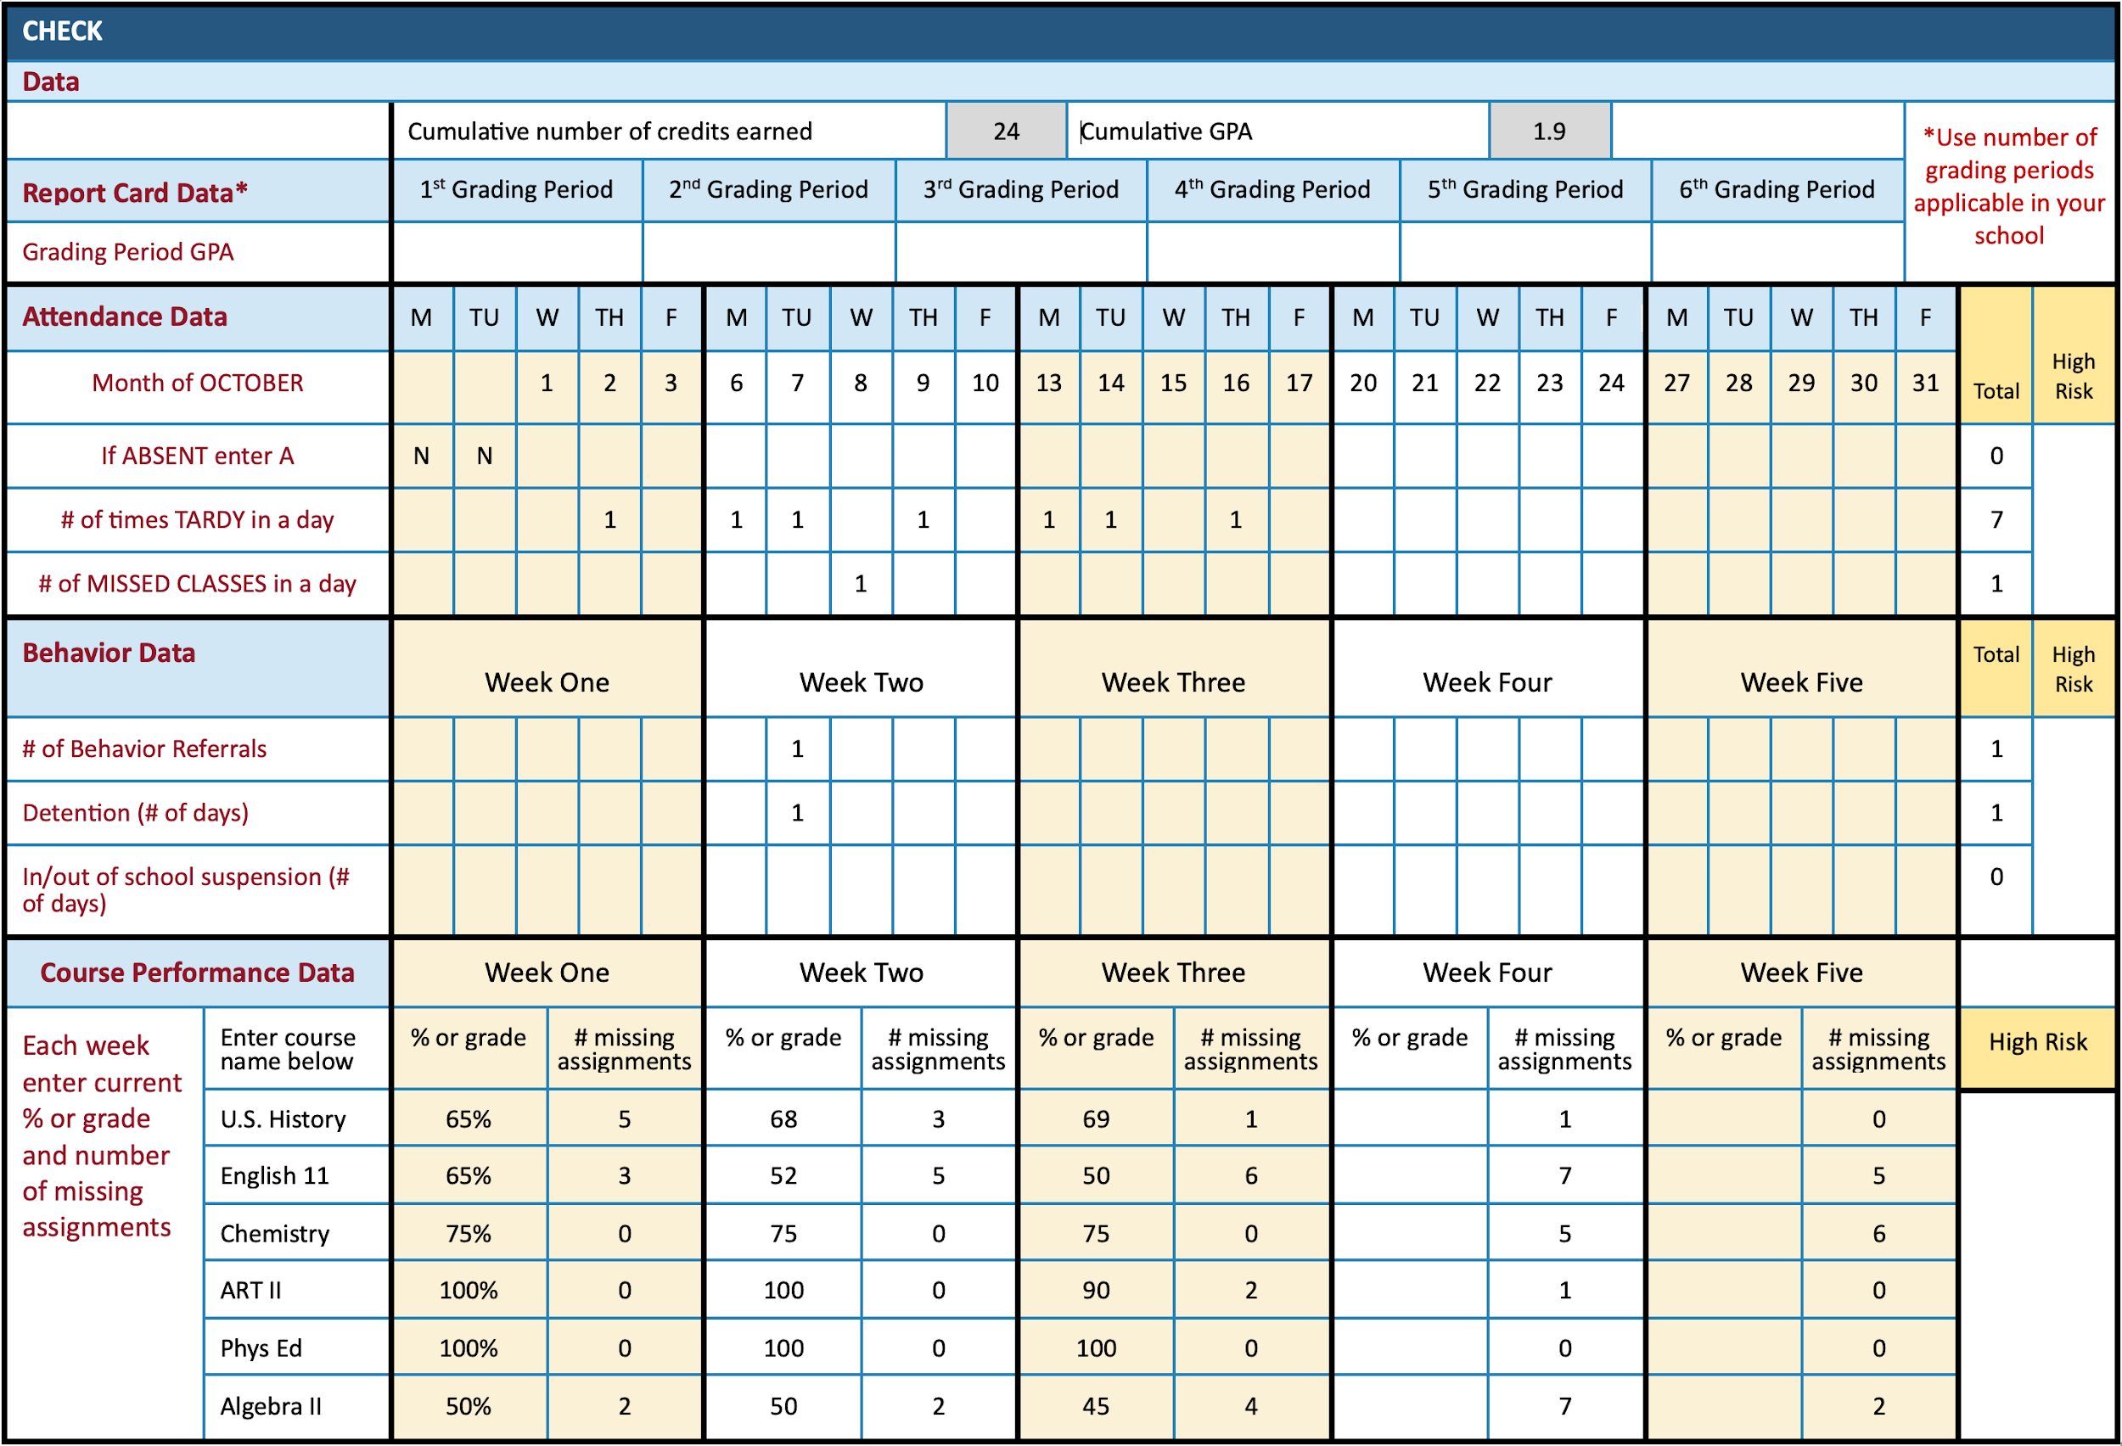
Sample Student Data
Notes:
Oklahoma GEAR UP. (2020). Check & Connect program overview. https://www.okgearup.org/wp-content/uploads/2020/10/Check-and-Connect-brochure.pdf [okgearup.org]

Slide 13

I Notice, I Wonder
What do you notice about the data?
Thinking about your role, who else do you need support from to help this student?
  What do you need from them (extra information, data, etc.)?
What do you wonder about how to help this student?
Notes:
K20 Center. (n.d.). I notice, I wonder. Strategies. https://learn.k20center.ou.edu/strategy/180

Slide 14
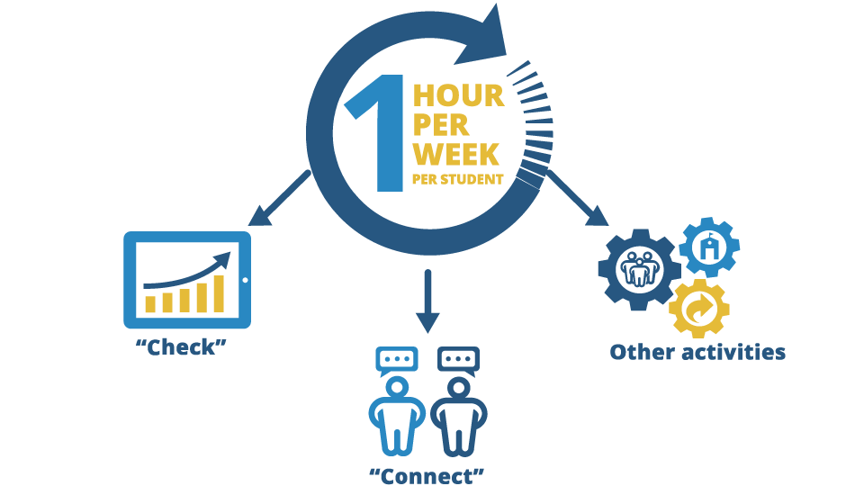
Mentor Tasks and Time
Notes:
Oklahoma GEAR UP. (2020). Check & Connect program overview. https://www.okgearup.org/wp-content/uploads/2020/10/Check-and-Connect-brochure.pdf [okgearup.org]

Slide 15

Four Corners
Who do you think has the most important
role in supporting the success of Check & Connect®?
Students
Family/Guardian
Mentors
School Staff
Notes:
K20 Center. (n.d.). Four corners. Strategies. https://learn.k20center.ou.edu/strategy/138

Slide 16

Stakeholder Support
How does each stakeholder support the
success of the Check & Connect® program?
Notes:
Oklahoma GEAR UP. (2020). Check & Connect program overview. https://www.okgearup.org/wp-content/uploads/2020/10/Check-and-Connect-brochure.pdf [okgearup.org]

Slide 17

List of 8
In your small groups
Select a scribe.
Determine an order for everyone in your group to respond (clockwise, etc.).
Quickly respond to each prompt, one response per person, in the order you determined.
Say “pass” if you cannot think of a response; the next person in the determined order can then respond.
Notes:
K20 Center. (n.d.). List of 8. Strategies. https://learn.k20center.ou.edu/strategy/3616

Slide 18
List of 8
List 8 characteristics or skills of a good mentor.
List 8 resources a mentor needs to support a student.
List 8 ways a family can help a student remain in school.
List 8 things a student can do to remain in school.
List 8 things school staff can do to help a student remain in school.
Notes:
K20 Center. (n.d.). List of 8. Strategies. https://learn.k20center.ou.edu/strategy/3616

Slide 19
What a Mentor is Not
Mentors play an intentional and specific role.
Mentors are not:
Disciplinarians
Therapists
Counselors
Replacement parents or
guardians
Teacher’s assistants
Translator for the schools
“The first 3-4 months I was thinking: When are you going to leave? The 5th & 6th month I’m thinking: You’re showing pity. You pity me. You don’t care about me. By the 18th month, I’m like: This person loves me, because I have nothing to offer, and they are showing that they are not trying to use me. So stick in their lives, through thick and thin.”
James Andersen
2014 National Mentoring Summit

Slide 20
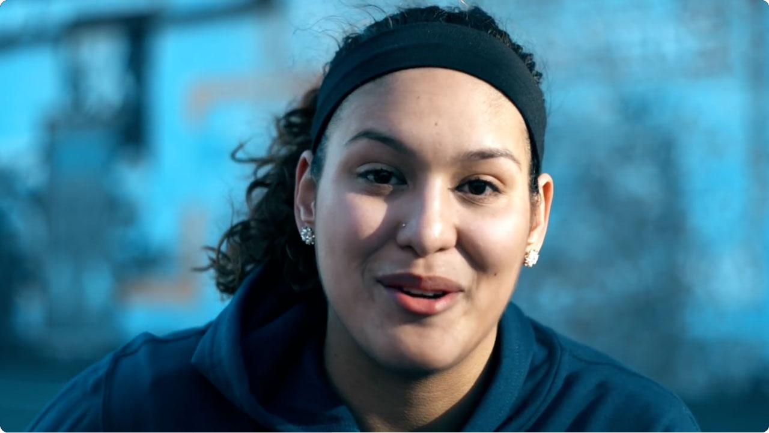
“If You Mentor Me…”
Notes:
@mentoringorg. (2018, January 2). “If You Mentor Me...” https://youtu.be/gcnX-wvp98Q?si=4wM_x_3uF8ZezIxP

Slide 21

How Am I Feeling? What Am I Thinking?
How are you feeling about the Check & Connect® program?
What are you thinking about your role in supporting the Check & Connect® program?
Notes:
K20 Center. (n.d.). How am I feeling? What am I thinking?. Strategies. https://learn.k20center.ou.edu/strategy/187

