Slide 2
Math In Action
Bringing Principles to Life with Authentic Learning

Slide 3

Honeycomb Harvest
Each hexagon has one of the following:
  NCTM Teaching and Learning Practice (Bold)
  Definition (Plain)
With your partner, match an Effective Teaching and Learning Practice and a definition.
Arrange hexagons so the sides of related hexagons are touching.
Notes:
Explain in detail what the honeycomb harvest is..
In general Honeycomb Harvest is a strategy where students are presented with multiple concepts on hexagons and they have to identify, organize and interpret the relationships between those concepts. They arrange the hexagons in a way that show how the concepts relate creating a honeycomb.
We will do a version of this
Get into groups of 4. Your group of 4 split into two groups. There are 8 practices, 2 will have 4 practices and the other 2 will have the other 4 practices
"here's what in front of you" and describe the 2 types of cards (if time allows include the quote cards)
* tell them that at this point they will be doing more of a card sort
K20 Center. (n.d.). Honeycomb harvest. Strategies. https://learn.k20center.ou.edu/strategy/61

Slide 4
Honeycomb Harvest
Which practice(s) do you see most often in your own instruction?
Which practice(s) feels more challenging to implement?
Notes:
After discussion, tell participants to not move their cards because we will come back to them
K20 Center. (n.d.). Honeycomb harvest. Strategies. https://learn.k20center.ou.edu/strategy/61

Slide 5
Essential Question
How can teachers enhance student engagement and learning?

Slide 6
Learning Objectives
Analyze the relationship between the NCTM Effective Teaching and Learning Practices and the K20 Authenticity Framework.
Create a plan to implement best teaching practices in the classroom.

Slide 7
K20 IDEALS
Authentic learning aims to infuse learning with purpose and meaning so that students develop the skills necessary to fully engage with the world at large.
Notes:
Emphasize that these Teaching and Learning practices are not standalone; they are most effective when embedded in authentic learning experiences.
K20 Center. (n.d.). Authenticity: Practitioner’s Brief. The IDEALS Framework. https://k20center.ou.edu/wp-content/uploads/2023/07/Authenticity_Practitioners_Brief.pdf

Slide 8
Authentic Honeycomb Harvest
Connect the Authenticity Component cards to the Teaching and Learning Practices cards.
If a component can align with multiple practices, organize and arrange the hexagons so that the sides of that component card and those practices are touching to create a honeycomb effect (mind map).
Discuss reasoning as you work together to build the honeycomb harvest.
Use evidence from your teaching experience or understanding of the Authenticity Component.
Notes:
Authenticity is a research backed teaching and learning Framework that is composed of 4 components the green cards IBL, SCL, COK, RWC
Groups of 2 become groups of 4
*Now explain what the green cards are - explain in detail the concept of a mind map and how they will use the green cards to connect the concepts
K20 Center. (n.d.). Honeycomb harvest. Strategies. https://learn.k20center.ou.edu/strategy/61

Slide 9
Authentic Honeycomb Harvest
How do these components of authenticity show up in your classroom when you use these practices?
Where do you see overlap or tension between a practice and an authenticity component?
Notes:
The thing with authenticity is it is multifaceted. We all probably interpreted connections differently and that is ok. It’s the intention and justification that matters. There is no one single path fitting all contexts

Slide 10
Authentic Honeycomb Harvest
Inquiry-Based Learning
Implementing Tasks that Promote Reasoning and Problem Solving
Facilitate Meaningful Mathematical Discourse
Pose Purposeful Questions
Construction of Knowledge
Establish Mathematics Goals to Focus Learning
Build Procedural Fluency from Conceptual Understanding
Notes:
Lydia

Slide 11
Authentic Honeycomb Harvest
Student-Centered Learning
Support Productive Struggle in Learning Mathematics
Elicit and Use Evidence of Student Thinking
Real World Connections
Use and Connect Mathematical Representations
Notes:
Lydia

Slide 12
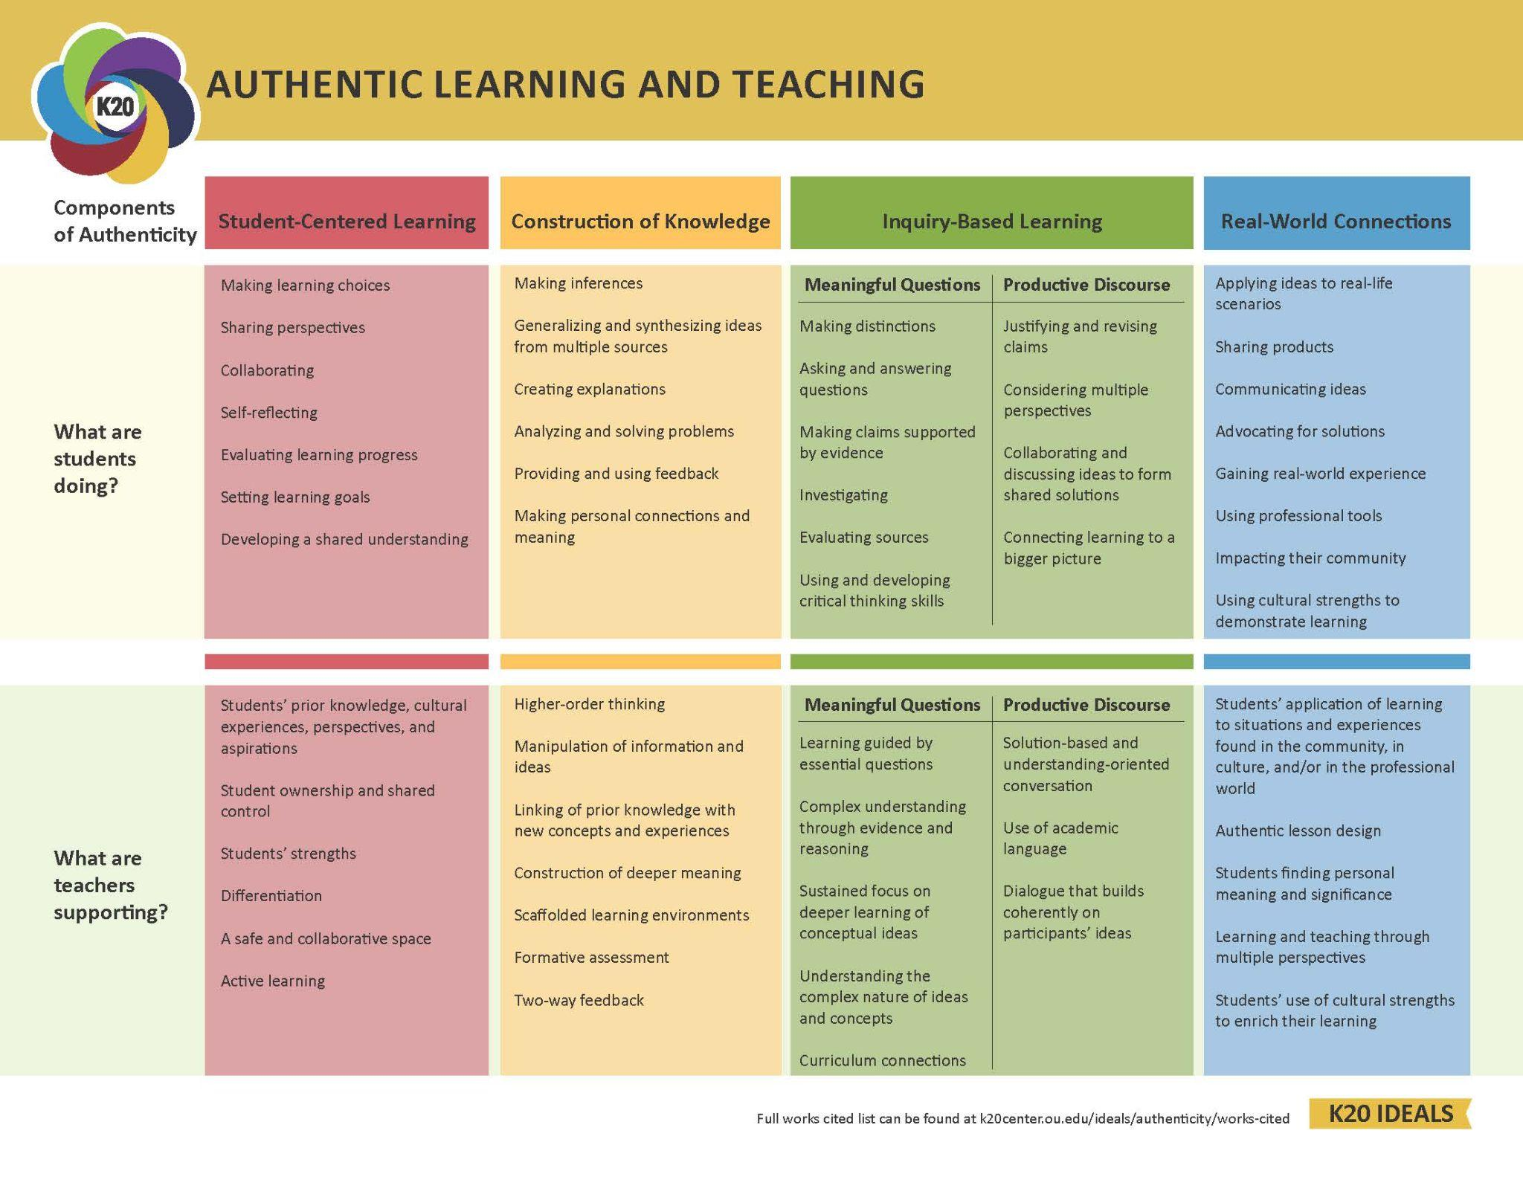
Notes:
(hand out the teaching and learning chart)
Look at the specific actions of the teachers and students in a classroom when Authenticity is present.
Ask the question: What characteristics in the Teaching and Learning Practices chart are familiar?
Ask the question: What characteristics are new or surprising? (using professional tools)
This is what the K20 center says about Authenticity

Slide 13
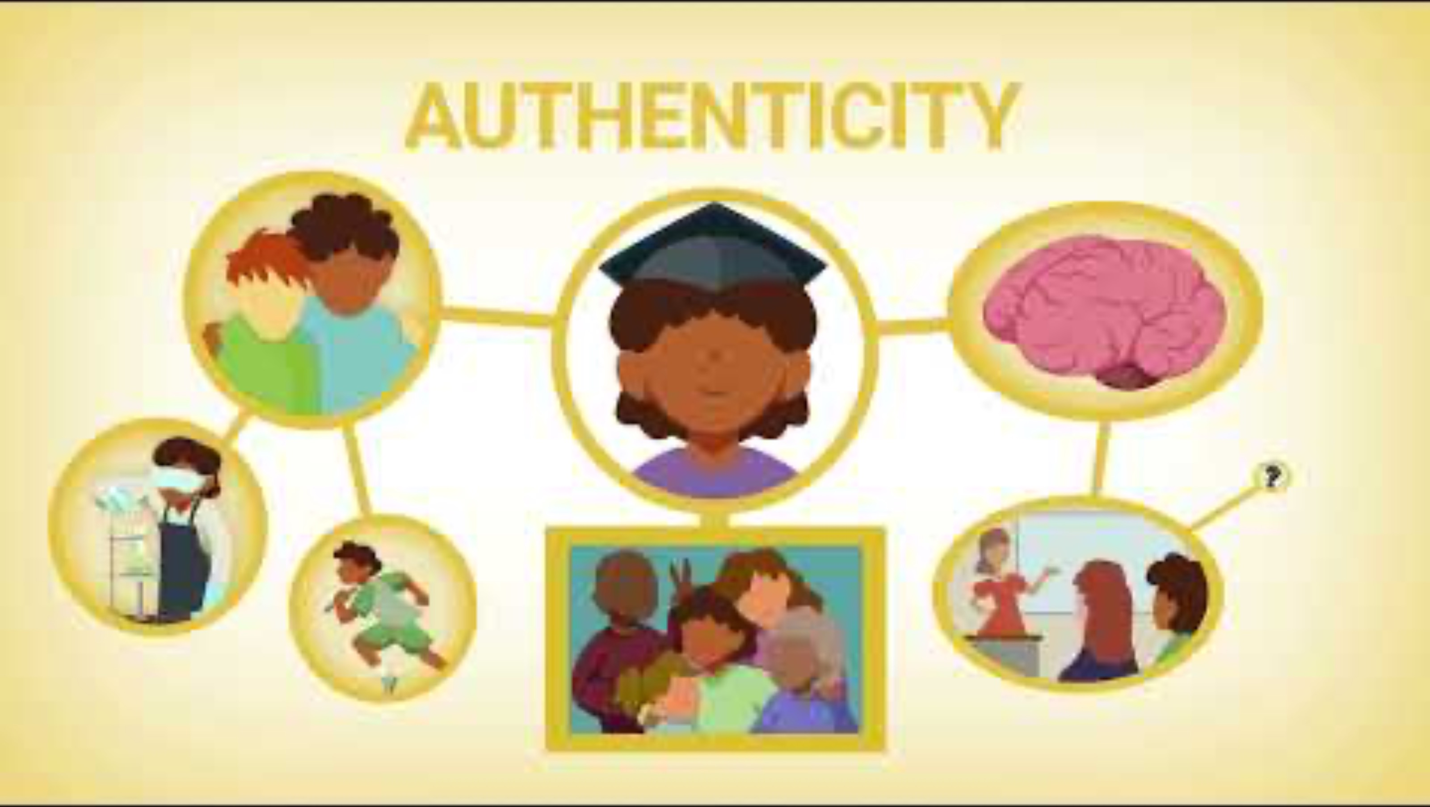
Authenticity
Notes:
K20 Cneter. (n.d.) Authenticity. Youtube. https://www.youtube.com/watch?v=UrtgMJVmNAQ

Slide 14
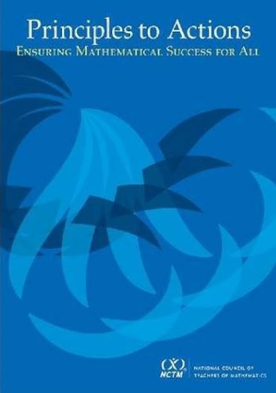
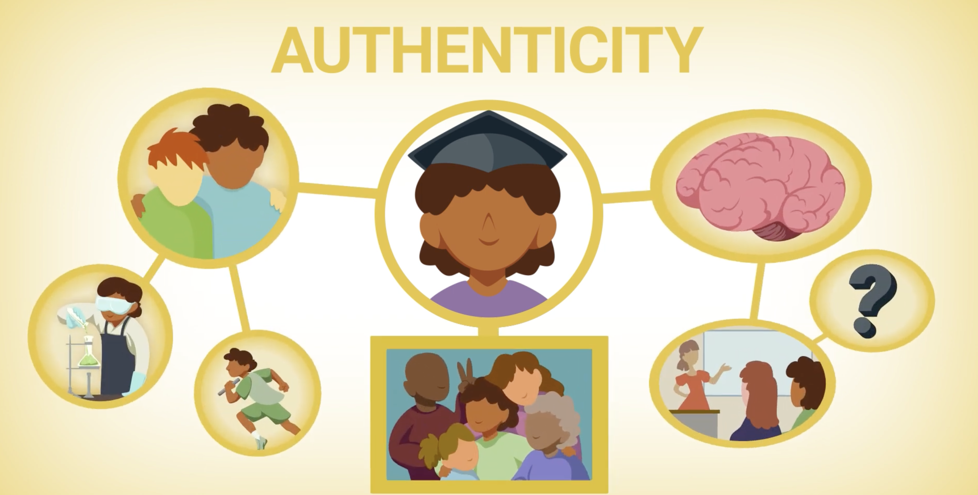

Slide 15

Making the Connection
Authenticity Components
Effective Teaching and Learning Practices
Instructional
Strategies
Notes:
https://thenounproject.com/icon/pyramid-4670005/
"Authenticity is the overarching framework—it’s the lens through which we define our teaching philosophy and purpose.
The Effective Teaching and Learning Practices from NCTM are the high-leverage actions we use in the classroom to foster those authentic outcomes.
And instructional strategies are the day-to-day tools—like routines, structures, or moves—we can use to enact those practices effectively.
Like I said, our State Standards and curriculum offer focus, direction, and shared goals. But they don’t tell us how to transform our instruction to reach every student in a meaningful way.
That’s where authenticity and the practices come in—they bridge the gap between what’s written in policy and what happens in the classroom.
By shifting our mindset toward authentic instruction, we begin to ask: 'What practices will help me meet these standards while also engaging students in deeper, more connected learning?'"

Slide 16
Making the Connection
How can this model shape how we plan our math instruction?
Authenticity Component
Effective Teaching and Learning Practices
Instructional
Strate-
gies
Notes:
https://thenounproject.com/icon/pyramid-4670005/
*We are more intentional about the lessons we plan and the way we teach. planning lessons that are more engaging and less direct instruction.

Slide 17
Sample Scenario
Student-Centered Learning
Authenticity Component
Effective Teaching and Learning Practices
Instructional
Strate-
gies
Notes:
"Let’s take a closer look at one authenticity component: Student-Centered Learning—a phrase we hear a lot in education.
But what does it look like in math? And how do we make it actionable?
Let’s say that one of our goals this year is to strengthen student-centered learning in our classroom—giving students more agency, more voice, and more ownership over their learning."
.

Slide 18
Sample Scenario
Student-Centered Learning
Authenticity Component
Elicit and Use Evidence of Student Thinking
Effective Teaching and Learning Practices
Instructional
Strate-
gies
Notes:
"To strengthen Student-Centered Learning, we might look to the practice:
Elicit and Use Evidence of Student Thinking.
This practice is about listening carefully to students—during lessons, assessments, and even informal moments—to understand their thinking and adjust instruction accordingly.
By doing this, we position students as knowers, not just receivers of information. And we make our instruction more responsive and personalized."

Slide 19
Sample Scenario
Student-Centered Learning
Authenticity Component
Elicit and Use Evidence of Student Thinking
Effective Teaching and Learning Practices
Instructional
Strate-
gies
Math Interview
Notes:
"One strategy that supports this practice is the Math Interview.
This strategy gives students a chance to talk through their thinking in a 1:1 setting. It builds autonomy, perseverance, and ownership of their ideas. In this strategy pairs are interviewing each other about a math task they have completed - they describe their process, thinking, etc.
This is where the full scaffold comes together:
The strategy (Math Interview) supports
the practice (Elicit and Use Evidence of Student Thinking) because students are communicating, writing others ideas, and making suggestions, which promotes
the authentic component (Student-Centered Learning) because students are taking ownership over their learning experience and teachers can use the formal and informal data from the Math interview to inform future lessons.
And that’s the heart of this framework:
Effective teaching is non-negotiable. It’s what ensures every student has access to deep, connected math learning. But to get there, we need strategies that are intentional and aligned to our larger goals."

Slide 20


Gallery Walk
Travel to each Effective Teaching and Learning Practices poster.
Explore the strategies on the posters and choose a strategy from each poster you are interested in trying in your classroom.
Identify which component of authenticity your chosen strategy is connected to.
Record the Practice, Strategy, and what students will gain in the row of your identified authentic component on your note catcher.
Notes:
K20 Center. (n.d.). Gallery walk/carousel. Strategies. https://learn.k20center.ou.edu/strategy/118
K20 Center. (2021, September 21). 10-Minute Timer. YouTube. https://www.youtube.com/watch?v=9gy-1Z2Sa-c

Slide 21
Gallery Walk Discussion
After you look at the different strategies share with your table:
One or two strategies you liked and why.
Explain how that strategy can be used to support authentic learning.
Notes:
K20 Center. (n.d.). Gallery walk/carousel. Strategies. https://learn.k20center.ou.edu/strategy/118

Slide 22
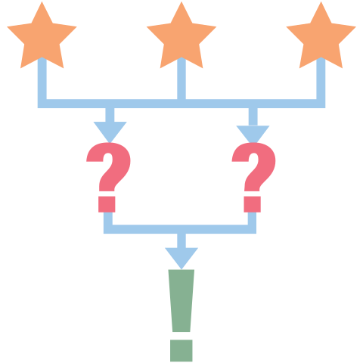
3-2-1
Think about what you have learned in this session. On your paper write:
3 things you will do this Semester.
2 things you will do this Month.
1 thing you will do this Week.
Notes:
K20 Center. (n.d.). 3-2-1. Strategies. https://learn.k20center.ou.edu/strategy/117

Slide 23
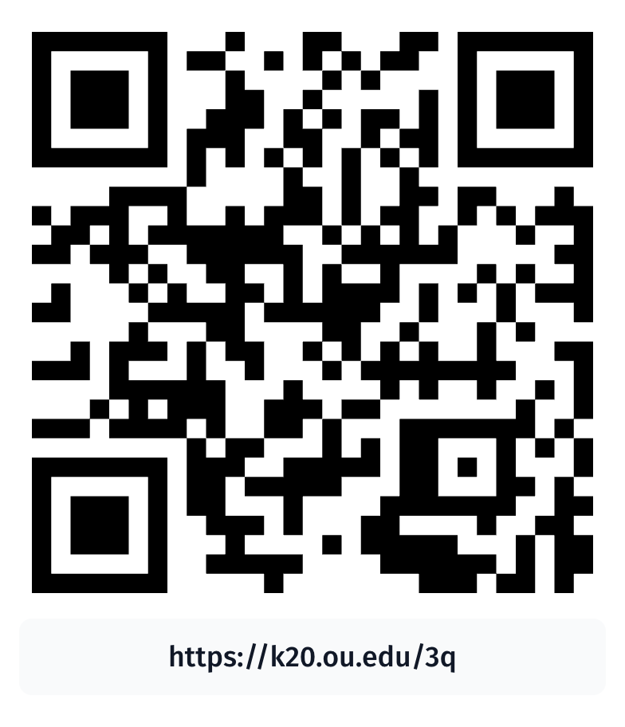
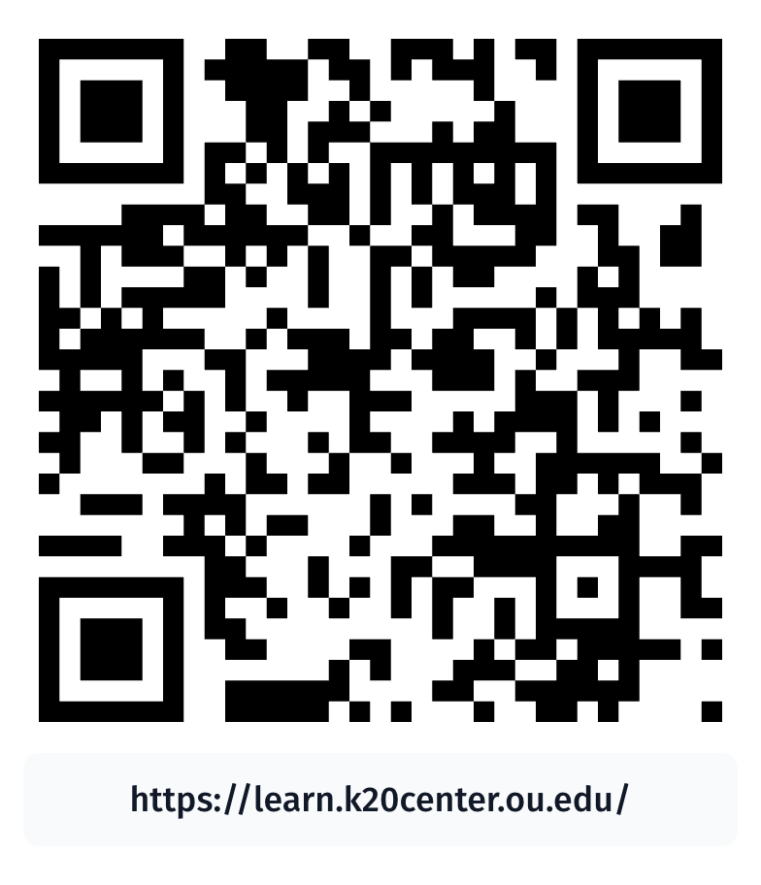
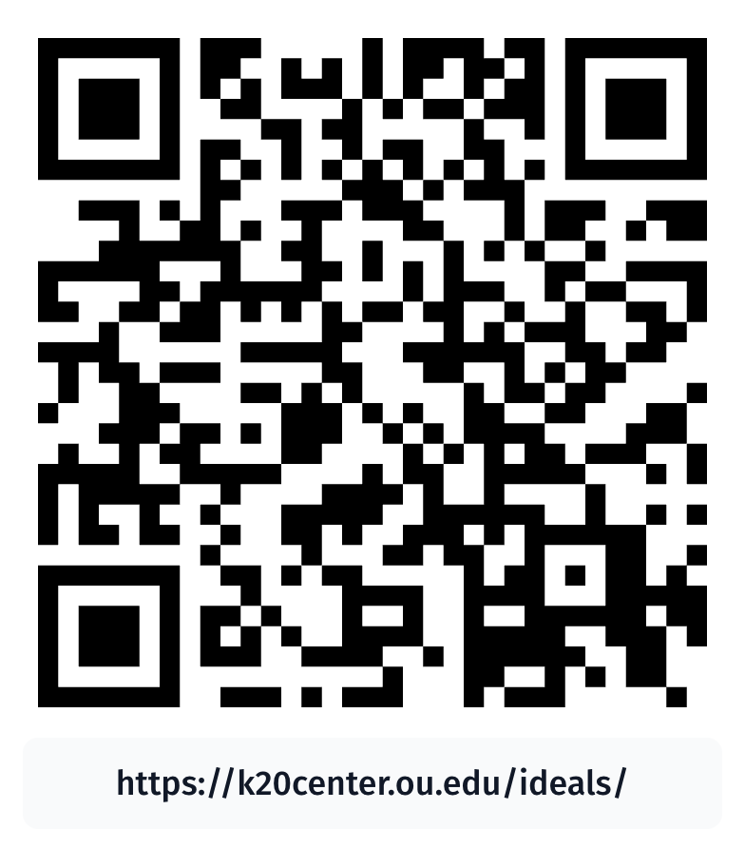
Resources
Principles to Action
K20 LEARN Website
K20 IDEALS Website

