Slide 2
Teaching Smarter
AI Bots as Your Digital Tutoring Sidekick

Slide 3

Chalk Talk
In your groups, silently explore this question:
  What are the possible benefits and concerns of using artificial intelligence (AI) in our lives?
Notes:
Facilitator’s Note: After five minutes, consider asking these follow-up questions:
What did you notice about the responses?
Were there any surprises or common themes?
What are you still wondering about AI?
K20 Center. (n.d.). Chalk talk. Strategies. https://learn.k20center.ou.edu/strategy/197

Slide 4
Essential Question
How can I guide students in using AI as a supportive learning tool while maintaining academic integrity and promoting critical thinking?

Slide 5
Learning Objectives
Examine how AI-powered platforms can support student learning by practicing a tutoring conversation across various subjects.
Design and refine AI tutoring prompts that guide students in generating meaningful questions, reviewing content, and engaging in self-directed learning.
Evaluate the effectiveness and limitations of AI tools in supporting student understanding and reflect on how AI can be integrated into instructional practices to enhance personalized learning.

Slide 6
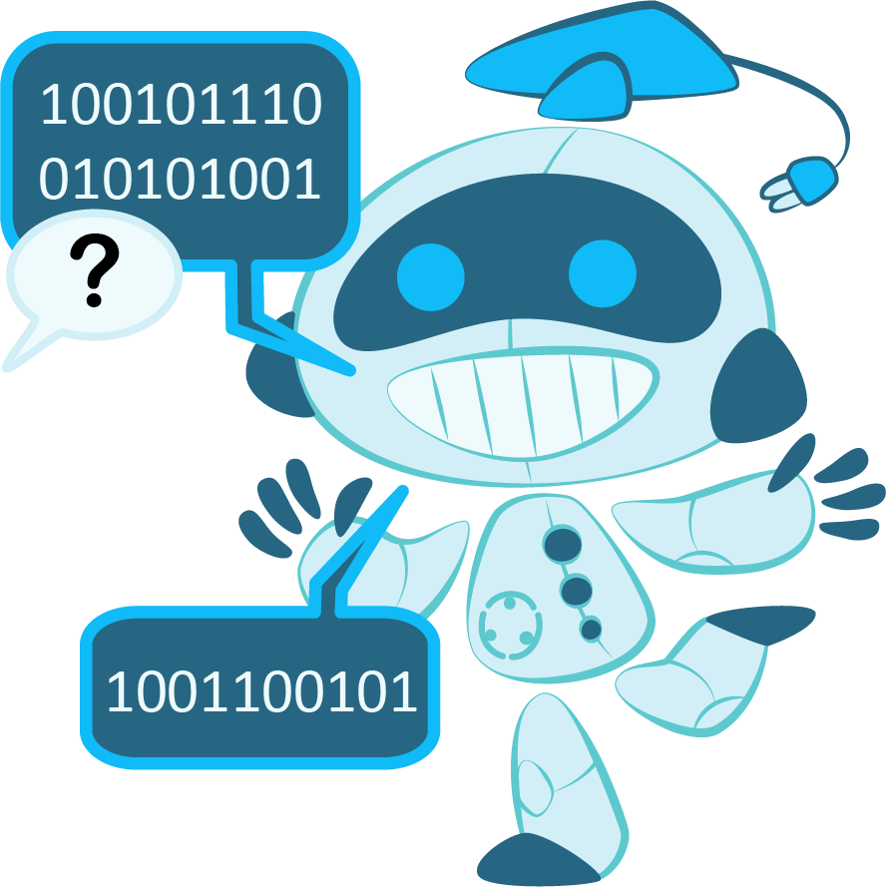
Try a Tutoring Prompt
Pretend you are a student and complete a tutoring session with an AI Chatbot.
Access the Padlet at this link: INSERT LINK
Copy the example prompt.
  Select “…”
  Select “Open post”
  Highlight the entire post and copy it.
Navigate to chatgpt.com.
Paste the prompt and begin your tutoring session with the chatbot.
Notes:
Facilitator’s Note: Paste the link to the Padlet you created in the “Preparation” section into the highlighted portion of the slide.
K20 Center. (n.d.). AI chatbot. Tech Tools. https://learn.k20center.ou.edu/tech-tool/3478

Slide 7

S-I-T
S: What was surprising about the interaction?
I: What did you find interesting that could be valuable in your classroom practice?
T: What was troubling? Were there any gaps, inaccuracies, or moments that might confuse a student?
Notes:
K20 Center. (n.d.). S-I-T (Surprising, interesting, troubling). Strategies. https://learn.k20center.ou.edu/strategy/926

Slide 8

5 Minute Timer
Notes:
K20 Center. (2021, September 21). K20 Center 5 minute timer [Video]. YouTube. https://www.youtube.com/watch?v=EVS_yYQoLJg

Slide 9

Categorical Highlighting
Highlight information about each of the following in a different color:
Task
Format
Voice
Context
Notes:
K20 Center. (n.d.). Categorical highlighting. Strategies. https://learn.k20center.ou.edu/strategy/192

Slide 10

Additional AI Tools
Skrappy
  Skrappy is an AI chatbot that is integrated into eKadence.
  This option is good if your school uses eKadence, but it is not free.

Slide 11

Additional AI Tools
ChatGPT
  ChatGPT is a free AI tool.
  This is a good all-around option.
  Prompting is especially useful with ChatGPT because it hasn’t been set up for schools and students like other AI tools.
Notes:
K20 Center. (n.d.). AI chatbot. Tech Tools. https://learn.k20center.ou.edu/tech-tool/3478
OpenAI. (2023). ChatGPT (Jun 2025 version) [Large language model]. https://chatgpt.com/

Slide 12

Additional AI Tools
SchoolAI
  School AI is a program designed specifically for teachers to use with students.
  Teachers can set up the chatbot with a prompt then assign the prompt to students.
  Allows teachers to monitor student use.
  Free for a specific number of users.
Notes:
K20 Center. (n.d.). SchoolAI. Tech Tools. https://learn.k20center.ou.edu/tech-tool/3919

Slide 13

Additional AI Tools
MagicSchool with MagicStudent
  MagicSchool AI is a program designed specifically for teachers to use with students.
  Teachers can set up task-oriented tools for students.
  Allows teachers to monitor student use.
  Free for a specific number of users.
Notes:
K20 Center. (n.d.). MagicSchool AI. Tech Tools. https://learn.k20center.ou.edu/tech-tool/3416

Slide 14

Additional AI Tools
Thetawise
  Thetawise is a chatbot designed specifically to help students with math.
  The free version allows users 50 chats per day.

Slide 15
Try Your Own Prompt
Select an AI chatbot tool.
Use your highlighted outline to create a prompt specific to your subject area.
Input your prompt into the tool.
Adjust your prompt as needed.
Share successful prompts in the Padlet under your subject area.
Notes:
K20 Center. (n.d.). AI chatbot. Tech Tools. https://learn.k20center.ou.edu/tech-tool/3478

Slide 16
Test Other Tutoring Prompts
Pair up with someone from a different subject area.
Share your prompt with your partner.
Enter your partner’s prompt in a chatbot of your choice as if you were a student.
Notes:
K20 Center. (n.d.). AI chatbot. Tech Tools. https://learn.k20center.ou.edu/tech-tool/3478

Slide 17

How Am I Feeling? What Am I Thinking?
On your sticky note, respond to the following question:
What are some benefits and concerns of using artificial intelligence (AI) in our lives?
Notes:
K20 Center. (n.d.). How am I feeling? What am I thinking?. Strategies. https://learn.k20center.ou.edu/strategy/187

Slide 18
Instructional Strategy Note Catcher
Strategy or Tool | How was it used? | How could I use it?
Chalk Talk
AI Chatbot
S-I-T
Categorical Highlighting
How Am I Feeling? What Am I Thinking?

