Slide 1
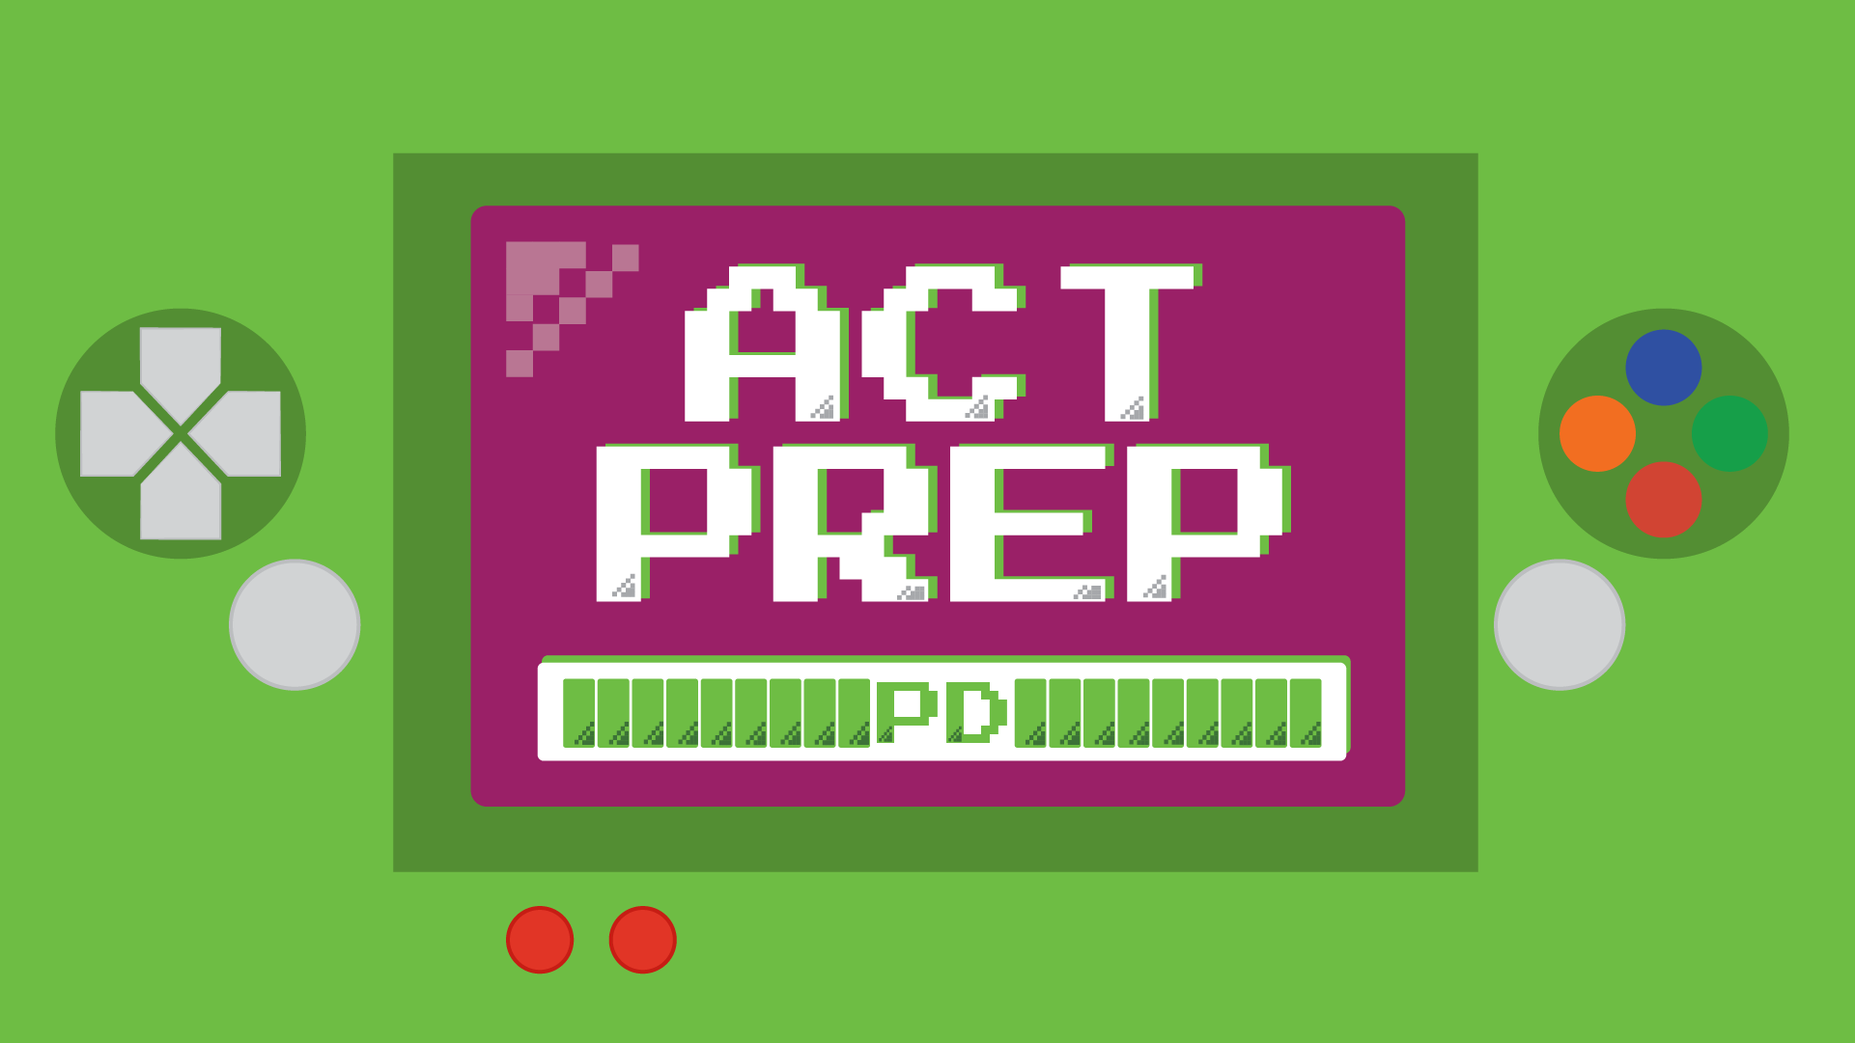


Slide 2

Power Up: ACT Prep
Implementation

Slide 3
Essential Question
How can we strategically plan and implement the Power Up: ACT Prep curriculum to ensure all students are prepared for ACT success?

Slide 4

Learning Goals
Demonstrate understanding of the curriculum structure and instructional strategies
Successfully complete a guided practice on how to report cohort student attendance with at least one mock entry submitted per participant.

Slide 5
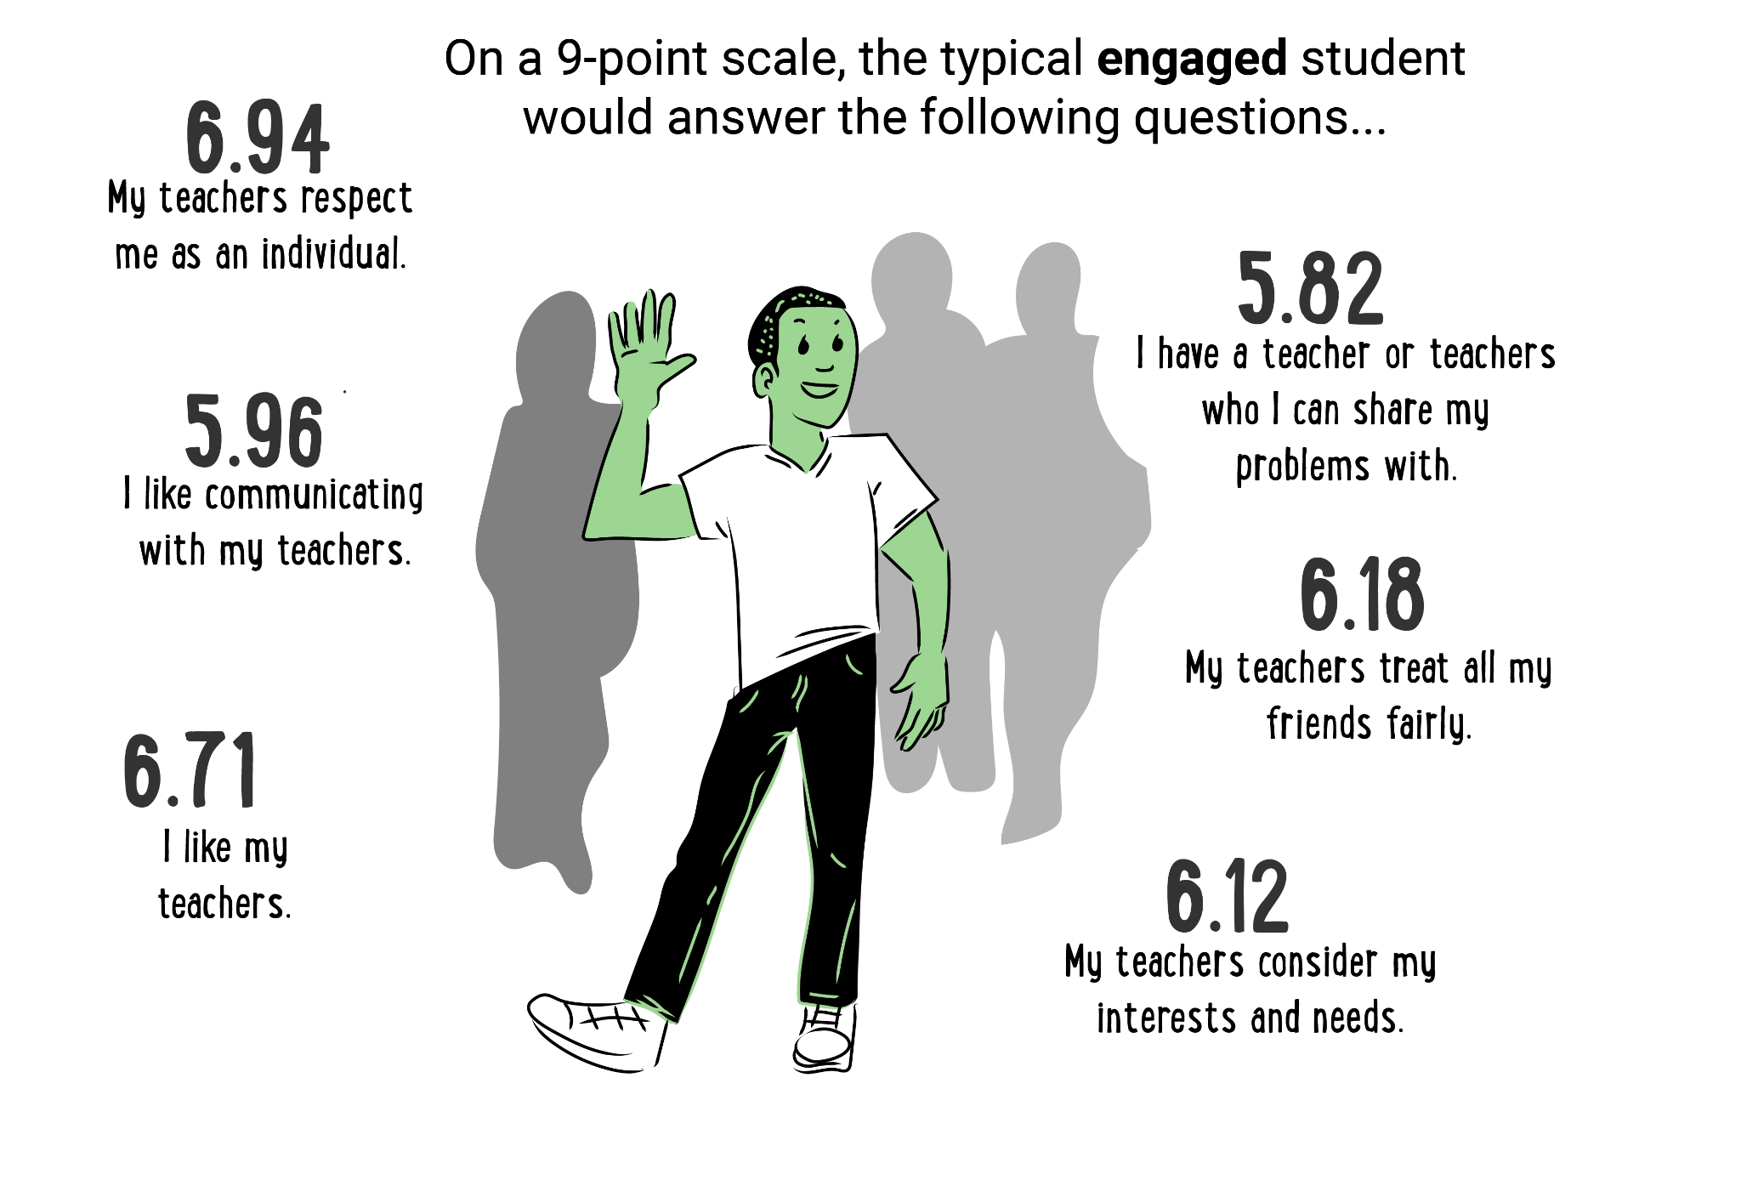
Marcus
Marcus lives with his grandmother and works 25 hours/week at local grocery store.
He struggles with math, barely passing Algebra II.
He talks about "just wanting to graduate and get a real job."
Initial ACT Score: 16

Slide 6

Jasmine
Both of Jasmine’s parents work
factory jobs. She is a potential first-generation college student.
She is a good student, but says "college isn't for people like me."
She is interested in healthcare but thinks it's "too expensive and too hard."
Initial ACT Score: 18

Slide 7
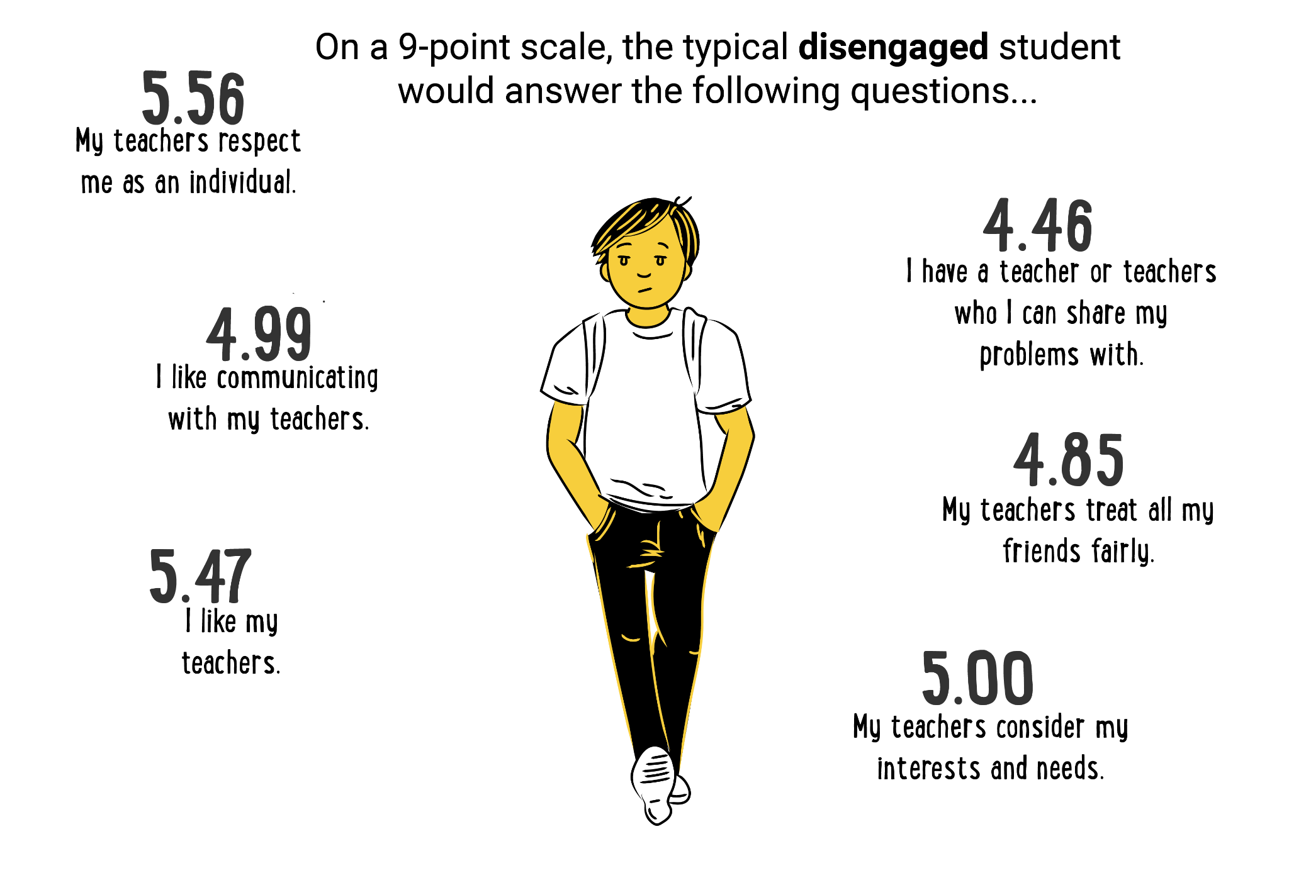
Tyler
Tyler lives in a rural area. He loves working
on cars and farming equipment.
He plans to work at his uncle's auto shop after graduation.
He says he's "not book smart" but is incredibly
skilled with his hands.
Initial ACT Score: 17

Slide 8
Marcus
Score increases from 16 → 18
Marcus now qualifies for community
college automotive technology
program with minimal remedial
coursework.
The program has 95% job placement rate
with $45,000 starting salary.
He can complete certification while
working part-time.

Slide 9
Jasmine
Score increases from 18 → 20
Jasmine qualifies for state university’s bridge program for first-generation students.
She is eligible for needs-based aid that
covers 80% of tuition.
She can pursue a 2-year nursing program
at a community college first.
There are multiple healthcare pathway options
now available.

Slide 10
Tyler
Score increases from: 17 → 19
Tyler meets admission requirements for an agricultural technology degree.
He qualifies for rural scholarship program.
He can combine hands-on skills with business/technology training.
He has the potential to own his own shop or agricultural equipment business.

Slide 11

Navigate to learn.k20center.ou.edu
Search “Power Up.”
Scroll to find the “Week 1” Activity for your subject.
Read through the activity and materials using the Implementation Fidelity Checklist.

Slide 12
Entering Attendance
Navigate to trek.k20center.ou.edu
Sign in.

Slide 13
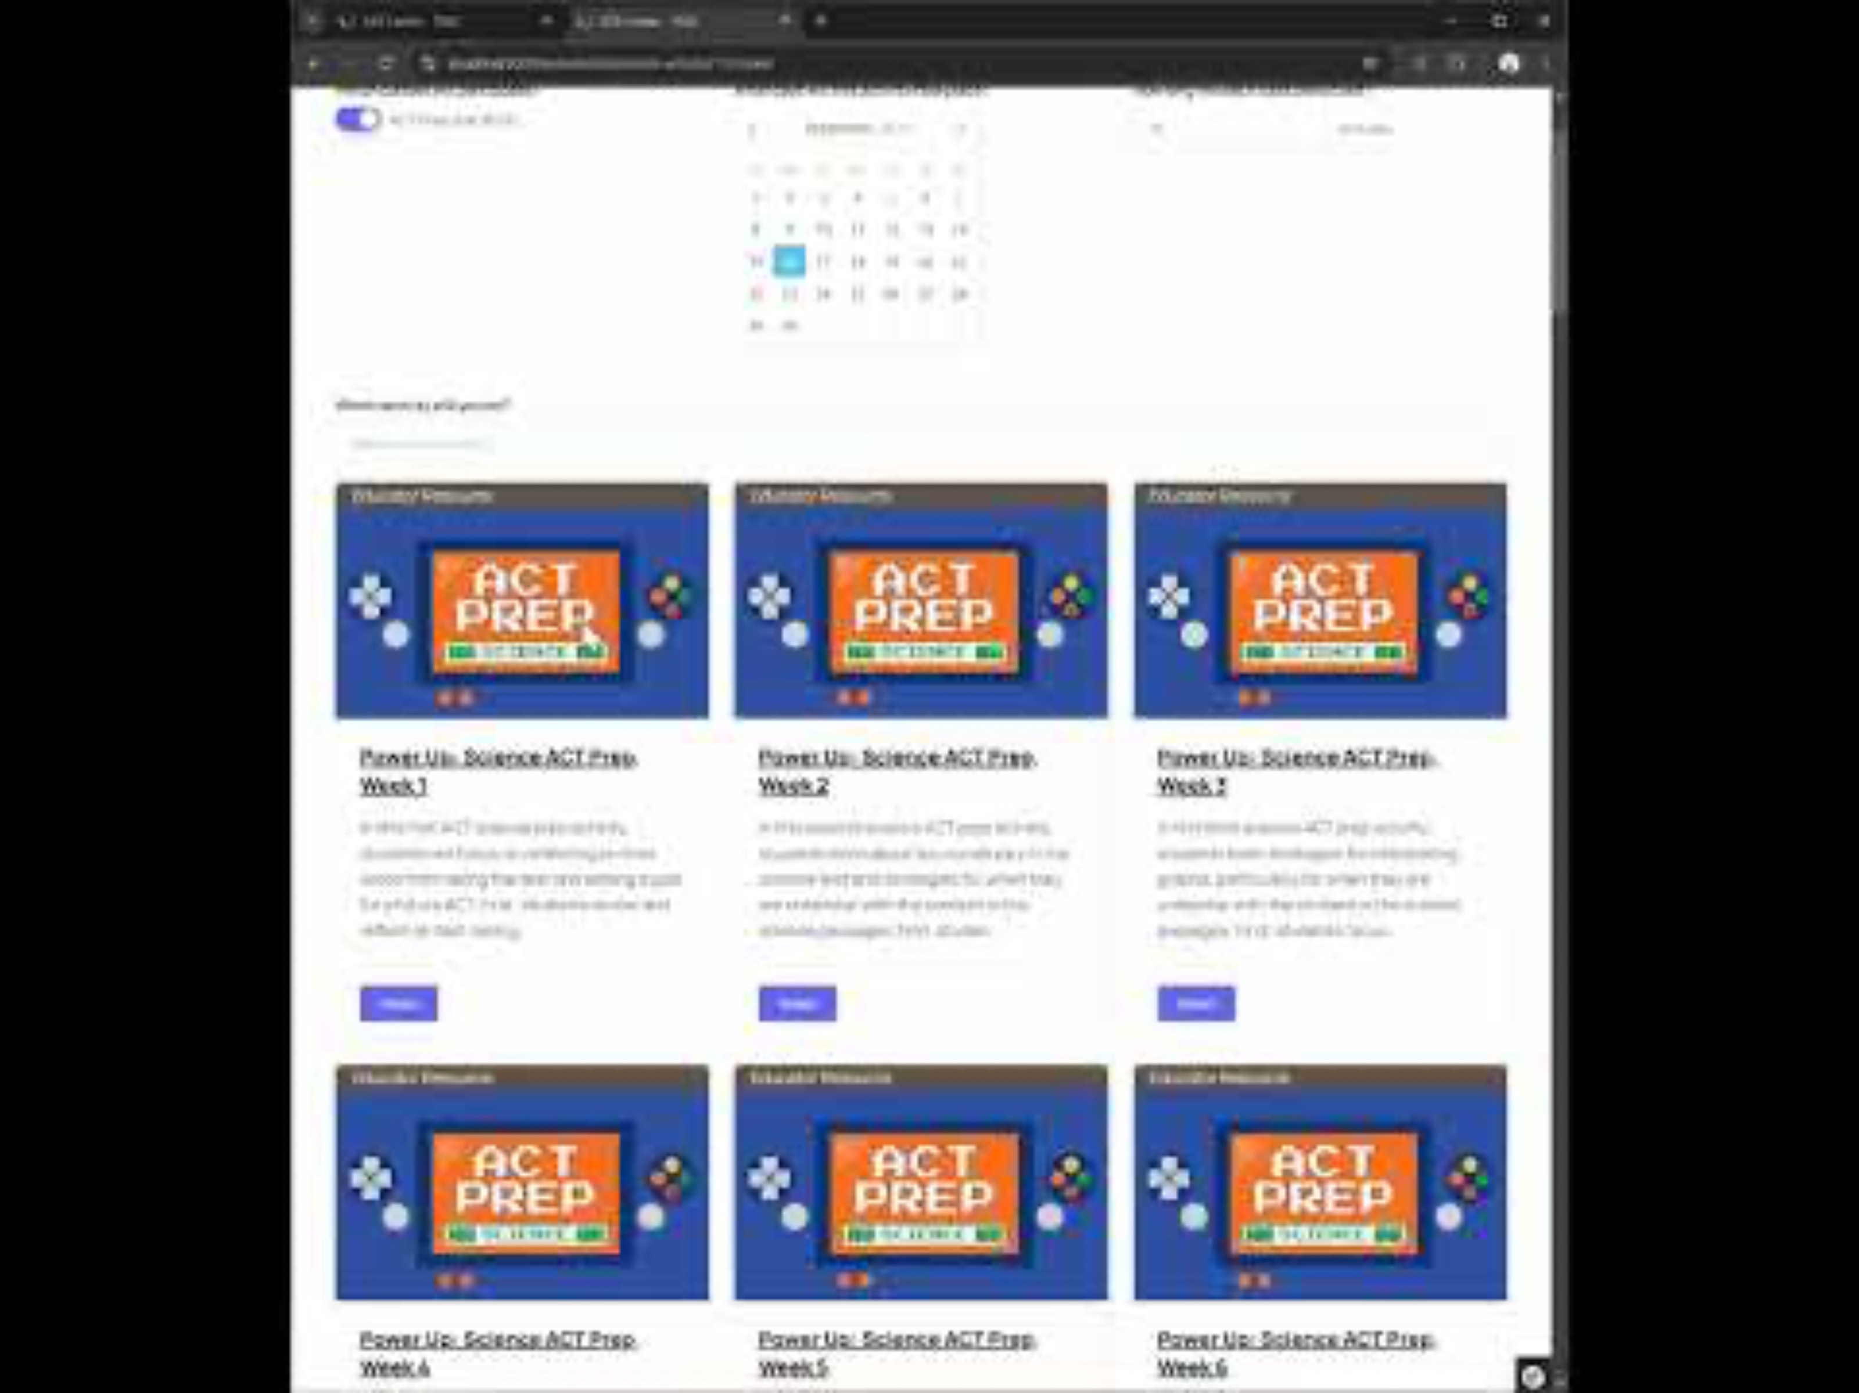
Notes:
https://www.youtube.com/watch?v=OXCLUltgsLs

Slide 14
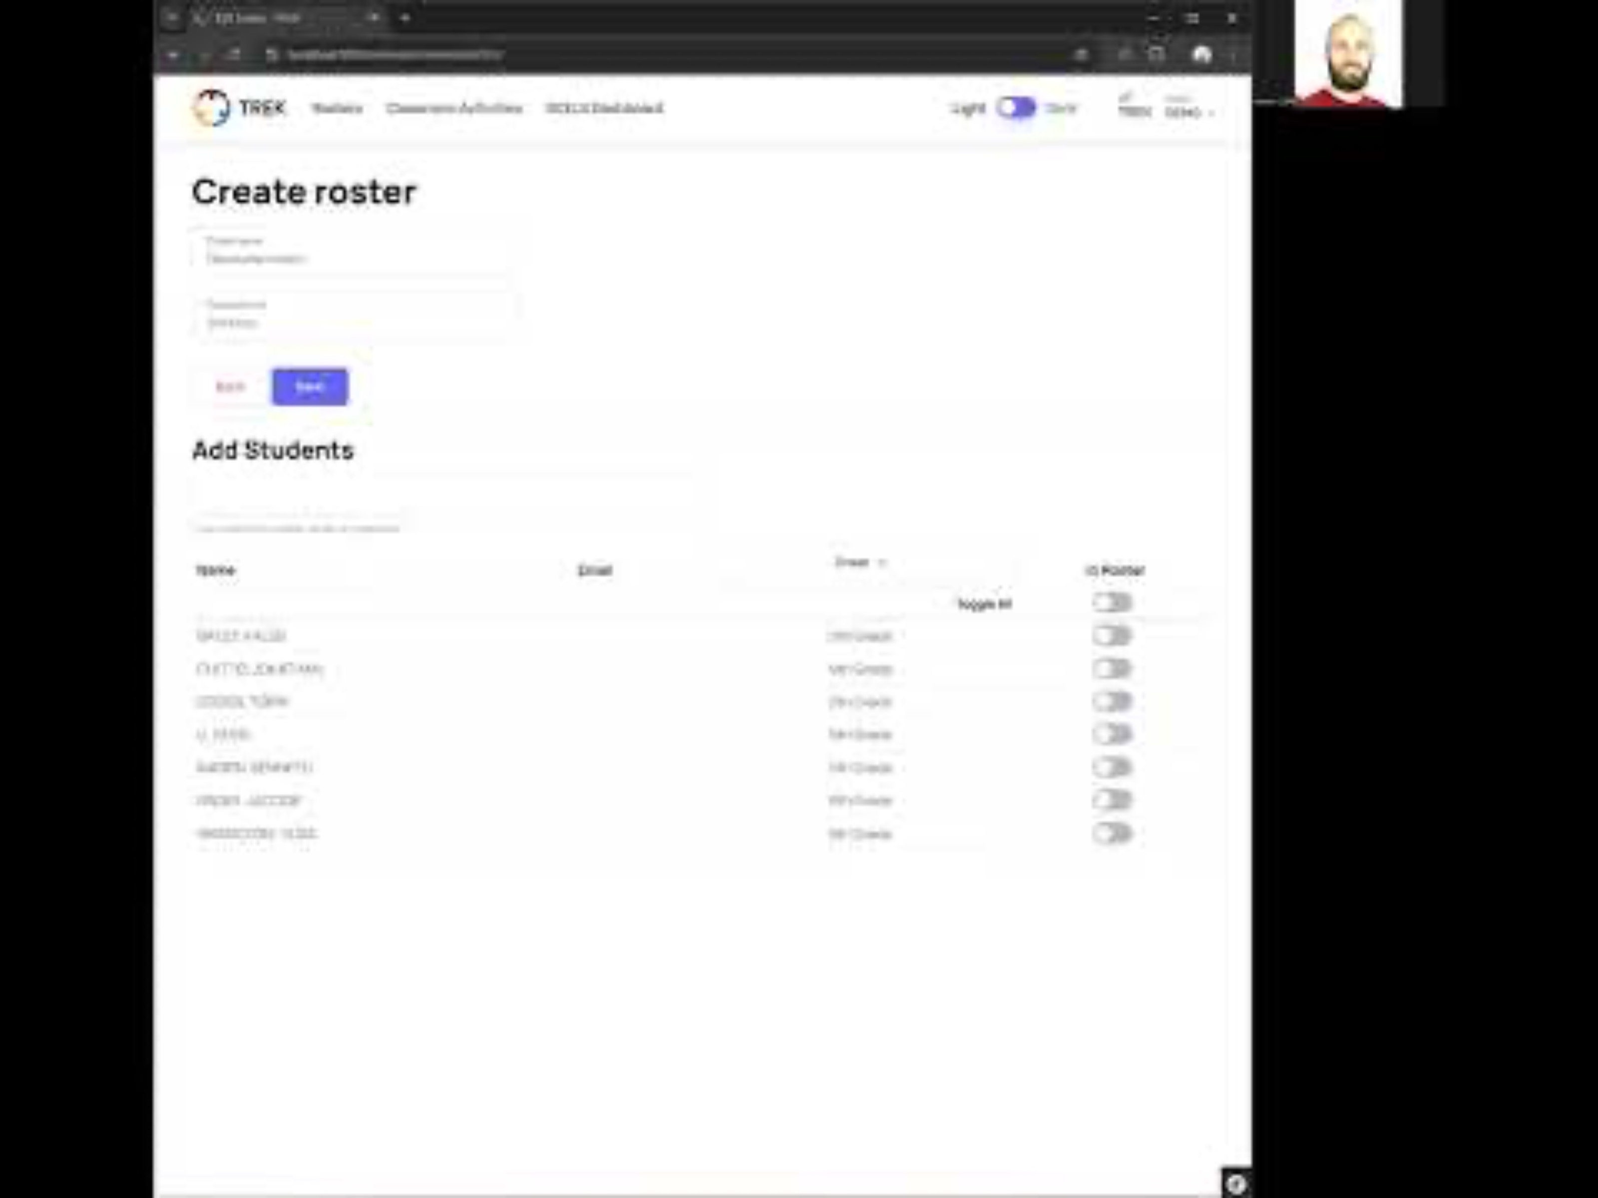
Notes:
https://www.youtube.com/watch?v=gki-LQTKYJ0

Slide 15
Power Up: ACT Prep Curriculum Study
1,496 11th grade students from 9 high schools in an urban district (67.1% Hispanic, 19.5% Black, 5.3% White).
~2 point increase in composite ACT scores from the Pre-test taken in Fall 2023 to Post-test in Spring 2024.
The results indicated a significant, positive effect of the total number of prep sessions attended on these scores.

Slide 16
Delivery of Curriculum
84% completed all 10 activities.
82% facilitated 1 activity per week.
44% used paper handouts and 40% used a mix of paper and digital.
49% gave grades to students for participation.

Slide 17
Themes in Barriers Reported
Preparation required for paper materials attached to each activity.
Relevance of this curriculum to students who don’t consider themselves to be college-bound.
Learning new technology.

Slide 18
Adaptations made to accommodate time constraints
Shortening or removing parts of an activity.
Splitting activities across more than one class period.
Remove bell-ringer/warm-up.

Slide 19
Adaptations made to accommodate student learning needs
Modifying or subbing in different practice problems (easier or harder to meet students at their level).
Adding more ACT practice problems to an activity.
Expand on by further teaching the concepts students struggled with that were required by the activity.
Adding time to go over the practice problem
answers and learn from mistakes.

Slide 20
Adaptations made to align activity to a lesson or unit
Rearranging the order of the weeks.
Rearranging parts of an activity.

Slide 21
Themes in Barriers Reported
Preparation required for paper materials attached to each activity.
Relevance of this curriculum to students who don’t consider themselves to be college-bound.
Learning new technology.

Slide 22

Role-Play Conversations
Do three rounds of role-play where one of you is the student, one the teacher, and one a scribe.
Help the student see how the ACT prep activities will benefit them.
Take notes on the conversation.

Slide 23
Marcus
"I just want to graduate
and get a real job."
Tyler
"I’m not book smart, but I’m good with my hands.”
Jasmine
"College isn't for people like me; it's too expensive and hard."

Slide 24
Power UP: ACT Prep Implementation Schedule
Pre-testing:[date]
Week 1 Activity
PLC Check-in:[date]
Weeks 2-4 Activities
PLC Check-in:[date]
Weeks 5-8 Activities
PLC Check-in:[date]
Weeks 9-10 Activities
Post testing:[date]
Celebration & Reflection: [date]
Notes:
Fill in the dates for your school.

Slide 25
PLC Check-in Meeting Norms
Start and end on time.
Arrive with the PLC Check-In form completed.
Be fully present, focusing on student learning issues with ACT implementation and instruction.
Rotate leadership roles (facilitator, note-taker, timekeeper).

