Slide 1
From Input to Impact:
Equipping Educators to Model and Teach AI Literacy

Slide 2
Decision Division: Human Hands or AI Commands?
Divide into groups of 4
Each group will focus on one topic and decide which tasks/decisions humans should make and which tasks/decisions AI should make regarding that topic.
Record ideas on the provided t-chart handout

Slide 3
Essential Question
How can educators effectively model the evaluation and responsible use of AI-generated content for students?

Slide 4
Learning Objectives
Evaluate appropriate and effective use of AI for specific instructional tasks.
Examine inputs in AI interactions to identify opportunities for improving outputs.
Explore essential AI literacy skills and plan instructional methods to integrate them into student learning.

Slide 5
Say It Right, Get it Right: Prompt Engineering in AI
Using the scenarios provided, select one and answer the following question:
What prompt would you give an AI chat tool to get support for this task?

Slide 6
Say It Right, Get it Right—Group Consensus
Share individual prompts.
Choose one prompt exactly as written with no changes.

Slide 7
TAG & RATE: Evaluating Your AI Output
📝 1. Input Your Prompt
Run your group’s prompt in an AI tool (Chat GPT, Gemini, CoPilot, etc.) and review the output.

Slide 8
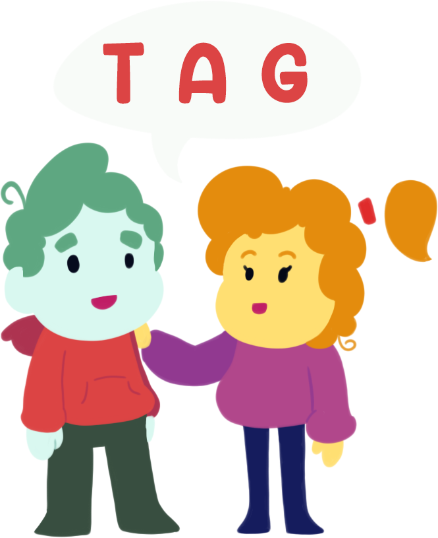
TAG & RATE: Evaluating Your AI Output
🔍 2. Reflect with TAG
T – Tell something that worked well
A – Ask what could be improved
G – Give yourself a suggestion for revising the prompt

Slide 9
TAG & RATE: Evaluating Your AI Output
📊 3. Rate the Output
Use the criteria below (1=Not at all, 2=Somewhat, 3=extremely):
✅ Relevance to scenario
✅ Alignment to prompt
✅ Clarity of information
✅ Usefulness to Educator

Slide 10
Prompt Like a Pro: Using the PARTS Method
There are five prompt-writing building blocks. Remember them as the “parts” of a prompt:
Persona: Identify your role.
Aim: State your objective.
Recipients: Specify the audience.
Theme: Describe the style, tone, and any related parameters.
Structure: Note the desired format of the output.

Slide 11
Prompt Like a Pro
🔁 4. Revise and Retry
Update your prompt, rerun it, and evaluate again.
Did it improve?

Slide 12
Jigsaw - AI Literacy and Readiness Competencies for Students
Each person in your group will be assigned a domain of AI Literacy & Readiness Competencies to analyze.
For your assigned domain, identify which competency:
Rose - you feel confident about teaching to your students.
Bud - you are looking forward to presenting to your students.
Thorn - may present an obstacle for you to teach to your students.

Slide 13
Strategy Harvest
Groups choose a student competency and find 1 strategy on learn.k20center.ou.edu to support that competency.

Slide 14
Triangle-Square-Circle
Triangle - Identify 3 important points from today.
Square - What squares with your current knowledge or beliefs about AI Literacy?
Circle - What question is circling in your mind?

