Slide 2
GEAR UP for LIFE
High School Overview

Slide 3

Commit and Toss
What experiences do high school students need to ensure college and career readiness?
Notes:
K20 Center. (n.d.). Commit and toss. Strategies. https://learn.k20center.ou.edu/strategy/119

Slide 4
Objectives
Identify the goals, benefits, and expectations of GEAR UP
Recognize the collaborative partnership between the K20 Center’s GEAR UP for LIFE grant and your school

Slide 5
GEAR UP for LIFE Grant Goals
Increase cohort student engagement in learning.
Increase student academic preparation for PSE upon graduating from participating schools.
Increase high school graduation/PSE enrollment rates.
Increase students’/families’ knowledge of PSE options, preparation, and financing.

Slide 6
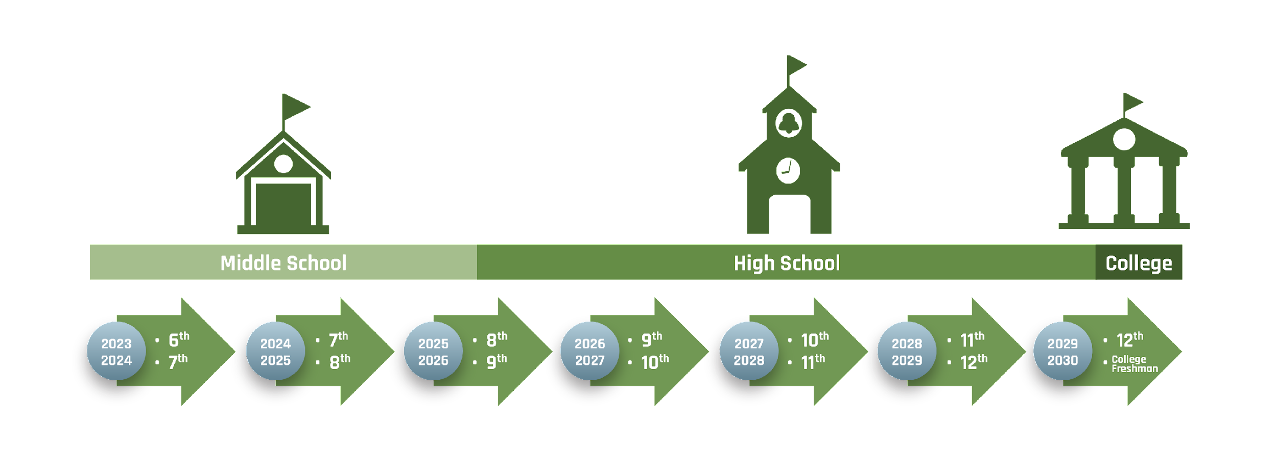
GEAR UP for LIFE – Cohort Model
Gaining Early Awareness and Readiness for Undergraduate Programs

Slide 7
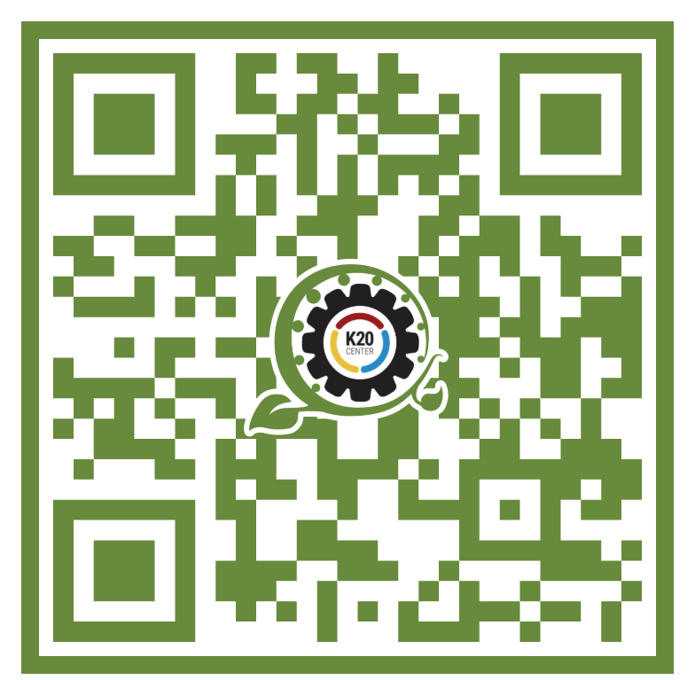
I Notice, I Wonder
Read through the first page of the infogram, stopping at the green section at the bottom.
Jot down what you notice and wonder about the impact of K20’s GEAR UP.
Be ready to share!
k20.ou.edu/8m

Slide 8
GEAR UP for LIFE Services
Click on the large GEAR UP for LIFE gear at the bottom of the page.
Choose ONE service from EACH section to read.
Students School/Educators
Family Additional K20 Services
Write at least ONE I Notice and ONE I Wonder statement on the provided sticky notes.
Place each sticky note on the corresponding group poster.

Slide 9

Goals and Benefits
How can the GEAR UP for LIFE services support the experiences students need to be successful after high school?

Slide 10
Teamwork makes the dream work!
Consider what you are already doing in your classroom.
What is one way you could support GEAR UP in your classroom and beyond?

