Slide 2
Who Makes the Rules?
Setting Expectations

Slide 3
Objectives:
Engage in collaborative rules, procedures, and expectations creation.
Explore data and research on effective classroom management and rules/procedures.
Create your own list of classroom/site rules and procedures and explore how student/staff input can build a positive culture.

Slide 4
Essential Questions:
How can establishing collaborative rules and expectations contribute to a more positive classroom environment?
How can you modify your current classroom rules and procedures to increase student engagement?

Slide 5

Magnetic Statements
Read each of the statements posted around the room.
Choose one of the statements that you are most attracted to.
Discuss your reasons with the others gathered around your statement.
Select one person to share out.
Notes:
K20 Center. (n.d.). Magnetic statements. Strategies. https://learn.k20center.ou.edu/strategy/166

Slide 6
Magnetic Statements
Positive teacher-student relationships thrive when the classroom feels like a community.
Classroom procedures and rules should be established through collaboration with students as students are more likely to adhere to rules they have helped to create and understand.
Providing praise for correct and expected behavior rather than correcting poor behavior can increase student engagement.
Effective and clear rules and procedures enhance student sense of support, enthusiasm, and engagement.

Slide 7
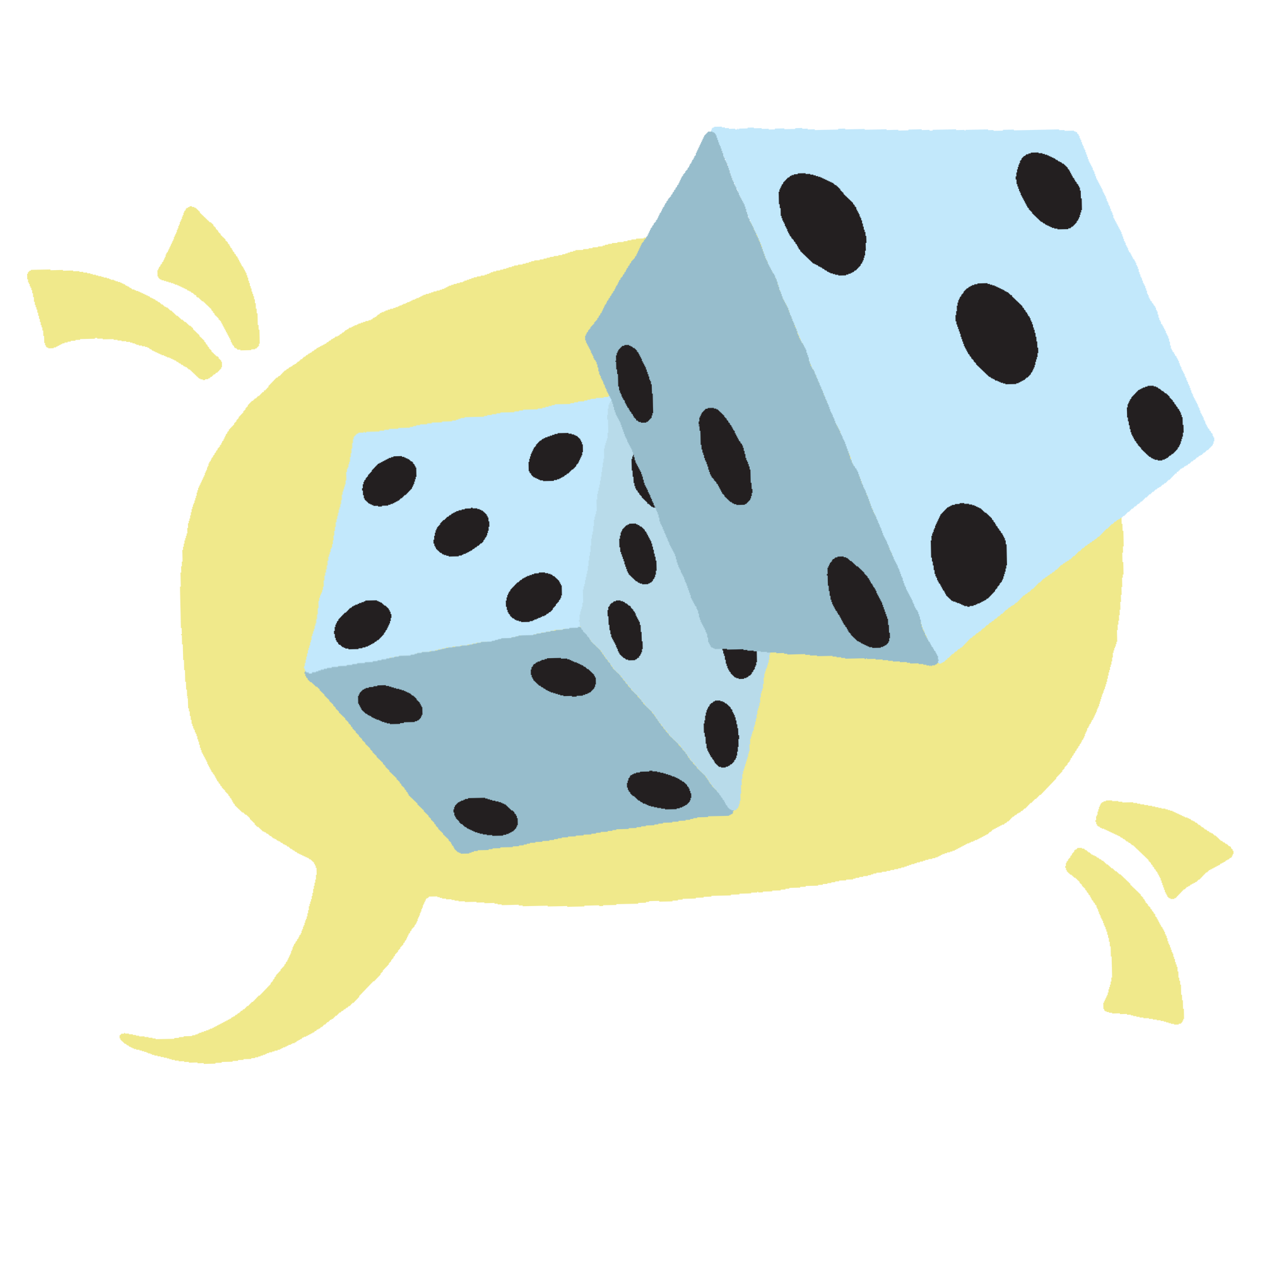
Take a Chance
As a group, take turns rolling the dice for a total of three times.
Each turn will determine the total number of words your group has to create to respond to one of the definitions.
Notes:
K20 Center. (n.d.). Take a chance. Strategies. https://learn.k20center.ou.edu/strategy/3480

Slide 8
Creating Definitions
Using the numbers from your rolls, on sticky notes create a definition for each of the words:
  Rule
  Expectation
  Procedure
Be prepared to share your definitions with the group.

Slide 9

K20 5 Minute Timer
Notes:
K20 Center (Sept. 2021). 5 minute timer. YouTube [video]. https://youtu.be/EVS_yYQoLJg?si=ikp2o1z92XSxBNJJ

Slide 10
Creating Definitions
Using exactly 15 words, on sticky notes create a definition for each of the words:
  Rule
  Expectation
  Procedure
Be prepared to share your definitions with the group.

Slide 11
Rule, Procedure, and Expectation
Rules: Have consequences. Fewer is better.
Procedures: Have reminders. General classroom or event process.
Expectations: Guidelines to ensure a positive learning environment.

Slide 12
What is a Social Contract?
A social contract is an agreement negotiated between students and teacher that states classroom principles, rules, and consequences rather than punishments for classroom behavior.
Notes:
Curwin, R. L., & Mendler, A. N. (1988). Discipline with dignity. Alexandria, VA: Association for Supervision and Curriculum Development.

Slide 13
The Social Contract
At your table:
  Title your paper “Today’s Expectations.”
  Think about your expectations for this session, then list out the rules, procedures, and expectations that need to be in place for this session to be successful.
  Consider the following:
    What do I need to do?
    What do the presenters need to do?
    What do other participants need to do?

Slide 14

K20 10 Minute Timer
Notes:
K20 Center (Sept. 2021). 10 minute timer. YouTube [video]. https://www.youtube.com/watch?v=9gy-1Z2Sa-c

Slide 15
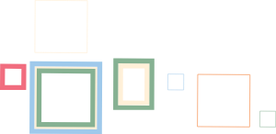
Gallery Walk
Once your contract is completed, find a space around the room to hang it.
With your group, rotate through all the posters. If a statement on one resonates with your group, star the statement.
Rotate until you are at your original poster.
Notes:
K20 Center. (n.d.). Gallery walk/carousel. Strategies. https://learn.k20center.ou.edu/strategy/118

Slide 16
Creating a Collective Social Contract
Social contracts are meant to be a proactive intervention for the classroom.
Refer to the Social Contracts Handout for tips on how to successfully create one for your classroom.
How can you incorporate your definitions of rules, procedures, and expectations when creating a class social contract?

Slide 17

Why-Lighting
Read the Classroom Management: Procedures and Rules brief.
Highlight parts of the text that interest you.
In the margins, write “why” you highlighted each part.
Be prepared to discuss.
Notes:
K20 Center. (n.d.). Why-lighting. Strategies. https://learn.k20center.ou.edu/strategy/128

Slide 18
Why-Lighting Discussion
In your groups, discuss the following questions:
  What resonated with you the most from the reading, and why?
  What is one classroom procedure, rule, or expectation that has been successful in your classroom?

Slide 19

Exit-Ticket
What is one classroom procedure, rule, or expectation that you are considering creating or modifying after today's session?
Notes:
K20 Center. (n.d.). Bell ringers and exit tickets. Strategies. https://learn.k20center.ou.edu/strategy/125

