Slide 2
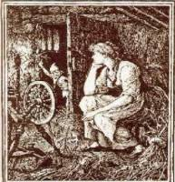
Authenticity
It's Not Just a Fairy Tale (Shortened Version)

Slide 3

Commit and Toss
Think of your most meaningful learning experience and record it on your paper.
Notes:
K20 Center. (n.d.). Commit and Toss. Strategies. https://learn.k20center.ou.edu/strategy/119

Slide 4
Essential Questions
How does authentic teaching enhance student learning?
Why is creating authentic lessons important for student achievement?

Slide 5
Learning Objectives
Explore a collaborative, authentic lesson with a variety of instructional strategies and examine the components of authentic teaching and learning.
Compare different classroom environments and how they support authentic teaching and learning.
Connect authentic teaching and learning practices with the goals of the GEAR UP grant.

Slide 6

Fold the Line
How well do you know the Rumpelstiltskin story?
  1 (not very well) to 10 (could retell the whole story and portray the characters)
Notes:
K20 Center. (n.d.). Fold the line. Strategies. https://learn.k20center.ou.edu/strategy/171

Slide 7
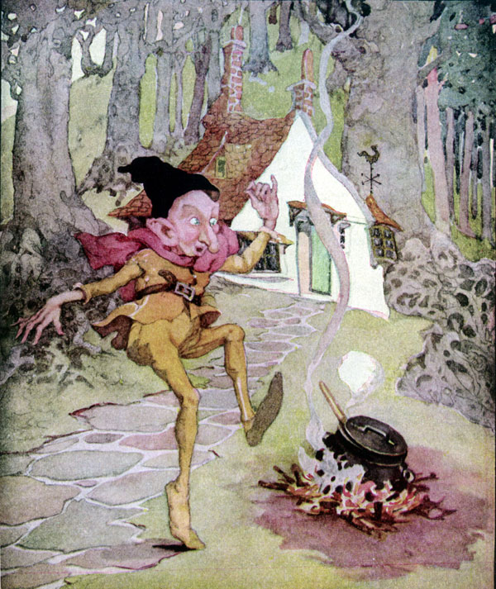
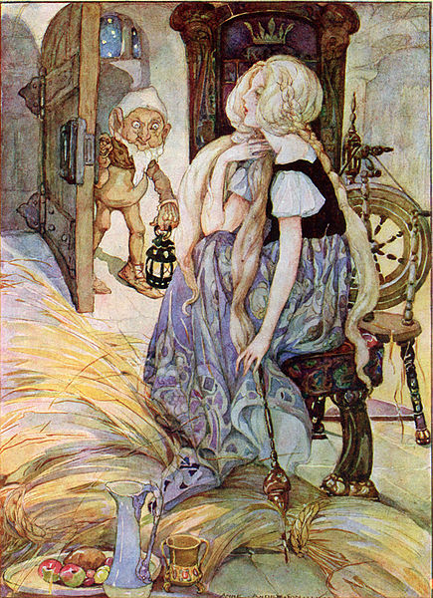
The Story
Happily Ever After
…until…
Notes:
Left image source: Anderson, A. (n.d.). Rumplestiltskin is my name. Public domain. Retrieved from https://en.m.wikipedia.org/wiki/File:Rumplestiltskin_-_Anne_Anderson.jpg
Right image source: Anderson, A. (n.d.). The Miller’s Daughter. Public domain. Retrieved from https://commons.wikimedia.org/wiki/File:The_Miller%27s_Daughter_by_Anne_Anderson.jpg

Slide 8
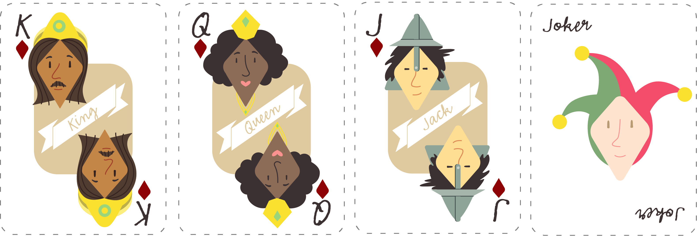
Playing Cards
The King
The Miller’s
Daughter/Queen
The Miller
Rumpelstiltskin
Notes:
K20 Center. (n.d.). Group Shuffle. Strategies. https://learn.k20center.ou.edu/strategy/4441

Slide 9
The Imaginary People’s Court
The Miller
Charged with bribery, human trafficking, and tax fraud.
The King
Being impeached for accepting illegal tax contributions, intimidation, and unlawful detention.
Rumpelstiltskin
Charged with extortion, attempted kidnapping, and coercion.
The Miller’s Daughter/Queen
Charged with child abandonment, child endangerment, and human trafficking.

Slide 10
CUS and Discuss
CIRCLE any mention of your character.
UNDERLINE any actions taken by your character.
STAR any emotions or important adjectives.
Discuss the defense of your character’s innocence.
Notes:
K20 Center. (n.d.). CUS and discuss. Strategies. https://learn.k20center.ou.edu/strategy/162

Slide 11
CER Example
Claim – Chromebooks are better school technology tools than laptops.
Evidence – Most applications on a Chromebook are web-based and store data online.
Reasoning – Because data is stored online, students can use any device to access it. This prevents loss of student work and provides them with the ability to work both from school and home.
Notes:
K20 Center. (n.d.). Claim, evidence, reasoning (CER). Strategies. https://learn.k20center.ou.edu/strategy/156

Slide 12
Pair Square Legal Team
With your card group (jokers with jokers, queens with queens, etc.):
Create your character’s defense, using the CER template.
Reach a consensus about the defense of your client.
Choose your spokesperson, known as the lead defense attorney.

Slide 13




HEAR YE! HEAR YE! ALL RISE!
The Honorable Judge declares that court is in session.
State your character’s name and the crimes they are being accused of committing.
Present your argument (using CER).
“Guilty”
“Innocent”

Slide 14
Beyond Rumpelstiltskin
This was a lesson on process of instruction for students to think more critically.
The goal was to construct a logical and supported argument based on a guiding question.

Slide 15


LEARN Strategy Reflection
Group Shuffle
Commit and Toss
Fold the Line
CUS and Discuss
Claim, Evidence, Reasoning (CER)

Slide 16
Authenticity Framework Reading
Construction of Knowledge
Inquiry-based Learning
Real-World Connections
Student-Centered Learning

Slide 17

Jigsaw and Why-Lighting
Read your assigned section and Why-Light
Discuss big ideas with your group
Notes:
K20 Center. (n.d.). Jigsaw. Strategies. https://learn.k20center.ou.edu/strategy/179
K20 Center. (n.d.). Why-lighting. Strategies. https://learn.k20center.ou.edu/strategy/128

Slide 18

Represent!
Using large poster paper, create a GramIt to represent your component of authenticity in a visual way.
Add a short caption to describe the component.
CHALLENGE: Include a hashtag. #OneToThreeWordSummary
Notes:
K20 Center. (n.d.). GramIt. Strategies. https://learn.k20center.ou.edu/strategy/2554

Slide 19
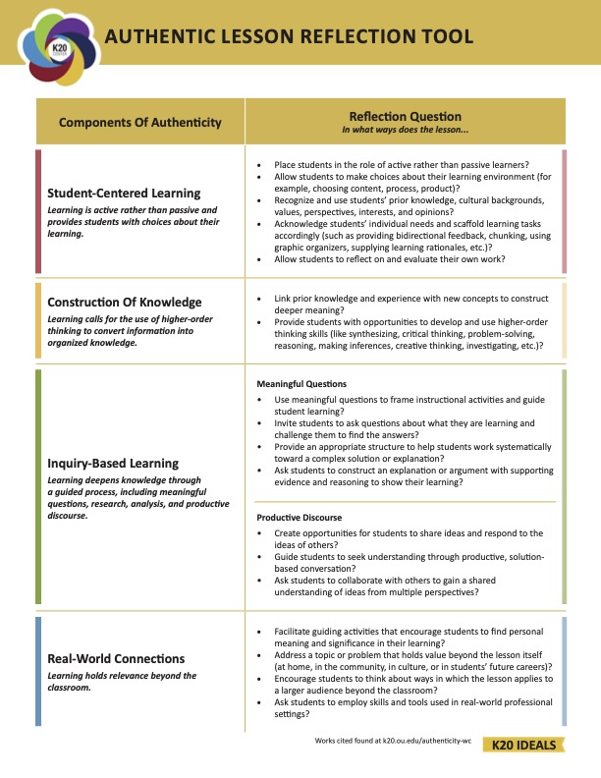
Authentic Lesson
Reflection Tool

Slide 20

LEARN Strategy Reflection
Jigsaw
Why-Lighting
GramIt

Slide 21

3-2-1
Three things that make a lesson authentic
Two authentic things you plan to implement in this week's lessons
One question you still have about authenticity or authentic lessons
Notes:
K20 Center. (n.d.). 3-2-1. Strategies. https://learn.k20center.ou.edu/strategy/117

Slide 22
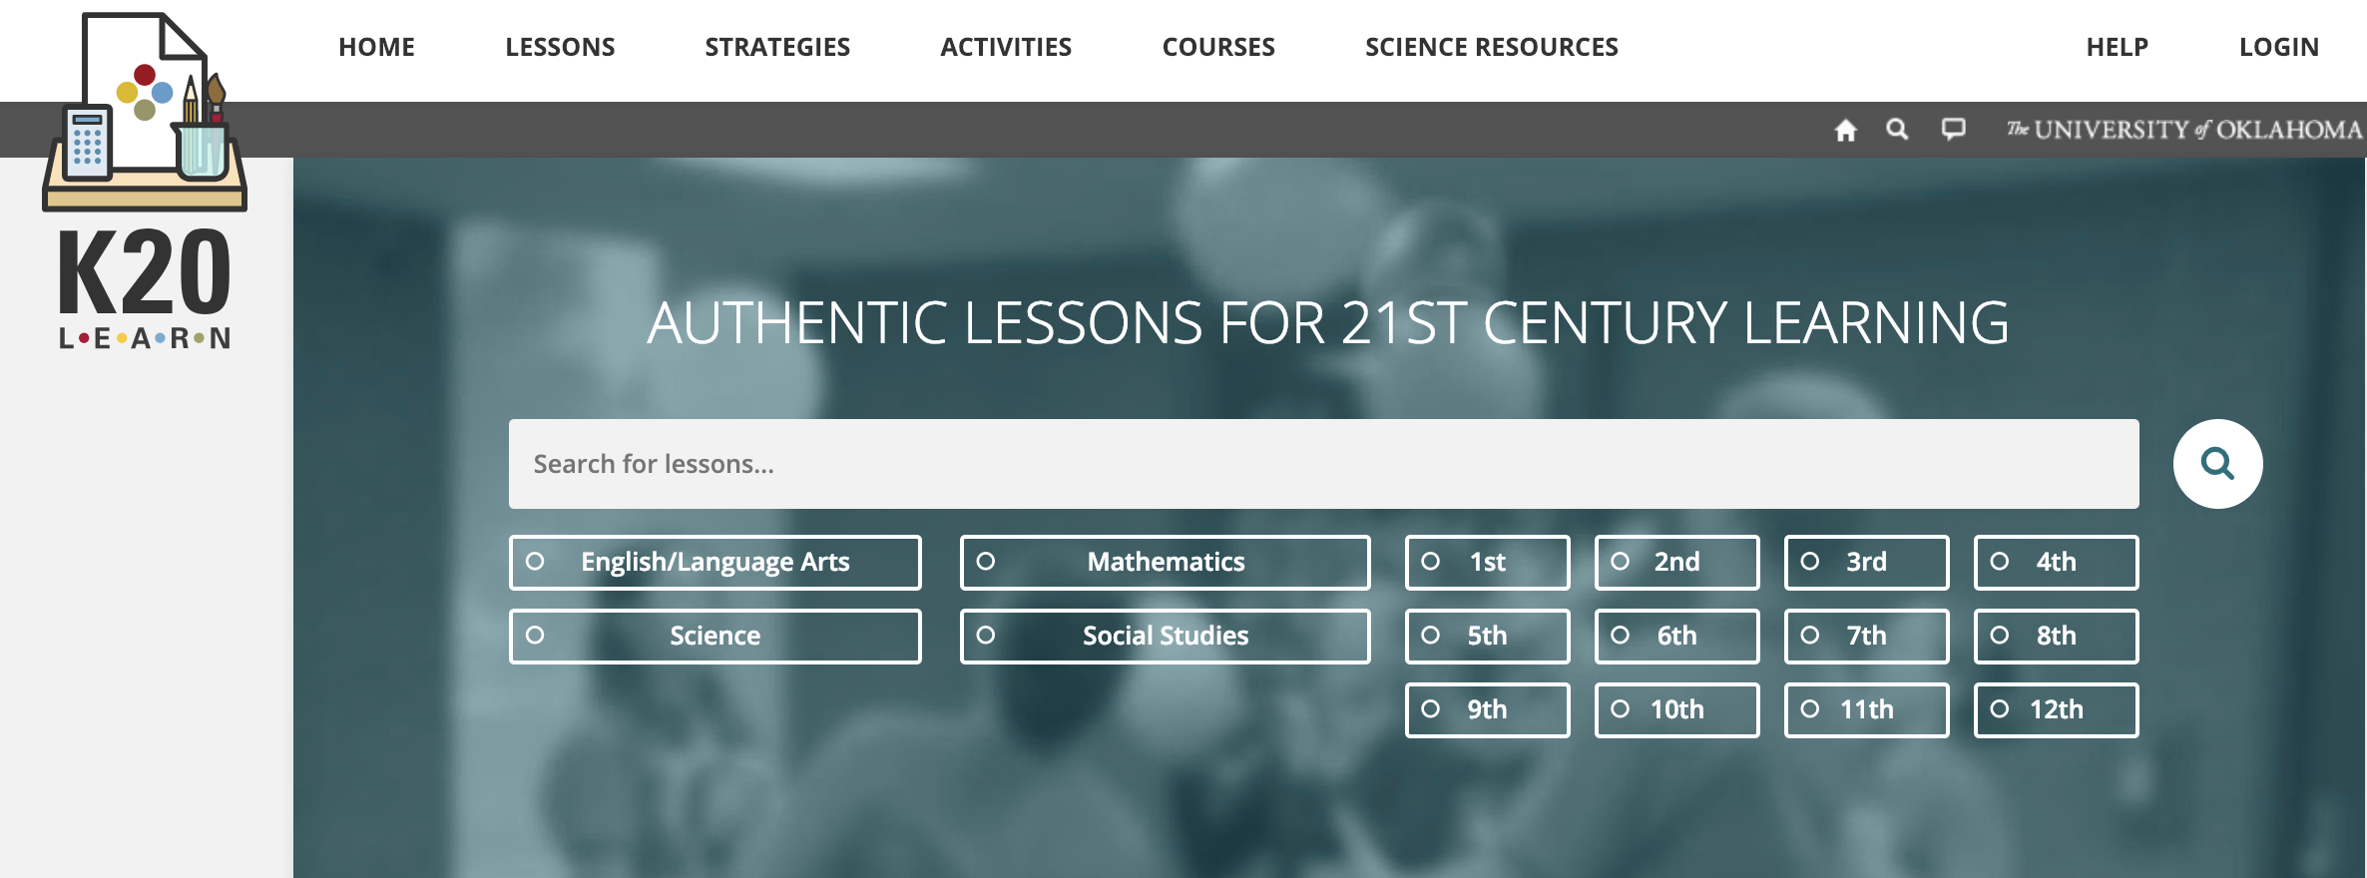
K20 LEARN
https://learn.k20center.ou.edu/

