Slide 2
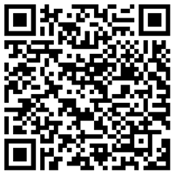
Play “Spot the Bot” while we wait to start.
Type in https://k20.ou.edu/bot OR scan the QR code.
Each slide has a pair of images or text.
Can you spot the bot?

Slide 3
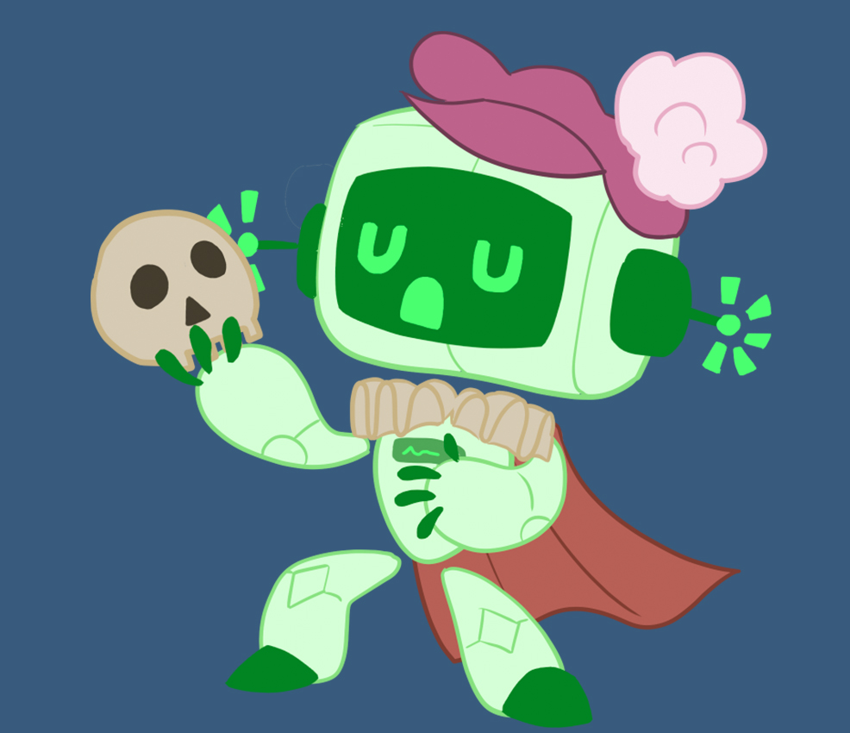
AI Act
The Need for New Digital Literacy?

Slide 4
Essential Question
How does AI change our definition of digital literacy?

Slide 5
Learning Objectives
Determine an appropriate strategy to identify AI-generated content.
Analyze the credibility of platforms, creators, and especially the content they distribute.
Cultivate ethical consumption and creation of content.

Slide 6
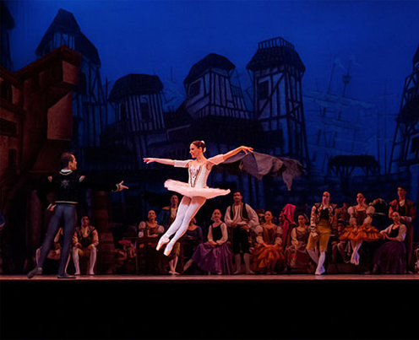
Suspension of Disbelief
We know actors are acting.
We know the set isn’t real.
But we believe for the sake of the story.
“All the world’s a stage, and all the men and women merely players.” - Shakespeare
Notes:
Folger Shakespeare Library. (n.d.). Shakespeare’s Plays, Sonnets and Poems from The Folger Shakespeare. Retrieved from https://www.folger.edu/explore/shakespeares-works/all-works/
Wilfredor (2013). Don Quijote in Teatro Teresa Carreno. [photo]. Wikimedia. https://commons.wikimedia.org/wiki/File:Don_Quijote_in_Teatro_Teresa_Carre%C3%B1o.jpg

Slide 7
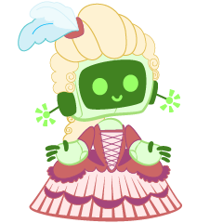
Suspension of Disbelief
We interact with AI knowing it’s not human–but still engage with it emotionally and socially.

Slide 8
Where have you seen AI used as more than a tool?

Slide 9
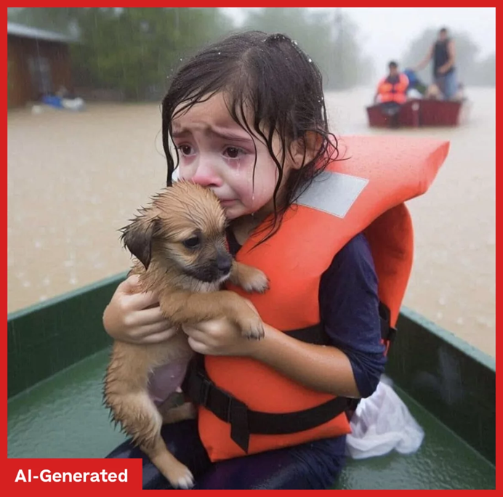
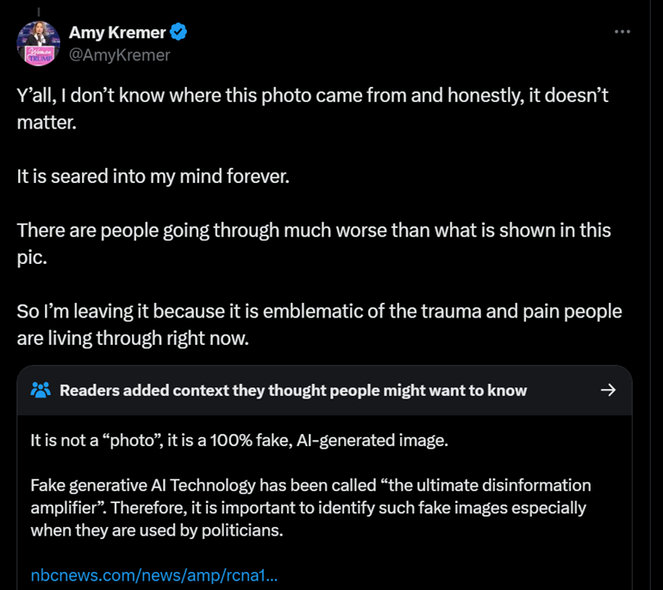
Notes:
Jingnan, H. (2024, October 18). AI-generated images have become a new form of propaganda this election season. NPR. https://www.npr.org/2024/10/18/nx-s1-5153741/ai-images-hurricanes-disasters-propaganda

Slide 10
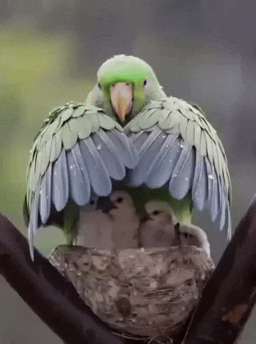
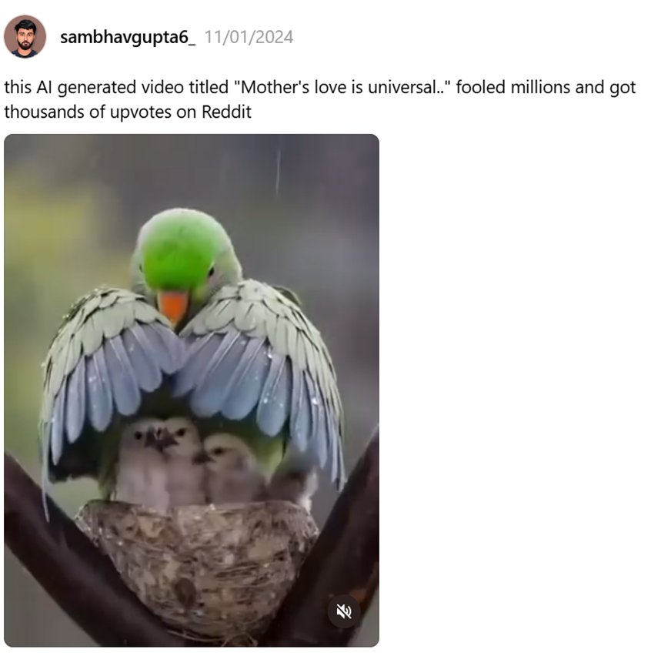
Notes:
Monge, J. C. (2024, November 4). This AI-generated video fooled the internet. Medium. https://generativeai.pub/this-ai-generated-video-fooled-the-internet-9dbf33732f2b

Slide 11

When the Lines Get Blurred . . .
Deepfakes, emotional manipulation, disinformation can take place.
You may treat AI like a friend, a tutor, a therapist.
Where have you seen AI used as more than a tool?

Slide 12
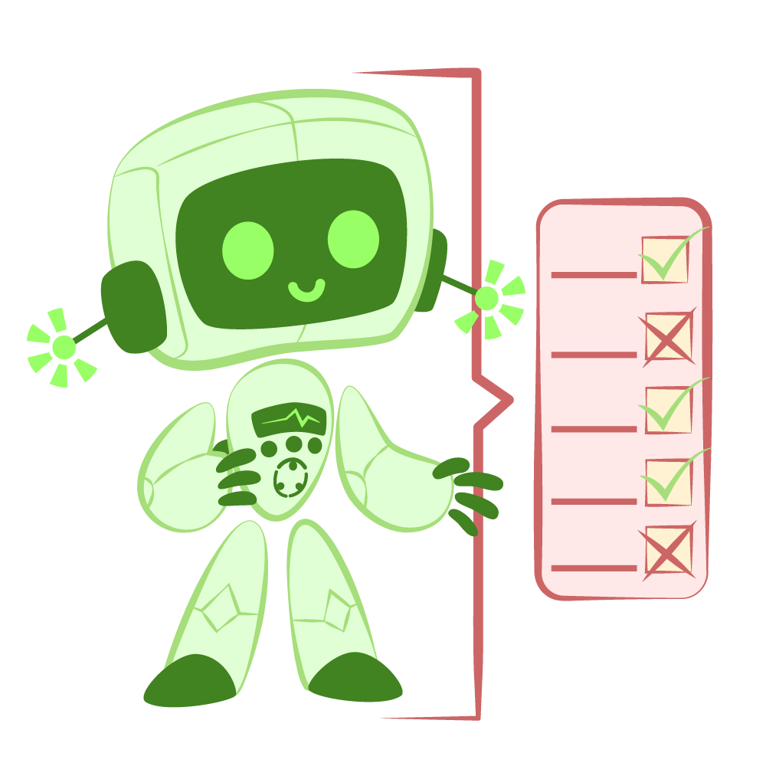
AI as Actor . . .
Imitates tone, knowledge, empathy;
Uses a script (training data);
Learns cues from the “audience” (user prompts).

Slide 13
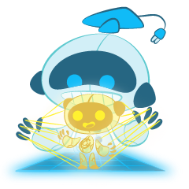
Behind the Curtain . . .
Uses predictive algorithms, not actual thinking;
Trained on vast human-created data;
Makes guesses vs choices.

Slide 14
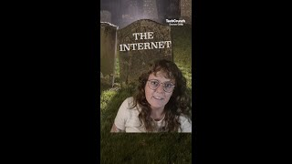
All the Internet is a Stage
Slop is low-quality media made by using generative artificial intelligence technology.
Dead Internet Theory poses the idea that the majority of internet traffic is created by bots and AI.
Dead Internet Theory
Notes:
TechCrunch. (n.d.). The Dead Internet Theory is still alive. YouTube. https://www.youtube.com/shorts/1pZ0dnf5GeI

Slide 15
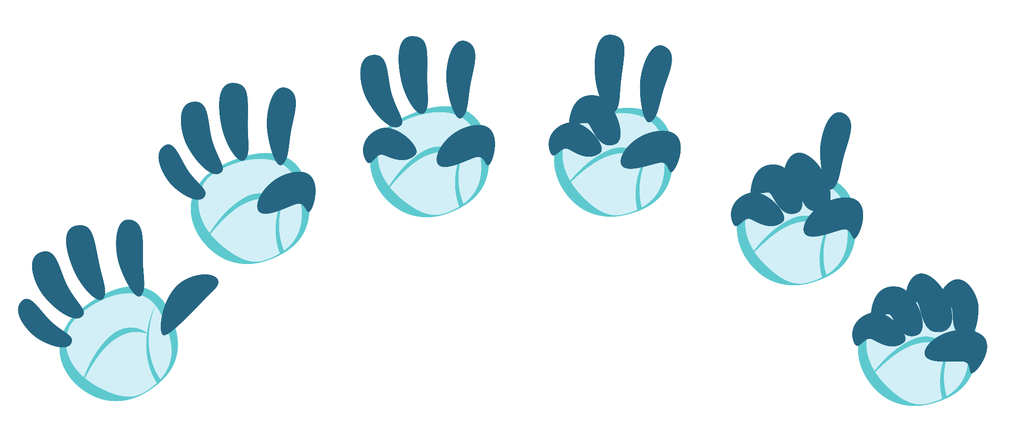


Fist to Five
Skim each article.
Decide whether it was written by AI or not.
Consider adding what “markers” you noticed on your handout.
Rate how confident you are in your decision using Fist to Five.
- not very confident
- super confident
Notes:
K20 Center. (n.d.). Fist to five. Strategies. https://learn.k20center.ou.edu/strategy/68

Slide 16
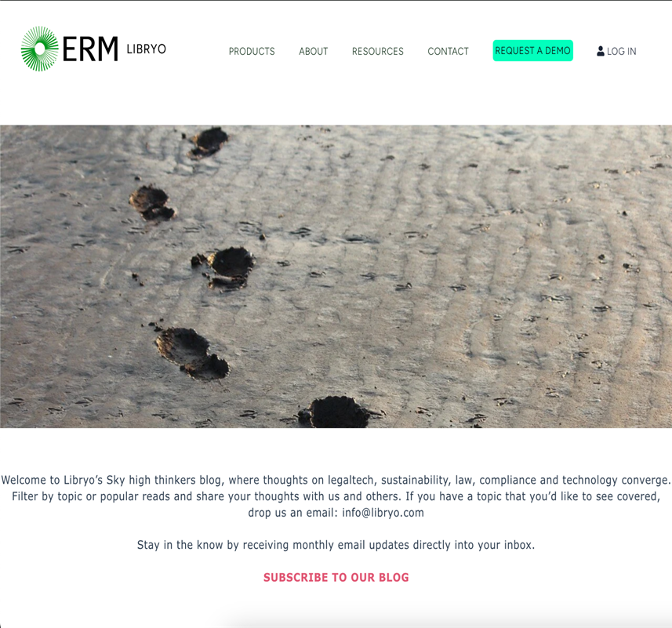

Slop-y Performance
https://k20.ou.edu/slop2
Notes:
Friedmann, A. (2025, January 17). What is Ai Slop and how to avoid it?. What is AI Slop and How to Avoid It? https://blog.libryo.com/what-is-ai-slop-and-how-to-avoid-it
K20 Center. (n.d.). Fist to five. Strategies. https://learn.k20center.ou.edu/strategy/68

Slide 17
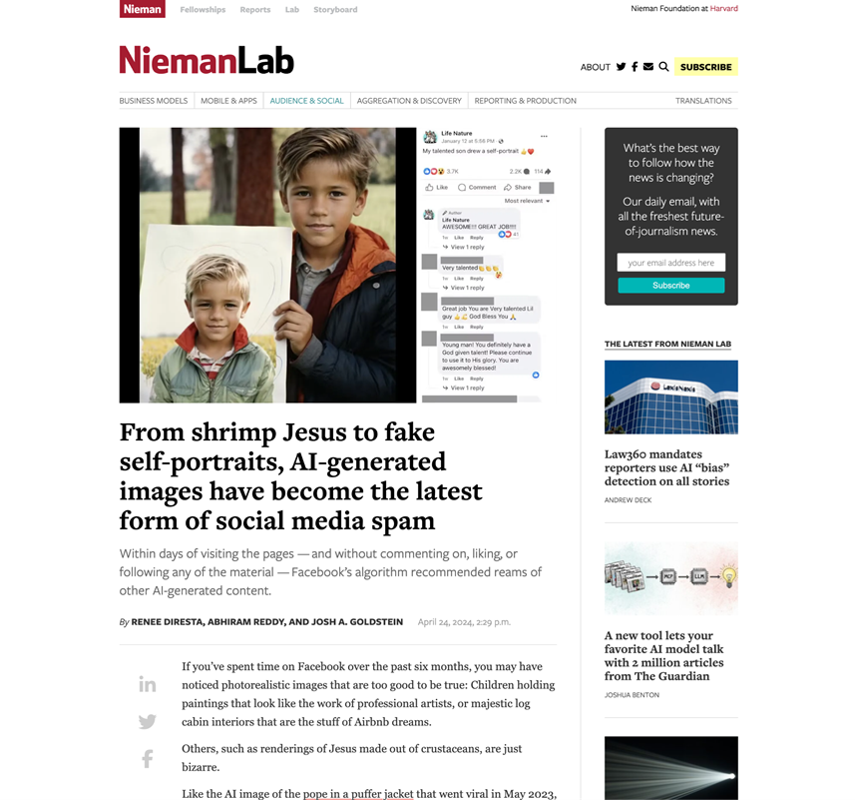

Slop-y Performance
https://k20.ou.edu/slop3
Notes:
Diresta, R., Reddy, A., & Goldstein, J. A. (2024, April 24). From shrimp Jesus to fake self-portraits, ai-generated images have become the latest form of Social Media Spam. Nieman Lab. https://www.niemanlab.org/2024/04/from-shrimp-jesus-to-fake-self-portraits-ai-generated-images-have-become-the-latest-form-of-social-media-spam/
K20 Center. (n.d.). Fist to five. Strategies. https://learn.k20center.ou.edu/strategy/68

Slide 18

Digital Literacy - Know the Script
Work the Angles
Trust your Instincts
Cross-check sources.
Look for inconsistencies.
Question perfect narratives.
If content feels off, investigate.
Watch for unnatural patterns.
Notice emotional manipulation.

Slide 19

AI Literacy - Know the Script
Be an Active Audience
Learn AI’s patterns.
Test AI tools yourself.
Understand AI limitations.

Slide 20
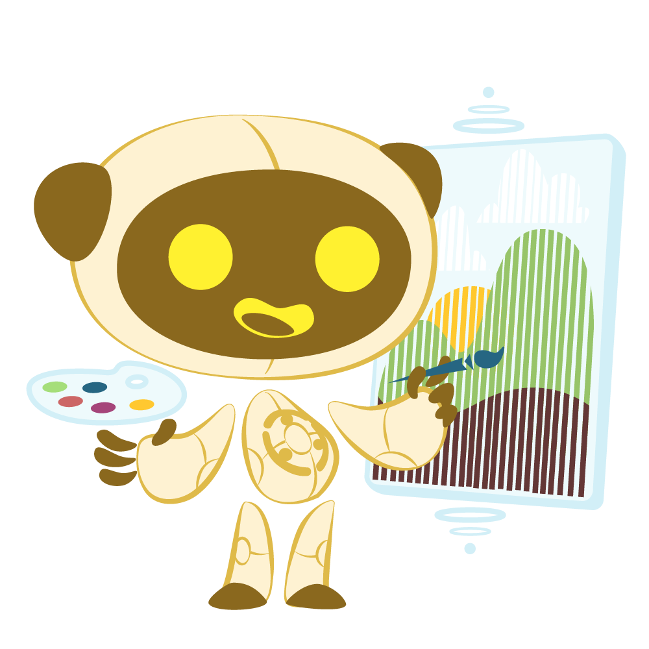
Spot the Bots
Which image is real?
k20.ou.edu/aiornot
Make sure you click on the image you’ve chosen!
Notes:
Note: AI continuously trains and improves its ability mimic reality. Some of the indicators today may not exist tomorrow, and there may even come a time when we are unable to distinguish between human and AI-generated content.

Slide 21
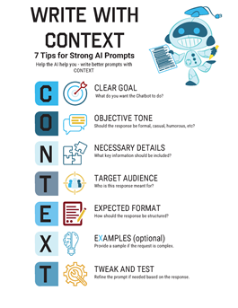
Context
Start with a goal in mind.
  What exactly do you want the AI to do?
Add relevant context
  Who is the audience (e.g. students, educators, admin)?
  How will it be used (e.g. lesson plan, discussion)?
Be specific about format and style.
  No bullet points, casual vs formal tone.

Slide 22
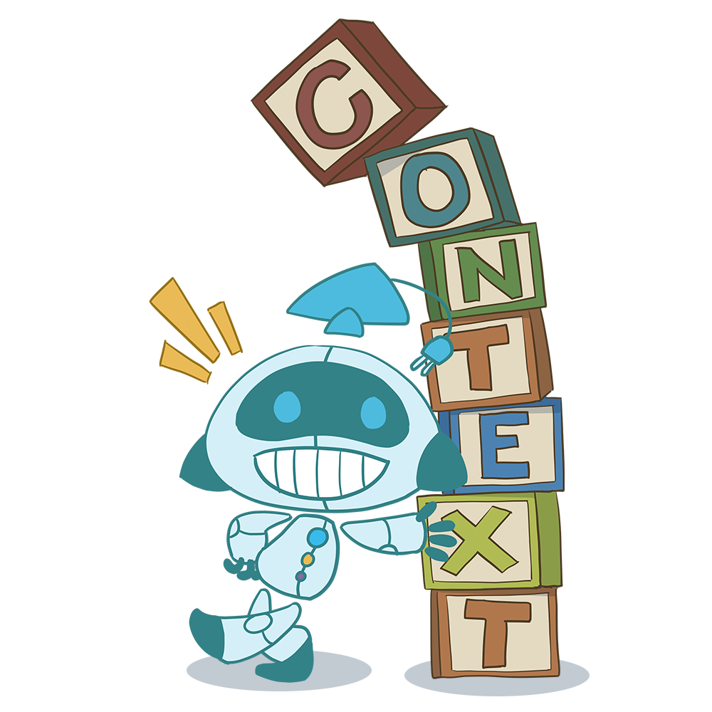
Context
Provide constraints or examples.
  How long do you want it? What elements do you require?
Iterate and Refine.
  If you don’t like the response, try adjusting the prompt, be specific!

Slide 23

Example & Non-Example
I'm a high school senior interested in the University of Oklahoma's meteorology program. Can you help me figure out how to outline an admissions essay that needs to be less then a page and addresses the following prompts: Discuss an accomplishment, event, or realization that sparked a period of personal growth and a new understanding of yourself or others. I used to attend OU's weather center summer camp every year so I thought about adding that somehow.
Write an essay to help me get into college. I like weather, but I don’t know what I want to major in.
Notes:
K20 Center. (n.d.). Examples and non-examples. Strategies. https://learn.k20center.ou.edu/strategy/163

Slide 24





Example & Non-Example
I'm a high school senior interested in the University of Oklahoma's meteorology program. Can you help me figure out how to outline an admissions essay that needs to be less then a page and addresses the following prompts: Discuss an accomplishment, event, or realization that sparked a period of personal growth and a new understanding of yourself or others. I used to attend OU's weather center summer camp every year so I thought about adding that somehow.
Target Audience
Clear Goal
Expected Format
Necessary Details
Examples
Notes:
K20 Center. (n.d.). Examples and non-examples. Strategies. https://learn.k20center.ou.edu/strategy/163

Slide 25





Example & Non-Example
I'm a high school senior interested in the University of Oklahoma's meteorology program. Can you help me figure out how to outline an admissions essay that needs to be less then a page and addresses the following prompts: Discuss an accomplishment, event, or realization that sparked a period of personal growth and a new understanding of yourself or others. I used to attend OU's weather center summer camp every year so I thought about adding that somehow.
Target Audience
Clear Goal
Expected Format
Necessary Details
Examples
Notes:
K20 Center. (n.d.). Examples and non-examples. Strategies. https://learn.k20center.ou.edu/strategy/163

Slide 26
AI Prompt Writing
Now it’s your turn!
Choose an experience with a student you had recently that dealt with student writing.
Access an AI chat bot.
Write a prompt from the student’s perspective.
How did it go?
Notes:
K20 Center. (n.d.). AI Prompt Writing. Strategies. https://learn.k20center.ou.edu/strategy/5080

Slide 27


Audience Reactions
What are 2 things about the presentation or content you feel good about?
What is 1 thing you wish had been in the presentation?
Notes:
K20 Center. (n.d.). Two stars and a wish. Strategies. https://learn.k20center.ou.edu/strategy/83

Slide 28
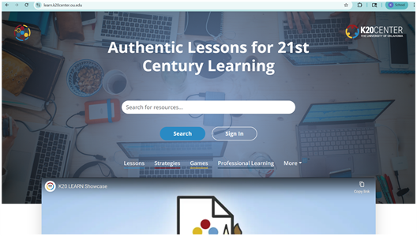
The Show Must Go On!
https://learn.k20center.ou.edu/

Slide 29
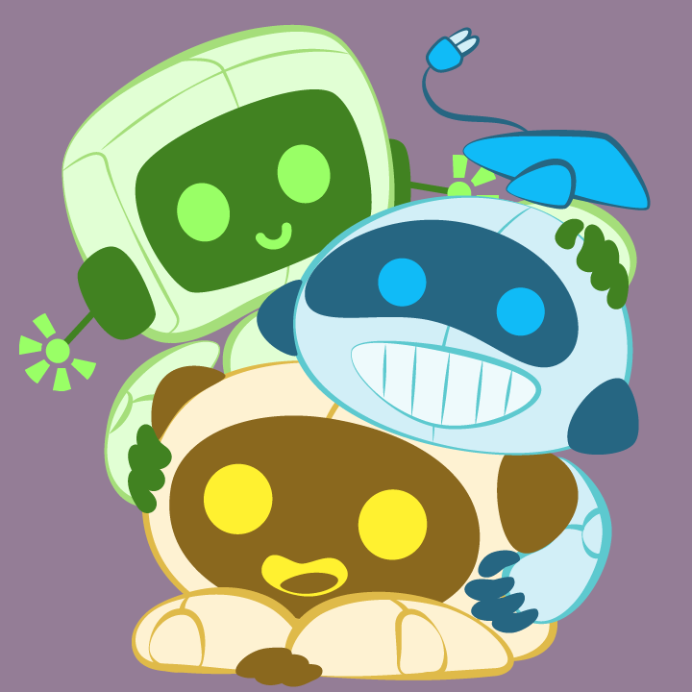
Stars of the Show!
AI Collections
Artificial Intelligence (AI) Tech Tool
Artificial Intelligence (AI) Instructional Strategies
Artificial Intelligence (AI) Professional Learning
Notes:
Tech Tools collection: https://learn.k20center.ou.edu/collection/3571
Instructional Strategies collection: https://learn.k20center.ou.edu/collection/4306
Professional Learning collection: https://learn.k20center.ou.edu/collection/4984

