Slide 2

Family-School Connections for Student Success
Encouraging Family Engagement

Slide 3
Essential Question
How do schools create strong partnerships with families that support students’ future success?

Slide 4
Learning Objectives
Identify strategies for engaging families in college and career readiness efforts.
Examine how family partnerships can directly influence student postsecondary success.

Slide 5
Family Engagement in Your School
In 1–2 words, describe the impact that active parent and family presence has had in your school.

Slide 6
Family Presence in Your School
Share your thoughts and responses to the following questions:
How does family presence in your school and classroom impact your students?
How does a lack of family presence in your school and classroom impact your students?

Slide 7

Think-Pair-Share
Read and think about the following prompt:
  What are some family engagement strategies that you currently practice in your classroom and school that have successfully increased family presence?
Pair up with someone and discuss your responses.
Share your thoughts with the whole group.
Notes:
K20 Center. (n.d.). Think-Pair-Share. Strategies. https://learn.k20center.ou.edu/strategy/139

Slide 8
Reflect
It is common for parents and families to be present in the classroom and school during elementary school. Once students move to secondary schools, this participation seems to decline.
  Why do you think this happens?

Slide 9
Booster Clubs
Do you have booster clubs at your school?
What is the purpose of booster clubs at your school?
Who typically leads booster clubs at your school?

Slide 10

Looks Like, Sounds Like, Feels Like
What does a family booster club look like to you?
What does a family booster club sound like to you?
What does a family booster club feel like to you?
Notes:
K20 Center. (n.d.). Looks like, sounds like, feels like. Strategies. https://learn.k20center.ou.edu/strategy/88

Slide 11
Family Booster Clubs
Imagine you’re creating a family booster club made up of key members of your school and community. What would be the overall goal of your club?
Which key people or roles would you include in your club?
In what ways can you or your school connect with families to encourage them to be a part of this club?
  For example: flyers, emails, conferences, etc.

Slide 12
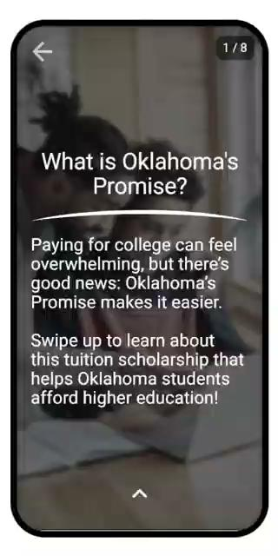
Explore QUEST
QUEST is a mobile application that delivers quick, interactive lessons designed to inform and engage busy families.

Slide 13



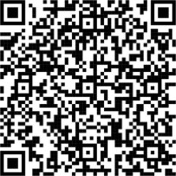
Download and Install QUEST
Wi-Fi Network:
k20.ou.edu/quest-apple​
k20.ou.edu/quest-play​
Notes:
Facilitator’s Note: Edit this slide to include your site’s Wi-Fi information for families.

