Slide 2
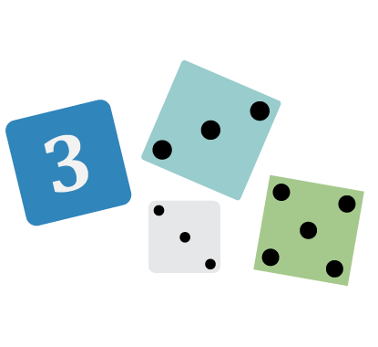
Not Like the Others
Which number doesn’t belong, and why?
28 36 45 64
Notes:
K20 Center. (n.d.). Not like the others. Strategies. https://learn.k20center.ou.edu/strategy/77

Slide 3
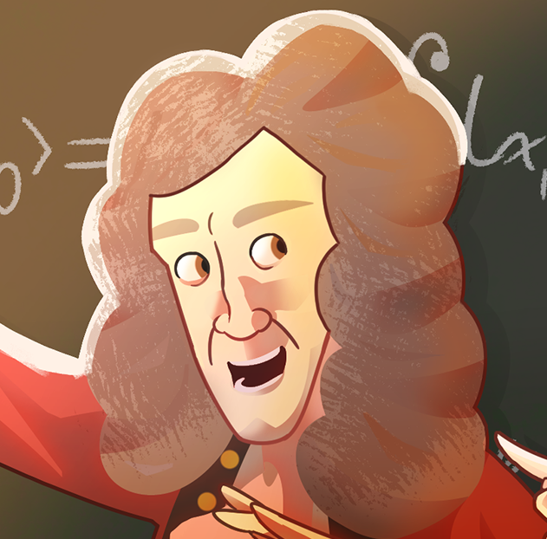
Who’s Asking?
Inquiry and Discourse in Math

Slide 4
Essential Question
How do we promote inquiry and discourse in the math classroom?

Slide 5
Learning Objectives
Analyze how inquiry-based learning and mathematical discourse support student engagement and deeper mathematical understanding.
Model the implementation of strategies that engage students in inquiry and discourse in the math classroom.

Slide 6
Not Like the Others
Which number doesn’t belong, and why?
28 36 45 64
Notes:
K20 Center. (n.d.). Not like the others. Strategies. https://learn.k20center.ou.edu/strategy/77

Slide 7
Not Like the Others
Given a group of pictures, words, graphs, etc., students decide which one does not hold as strong a connection to a topic as the others in the group.
How does this strategy…
…develop vocabulary?
…lower barriers to participation ?
How could you use it?
Notes:
K20 Center. (n.d.). Not like the others. Strategies. https://learn.k20center.ou.edu/strategy/77

Slide 8

Strategy Harvest
Do the following problem in your head and be prepared to explain how you got your answer:
500 - 236
Notes:
K20 Center. (n.d.). Strategy harvest. Strategies. https://learn.k20center.ou.edu/strategy/135

Slide 9
500 - 236

Slide 10
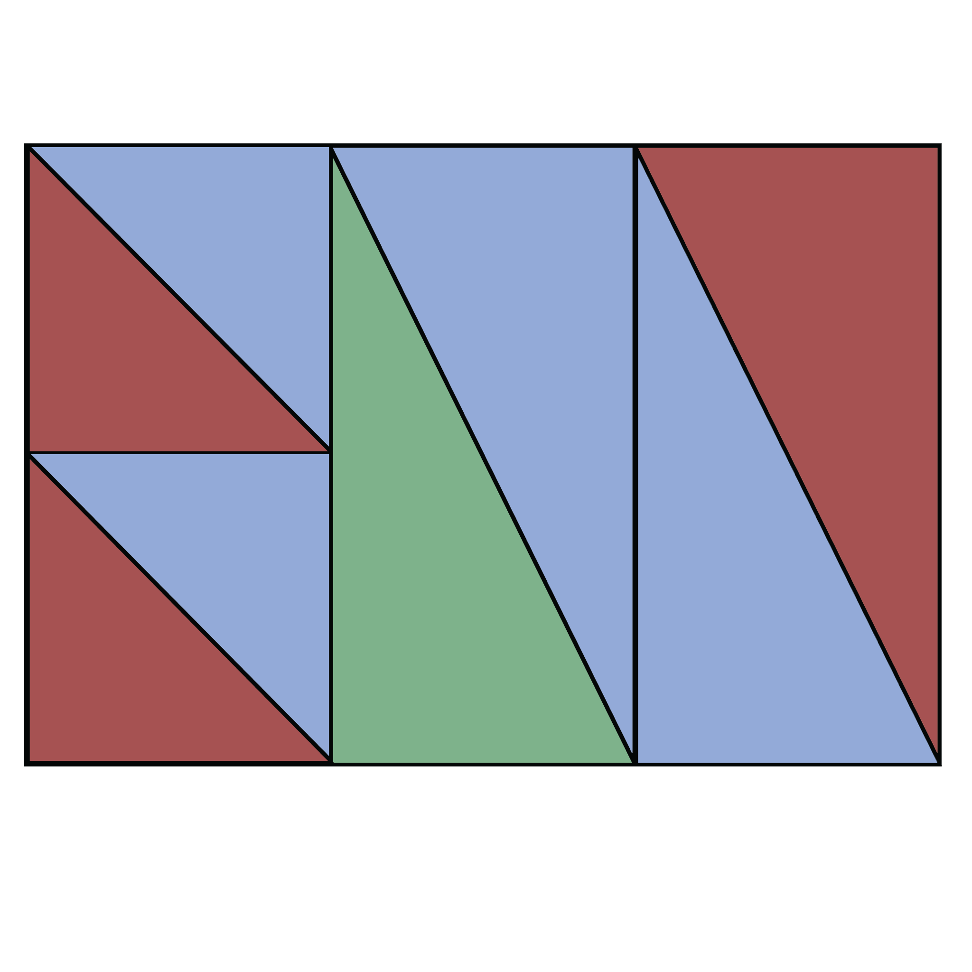
Strategy Harvest
What percentage of the rectangle does each color cover?
Notes:
K20 Center. (n.d.). Strategy harvest. Strategies. https://learn.k20center.ou.edu/strategy/135

Slide 11
Strategy Harvest
Students solve a problem then explain how they reached their solution. This strategy encourages the comparison of various methods to help students see the similarities and differences between the methods.
How does this strategy…
…strengthen metacognitive skills?
…increase student confidence?
How could you use it?
Notes:
K20 Center. (n.d.). Strategy harvest. Strategies. https://learn.k20center.ou.edu/strategy/135

Slide 12
“It is not the answer that enlightens but the question.”
—Eugène Ionesco
Notes:
Ionesco, E. (1969). Découvertes. Editions d’Art Albert Skria.

Slide 13
Why are Inquiry and Discourse Important?
Construction of Knowledge
Authenticity
Student-Centered Learning
Real World Connections
Inquiry-Based Learning

Slide 14
What is Inquiry-Based Learning?
Engages students in exploration, questioning, investigation, and analysis
While open inquiry gives students free rein to take any direction of their choosing, research shows that most students require support while using inquiry-based learning.

Slide 15
What is Inquiry-Based Learning?
Read the table of teacher and student actions in inquiry-based learning. Use one color to highlight things students already do and you support in your classroom.
Use a different color to highlight things that you want to improve in your classroom.
Share with others in your group.

Slide 16
Inquiry vs. Discourse
Inquiry
Asking questions
Looking for answers
Discourse
Collaborative
Making sense
Inquiry without discourse meaningless answers
Discourse without inquiry meaningless conversation

Slide 17
Mathematical Practices
Make sense of problems and persevere in solving them
Reason abstractly and quantitatively
Construct viable arguments and critique the reasoning of others
Model with mathematics
Use appropriate tools strategically
Attend to precision
Look for and make use of structure
Look for and express regularity in repeated reasoning
How are these actions and processes supported in an inquiry-driven classroom?
Source: The Core Standards for Mathematical Practice
Notes:
Common Core State Standards Initiative. (2010). Standards for mathematical practice. https://www.thecorestandards.org/Math/Practice/

Slide 18

Question Formulation Technique (QFT)
Rules for Creating Questions
Ask as many questions as you can without stopping to discuss, judge, or answer questions.
Write down every question exactly as it is stated. Change any statement into a question.
Notes:
K20 Center. (n.d.). Question formulation technique. Strategies. https://learn.k20center.ou.edu/strategy/5188

Slide 19

QFT
Quadrilateral
Trapezoid
Parallelogram
Isosceles Trapezoid
Rhombus
Rectangle
Square
Notes:
K20 Center. (n.d.). Question formulation technique. Strategies. https://learn.k20center.ou.edu/strategy/5188

Slide 20
QFT
Identify one closed-ended question and change it to an open-ended question.
As a group, identify your top 3 questions and prepare to share.
Quadrilateral
Trapezoid
Parallelogram
Isosceles Trapezoid
Rhombus
Rectangle
Square
Notes:
K20 Center. (n.d.). Question formulation technique. Strategies. https://learn.k20center.ou.edu/strategy/5188

Slide 21
QFT
Students are presented with a prompt and create as many questions as they can regarding the prompt. They then refine their questions and choose some questions to drive the lesson.
How does this strategy…
…build curiosity?
…clarify thinking and focus?
How could you use it?
Notes:
K20 Center. (n.d.). Question formulation technique. Strategies. https://learn.k20center.ou.edu/strategy/5188

Slide 22
Recap & Reflection
How can an increase in inquiry and discourse help my students?
Not Like the Others
Strategy
Harvest
QFT
What is one strategy I
can integrate into my content within the next two weeks to encourage inquiry and discourse with my students?
Notes:
K20 Center. (n.d.). Not like the others. Strategies. https://learn.k20center.ou.edu/strategy/77
K20 Center. (n.d.). Question formulation technique. Strategies. https://learn.k20center.ou.edu/strategy/5188
K20 Center. (n.d.). Strategy harvest. Strategies. https://learn.k20center.ou.edu/strategy/135

